Slide 1
Developing Study Abroad Programs
International Business Institute for Community College Faculty
June 8, 2011
Brett Berquist
berquis6@msu.edu
Notes:
Brett Berquist is the Executive Director of the Office of Study Abroad at Michigan State University, Brett Berquist leads the largest study abroad program at a U.S. public university. He holds dual French and American citizenship and has over 20 years experience working in international education in the U.S., U.K., France, and Korea. His assignments have ranged from chairing language departments in Europe to managing large learning mobility programs. Berquist has served on internationalization taskforces in 4 universities.

Slide 2

Developing SA programs
Objectives of session
Portrait EA @ MSU
Program models for CC
Collaboration
Mauritania
Notes:
Take some time here:
Query audience:
-which institutions?
-International experience?
-How many offer EA?
-Plans/discussions to do so?
>100 of >1,200 CC offer EA (10%)
7k CC stdts in 2007 growth rate>overall national growth
Rosalind Raby (CCIE) and Gary Rhodes. Barriers are not student interest, inability to travel, or program costs. ARE: shortage of program offerings, lack of awareness of existing programs, and absence of long-term planning. www.iienetwork.org/page/91081/

Slide 3

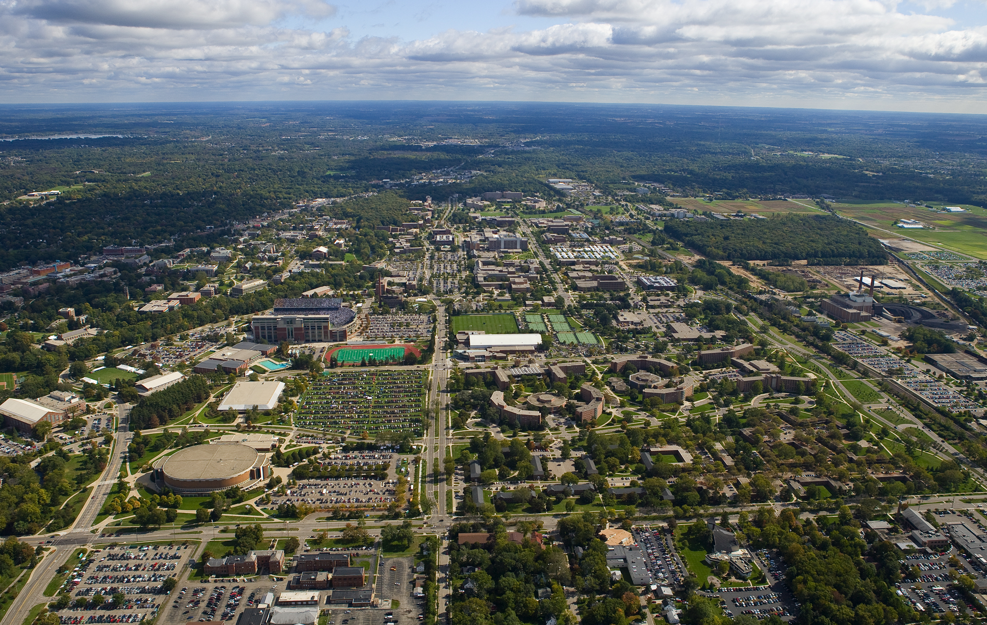



5,000 faculty and academic staff
5,200
acre campus
47,000
students
200 Programs of Study in 17 Colleges
Est. 1855
LAND
GRANT
model
Site of
$550 million Facility for Rare Isotope Beams
$405 million sponsored
research
Notes:
BRIEF – just leave slide up – no discussion.
Founded 1855. Morrill Act established Land Grant model 1862
5,200-acre campus with 15,000 acres throughout Michigan used for agricultural, animal, and forestry research
More than 47,000 students
200 programs of study in 17 colleges
Only university in the country with three on-campus medical schools, graduating allopathic (MD) and osteopathic (DO) physicians, and veterinarians (DVMs)
5,000 faculty and academic staff
427,000 living alumni; and 40,000 international alumni
Sponsored research $405 million 2008-2009
Site of the proposed $550 million Facility for Rare Isotope Beams, which will enable researchers from around the world to address leading-edge questions in nuclear structure and astrophysics and bring significant economic activity to Michigan
Notable discoveries include:
Cross-fertilization of corn in the 1870s
Homogenization of milk in the 1930s
Anticancer drug cisplatin in the 1960s
Materials that reduce dependence on fossil fuels in the 21st century

Slide 4


from land grant to world grant
Notes:
Founded 1855. Morrill Act signed by Lincoln1862. The Jetsons study abroad
Founded in 1855, Michigan State University was the prototype for 69 U.S. land-grant institutions established under the Morrill Act of 1862. MSU has a long history of international engagement and has been the national leader in study abroad participation among U.S. public universities for five consecutive years sending almost 3,000 students abroad on nearly 300 programs to all continents. President Lou Anna Simon recently challenged the university to transform its public service mission from land-grant to ‘world-grant’.
Simon, L.A.K. (2009). Embracing the world grant ideal: Affirming the Morrill Act for a twenty-first-century global society. East Lansing: Michigan State University. Retrieved from http://worldgrantideal.msu.edu

Slide 5
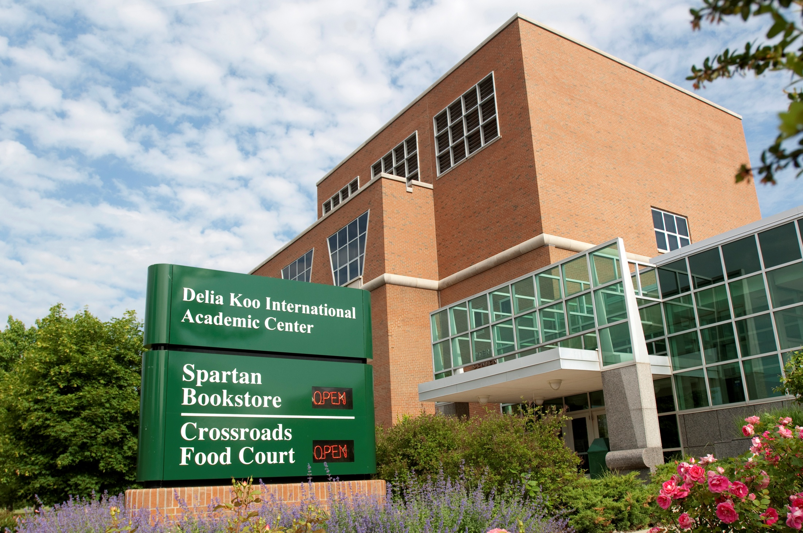
$ 61 million
of MSU’s instructional budget is dedicated to international programming
“MSU is
a university not only for the people of Michigan
but also for the world”
More than
180 International Partners
More than
50 YEARS
of International programming
1st DEAN
of International Programs
TOP 10
International student enrollment
Ambitious
goals for
study abroad
set in 1995
Notes:
BRIEF
John Hannah – 12th MSU president - "MSU is a university not only for the people of Michigan but also for the world"
Created the first Dean of International Programs at a major U.S. university in 1956
The beginning of over 50 years of institutional commitment to international programming and activity
1995 MSU set an ambitious goal for study abroad participation.
Today, MSU has the largest catalog of study abroad programs in the country, sending nearly 1/3 of all undergraduates abroad on some 275 programs on all continents.
Ranked #1 in study abroad for public universities (Open Doors 2009)
Ranked #10 in international student enrollment (Open Doors 2009)
MSU dedicates $61 million of its instructional budget to international programming.
Today MSU has formal agreements with more than 180 institutions and universities abroad

Slide 6

Freshman Seminars Abroad
#1
Public University
MSU sends
3,000 students abroad on nearly 300 programs to all 7 continents
Study Abroad
top rated
attraction for admitted
students
1/3 of MSU
undergraduate
students
Notes:
MSU Students Abroad
MSU sends 3,000 students abroad on nearly 300 programs on all 7 continents. 1 in 3 MSU undergraduate students
Program types: faculty-led, FSA, internships, Community Engagement, exchange, graduate
CIP
In a survey asking newly admitted MSU students what they see as valuable
opportunities provided by MSU, Study Abroad is mentioned more often than any other program.
community engagement
internships
UG research
Grad programs
Pre-departure & re-entry training
MSU’s appraoch to SA:
Client driven
Cost control
Variety of models/options/locations
Throughout the curriculum – integrated
College and faculty ownership/partnership
Expectation that participation is the norm
Growth-driven funding
Matrix management model

Slide 7
SA program growth
Notes:
Reflects national trend. <50% U.S. SA students on long-term programs.
Need for more intentional program design – out of the slow bake oven and into the microwave.
About 40% of students studying abroad do so through mid-length programs, while 56% of U.S. students choose short-term programs (including summer, January term and any program of 2 to 8 weeks during the academic year). Short-term programs serve the largest number of Americans studying abroad, including community college students and others whose financial or academic needs preclude a longer stay; 68% of students at Associates Degree granting institutions who studied abroad did so for 8 weeks or less. Mid-length programs (one semester, one quarter or two quarters) allow for deeper immersion into host cultures and increased opportunity for language acquisition. A little more than 4% of study abroad students spend a full academic or calendar year abroad.

Slide 8
SA growth (IIE Open Doors)
Notes:
Reflects national trend. <50% U.S. SA students on long-term programs. >70% of CC students SA short-term.
About 40% of students studying abroad do so through mid-length programs, while 56% of U.S. students choose short-term programs (including summer, January term and any program of 2 to 8 weeks during the academic year). Short-term programs serve the largest number of Americans studying abroad, including community college students and others whose financial or academic needs preclude a longer stay; 68% of students at Associates Degree granting institutions who studied abroad did so for 8 weeks or less. Mid-length programs (one semester, one quarter or two quarters) allow for deeper immersion into host cultures and increased opportunity for language acquisition. A little more than 4% of study abroad students spend a full academic or calendar year abroad.

Slide 9
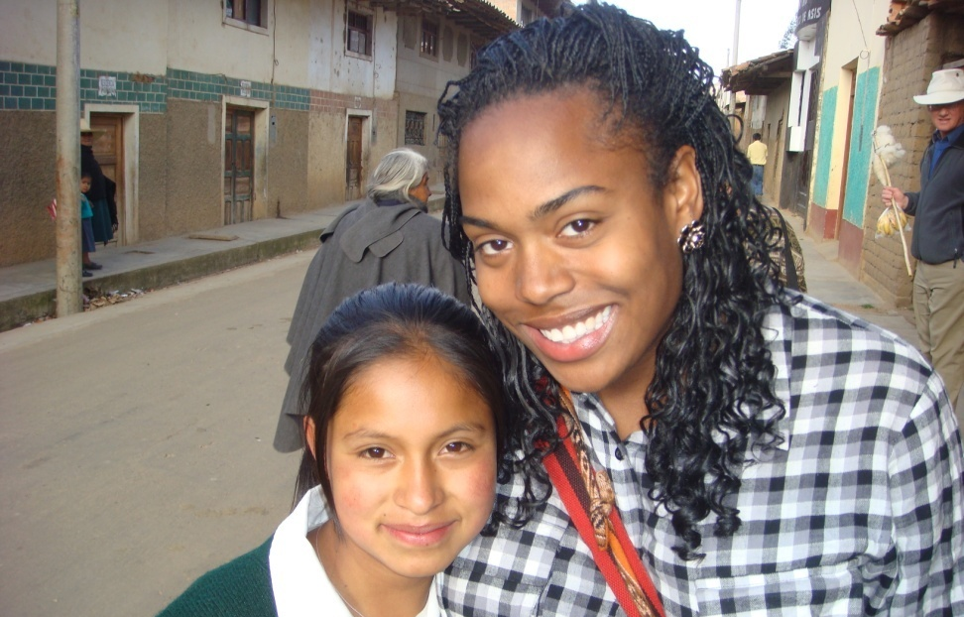
Personal growth
Professional development
Intercultural competence
Intellectual growth
Self-awareness & C1
Notes:
MSU SA goals
Facilitate students’ intellectual growth
Contribute to students’ professional development
Accelerate students’ personal growth
Develop students’ skills for relating to culturally different others
Enhance students’ self-awareness and understanding of their own culture
Contribute to the internationalization of the student’s home department, college, or university

Slide 10
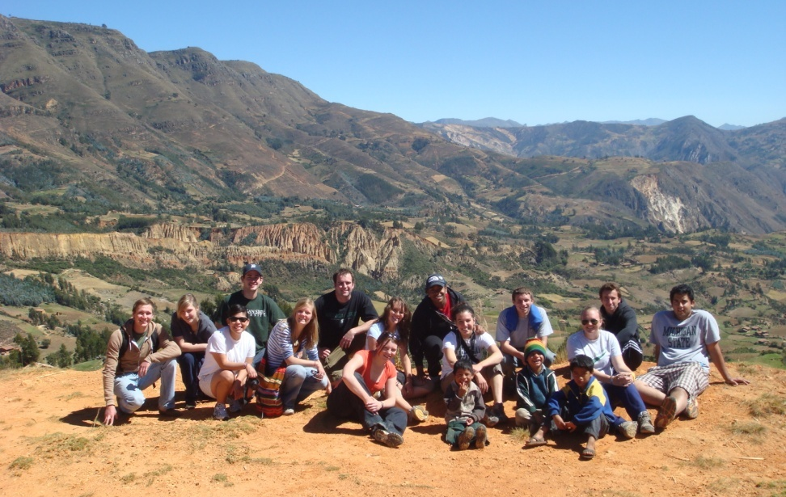
    QUALITY
Study Abroad Priorities
ACCESSIBILITY
DIVERSITY
Forum on Education Abroad
Standards for Good practice
Notes:
OSA works with college representation in a shared governance style. Strategy and implementation is shared through ISP’s matrix management model with the academic colleges.
1995 & 2008 Task Force Report give clear marching orders for OSA’s current priorities and efforts. Summarized through our QAD model.
Quality:
-OSA - leadership service role to assist colleges in their review and development of programs
-Research capacity statement to identify ways to encourage program leaders to undertake research on their study abroad programming.
Standards: review feasibility to adopt and integrate the Forum Standards of Good Practice as well as the Global Competencies defined by the Internationalizing the Student Experience project.
“Quality by program design”: encourage colleges to focus on template models that best reflect the learning goals for the college. Particular emphasis on programs that offer student research activities and programs that incorporate community engagement.
Support research on program design
Diversity:
-Diversity of students: demographics such as gender (SA traditionally has 2/3 females), underrepresented academic disciplines, etc.
-Diversity of programs: programming priorities below (experiential).
-Diversity of models: making it easier for students to go abroad; and address administrative hurdles (i.e. faculty incentive on faculty-led programs.) Defining engagement on study abroad. Revise policy on semester programs (coming to governance)
Accessibility:
-Student profile: encourage more foreign language programming.
-Academic support for study abroad: before and after (i.e. AL 200 course and “Unpacking Your Study Abroad Experience”)
-Ensuring high value for money. Increase access to external scholarships and increase funding for MSU scholarships. All pricing done in November. OFA began awards on December 1 for summer. Increased aid 45%.
-Strategic review of efforts in curriculum integration.
See report from October DD mtg.

Slide 11

Program options:
Exchanges
Affiliations
Faculty-led
Direct enroll
Program provider
Program models
Notes:
Take some time to identify options most useful for CCs. Focus on providers and consortial arrangements with other CCs.
Click through to program development page

Slide 12
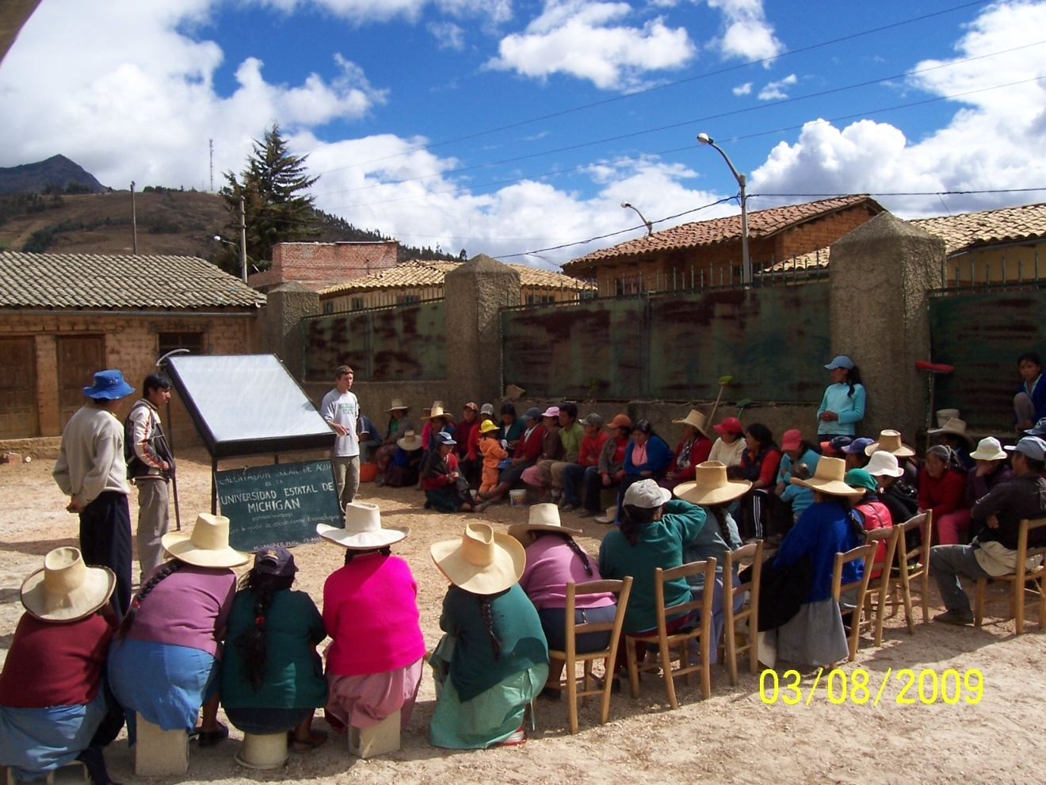
Collaboration
CCID
AACC
CCIE
NAFSA-EA-KC-CC
Forum EA
Notes:
Click through to websites:
NAFSA – EA-KC-CC – see toolkit
Forum EA
Community Colleges for International Development (CCID)
American Association of Community Colleges (AACC)
California Colleges for International Education (CCIE) -

Slide 13
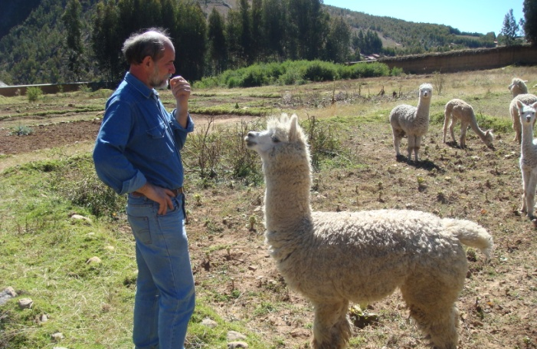
CONCLUSION
What next?
berquis6@msu.edu

Slide 14
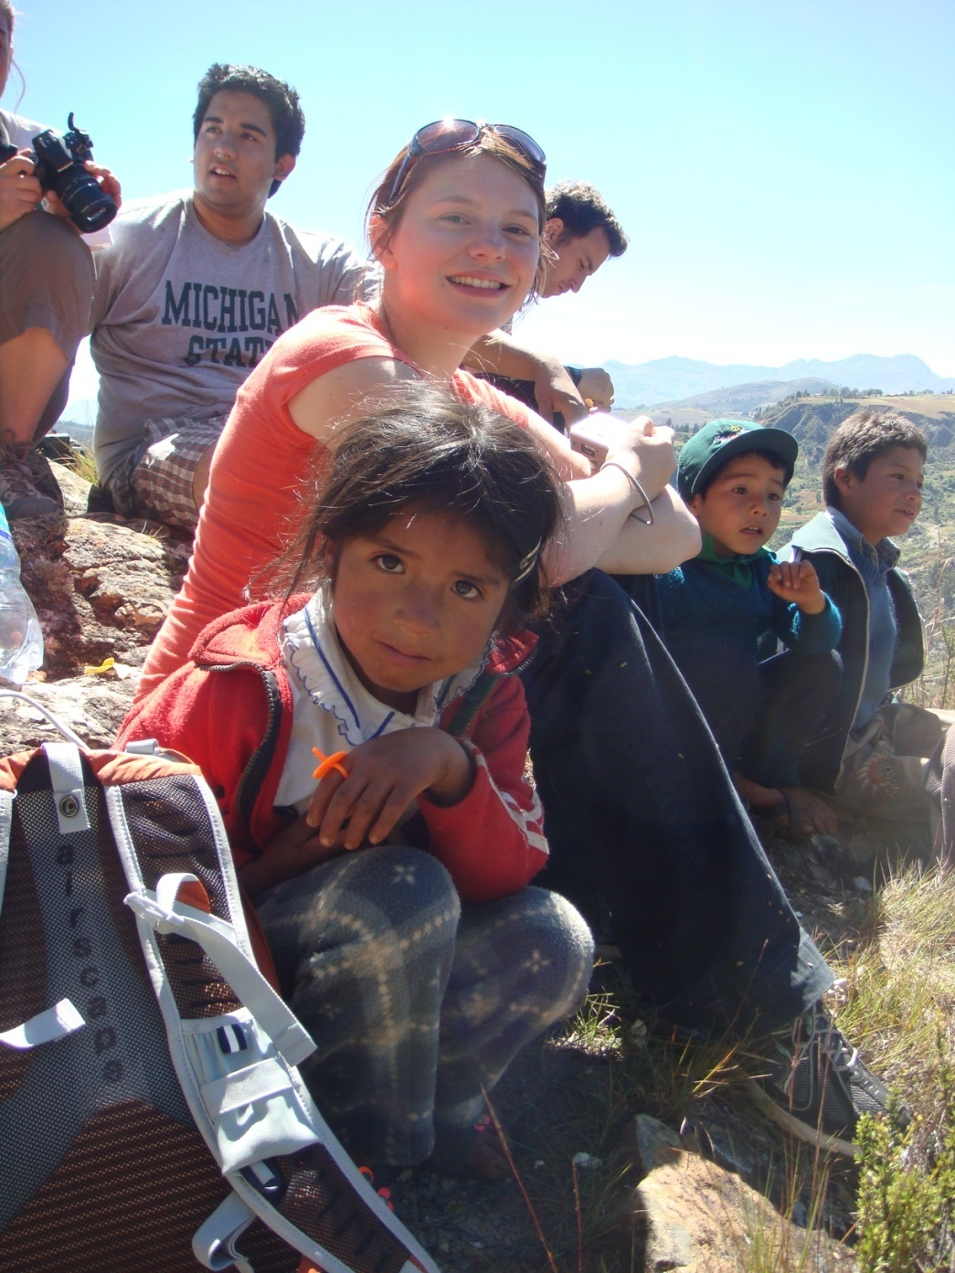
Global Competence Goals
an understanding of themselves culturally and the ability to use this knowledge to live and work effectively in diverse settings and with diverse individuals
the knowledge and skills associated with international, global, and intercultural content areas such as language, geography, history;
a desire and ability to seek out and use diverse sources of information to inform their decision making; and
a desire and ability to engage in communities of practice as citizens and scholars.
Notes:
Global Competence
MSU—recognizing that its students live and work in an increasingly complex and interconnected world—provides opportunities for its students to engage the world as professionals and citizens who will demonstrate leadership in their professional, personal, and civic life.
More specifically, MSU graduates will possess global competencies as related to the following goals:
an understanding of themselves culturally and the ability to use this knowledge to live and work effectively in diverse settings and with diverse individuals
the knowledge and skills associated with international, global, and intercultural content areas such as language, geography, history;
a desire and ability to seek out and use diverse sources of information to inform their decision making; and
a desire and ability to engage in communities of practice as citizens and scholars.
In the context of MSU’s land-grant tradition, MSU will provide opportunities for all its undergraduate students to become globally-competent professionals and citizens, people with the following knowledge, attitudes, and skills:
Graduates will demonstrate Analytical Thinking to:
Understand the complexity and interconnectedness of global processes—such as environment, trade, and human health—and be able to critically analyze them, as well as compare and contrast them across different cultures and contexts.
Synthesize knowledge and meaning from multiple sources to enhance decision-making in diverse contexts.
Use technology, human and natural capital, information resources, and diverse ways of knowing to solve problems.
Graduates will demonstrate the Cultural Understanding to:
Understand the influence of history, geography, religion, gender, race, ethnicity, and other factors on their identities and the identities of others.
Recognize the commonalities and differences that exist among people and cultures and how these factors influence their relationships with others.
Question explicit and implicit forms of power, privilege, inequality, and inequity.
Engage with and be open to people, ideas, and activities from other cultures as a means of personal and professional development.
Graduates will demonstrate Effective Citizenship to:
Develop a personal sense of ethics, service, and civic responsibility that informs their decision-making about social and global issues.
Understand the connection between their personal behavior and its impact on global systems.
Use their knowledge, attitudes, and skills to engage with issues that address challenges facing humanity locally and globally.
Graduates will demonstrate the Effective Communication to:
Recognize the influence of cultural norms, customs, and traditions on communication and use this knowledge to enhance their interactions across diversity.
Employ a proficiency in a second language and understand how language relates to culture.
Use observation, conflict management, dialogue, and active listening as means of understanding and engaging with different people and perspectives.
Communicate their ideas and values clearly and effectively in multiple contexts, with diverse audiences, and via appropriate media and formats.
Graduates will demonstrate Integrated Reasoning to:
Understand their place in the world relative to historical, geopolitical, and intellectual trends, including the geographic, socio-cultural, economic, and ecological influences on these trends.
Perceive the world as an interdependent system, recognizing the effects of this system on their lives and their personal influence on the system.
Frame, understand, and act upon their judgments from multi-disciplinary perspectives and worldviews.
Understand how different disciplines contribute to knowledge of global processes, such as those related to health, food systems, energy and other areas.
Understand the cultural, disciplinary, and contextual role, potential, and limits of problem-solving techniques and that cultures and disciplines conceptualize data, methodologies, and solutions differently.

Slide 15
    GAINS:
    FL
    personal devp’t
    IC devp’t
    Intell devp’t
What do we think we know?
Shorter graduation
>GPA >retention
Influence ed experience & career choices
low SES & low cultural capital – particular benefit
Notes:
What do we think we know?
Shorter time to graduation, higher GPA, higher retention.
Particular benefit to low SES and low cultural capital – academic, retention, completion
Gains in
foreign language proficiency
personal development
intercultural development
intellectual development
lasting influence on following education experience and choices as well as career

Slide 16
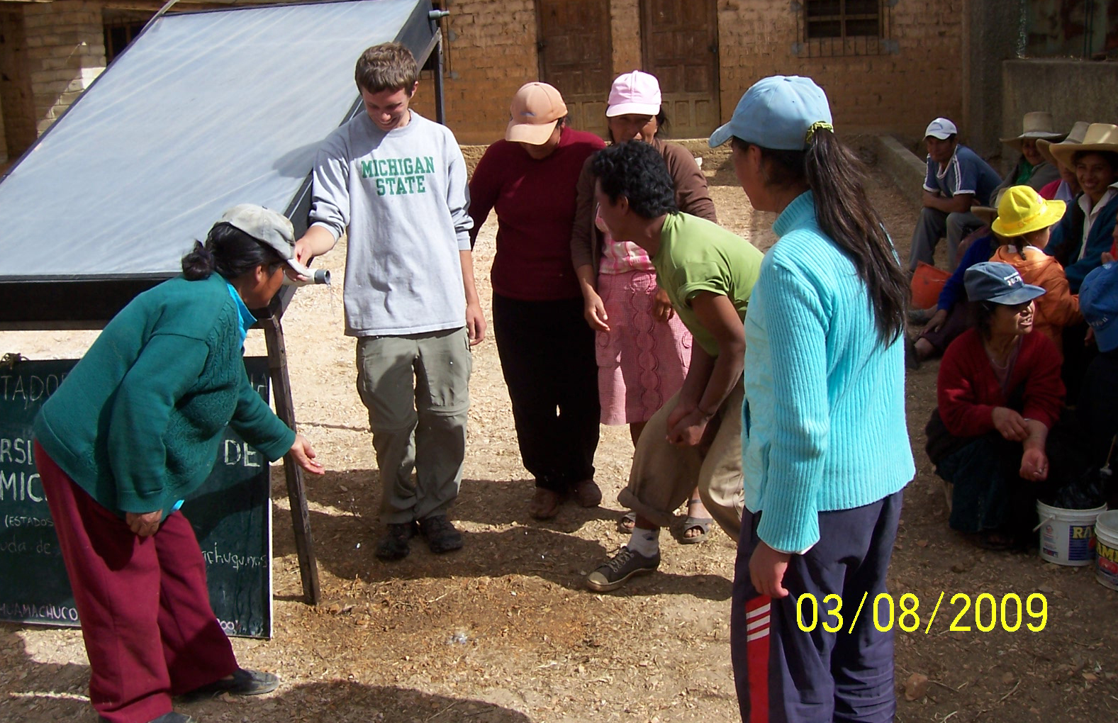
How do we know?
IDI
CCAI
GPI
BEVI
Dwyer
Engle & Engle
Georgetown
GLOSSARI
SAGE
Notes:
How do we Know?
Measuring: GPA, graduation rates, change in student attitude and behaviors, language acquisition, discipline information acquisition.
Dwyer Engle & Engle
Georgetown GLOSSARI SAGE
These landmark studies have informed the field and influenced the development of the Forum Standards. The review showed a progressive increase in quality and intent, from an extensive self-reporting survey of study abroad alumni via a provider, IES (Dwyer 2004), to the University of Georgia system’s long-term project on learning outcomes (Sutton and Rubin 2004) which included external measures of academic performance. From the Georgetown project (Vande Berg, Connor-Linton, and Paige 2009), a wide-reaching project assessing foreign language and intercultural communication competencies, to the as yet unfinished comprehensive SAGE model developed in Minnesota, the field is developing increasingly sophisticated concepts and means to measure the learning outcomes of education abroad.
Ingraham & Peterson 2004. This is a single institution study on the learning outcomes of study abroad from the perspective of the students and the faculty, and includes self-reflected survey results, faculty questionnaires and GPA/graduation data taken from the student system. The student surveys found significant results in the areas of personal growth, academic performance and intercultural awareness. Results were lower in the areas of language learning and career development, and this may be explained by many programs being offered in English language destinations, and a large number of short-term programs (with limited expectation of impact on career development). The results were examined by program length, with longer programs resulting in more significant results in all categories.
Career benefit
Stronger research design with objective control groups. Sort multiple factors. “chicken or egg”
>85 tools to measure IC competence
Impact of program design choices - particularly short-term
Design for experiential programs – research, internship, community engagement

Slide 17
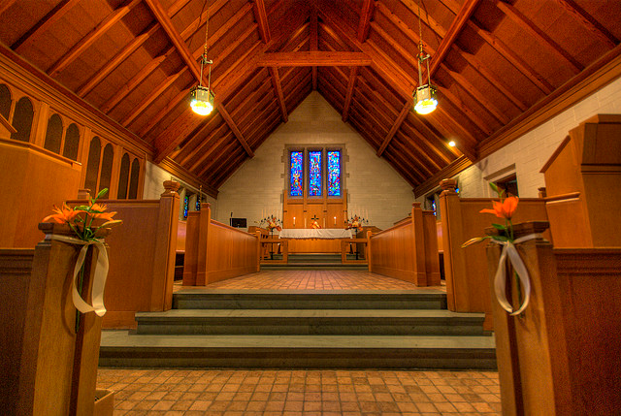
1920-1940 | junior year abroad to Europe
1950s-60s Late 1960s | Government invests in FL training. MSU 1st Dean Int’l Programs. Research on academic rigor of programs. identification of extra-curricular benefits – personal development
1970s | program expansion, beginning of research on attitude and behavior.
1980s | search for success in programs – too complex
1990s | IC development central focus.
2000-2010 | Growth of major research studies SA tripled over last 20 years through Faculty-led ST programs broaden disciplinary focus and engage significant growth.
Notes:
Chapel – 1952. Morrill Act 1862. International 1950s, 1st dean, Jetsons study abroad.
1920s -40s junior year abroad to Europe
1950s/60s government invests in FL training
1958 National Defense Education Act
MSU created the first Dean of International Programs at a major U.S. university in 1956.
Faculty encouraged to develop and lead SA programs.
1960s research on academic rigor of programs – courses as good as in U.S.?
Late 60s – identification of extra-curricular benefits – personal development
1970s – program expansion, beginning of research on attitude and behavior.
Program evaluation mainly participant satisfaction
MSU builds catalog of faculty-led programs in many disciplines
1980s – search for success in programs – too complex
Simon – the Tongue Tied American
MSU sends approx. 1,000 students/year
1990s – IC development central focus
1995 MSU sets goal of 40% UG SA participation rate
2000 – growth of major research studies
Faculty-led ST programs broaden disciplinary focus and engage significant growth
Engle and Engle’s ‘defining components’ : program duration, pre-departure FL study, FL; academic context, type of housing, experiential learning initiatives, mentoring/guided cultural reflection
SA tripled over last 20 years
MSU sends 2,000/year
2008 –
3,100 students abroad, 1/3 of undergraduates, 260 programs on all continents,
New Task Force begins to develop vision for next phase
Rise of intentionality inprogram design. From immersion to intensive – out of the slow bake oven and into the microwave

Slide 18
Notes:
1980s – mid 90s, relatively stable.
1995 Task Force. McPherson calls for 40% UG participation by 2006
MSU # 1 public university for SA enrollment starting w/2003-2004 cycle, maintained last 6 yrs.
2008 – 32.6% of UG MSU students study abroad. 1 in 3.
2007-2008 – MSU convenes new task force
08-09 – 12% decline – Michigan economy hit hard, nationally, decline is 0.8%, first decline in 25 years, start of OD.
Summer 2010 – 5% increase over summer 2009.

