Slide 1
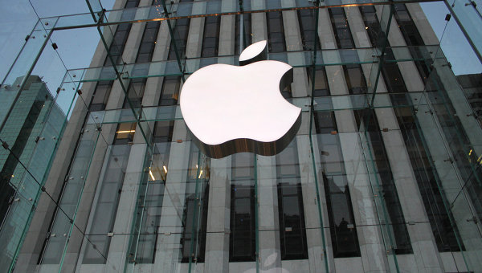
global Marketing
Gretchen Carroll, Ed.D., J.D.
Dean, School of Business
Owens Community College

Slide 2
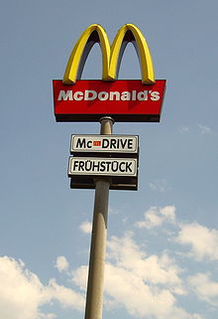
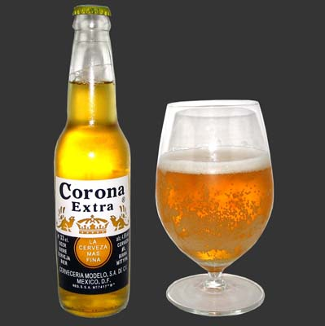
A Global versus local paradox
Think of brands and products known around the world and their sense of identity.

Slide 3
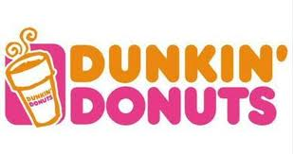
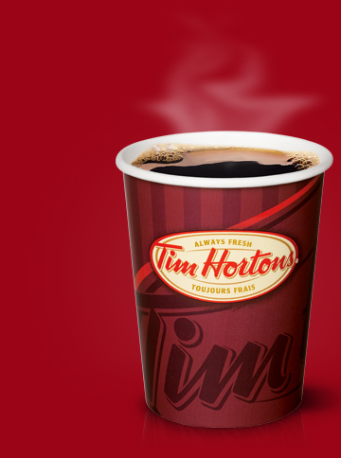
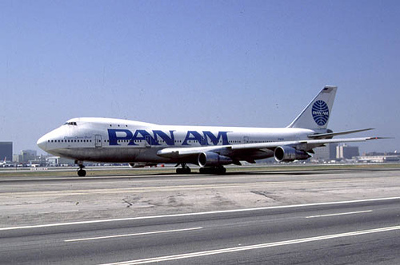
The growing importance of global marketing….
We are undergoing a sweeping transformation that is impacting people and industries of many nations.
Three decades ago the phrase global marketing did not exist.
Today, global marketing is imperative to survival.
Failure to understand global markets increases the risk of failure as global competitors enter domestic markets with lower costs, more experience, and better products.

Slide 4
The fundamental difference between regular marketing & global marketing?
The scope of activities.
A company that engages in global marketing conducts important business activities outside the home-country market.
Companies that engage in global marketing frequently encounter unique or unfamiliar features in specific countries or regions of the world.
Global marketers need to understand marketing concepts, but must also have a deep and broad understanding of the world’s varied business environments.

Slide 5
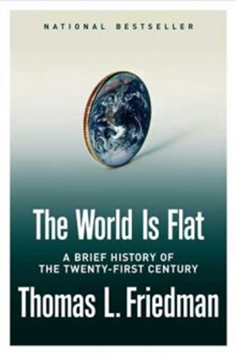
Forces Affecting Global Integration & Marketing
Remarkable growth in the global economy over the past 65 years.
Driving forces of globalization are greater than the restraining forces.
- Multilateral Trade Agreements (NAFTA, GATT, …)
- Converging Market Needs
- Democratization of Information (satellite dishes, CNN, MTV, broadband internet, social networking…)
- Transportation and communication improvements (containerization, Skype, e-mail, broadband internet, video teleconferencing…)
- Increasing product development costs (pharmaceuticals…)
- Quality (global companies raise benchmarks)
- World Economic Trends
- Leverage (experience transfers, scale economies, resource
utilization, global strategy)
Restraining forces
- Management myopia & organizational culture
- National controls
- Opposition to globalization

Slide 6
The Global economic environment
World economy has changed profoundly.
Most fundamental change is the emergence of global markets.
Global competitors have steadily displaced or absorbed local ones. Examples?
Economic integration was 10% at the beginning of the twentieth century; today it is 50%. Interesting to examine EU and NAFTA.
The global economic crisis illustrates the dynamic, integrated nature of today’s economic environment.
Of special interest are the BRIC nations. The US growing trade deficit is a concern especially since U.S. trade deficit with China reached $250 billion in 2007. China has more than $1 trillion in foreign reserves, more than any other nation. China is also investing heavily in U.S. land, real estate, and government securities. Foreign-owned U.S. assets total $2.5 trillion.

Slide 7
Bright SPOT- U.S. Services Export surplus
A fundamental shift has been taking place in the world's economy over the past 25 years for most developed economies and multinational firms. The following industries have high export potential.
Travel and tourism. The largest single category within the U.S. service sector.
Transportation services.
Architectural, construction, and engineering.
Education and training services. Management training, technical training, and English language training are areas where U.S. expertise remains unchallenged.
Banking, financial, and insurance services. U.S. financial institutions are very competitive internationally,.
Entertainment. YouTube - Hakuna Matata Lion King (Mandarin-Chinese)
The Lion King is the highest grossing animated film of all time- $300 million in global sales
Information services.
Professional business services. This sector includes accounting, advertising, legal, and management consulting services. The international market for these services is expanding at a more rapid rate than the U.S. domestic market.

Slide 8
Global marketing Requires companies to think globally and act locally
U.S. represents approximately 25% of the total world market for all products and services. So…..
75% of world market is outside of our home country.
85% of the world market is outside of Japan for Japanese companies
94% of the world market potential for German companies is outside Germany.
Industries that were essentially national in scope are dominated today by a handful of global companies.
In most industries, the companies that will survive and prosper in the 21st century will be global enterprises.

Slide 9
Fortune’s top ten global companies
Rank | Company | Country | Field
1 | Wal-Mart Stores | United States | Retail
2 | Royal Dutch Shell | Netherlands† | Petroleum
3 | Exxon Mobil | United States | Petroleum
4 | BP | United Kingdom | Petroleum
5 | Toyota Motor | Japan | Automobiles
6 | Japan Post Holdings | Japan | Diversified
7 | Sinopec | China | Petroleum
8 | State Grid | China | Power
9 | AXA | France | Insurance
10 | China National Petroleum | China | Petroleum

Slide 10
The top 10 countries with the most global 500 companies
Rank | Country | Companies
1 | United States | 139
2 | Japan | 71
3 | China | 46
4 | France | 39
5 | Germany | 37
6 | United Kingdom | 29
7 | Switzerland | 15
8 | Netherlands | 13
9 | Canada | 11
9 | Italy | 11

Slide 11
Social and Cultural environments
Independent of social class and income, culture is a significant influence on consumption behavior and durable goods ownership.
The social and cultural environment impacts every aspect of the marketing mix. It becomes even more difficult in nations with multiple cultures and languages. India has 18 national languages , but there are 347 spoken languages.
Deep cultural understanding that is based in language can be an important source of competitive advantage for global companies.
Procter & Gamble India : advertising and marketing profile at adbrands.net
P&G has 23 Billion Dollar Brands and 20 that sell ½ a billion a year. Eg. Tide, Crest, Charmin, Pampers, Head and Shoulders, Ace and Ariel?

Slide 12
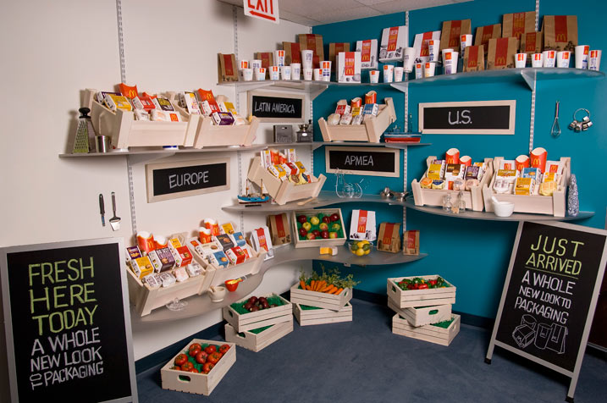
mcDonALD’s - # 4 GlOBAL Brand McDonald's School in China Trains Workers Amid Expansion - Video - Bloomberg
Number of Global Restaurants:
More than 32,000
Number of Countries:
117
Number of worldwide employees:
1.7 million
Percentage of franchised restaurants around the world:
More than 80%

Slide 13
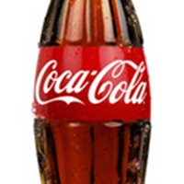
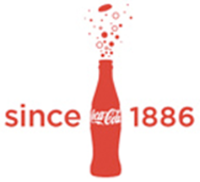
Coca-CoLA is the #6 Global Brand & a great case study in Global Branding Coca-Cola Conversations
Coca-Cola - Contact Us - Student Zone

Slide 14
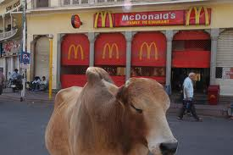
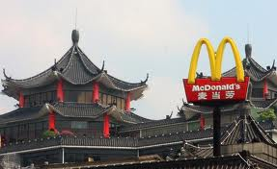
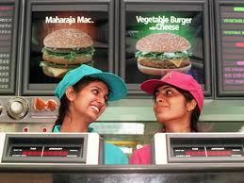
Marketing’s impact on culture
Universal aspects of the cultural environment represent opportunities for global marketers to standardize some or all elements of a marketing program.
Widespread shared preference for convenience fools, disposable products, popular music and movies in U.S., Europe, Asia.
Convergence of tastes and preferences in a number of product categories.
The impact of marketing and global capitalism on culture can be controversial.
“McDonaldization of culture”- when global companies break down cultural barriers while expanding into new markets with their products.

Slide 15
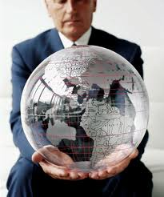
In Closing…

