Slide 1
Spotlight on the Middle East
9th Biennial International Business Institute
June 5-9, 2011
Dr. Tunga Kiyak
Michigan State University

Slide 2
Doing Business in the Middle East
Defining the Middle East
Key Challenges
Key Opportunities
Top 10 Tips for the Middle East
Recommended Sources for Information

Slide 3
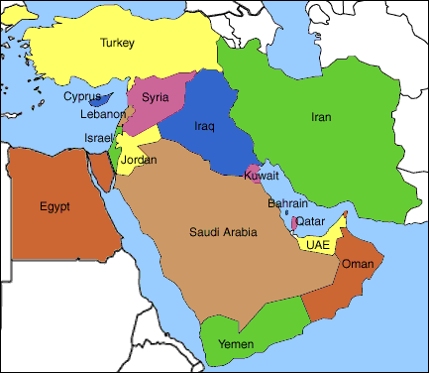
Traditional Definition of Middle East
Turkey is usually accepted as part of Middle East.
A “greater” definition sometimes includes Northern African countries
Primary language is Arabic, other than in Iran (Persian), Turkey (Turkish), and Israel (Hebrew).

Slide 4
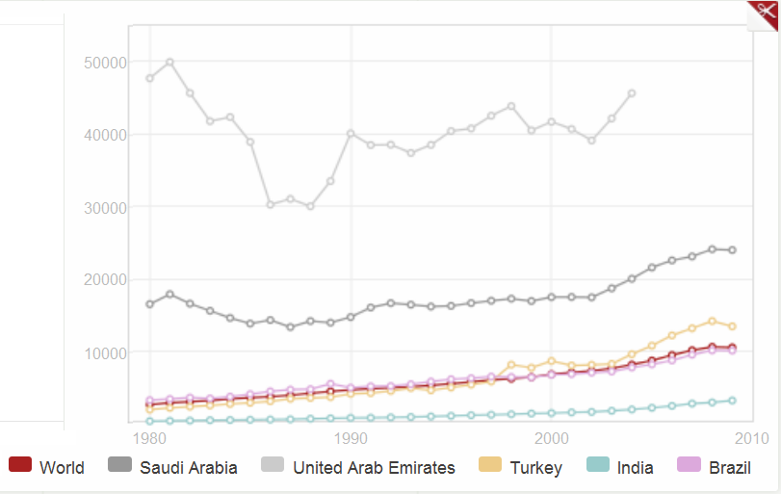
GNI per Capita

Slide 5
Other Statistics of Interest
Country | Population | Land Area (km²) | % Internet Users
Bahrain | 1,300,000 | 760 | 88.0
Egypt | 14,000,000 | 1,001,450 | 21.2
Iran | 75,100,000 | 1,648,195 | 43.2
Iraq | 31,500,000 | 438,317 | 1.1
Israel | 7,600,000 | 20,770 | 71.6
Oman | 3,100,000 | 309,500 | 41.7
Qatar | 1,700,000 | 11,586 | 51.8
Saudi Arabia | 29,200,000 | 2,149,690 | 38.1
Turkey | 73,600,000 | 783,562 | 45.0
UAE | 5,400,000 | 83,600 | 75.9
Yemen | 23,600,000 | 527,968 | 1.8
USA | 309,600,000 | 9,826,675 | 77.3

Slide 6
Key Challenges
Regional conflicts and political/economic uncertainty
The Arab Spring (http://is.gd/aBjtQN)
Global security issues
US foreign policy
Restrictions and trade sanctions (e.g. Iran, Syria)
Dependence on oil revenues and state-sponsored subsidiaries
High unemployment rates (25% is the Middle East average), young population, and other problems common to emerging country markets
Cultural, political, and economic differences among countries in the Middle East. (e.g. Turkey, Israel, Iran, Saudi Arabia)
Corruption (UN Food for Oil [El Paso, Volvo, Innospec, AGCO], Siemens, Textron, BAE Systems, Control Components, Delta & Pine, Latin Node )

Slide 7
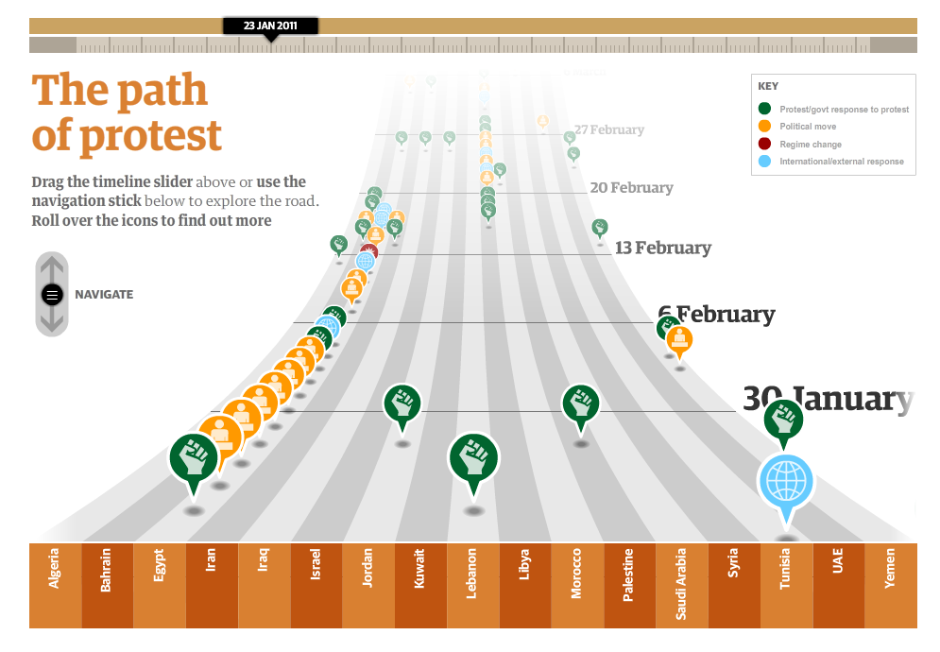
The Arab Spring

Slide 8
Key Opportunities
Bilateral free trade initiatives and agreements with the US and EU (e.g., Bahrain, Egypt, Israel, Jordan, Oman)
Policies intended to attract FDI and to diversify economically.
Privatization of traditionally state-owned enterprises.
Population growth and economic development
Significant progress on building institutional infrastructure (e.g., Bahrain, Israel, Turkey, UAE, Kuwait)
Rebuilding of Iraq

Slide 9
Ease of Doing Business
 | DB 11 Ranking | Procedures (#) to start a business | Documents (#) to import | Cost to import (US$ /container) | Enforcing a contract (Cost % of claim)
Brazil | 127 | 15 | 7 | 1730 | 16.5
Mexico | 35 | 6 | 4 | 1880 | 32.0
India | 134 | 12 | 9 | 1025 | 39.6
China | 79 | 14 | 5 | 545 | 11.1
Saudi Arabia | 11 | 4 | 5 | 686 | 27.5
UAE | 40 | 8 | 5 | 542 | 26.2
Qatar | 50 | 8 | 7 | 657 | 21.6
Bahrain | 28 | 7 | 6 | 995 | 14.7

Slide 10
Saudi Arabia
Dominant player in the area
Relatively isolated from the Arab Spring for now
Biggest market in the area for construction, IT, infrastructure projects (power, gas and water equipment, telecommunication).
Third largest consumer of water per capita in the world, but has very limited groundwater to tap.
Has the largest oil reserves in the world

Slide 11
United Arab Emirates
Consists of 7 Emirates
One of the wealthiest countries in the world (GDP/capita)
No corporate tax, no income tax, low import duties
Dubai - The darling of the Western world
Only 6% of Dubai’s revenues come from oil and gas
It’s share of UAE gas revenues is about 2%. It’s oil is expected to be exhausted in 20 years
Hit hard by the world economic crisis – Dubai World incident
Abu Dhabi – The conservative, wealthier brother
Owns 95% of the oil and 92% of the gas in UAE (that’s 8% of world reserves in oil and 5% of world’s natural gas)

Slide 12
Qatar
Strong performer economically
Oil and gas sector makes up 61% of GDP.
Qatar has 14% of the world’s total natural gas reserves.
Highest per capita GDP in the world: $90,300 (approximately twice of the US)
Imports 90 percent of its food
Market opportunities in energy, infrastructure, health care, education, transportation, and food
Will host the 2022 World cup ($100 billion in proposed infrastructure spending)

Slide 13
Turkey
Middle East’s gateway to the European Union – has a customs union with EU since 1996
Is frequently referred to as a “model” with regards to the emerging democratic reforms in the region. Is secular by law.
Has made strong market reforms especially in the banking sector.
One of the few countries in the region where there are no restrictions on foreign ownership. The government has a very liberal policy towards foreign investment.

Slide 14
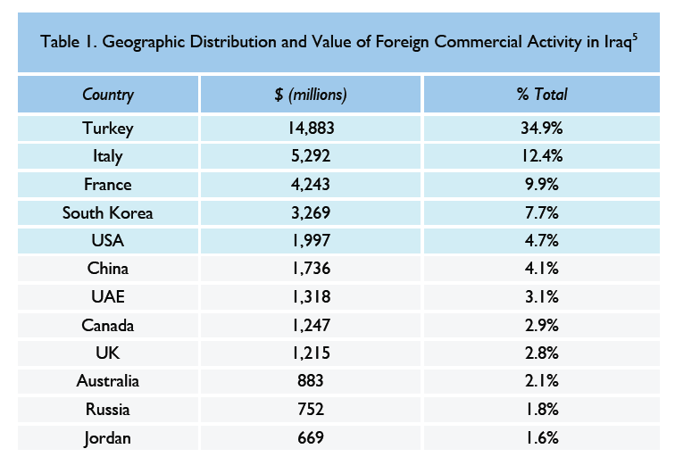
Iraq
Major rebuilding opportunities – target GDP growth rate for the next 5 years is 9.4% per year
The planned infrastructure projects are worth up to US$186 billion.
Houses, airports, ports, power plants, hotels, roads, water, sanitation – all needs to be rebuilt
Corruption, security, and securing payments remain major concerns.

Slide 15
Top 10 Tips for Middle East
It’s not what you know that is important so much as who you know -- “Wasta”
“Who is your sponsor?” - Connections can make or break a deal
- With the right people, you will find that doors open for you and rules are bent enough to accommodate you. Favors are not forgotten and often reciprocated.
Without the connections, you will more often find that you lose the deal in the last minute to the cousin of the company or government executive.
Therefore, choosing the right partner is critical – take your time to find someone with commercial synergy, intellectual synergy, and with political muscle and business acumen.
Start with a couple small, quick deals to test the partner out before going for that mega deal.

Slide 16
Top 10 Tips for Middle East
2. Patience is a virtue
Patience is the single most important trait you need to have when dealing with Middle Eastern countries.
Closing a deal, finalizing an agreement, establishing consensus will take time. Set your expectations accordingly.
Showing impatience is a poor reflection on your character
Be flexible, be able to accommodate shifting schedules
Meetings may often start late, or cancelled all together due to ‘family obligations’. But you are expected to be punctual.

Slide 17
Top 10 Tips for Middle East
3. Business and Personal Relationships are One and the Same
Arabs will do business only with people they know and like
Small talk is essential for the counterparts to become comfortable with you
Trying to get down to business immediately is a sure way to fail
Humor is appreciated and is commonly used

Slide 18
Top 10 Tips for Middle East
4. Face-to-face Communication is Essential
Regular personal visits are essential
No important business will be conducted or finalized over the phone, but minor business can be conducted this way
Emails and faxes are the least personal and the least important and may be ignored until you follow-up with the phone.
Body language is usually as important as the spoken word, so be on the lookout for non-verbal signals and also pay attention to your own posture. Maintain eye contact.

Slide 19
Top 10 Tips for Middle East
Be prepared to bargain
Man to the boy: “What is 2 + 2, Mohammad?” Boy responds: “Am I buying or selling?”
Bargaining is in their blood. Everyone bargains, it’s seen as ‘entertainment’ or ‘sport’ .
No other business activity is more important or more stimulating
The Arabs may raise their voice, show temperament or engage in sudden outbursts – It’s part of their theatrics
However, you have to maintain composure; not raising your voice or losing your temper is critical. So is showing confidence.

Slide 20
Top 10 Tips for Middle East
6. Personal word is more important than a written agreement
Everything is negotiable, even a contract (which is seen more of a memorandum of understanding)
Personal relationships and trust are more important than legal papers or man-made laws
Spoken promises carry more weight than contractual clauses.
Important: Do not expect this to work in both directions. Westerners are outsiders and they are expected to follow their contractual obligations.

Slide 21
Top 10 Tips for Middle East
7. Understand Islam’s influence on business and personal life
Islam permeates all levels of society, and provides guidance, values and rules for personal life as well as for doing business.
All offices have prayer rooms, and meetings will not be scheduled during prayer times
Avoid conducting business during Ramadan. Muslims fast from dawn till dusk. General business activity is held to a minimum during the month.
Also, two religious holidays, Eid al-Fitr and Eid al-Adha are 3-days long, but are usually extended to be a week long, so don’t expect business can be conducted during those times.
Friday is the day of congregational worship where all males are required to attend the prayers. No business is conducted on Fridays (Saturday is the other weekend day usually).
DO NOT criticize Islam under any circumstance! It’s not only offensive, but is also illegal in many countries.

Slide 22
Top 10 Tips for Middle East
Like many other cultures, showing appreciation of one’s culture is appreciated
Business language is English (it is a status symbol), but learning a few words of Arabic will be very appreciated
Do not generalize as “Arabs” or “Middle Easterns” – thre are significant differences between the different countries and tribes, and many folks do not appreciate being put into a single basket.
Understand how names work. The name structure is:
First name - Father’s Name - Family name
People are usually referred to by their first names, so it’s Mr. John, not Mr. Smith.
Right has importance over left:
Eat with right
Shake hands with right
More important person, or the guest, stays or sits on the right.
Dress conservatively
‘Loss of face’ is the same as ‘loss of reputation’ and is important for them to avoid. If you take the blame, you will be appreciated.

Slide 23
Top 10 Tips for Middle East
9. Personal Space
Arabs enjoy standing in close proximity, and casual touching to the person they speak to is common. Showing signs of discomfort or moving away is offensive.
Handshakes are almost ceremonial. Expect a strong handshake and expect it to last very long. Islamic etiquette requires you to wait until the other person withdraws their hand. It’s common for men to walk while holding hands.
IMPORTANT: These only apply to people of same gender.
Only initiate handshakes with people from the same gender. Do not initiate a handshake with an opposing gender. If they are used to dealing with Westerners, they may extend their hand in which case you can accept (then a short, soft, and brief handshake is appropriate), but if you initiate it you may be refused.
Do not touch or keep eye contact with a person of the opposite sex

Slide 24
Top 10 Tips for Middle East
10. Food and drinks are a sign of generosity
If offered a snack, always accept, and take at last a bite. You don’t have to finish it but you cannot refuse it.
Tea and coffee is a feature of meetings (companies typically have a “tea man” employed) and is a mark of hospitality, so do not refuse that either. After the first one, you can wiggle your cup to indicate you have had enough
Arabic Coffee – spicy, more like tea
Turkish Coffee – small, with settlements
Tea – sometimes black, sometimes sweet with condensed milk

Slide 25
Islamic Finance
As with everything else, Islam dictates the rules for finance and banking
Four main prohibitions, distinguishing Islam from Western finance:
Riba, or interest is forbidden to prevent unjust exploitation
Gharar, uncertainty in contracts is un-Islamic (you cannot sell real estate at project phase, ground needs to be broken)
Masir, gambling is immoral and leads to evil (so speculative instruments, futures/options cannot be used)
Investing in prohibited products (pork, alcohol) is forbidden

Slide 26
Alternative Instruments
Modaraba (Trust Financing)
A financial institution provides capital to finance a project, the entrepreneur provides management skills. The institution does not provide its own funds, but only funds of its investors. After paying for the management skills, the financial institution deducts a fee from the enterprises profits for managing its investor’s funds. The remaining profits are distributed to investors according to an agreed on ratio.
Morabaha (Cost-plus Financing)
The financial institution purchases a commodity or product, and then resells it to the customer at a later date for a predetermined price. The institution’s profit is the difference between the two rates.

Slide 27
Recommended Sources of Information
globalEDGE – http://globaledge.msu.edu/
“Don’t they know it’s Friday?” - Jeremy Williams - (2010), 978-1-86063-074-3
“Understanding Arabs: A Guide for Modern Times” - Margaret K. Nydell – (2005), 978-1-931-93025-3
“Legal Aspects of Doing Business in the Middle East” - Christian Campbell - (loose leaf – updated annually)
U.S. Dept of Commerce Country Commercial Guides

