Slide 1
INTERNATIONAL
ECONOMICS
Notes:
1

Slide 2
Carl Liedholm
Professor, Economics
Notes:
2

Slide 3
INTERNATIONAL TRADE
BASIC FACTS
Notes:
3

Slide 4
Which of the following is true about the United States and its international trade role?
The world’s largest exporter in absolute terms
A relatively “closed” economy (X/GDP low)
Largest trading partner is China
Largest trading partner is Mexico
None of the above
Notes:
4

Slide 5
WORLD EXPORTS – 2009 MERCHANDISE
1)
2) GERMANY $ 1.11 Trillion
3) U.S. $ 1.06 Trillion
4) JAPAN $ 0.58 Trillion
5) NETHERLANDS $ 0.50 Trillion
Notes:
5

Slide 6
OPENNNESS
MEASURE
EXPORTS/GROSS DOMESTIC PRODUCT
Notes:
6

Slide 7
EXPORTS/GDP
GERMANY 37%
CANADA 36%
CHINA 36%
WORLD AVERAGE 25%
JAPAN 12%
UNITED STATES ___
Notes:
7

Slide 8
U.S TRADING PARTNERS
Notes:
8

Slide 9
U.S TRADING PARTNERS (Percent of US Exports) 2009
1)
MEXICO 12 %
CHINA 6 %
JAPAN 5 %
U.K. 4 %
GERMANY 4%
Notes:
9

Slide 10
Which of the following is true about the United States and its international trade role?
The world’s largest exporter in absolute terms
A relatively “closed” economy (X/GDP low)
Largest trading partner is China
Largest trading partner is Mexico
None of the above
Notes:
10

Slide 11
GLOBALIZATION
*
Notes:
11

Slide 12
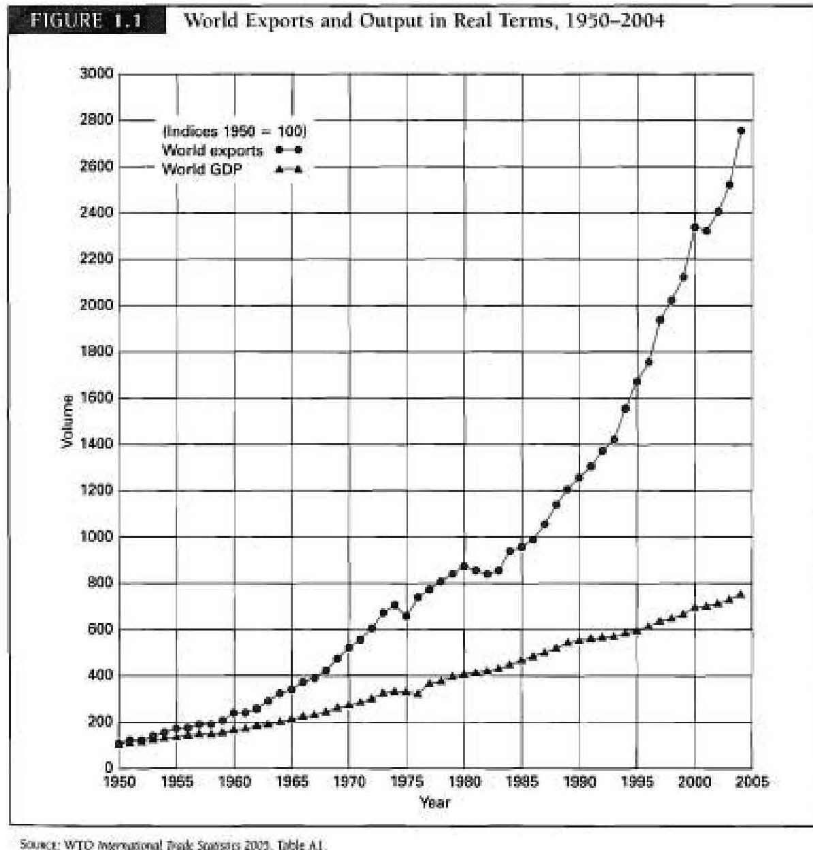
Notes:
12

Slide 13
GROWTH SINCE 1950
WORLD TRADE 25X
WORLD OUTPUT 8X
Notes:
13

Slide 14
Recent Period
6 %
2 %
-12 %
* +13 %
Notes:
14

Slide 15
GLOBALIZATION
NOT A NEW PHENOMENON
Expansion of Roman Empire
Voyages of Discovery
End of Napoleonic Wars
Notes:
15

Slide 16
PRIMARY DRIVING FORCES OF RECENT WAVE OF GLOBALIZATION
REDUCTION OF TRADE BARRIERS
*
Notes:
16

Slide 17
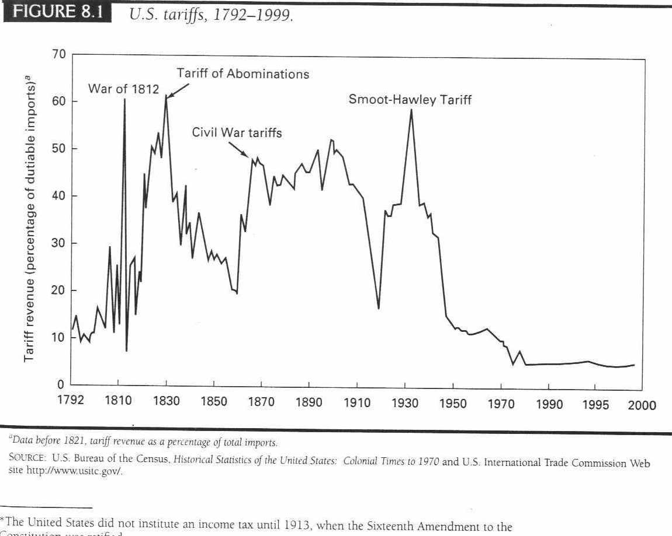
Trade and welfare
slide 17
Notes:
17

Slide 18
Effect on U.S. Household
$1 Trillion/year
$10,000/ household per year
Notes:
18

Slide 19
2. TECHNOLOGICAL CHANGE
Notes:
19

Slide 20
3. EMERGENCE OF NEW COUNTRIES
1)
2)
3)
Notes:
20

Slide 21
EFFECT ON JOBS
Notes:
21

Slide 22
EFFECT ON TRADE BALANCE
IMPORTS NOW GREATLY EXCEED EXPORTS
Notes:
22

Slide 23
U.S. FOREIGN TRADE DEFICIT 2010
CURRENT ACCOUNT DEFICIT
- $ 470.2 Billion
3.2 % of GDP
Notes:
23

Slide 24
INTERNATIONAL ACCOUNTING
CURRENT ACCOUNT
(Goods and Services Transactions)
+
FINANCIAL ACCOUNT
(Purchase and sale of Assets)
=
0
Notes:
24

Slide 25
INTERNATIONAL ACCOUNTING
CURRENT ACCOUNT
-$470 Billion
+
FINANCIAL ACCOUNT
+$470 Billion (Liability to Foreigners)
=
0
Notes:
25

Slide 26
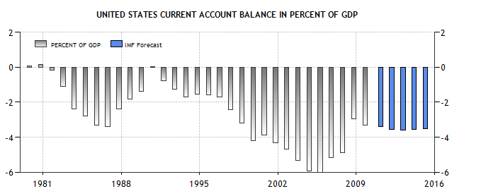

Slide 27
INTERNATIONAL FINANCE
*
Notes:
27

Slide 28
:
$
*
Notes:
28

Slide 29
The coins used in colonial America were primarily::
British (Shillings and Pounds)
Spanish (Pieces of Eight)
German (Thalers)
French (Ecus)
Dutch ( Ducatoons)

Slide 31
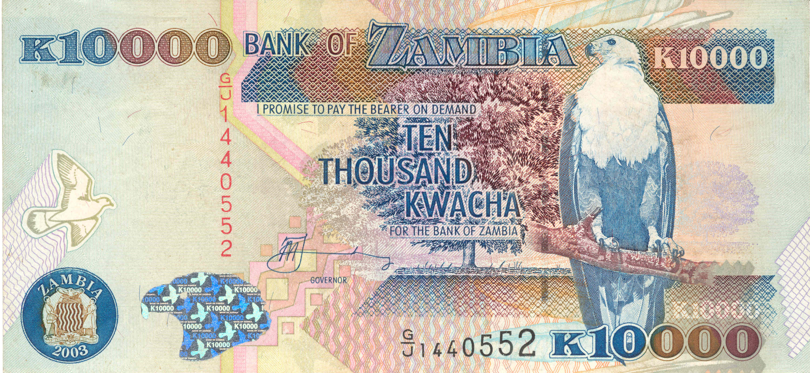
Notes:
31

Slide 32
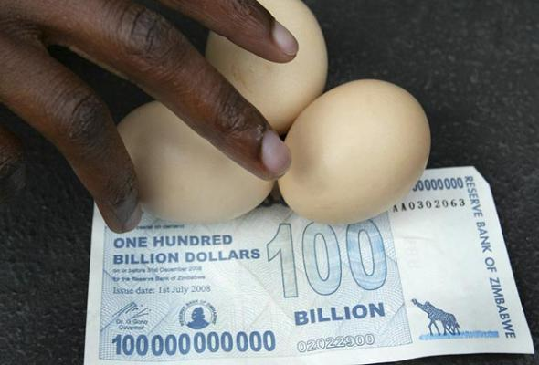

Slide 33
EXCHANGE RATE
PRICE (RATIO)OF ONE CURRENCY IN TERMS OF ANOTHER
L/$
CURRENCY ON BOTTOM KEY
Notes:
33

Slide 34
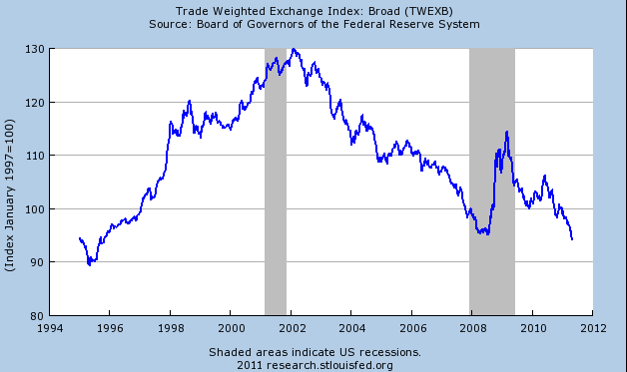

Slide 35
EFFECT OF FALLING DOLLAR
MAKES U.S. FIRMS MORE COMPETITIVE INTERNATIONALLY
LOWERS PRICE OF U.S. GOODS ABROAD
INCREASES PRICE OF IMPORTED GOODS
Notes:
35

