Slide 1

Cultural Intelligence: Why HR needS it!
International Business Institute| June 7, 2011
David Livermore, Ph.D.
Cultural Intelligence Center, East Lansing, MI
Notes:
1
Our fam moved to GR about 7 years ago and at the risk of offending those of you native to W.Mich, I came here a bit kicking and screaming…
But as Nancy was introducing me this morning, I was reminded of the contrast to how I was introduced at a speaking engagement in DC last yr
--”Our speaker…”
--kind of like when someone rips on your ext family—ok for me but not for you
--couldn’t resist defending GR…home to international companies like Amway & Steelcase; Kentwood public schools

Slide 2
OPPORTUNITIES AND CHALLENGES
1 billion The number of people expected to join the middle class in the next decade.
60% The growth GE predicts will come from emerging markets in the next decade.
Notes:
Let me remind you of just a few stats that speak to the shifts in our global economy…in Michigan—it stings pretty close to home to think about the outsourcing of jobs…but we need to balance that with an understanding of the growing opportunities that exist globally
60% GE (in last decade it was 20% of their profits were from emerging markets)

Slide 3

Air Travel
N. American and European
Airlines
Asian and Middle Eastern
Airlines
$
$
67%
62%
41%
29%
34%
31%
Notes:
The International Air Transport Association recently released the stats on this next slide…demonstrating where the greatest growth lies
If there’s any industry that’s really struggled over the last 10 years—is airlines
Of all the flights, revenue, and passengers who travel each year—here’s what percentage is held by N. Amer and European airlines
FLIGHTS REVENUE TRAVELERS

Slide 4
OPPORTUNITIES AND CHALLENGES
Team Competencies
Conflict
Resolution
Global Collaboration Personnel are expected to collaborate with globally dispersed colleagues and clients more than ever before. Cultural differences make collaboration even more difficult.
Collaborative
Problem Solving
Communication
Goal Setting &
Performance Management
Planning & Task
Coordination
5 Competencies for Collaboration
(Stevens & Campion 2004)
Notes:
Let me remind you of just a few stats that speak to the shifts in our global economy…in Michigan—it stings pretty close to home to think about the outsourcing of jobs…but we need to balance that with an understanding of the growing opportunities that exist globally
60% GE (in last decade it was 20% of their profits were from emerging markets)

Slide 5
Examples of Intercultural Challenges
How to voice disagreements (direct versus avoidance) and resolve conflict (confrontational versus withdrawal)
Team Competencies
Conflict
Resolution
Attitudes towards knowledge sharing
– e.g. collectivistic cultures may be less willing to share with out-group members, due to emphasis on relationships
Collaborative
Problem Solving
Differences in language and communication style may create misunderstandings and misattributions
-- e.g. viewing those less fluent in English as slower or lacking attention, enthusiasm or confidence
Communication
Preference for participative versus assigned goals, and individual versus team rewards may affect effectiveness of different project controls
Goal Setting &
Performance Management
Different views of time may affect project deadlines & schedules – e.g. cultures with cyclical view of time tend not to view deadlines as urgently
Planning & Task
Coordination

Slide 6
OPPORTUNITIES AND CHALLENGES
90% of leading executives from 68 countries said finding effective cross-cultural personnel is their top management challenge.
--Economist Intelligence Unit
Notes:
All of this makes it easy to understand why 90%..
Don’t imagine you need me to spend our time together this morning convincing you to be culturally sensitive and globally aware—overstated and trite
And for any of us living in W. Michigan—the idea that Steelcase is a global company is etched into our minds—especially you!
But wonder if at times it feels a few steps removed for you—particularly for those of you who rarely leave GR on behalf of the company
*Or deal with accusations
*Grow frustrated when you can’t understand colleague in KL

Slide 7

Myths
International Experience=Cultural Competence
Technical Competence = Success
High EQ=High CQ

Slide 8
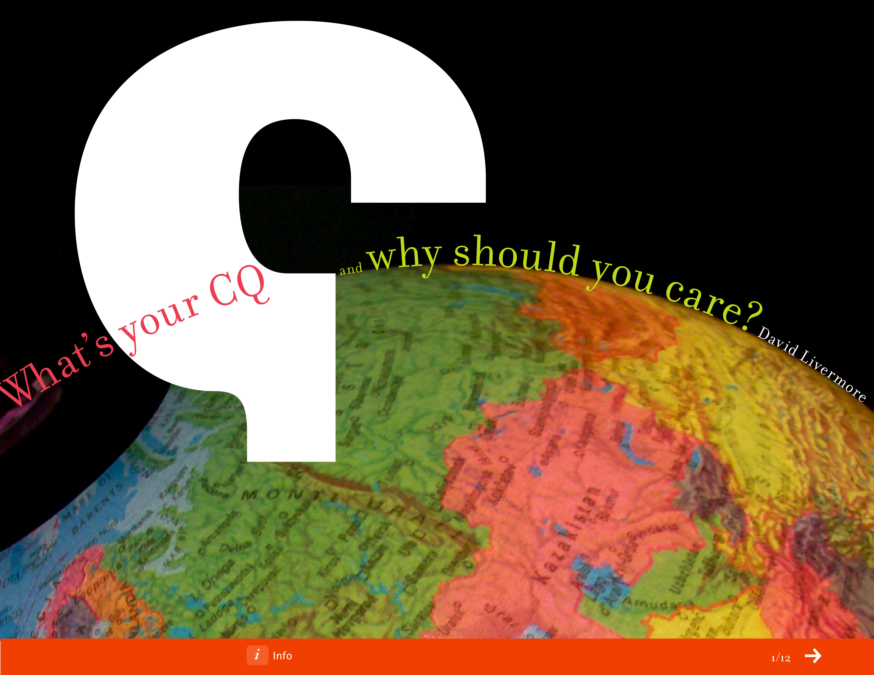
LEVERAGING GLOBAL OPPORTUNITIES WITH CULTURAL INTELLIGENCE
Notes:
Want to spend just a couple minutes giving you a quick overview of CQ

Slide 9

What’s the difference between individuals and businesses that succeed in today’s globalized, multicultural world and those that fail?
Notes:
Research found that individuals who are effective in culturally diverse situations are people who are comfortable in their own skin, which in turn allows them to learn and listen to the perspective of others.
It doesn’t sound like rocket science but it moves the emphasis away from traditional approaches that have emphasized learning cultural stereotypes and adapting to them: e.g. Here’s how Chinese behave versus Canadians; or This is how African American men vote versus Hispanic American women. In today’s globalized world, can we really label all Chinese or all African American men as viewing the world one way? And is the best approach to be like whomever you’re with? These approaches and stereotypes are way too elementary for today’s world.
Instead, the research discovered that cross-cultural effectiveness is largely a personal capability rooted in one’s internal motivation, consciousness, and adaptability. It’s led to a whole new way of approaching the age-old topics of cultural sensitivity, racism, and cross-cultural effectiveness because its based upon internal issues and individual strengths rather than upon artificial behavior changes or politically correct language.

Slide 10
Cultural Intelligence Quotient (CQ)
The capability to function effectively across various cultural contexts (national, ethnic, organizational, generational, etc.).
  --Soon Ang and Linn Van Dyne, “Conceptualization of Cultural Intelligence” in Handbook of Cultural Intelligence: Theory, Measurement, and Applications (Armonk, NY: M.E. Sharpe, 2008), 3.
Notes:
First…a definition
We’re using that term “intelligence” intentionally

Slide 11
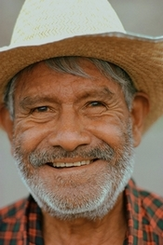
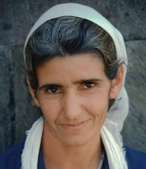
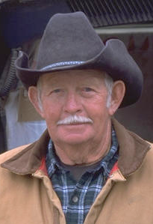



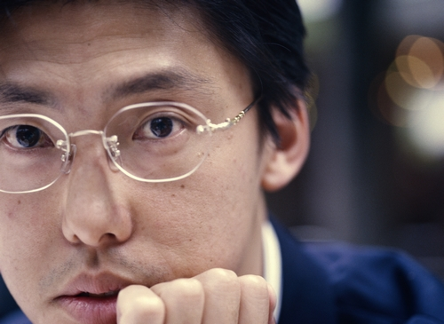

Higher CQ led to increased effectiveness across any cultural context
Notes:
Stable measurement and approach whatever the cultural context
What was interesting is what did NOT guarantee effectiveness
--not high IQ
--not international experience
--not speaking multiple languages
But…they consistently demonstrated strength in four key capabilities

Slide 12

Four Capabilities consistently emerge among individuals effective in culturally diverse situations
4. CQ
ACTION
1. CQ
DRIVE
3. CQ
STRATEGY
2. CQ
KNOWLEDGE
Notes:
Want to briefly describe for you the four capabilities that consistently emerge among individuals who are effective in culturally diverse situations:
List them here and then say a few things about each of them

Slide 13

CQ Drive:
They possess a level of interest, drive and motivation to adapt cross-culturally.
CQ
DRIVE
Notes:
This is the driver of the other 3—corporate has to be motivated to see why the expense of assessment and development is worthwhile
Associates need to see how this ties in with their personal and work-related goals

Slide 14
CQ Knowledge:
They have a strong understanding about cultural issues.
CQ
DRIVE
CQ
KNOWLEDGE
Notes:
Most typical part

Slide 15


Slide 16


Uncertainty Avoidance
Low UA Comfortable with risk High UA Uncomfortable with risk
Notes:
1 84 (avg 35)
China, India, Malaysia Japan, Russia, Israel, Germany, Mexico, France

Slide 17

Context
Low Context—Direct High Context—Indirect
Notes:
26 59 (45)
Canada Latin, Asian, African, India, China, Malaysia, Mexico
Israel
Germany
U.S (France—mid)

Slide 18
CQ Strategy:
They are aware and able to plan in light of their cultural understanding.
CQ
DRIVE
CQ
STRATEGY
CQ
KNOWLEDGE

Slide 19


How the world sees Americans…

Slide 20
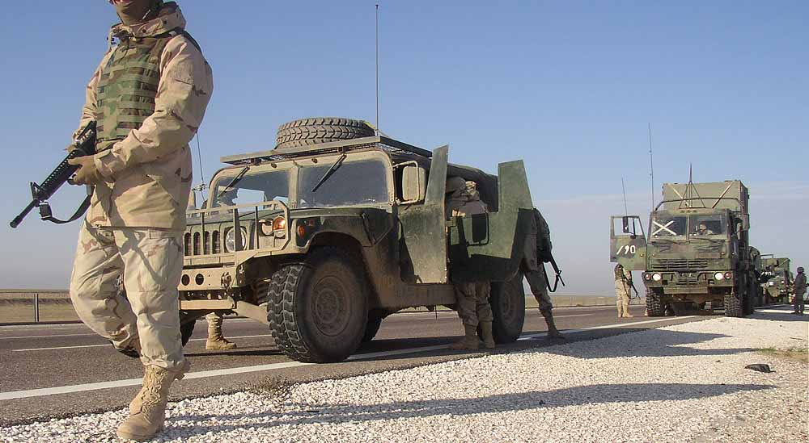


Slide 21
CQ Action:
They know when to adapt and when not to adapt when relating and working cross-culturally.
CQ
ACTION
CQ
DRIVE
CQ
STRATEGY
CQ
KNOWLEDGE

Slide 22

Results of Higher CQ
Cross-Cultural Adjustment
Your CQ has more to do with your success and effectiveness in multicultural situations than your age, gender, location, IQ, or EQ.
Notes:
Lots of the research focused upon what leads to CQ…but at the end of the day..SO WHAT? What are the results if we improve our CQ
It might sound obvious but one of the things that was most important to me when examining this research was asking—does it actually improve the way people adjust to cross-cultural situations
*Can’t prove this from global mindset or cultural sensitivity alone
But numerous studies, across 30 different countries have found that your CQ has more to do with your success…
Among the 20,000…age, gender, geography…

Slide 23
Results of Higher CQ
Individuals with higher CQ are better:
Negotiators
Networkers
Innovators
Leaders of Multicultural Teams
Job Performance
Notes:
Series of studies that looked at the negotiation abilities of those with higher CQ
*Think about the challenge of negotiation—you’re trying to read inbetween the lines; take on POINT OF VIEW
Ability to build networks…what will build trust…how to develop relationship…in Japan—the meal and golf game might be far more important to the contract
Innovators…interesting studies on creativity and CQ
Those individuals with higher levels of CQ were better able to build consensus among multicultural teams

Slide 24

Results of Higher CQ
Personal
Well-Being
Individuals with higher levels of CQ report a greater level of enjoyment and satisfaction from intercultural work and relationships than those with lower levels of CQ.
Notes:
The next result stems from a number of studies that focused upon the personal well being of individuals working in cultural diverse scenarios
Even those high in CQ Drive…can become fatigued dealing with the constant need to adjust
*You might understand why it is that corporate still organizes meetings around times that work best for people in the US…but it gets tiring

Slide 25

Results of Higher CQ
Profitability
Of companies that used the cultural intelligence approach through training, hiring, and strategizing, 92 percent saw increased revenue within eighteen months of implementation.
Notes:
Higher level of efficiency and profitability among companies with managers who had higher levels of CQ
One study worked with a number of MNC’s…

Slide 26
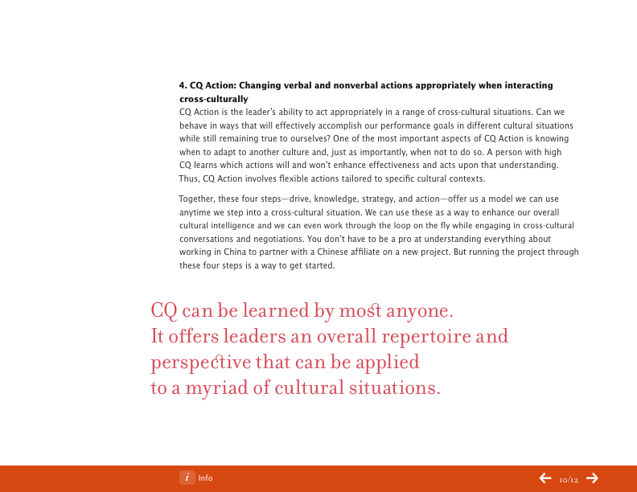
Information about assessments, certification courses and more at www.CulturalQ.com

Slide 27
Journal of a U.S. Visitor to Peru
June 22
“This is our first day here. The challenges began as soon as we landed last night. The airport looked like a dilapidated barn. But they sure took baggage security seriously. They wouldn’t let us have our bags until they checked the tags. I guess they have to do that here otherwise people would probably steal them.”

Slide 28
Journal of a U.S. Visitor to Peru
June 25
“Wow! The industrial revolution obviously skipped this place…The cool thing is, everything is so cheap.”
June 27
“We’re staying in one of the expat’s homes for a couple days while they’re away. If we weren’t here, the place would probably be robbed.”

Slide 29
Journal of a U.S. Visitor to Peru
June 29
“I taught today. They don’t speak English so I had to use an interpreter.”
July 4
“It’s so weird to be here on the 4th of July…Being here makes me so thankful for our country. Why did I get the blessing of being born in America? What if I had been born here instead?”

Slide 30

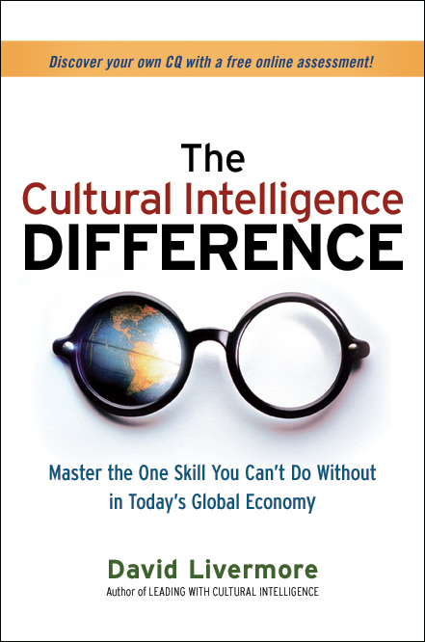
Thank You!
For More Information:
www.DavidLivermore.com
www.CulturalQ.com

