Slide 1
International Business Institute
Global Strategic Management
Robert M. Wiseman
Eli Broad Legacy Fellow of Management

Slide 2
International Strategy
What is strategic management?
Strategy in a global context
Liability of foreignness
  Impediments to transferring advantages
Institutional infrastructure
  opportunity v opportunism
Balancing economic and political imperatives

Slide 3
What is Strategy?
Creating and Appropriating Value

Slide 4
Value Chain
Administration and Infrastructure
Human Resource Management
Information Management
Purchasing
PROFIT
Inbound
Logistics
Outbound
Logistics
Operations
Marketing
Service
M. Porter, “Competitive Advantage”, 1984

Slide 5
Creating and Appropriating Value
Bargaining
Power of
Buyers &
Quality of
Substitutes
{
Buyer’s Surplus
Market
Price
Value
Created
{
Seller’s Profits
Net
Benefit
Bargaining
Power of
Suppliers
Input
Costs

Slide 6
Market Imperfections Influencing Price
Market Structure: (bargaining power)
Supply and Demand
Willingness-to pay (WTP)
Government Regulations
Parker Hannifin Corp.
Cost-plus pricing to WTP pricing in 2002
Net income: $120mm (’02) to $673mm (’06)
ROI: 7% (’02) to 21% (’06)
WSJ, 3/27/2007: A1

Slide 7
Forms of Economic Rent
Ricardian Rent
  ownership of a valuable assets (land, patents, brand, etc.)
Entrepreneurial (Schumpetarian) Rent
  entrepreneurial insight in a complex/uncertain environment (e.g., Microsoft, Amazon, Netflicks)
Monopoly Rent
  protection against competition (regulated industry or collusion), generally through control of supply
Quasi-rent (first-best minus second-best use)
  the amount a firm may appropriate from idiosyncratic capital or assets

Slide 8
Creating Value to Increase WTP
Buyer’s
Surplus
Economic
Rents
Buyer’s
Surplus
Price
Price
Profits
Profits
Input
Costs
Input
Costs
Total
Benefit

Slide 9
Bargaining Power to Capture Value
Buyer’s Surplus
{
Price
Economic
Rents
Seller’s Profits
Net
Benefit
Input
Costs

Slide 10
Bargaining Power to Capture Value
Buyer’s Surplus
Price
Seller’s Profits
Economic
Rents
Net
Benefit
Input
Costs

Slide 11
Strategy in a Global Context
Challenges and Opportunities

Slide 12
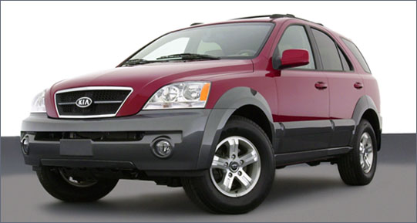
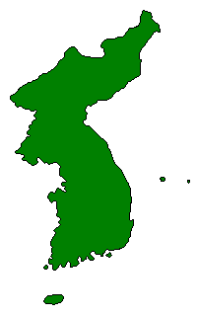
A Truly Global Economy
Korea
Kia Sorento
30,000 parts from Wales, Mexico, Sweden, China, Thailand….
Notes:
It takes 30,000 parts to make one Kia Sorento.
Tires from Michelin, Shocks from ZF Sachs, 4wheel drive from BorgWarner, Airbags from Autoliv (Sweden), electric motors from Daewoo Electronics, Mirrors from Gentex. Wales, Mexico, Sweden, China, Thailand,
Panasonic Automotive sources optical pickup units which read CDs in China.
These get shipped to Thailand. In Thailand, the mechanical structure and electronic components get added.
The unit is next shipped to Matsushita Communications, Industrial Plant in Reynosa Mexico where additional electronic components are assembled.
The units are then trucked to a Delco Electronics plan in Matamorros, Mexico where all components are assembled into into an audio system.
The audio system is then trucked into California where it is shipped to South Korea for insertion into the car.
The completed car is then shipped to the U.S. where it gets sold.

Slide 13
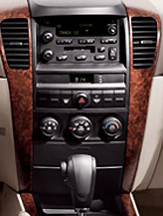
A Truly Global Economy
Making a Radio/CD player
Kia Sorento
One Radio, 5 countries, 5 companies
Notes:
It takes 30,000 parts to make one Kia Sorento.
Tires from Michelin, Shocks from ZF Sachs, 4wheel drive from BorgWarner, Airbags from Autoliv (Sweden), electric motors from Daewoo Electronics, Mirrors from Gentex. Wales, Mexico, Sweden, China, Thailand,
Panasonic Automotive sources optical pickup units which read CDs in China.
These get shipped to Thailand. In Thailand, the mechanical structure and electronic components get added.
The unit is next shipped to Matsushita Communications, Industrial Plant in Reynosa Mexico where additional electronic components are assembled.
The units are then trucked to a Delco Electronics plan in Matamorros, Mexico where all components are assembled into into an audio system.
The audio system is then trucked into California where it is shipped to South Korea for insertion into the car.
The completed car is then shipped to the U.S. where it gets sold.

Slide 14
Four Questions of Global Strategic Management
Motivations for going global
Challenges of a global business
Success in foreign markets
Managing a multinational business

Slide 15
Motivations for Globalization
Scale economies
Growth potential
Lower factor costs
Vertical integration demands
Opportunities
  Homogenization of global culture
Competitive dynamics
  Defending local markets may require competing globally

Slide 16
Global Challenges
The Liability of Foreignness

Slide 17
The Usual Suspects
Physical Context
  Transportation, education, and communication
Socio-Cultural Context
  Tastes, values and language differences
Industry Contexts
  Competitive rivalry, entry barriers, etc. differences
Political Context
  Regulatory, economic and political differences

Slide 18
Walmart Enters Germany
Does Small Town America Sell
in Europe?

Slide 19
Wal-Mart Activity System
Local Ctrl over prices
“We Sell for Less”
Efficiency from
Technology
Efficient use of
Floor Space
Low cost
store leases
Hard bargaining
w/ vendors
“Everyday Low
Prices”
Low Prices
Culture Emphasis:
Efficiency
Efficient
Operations
High T/O
Merchandise
Minimal Advertising
Strict Cost
Control
Hub & Spoke
Distr. System
Low Cost
Store Fixtures
Inventory Mgmt
Few Stock outs
Rural
Store Locations
Inbound Logistics:
Back Haul
Greeters”
Customer
Friendly
Low Pay scale
Incentive based
Frequent
Communication
Return Policy
Low in-Store
Licensing Fees
Non-union
Employees
Convenient
Store Hours
The
“Wal-Mart Cheer”
Associate
Satisfaction
“Product Mix”
Customer Demographic

Slide 20
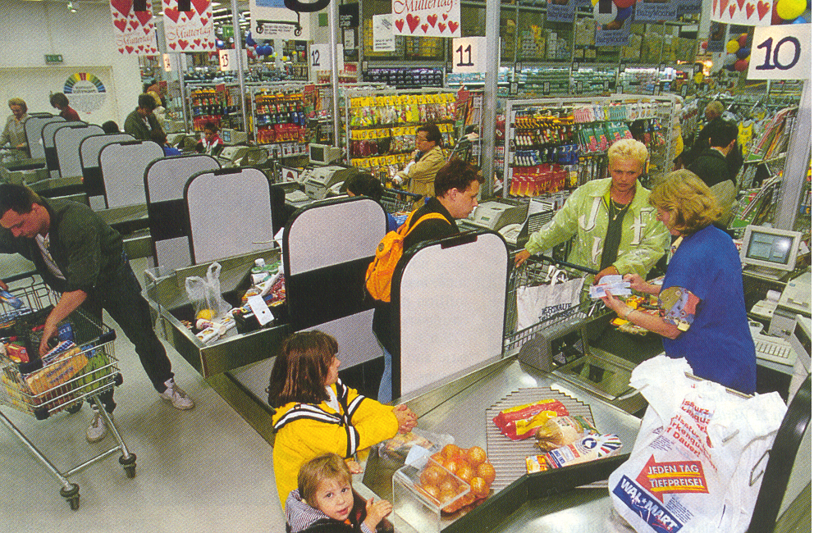

Slide 21
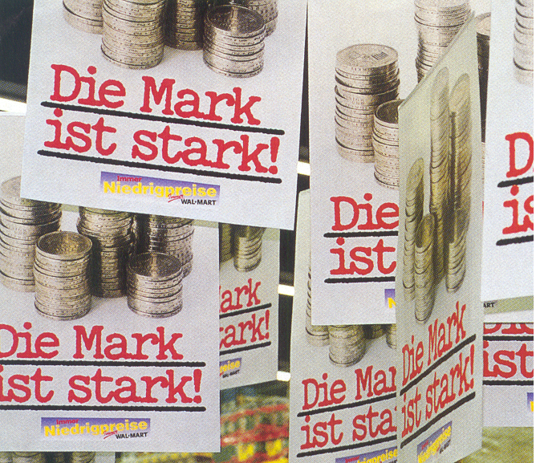

Slide 22
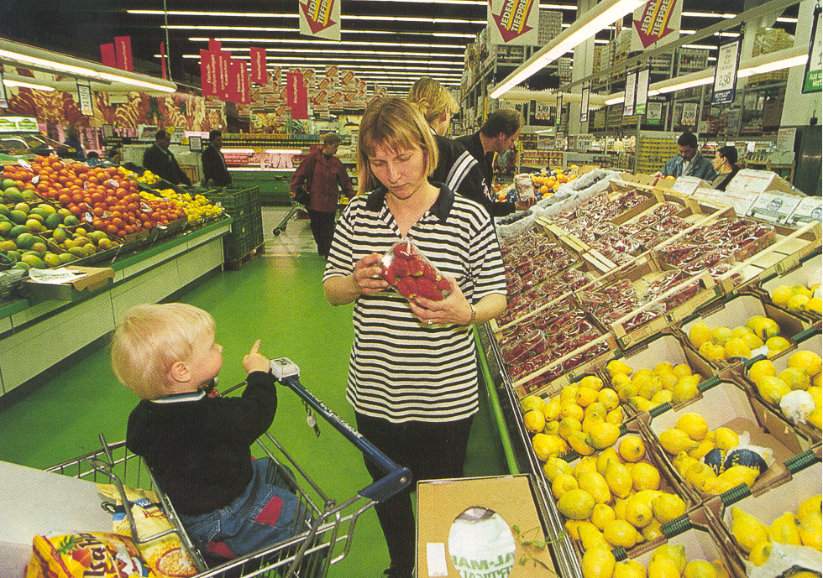

Slide 23




Slide 24
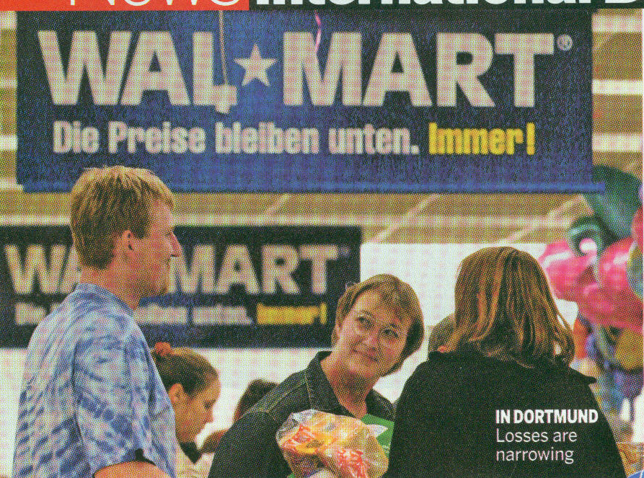
Wal-mart: Wir Übergaben!
Business Week, April 18, 2005
Notes:
Walmart’s performance in Germany of late has not been good. At present they have been forced close some stores (they are down to 91 stores from 95 two years ago). They still only have a 2% market share only turned a profit in 2004, after 7 years. The problem Walmart faces in Germany is partly that they have been unable to duplicate the competitive advantages that has allowed them to grow so rapidly in the US. In particular they don’t have sufficient sales volume in all product lines to give them bargaining power over suppliers. They do have volume advantages in some global product categories such as detergent and toiletries, but this is only a small percentage of the total product line that must be carried in stores in Germany. Most of the products are local, like local foods , and Walmart is at a distinct disadvantage against rivals Aldi (with 19% of the market) and Kaufland (which as five times as many stores as Walmart).
In addition, Walmart has tried to implement its own ethical standards on their employees (e.g., no romantic relations between supervisor and subordinates) which lead to significant conflict with its labor union.

Slide 25

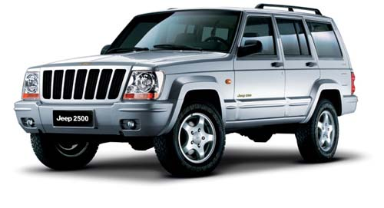
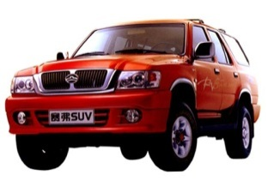
The Chinese Price Advantage
Jeep 2500 (Chrysler Group)
Price: $13,200
3 Domestic Competitors
Average Price: $10,000
158 unit sales
First 2 months of 2005
5,304 unit sales
Combined, First 2 months of 2005
“From Fat Profits to Hardscrabble?” The Outlook for China Car Market 2005-2010, Automotive News China Conference, 20 April 2005 Michael J. Dunne

Slide 26
Limitations on Transferability
Geographic advantages
  labor, monopoly positions, distribution network, reputation, customer or supplier relations
Tacit knowledge
  difficult to enact in different context, unknown interaction with context
Cost of transfer
  loss of effectiveness or efficiency
Mode of transfer
  joint venture, partnership, direct investment

Slide 27
Institutional Infrastructure
When markets fail

Slide 28
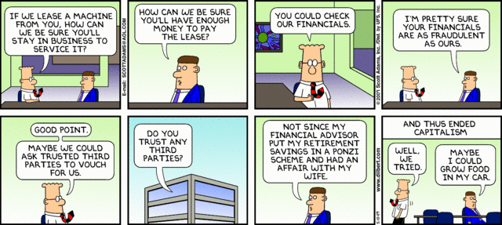
Markets Fail When Exchanges Don’t Occur
Dilbert, May 10, 2009

Slide 29
Market Failures: Institutional voids
Market failure occurs when mutually beneficial transactions do not occur because the cost of performing the transaction is too high
Transactions costs arise from uncertainty about potential transaction partners, the cost of writing and enforcing contracts.

Slide 30
Transaction Costs: information asymmetry
Those who are information disadvantaged may be reluctant to transact
  the market for “lemons” leads to lower prices offered
  Lower market prices leads to the removal of higher valued goods from the market.
Costly to overcome information asymmetry
  If costs are privately born they may exceed value of transaction

Slide 31
Transaction Costs: Contracting costs
Long-term relationships in dynamic settings.
  A 5-yr contract to build an aluminum smelter in Botswana.
Relationship-specific investments, including all upfront costs to service the partner.
  Creates a potential for “hold-up.”
  Building a railroad spur to an auto plant.
Unclear property rights.
  especially true for intangible assets like knowledge, ideas, innovations.
  Who owns the rights to an idea for a movie?

Slide 32
Transaction Costs: Lack of public goods
Absence of impartial courts
Absence of laws protecting property rights
Absence of political will or ability to enforce laws
Absence of reliable economic facts!
  Hernando de Soto (Bloomberg Businessweek, 4/28/2011)
    The Mystery of Capital: Why capitalism triumphs in the west and fails everywher e else
  Douglass North (Institutions, Institutional Change & Economic Performance, 1990)

Slide 33
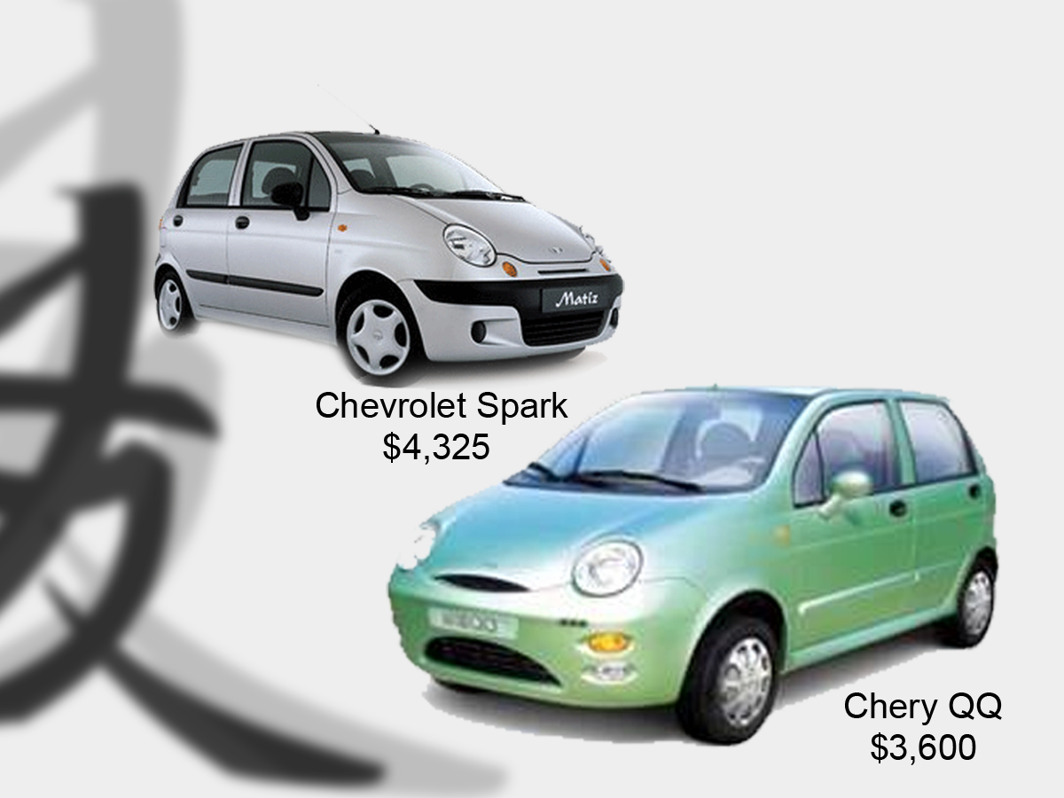
IP Protection?

Slide 34
Overcoming Market Failure
Bring transactions into the firm (i.e., hierarchical control)
  Prevents transaction parties from walking away
  Reduces “property rights” problem
  Provides enforcement mechanism
  Reduces information asymmetry

Slide 35
Overcoming Market Failure
Clustering of firms in geographic regions
  Frequent intra-group trading increases information
    Finding a key resource is more likely (e.g., talent)
  Tight communities discourage deviant behavior among rivals
    Informal networks develop to share information
  Lower risks of hold-up, hence more up-front investment
    Locate where there are many potential buyers

Slide 36
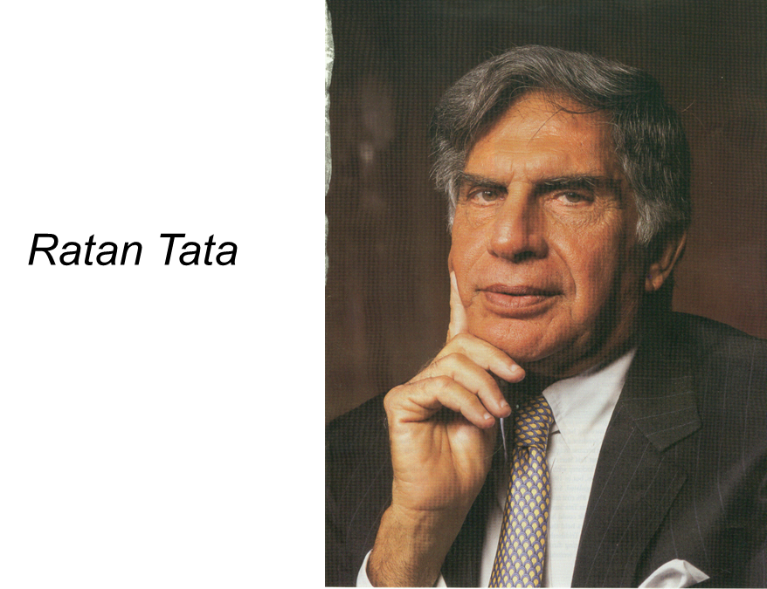
Overcoming Market Failure
Creation of a business group
  Creates an internal private capital market
  Interlocking ownership provides enforcement mechanism
  Family ties reduces information asymmetry, increases trust

Slide 37
Tata Board Interlocks Among Directors
Company | Chairman | Board Size | Dir. Overlap
Tata Sons | Ratan Tata | 16 | 13
TIL | Ratan Tata | 16 | 12
Telco | Ratan Tata | 11 | 5
Tisco | Ratan Tata | 11 | 4
Tata Chem. | Ratan Tata | 10 | 3
Tata Tea | Ratan Tata | 8 | 1
Tata Power | Ratan Tata | 6 | 1
Indian Hotels | Kerkar | 11 | 6
ACC | N. Palkhivala | 11 | 4

Slide 38
Tata Group Holdings, 1997
Company | Tata Sons’ Stake | Total Holdings*
Tisco | 8.5% | 15.0%
Telco | 2.9% | 15.2%
Tata Power | 6.4% | 20.0%
Tata Chemicals | 8.2% | 29.6%
Tata Tea | 8.6% | 29.0%
Indian Hotels | 14.5% | 37.0%
ACC | 11.2% | 12.0%
*Includes all cross-holdings

Slide 39
Nature of Business Groups
Business groups are not a legal entities
  Loose alliance of companies
Each individual company is legally independent
  Several companies are likely to be publicly traded
Group members hold ownership in each other

Slide 40
Development of Intermediation
As public sources of intermediation develop, the need for business groups declines.
  Active and reliable markets for labor, capital, technology, human resources etc.
  Government enforcement of contracts & property rights
  Independent sources of information about transaction partners
  Hence, the value added from being in a business group declines

Slide 41
Managing Multinational
Balancing Economics and Politics

Slide 42
Economic Demands to be Competitive
Improve efficiency by streamlining operations
Achieve economies of scale
Coordinate R&D efforts
Share assets and knowledge as much as possible
Transfer people and knowledge

Slide 43
Political Demands to be Responsive
Be responsible to local government demands
  jobs and taxes
Adjust to different regulatory setting
  restrictions on competitive practices
Recognize cultural differences
  product design and placement
  human resource practices

Slide 44
Summary
Strategic management seeks to generate economic rents by exploiting market imperfections
  Controlling supply, owning valuable resources or creating market disruptions
Foreign markets offer opportunities to leverage existing resources and forestall competitive threats
  Growth opportunities, leverage capabilities, forestall competitive threats
  Transferring advantages across national boundaries is risky and costly

Slide 45
Summary
Foreign markets present unique risks
  Liability of foreignness, lack of critical infrastructure, and threat of opportunism
  Political risks including investment and foreign exchange risks
Managing a multinational firm requires balancing economic and political imperatives
  Global efficiency versus satisfying unique local demands
  Managing the tension between corporate headquarters and local subsidiaries

Slide 46
Global Strategic Management
“I don’t think we’re in Kansas anymore, Toto.”
--Dorothy, Wizard of Oz

