Slide 1

Europe and the
Greater Middle East
Norman A. Graham
Center for European, Russian and Eurasian Studies and
James Madison College, Michigan State University
Suhnaz Yilmaz
Acting Director, Graduate Studies, Koc University
Istanbul

Slide 2
Convergence of the Eurocrisis and the
Arab Spring
Both were predictable but actually took everyone by surprise
-Regions had been stable for some time; the Euro was strong and most thought much of Middle East was immune to democratization
-Potential impact of creation of Islamic regimes
-Came to power by democracy but perhaps rather aiming at a certain typeof society
-Political ideology at work
-Revival in religious driven societies
Energy politics and resource competition tie the regions together with increasing intensity

Slide 3
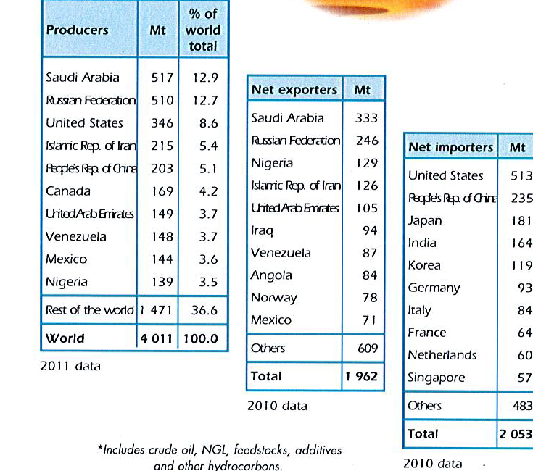
IEA: Oil Producers and Trade

Slide 4
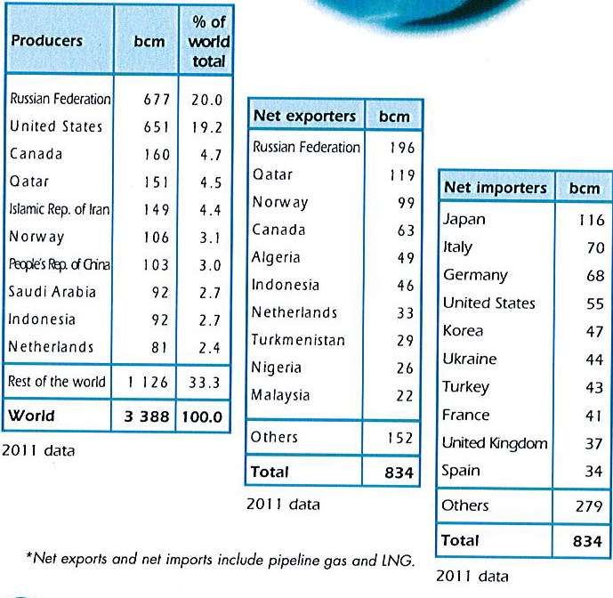
Global Natural Gas Production and Trade (IEA)

Slide 6
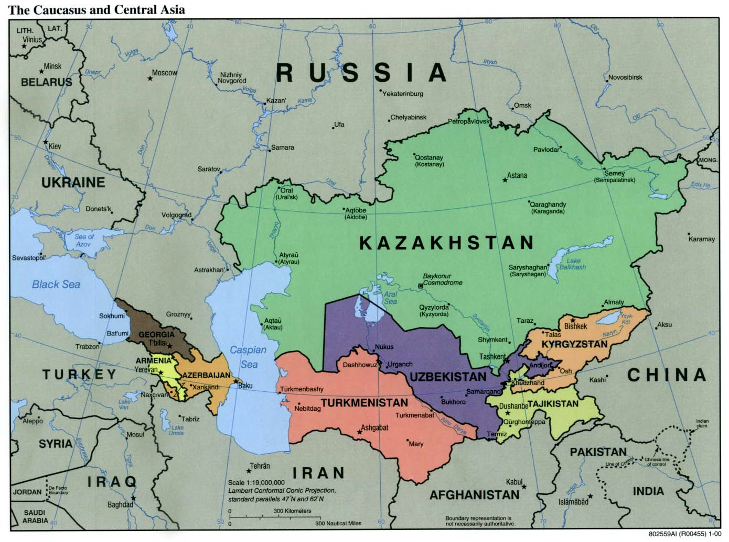

Slide 7
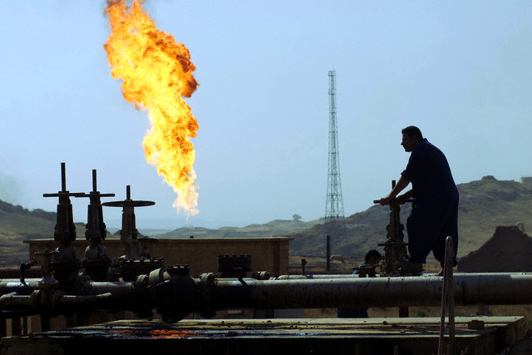
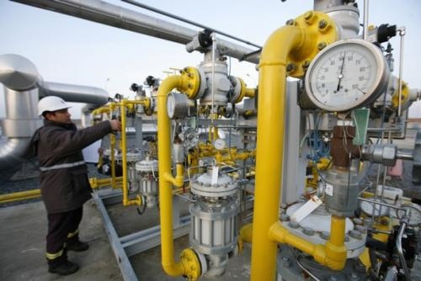
Energy Security
In the complex interaction between (i) energy producers, (ii) energy transit countries and (iii) energy consumers, the Gulf region and the Middle East, as well as Eurasia and the Caspian Basin emerge as extremely critical areas for global energy security
The Gulf region will maintain its position at the heart of energy politics
Caspian energy reserves are also significant for responding to the increasing oil and gas demand

Slide 8
Future Production and Consumption
While the Middle East, North Africa and the Caspian regions offer the most (physically) reliable and rich resources for the coming decades; developing Asia, the U.S. and EU will continue to be the biggest energy-thirsty markets with increasing dependency on energy imports from these regions.

Slide 9
EU Interest In Turkish Corridor
Turkish territory e effective way to transport energy from west to east
Important point → Turkey needs more outside capital for infrastructure
European Bank for Reconstruction and Development agreed to support Nabuco pipeline by funding %70 of the cost
Article of Carl Bildt and Massimo D’alema:‘’Turkey is a key actor in the realm of energy security. Given the uncertain state of energy markets, and the stakes involved, it is our shared interest to incorporate Turkey in a functioning integrated system’’

Slide 10
Turkey emerges as a key country
Turkey is at an energy crossroads. Three-fourths of the world’s proven oil and gas resources are located in regions neighboring Turkey. And with the increasing dependence of OECD and developing Asian countries on Middle Eastern and Greater Caspian oil, Turkey’s role as an important energy player has emerged.
This energy dependency is likely to have further major geopolitical implications. Given its unique geographical location between the Middle East and the Caspian regions on the one hand and the energy consuming markets on the other, Turkey stands as a key country in ensuring energy security.

Slide 11
The East-West Energy Corridor has been developed in close cooperation with Turkey, Azerbaijan, Georgia and the United States.
The Corridor essentially aims at transporting Caucasian and Central Asian oil as well as natural gas to western markets through safe alternative routes.
The main components of the Corridor are:
Baku-Tbilisi-Ceyhan (BTC) crude oil pipeline
The Shah-Deniz natural gas pipeline (Baku-Tbilisi-Erzurum)
The Trans-Caspian Natural Gas Pipeline projects, rail roads and other infrastructure

Slide 12
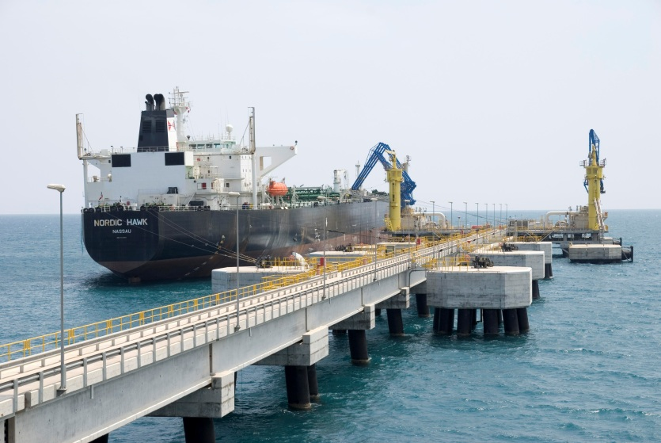
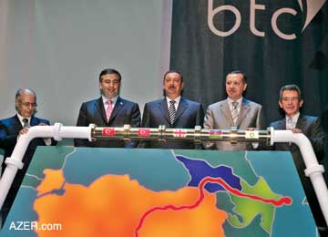
Baku-Tbilisi-Ceyhan Pipeline
Baku-Tbilisi-Ceyhan pipeline project was one of the first major energy initiatives in the Turkish-Azeri relations after the collapse of the Soviet Union and the independence of Azerbaijan.
The talks started in early 90’s
Fierce opposition from Russia and Iran
With the strong involvement and backing of the US government, the project started in 2002
The construction of the pipeline finished in 2005
In this positive environment, Turkey began purchasing natural gas from Azerbaijan in 2007

Slide 13
BTC Oil Pipeline
Completed in 2006
Length: 1767 km.
Cost: Approx. 4 billion dollars
One million barrels of Caspian crude oil is pumped each day
Azerbaijan and Kazakhstan signed a Transit Agreement in June 2006 to connect Kazakh oil to BTC
BTC is an alternative route to Russia and Iran for crude oil

Slide 14
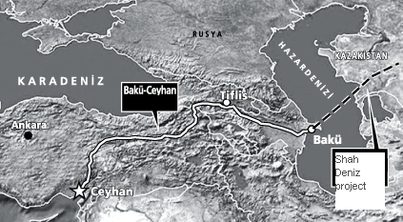
Baku-Ceyhan Pipeline and its prolongation to Kazakhstan
(Shah-Deniz Project)

Slide 15
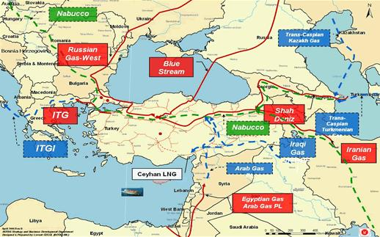

Slide 16
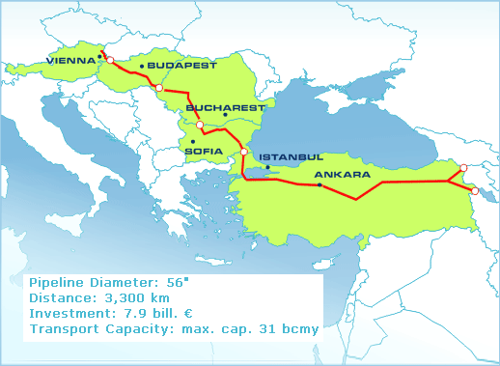
Nabucco
It is a critical nascent natural gas transit option
Potential target date for completion is 2015
Will be transporting gas primarily from Azerbaijan to Central Europe via the Turkish gas hub of Erzurum

Slide 17
Nabucco
It is significant for EU countries in terms of diversifying their supply and for bypassing Russian territory
Serious problems:
  Lack of throughput commitment
  Resource availability
  Prices and financing

Slide 18
Fate of Nabucco
After the memorandum of understanding, it was argued that the Trans-Anatolian pipeline project will be the end of Nabucco project or at least a serious competitor to it.
Minister of Energy and Natural Resources Yıldız: «It is not the end of Nabucco project. The two projects can be merged. Azeri gas will be connected to Nabucco in Bulgaria instead of Georgia»
Two days after the intergovernmental agreement, Shah Deniz gas producers’ consortium announced Nabucco West as the route for the Caspian gas into Europe.
TANAP will be a "kiss of death" for the Nabucco pipeline project in its current form, but will revive it as a more limited, yet more feasible project.
TANAP will connect to either Nabucco West or Trans-Adriatic Pipeline (TAP) and the Azeri gas will be transferred to Europe. The final decision is expected to be made in mid-2013.

Slide 19
Turkey’s Energy Dependency
Crude Oil Import
Turkey imports 92% of its total demand of crude oil.

Slide 20
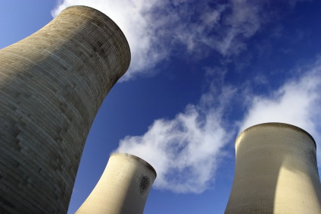
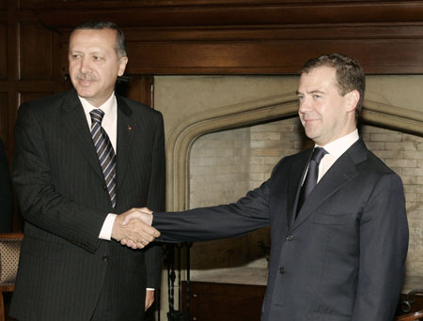
Turkey’s Nuclear Program
Turkey plans to have three nuclear power plants by 2023.
There are talks with mainly Russia and Japan for the construction of power plants.
Turkish Parliament approved a bill on an agreement between Russia and Turkey for the construction of Turkey’s first nuclear power plant in Akkuyu, a town in Mersin province, in July 2010.
Russian state-owned atomic power company ROSATOM is likely to start building the Akkuyu nuclear power plant in 2013, and the first reactor is expected to begin generating electricity in 2018.

Slide 21
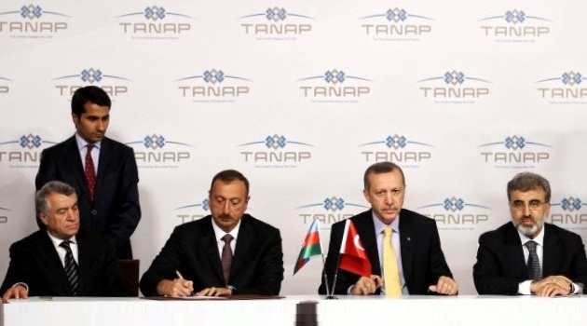
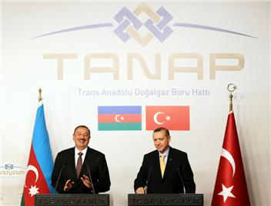
Trans-Anatolian Pipeline Project
On December 26, 2011, Turkey and Azerbaijan have signed a memorandum of understanding for the transfer of Azeri gas to Europe.
Intergovernmental agreement to launch Trans-Anatolian Pipeline (TANAP) was inked on June 26, 2012 by Erdoğan and Aliyev.
The projected amount of gas to transport is 16 billion cubic meters per year. 6 billion cubic meters/year will remain in Turkey, 10 billion cubic meters/year will be transferred to Europe. The capacity of gas flow is expected to reach to 31 billion m3 in fifteen years.
According to Erdogan, the first gas will flow in the pipeline in 2018.

Slide 22
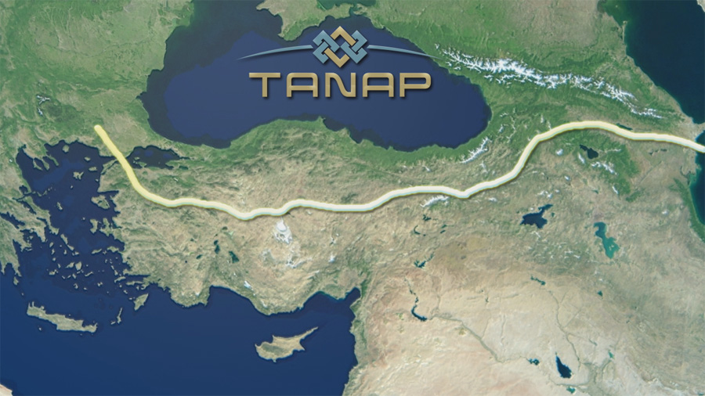
Trans-Anatolian Pipeline Project

Slide 23
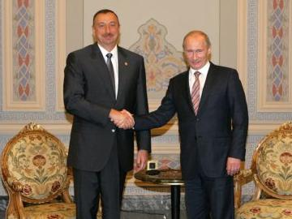
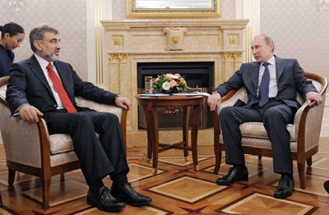
Russia does not want to lose its leverage in the regional energy politics. Thus put pressure on Central Asian countries not to enter Nabucco project.
Both Turkey and Azerbaijan are strongly dependent on Russia. Azerbaijan in politics and trade, Turkey in energy and trade.
Two days after the memorandum of understanding for the Trans-Anatolian Pipeline (on Dec 28, 2011), Turkey and Russia agreed on South Stream for transferring Russian gas to Europe through the Turkish Exclusive Economic Zone.
63 billion cubic meters per year. Discount in gas prices in return
A bypass project for Russia after Ukraine.
Putin: «A New Year’s gift to Russia.»

Slide 24
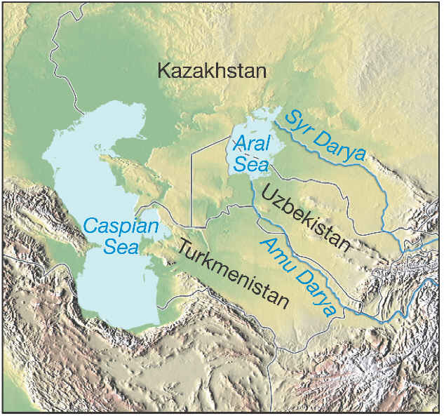

Slide 25
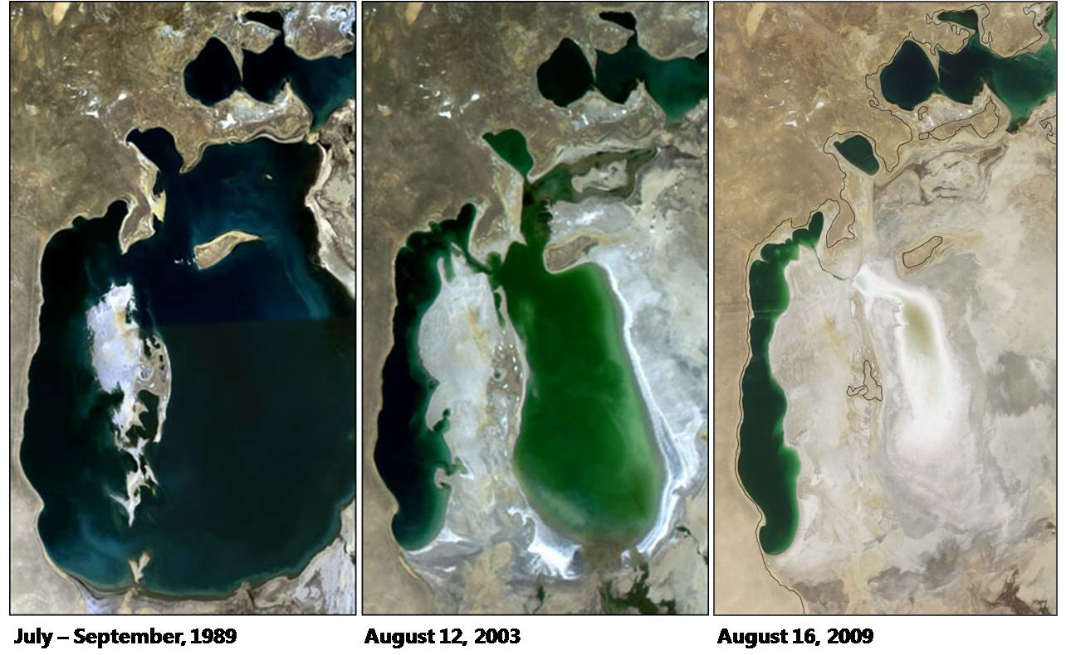

Slide 26
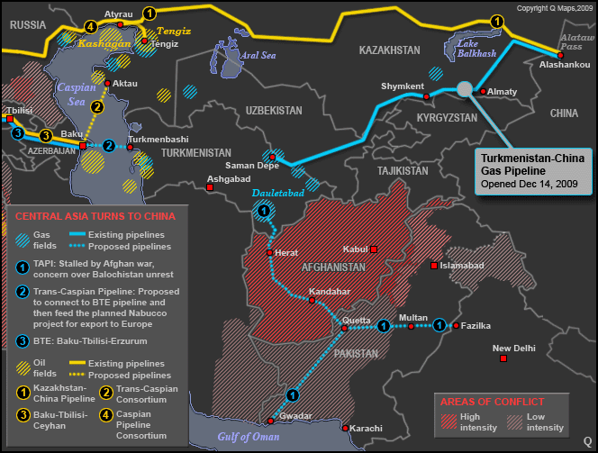
http://www.theoildrum.com/node/6068

Slide 27
Turkmen Gas Exports
Source: Pirani, Simon. Russian and CIS Gas Markets and Their Impact on Europe. Oxford University Press, New York, New York, 2009

Slide 28
Russia’s National Security Objectives
The National Security Strategy of the Russian Federation until 2020 (published 2009)
- stressed importance of energy security
- cited importance of Arctic, Caspian Basin and Central Asia regions
- emphasized need for modernization of forces and equipment

Slide 29
Russian Goals to Ensure Energy Security
Prevent European countries from diversifying their sources of energy supply
strengthen its hold over the international gas market with strategic purchasing of the domestic energy infrastructure of former soviet states
acquire downstream assets in
western countries, including distribution and storage capability

Slide 30
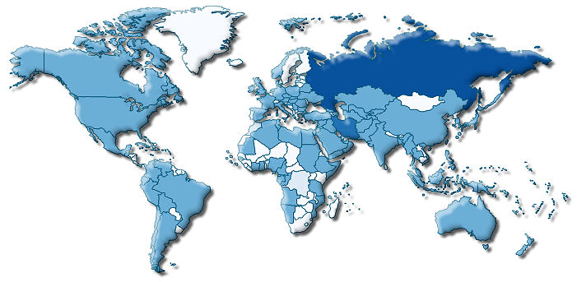
Russian Natural Gas System
-World’s leading natural gas producer and exporter
-Controls almost ¼ of natural gas trade worldwide and 1/3 of global natural gas reserves
-EU imports 50% of its natural gas from Russia
Gazprom: State controlled, massive company with international operations
Facing new challenge from shale gas revolution

Slide 31
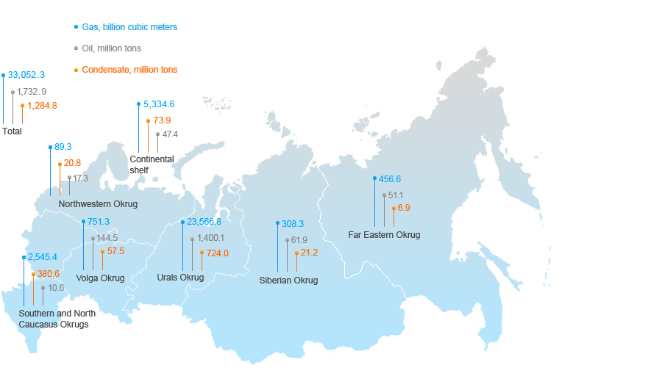
Russian Gas and Oil Reserves
Gazprom Group is the world's largest company in terms of natural gas reserves.
Gazprom Group owns 18 per cent of global and 70 per cent of Russian natural gas reserves.
Gazprom Group replenishes its mineral resource base through geological exploration in Russia and abroad as well as constantly
monitors the new projects and assets to be acquired.
As of the end of 2010 according to the Russian classification (A+B+C1 categories), the Company's reserves reached 33.1 trillion
cubic meters of gas, 2.98 billion tons of oil and gas condensate.

Slide 32
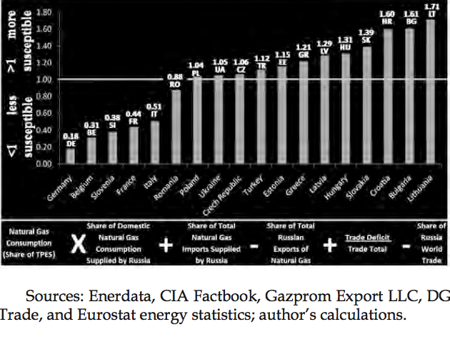

Slide 33
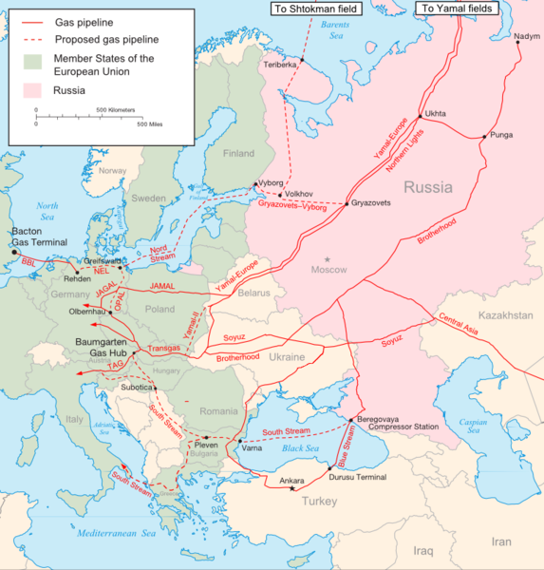
2006 Ukraine dispute
May 2005: Gazprom revealed that 7.8 billion cubic metres of gas that it had deposited in Ukrainian storage had not been made available. It was assumed that either Ukraine had stolen the gas or it had disappeared as a result of technical faults
December 2005: Negotiations continued over the price of Russian gas exports as both sides refused to concede
January 1st, 2006: Russia suspended all flows to Ukraine
January 4^{th,} ,2006: Agreement between Gazprom and Naftogaz ended the dispute
Agreement
-Set price of Russian natural gas exports for Ukraine at $230 per 1,000 cubic meters of gas
-Transit payments and gas prices would only be changed by the agreement of all parties
Results
-The rest of the world began to fully recognize the geopolitical leverage that Russia has over the former SU
“No interest is served if Russia uses its gas wealth as a political weapon, or if it treats its independent neighbors as part of some old sphere of influence” Condaleeza Rice, US Secretary of State
-Increased support for the Russian backed pipeline, Nord Stream

Slide 34
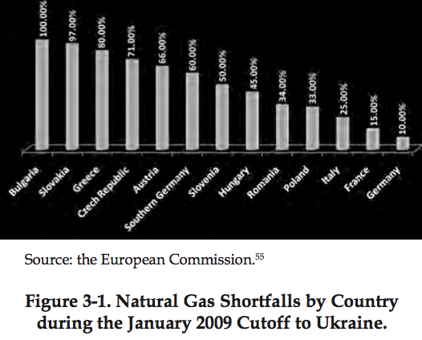
2009 Ukraine dispute
December 20th, 2008: Gazprom announces that Ukraine owed $1.4 billion in accumulated debt
January 1st, 2009: Russia diminished the flow of gas to Ukraine-within a week, it was shut off completely
January 12th, 2009: Russia, Ukraine and the EU agreed to the deployment of a Russian gas transit monitoring system
January 18th: Price agreement reached between Putin and Tymoshenko
Agreement
-10 year gas-purchase contract
-2009 price for Ukraine would be the prevailing European price less
a 20% discount with no change to the transit fee
-After 2009, Ukraine and Russia would switch to European
standards of pricing
-Ukraine would not raise the fee for Russian gas transit
Results
-1000s of European businesses were forced to shut down or cut
production because of reduced supplies
-Gazprom lost more than $1.1 billion in revenue for the unsupplied
gas
-Ukraine incurred major losses because its steel and chemical plants,
the backbone of the nations economy, were temporarily shut down
due to the lack of gas
-Ukraine lost $100 million in transit fees

Slide 35
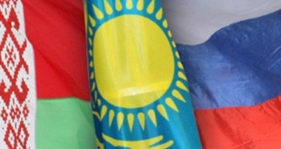
Ukraine Natural Gas Dispute in 2013
Eurasian Economic Community
Created to pursue a common market of goods, capital and labor, and the operation of common macroeconomic, competition, financial and other regulation, including harmonization of policies in areas such as energy and transport
-Originated in January 1995, when Russia signed a treaty on the formation of a customs union with Belarus and Kazakhstan
-October 2000 the grouping was transformed into a fully-fledged international organization, the Eurasian Economic Community
-January 2010, the common customs territory became effective as ECU Customs Code entered into force
Members: Belarus, Kazakhstan, Russia, Kyrgyzstan and Tajikistan
Observers: Ukraine, Moldova and Armenia
Ukraine’s dilemma: European Union or Eurasian Economic Community?
Natural Gas Dispute
-January 26: Gazprom presented Naftogaz with a $7 billion bill for the purchase in 2012 of a smaller amount of gas than that agreed in their 2009 contract, due to a ‘take or pay’ clause
-the minimum amount of gas which the Ukrainian company must receive or pay for is 33.3 bcm
-In 2012 Naftohaz bought only 24.9 bcm of gas from Gazprom. However, about 8 bcm of gas was imported from Russia by the Ostchem Holding company, which is a privately owned company

Slide 36
The End of the Russian Monopoly
Ukraine is estimated to have the 3rd largest shale gas reserves in Europe
Strong natural gas production will save Ukraine billions of dollars a year
With greater production capacity and more energy efficiency, Ukraine can very well become a gas exporter
  Would provide a much needed outlet for Europe gas diversification
    Closer EU-Ukrainian ties
Weaken Russian gas exports to the EU and force Russia to continue building new pipelines East
Challenges:
  Will need to create strong and sustainable institutions for its natural gas sector
  Will need to end corruption practices and political instability that leads to lower FDI
  Will need to increase energy efficiency

Slide 37
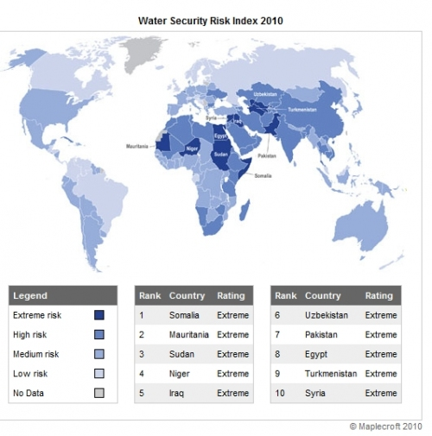

Slide 38
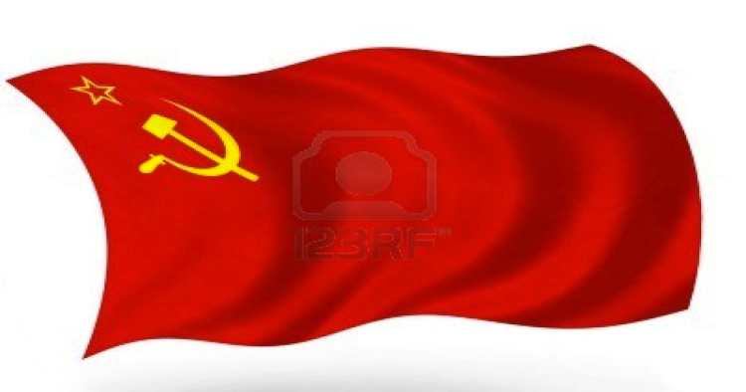
Soviet legacy of water management
The Soviet Union financed and constructed large-scale irrigation networks.
During the Soviet period, central planning created a “cotton belt” in the lowlands of what is now Kazakhstan, Uzbekistan, and Turkmenistan, irrigated through a complex system of dams, pumps, and channels using water coming from Kyrgyzstan and Tajikistan
Under the Soviet system of water allocation, water quotas imposed by Moscow favored downstream countries at the expense of the upstream
Post-independence the water allocation system from the Soviet Union has remained intact.

Slide 39
Uzbekistan
Uzbekistan is one of the World’s top 10 cotton exporters
Agriculture is the largest sector of the economy, accounting for more than 30 per cent of GDP, 40 per cent of employment and 60 per cent of foreign exchange earnings
About 88 percent of Uzbekistan is desert, steppe, and mountain;
Only 11 percent is arable land
Of Uzbekistan’s 45 million hectares, about 60 per cent is used for agricultural purposes and of that only 12 per cent is irrigated

Slide 40
Kazakhstan
Oil and gas production dominates the Kazakh economy
Agriculture accounts for only 5.2% of GDP, but 25.8% of the labor force;
Only 8.82% of Kazakhstan’s 2,699,700 sq. km of land is arable; 61% of its 765,000 sq. km of agricultural land is regarded as permanent pasture; 32% of it is considered arable

Slide 41
Kazakhstan (Cont.)
20,660 sq. km is irrigated; the total reusable water resources amount to 107.5 cu. km as of 2011.
An important producer of wheat, including exports, esp. to Russia and Ukraine
Production varies between 10-17 million tons, depending on weather
Also produces about 100,000 tons of cotton (still) in southern regions of country

Slide 42
Turkmenistan
Turkmenistan’s economy has an important agricultural sector, with cotton as its primary crop.
To grow cotton in Turkmenistan’s dry climate requires diverting great amounts of water.
Only 4.1% of Turkmenistan’s land is arable, yet 91% of its total water withdrawal goes to irrigation.
The irrigation canals built during the Soviet era to divert river water to cotton crops are inefficient and poorly maintained

Slide 43
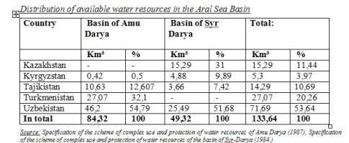

Slide 46
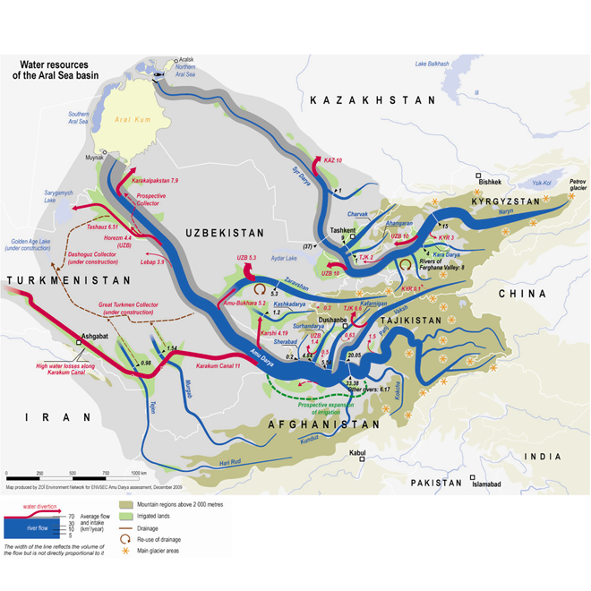

Slide 47
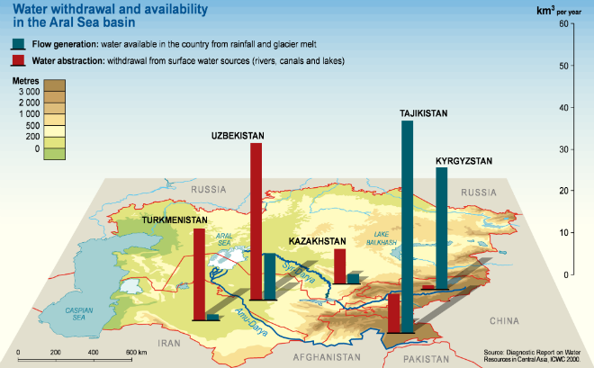
The role of Climate change
In the past 50 years, air temperatures in the basin have been increasing by 0.1-0.2oC a decade
Since the 1950s the number of days with air temperatures higher than 40oC has doubled in the Amu Darya delta region
Temperatures are projected to rise by 2-3oC in the next 50 years
Rapid exhaustion of the Amu Darya basin’s glaciers and changes in snow accumulation and

Slide 48
