Slide 1
Globalization and Community Colleges
Dr. Tomas Hult
Byington Endowed Chair & Professor of International Business
Director, Center for International Business Education and Research
Michigan State University
Executive Director, Academy of International Business
President, Sheth Foundation

Slide 2
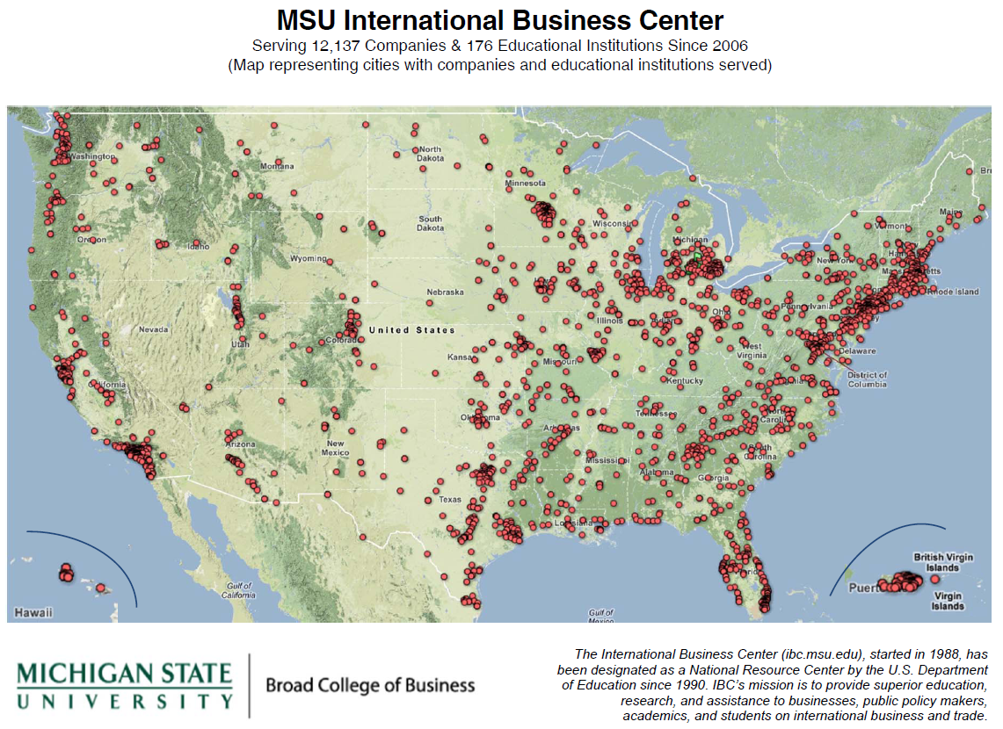

Slide 3
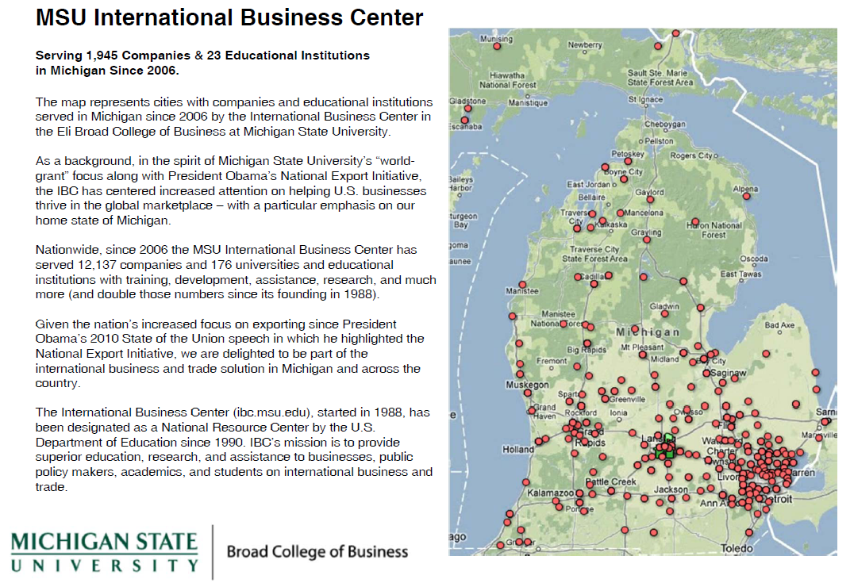

Slide 4
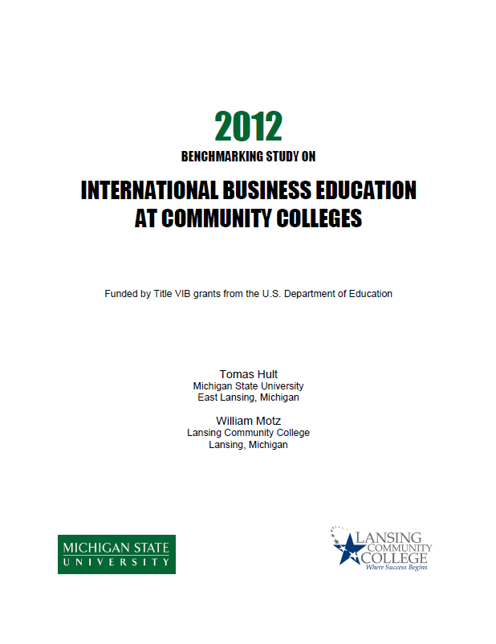


Slide 5


Slide 6
International Trade
MEGP
IBEX
IBC
CC
FDIB
Source: The World Bank World Development Indicators

Slide 7
Shifting Global Marketplace
Percentage share of the world production
Source: The World Bank World Development Indicators

Slide 8
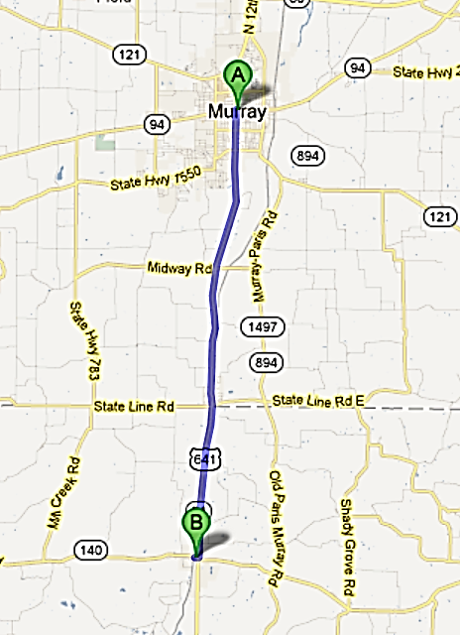


“What Makes
You Unique?”
Kentucky
Tennessee

Slide 9
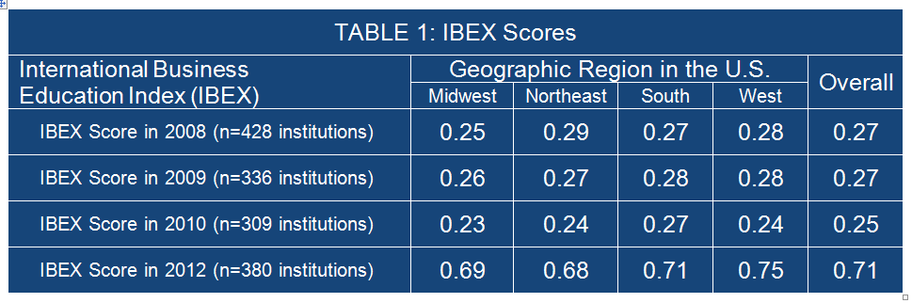
IBEX Scores
International Business Education Index
The scores in Table 1 are based on a range from 0 to 1, with 1 being the best.

Slide 10
Fundamental Drivers
Focused Global
Businesses
Emerging Reality
Domestic Isolated
Economy
Globally Integrated Economy
Past Reality
Diversified Domestic
Conglomerates

Slide 11
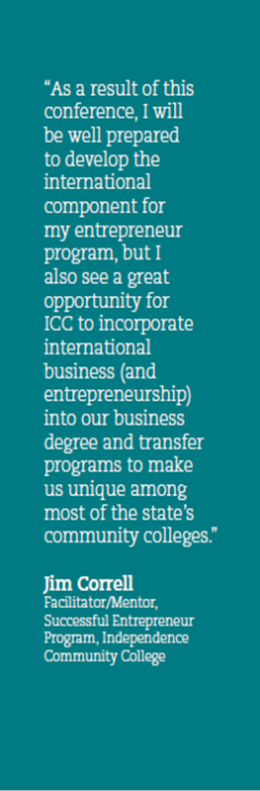
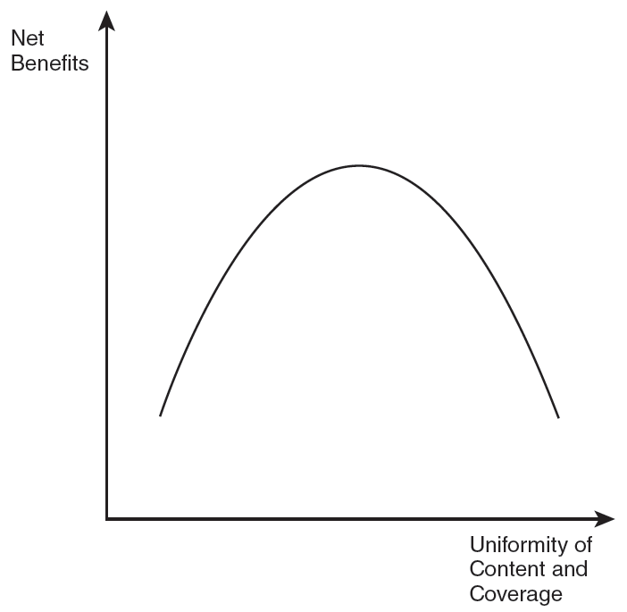
Globalizing Strategy

Slide 12
The Basics
Today, many firms need to be more globally integrated, use globally coherent strategies, operating within global networks, and maximizing profits on a global basis
  How global is your industry?
  How global should your firm’s strategy be?
  How global should your supply chains be?

Slide 13
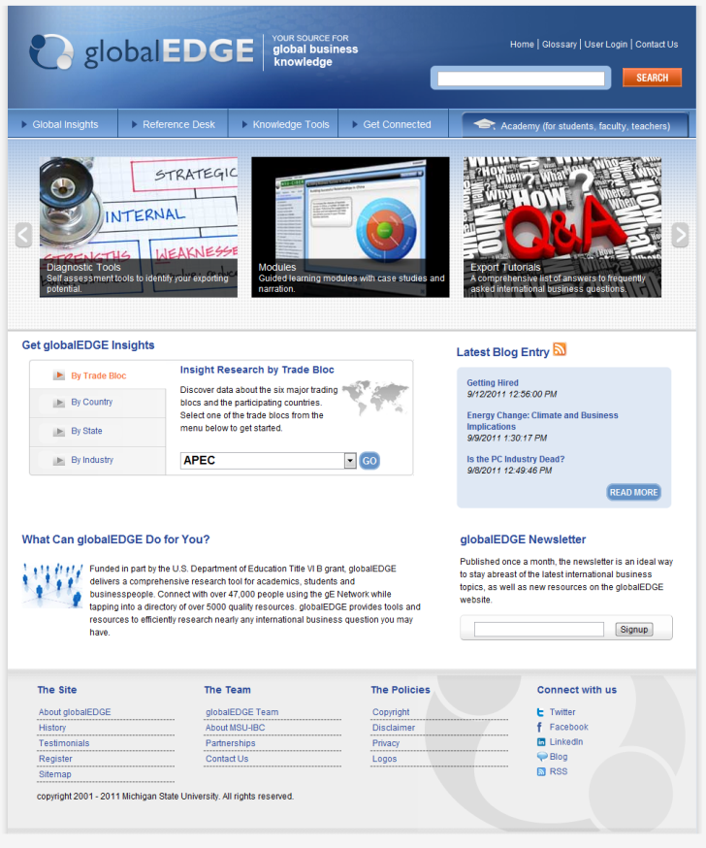
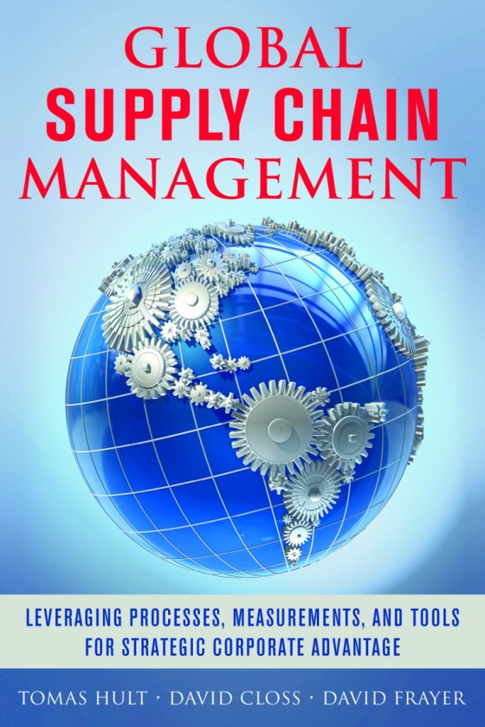

Slide 14
Global Alignment
100%
Globalized
Need to educate the global marketplace
Industry
Average
Not leveraging the global marketplace
100%
Domestic

Slide 15
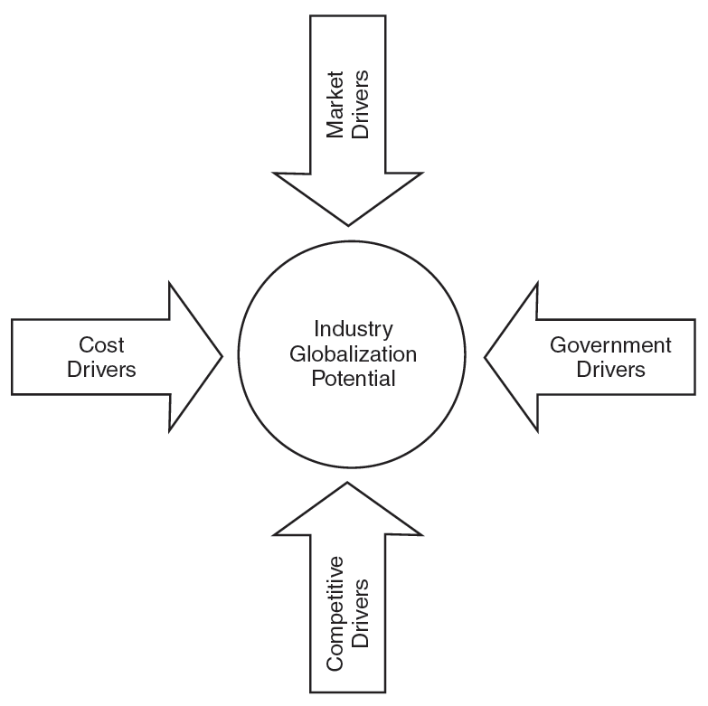
Common customer needs
Global customers
Global channels
Transferable marketing
Global scale economies
Steep experience curve
Low transportation costs
Differences in country costs
High product development costs
Need for technology transfer
Favorable trade policies
Compatible technical standards
Common marketing regulations
High exports and imports
Interdependence of countries
Competitors from different countries
Globalized competitors
Transferable Competitive Advantage

Slide 16
Globalization Efforts
20% Increase
from 2013 to 2018
38% Increase
from 2013 to 2023

Slide 17
Industry Potential to Globalize
INDUSTRY
Globalization

Slide 18
Industry Potential to Globalize
INDUSTRY
Under-
Globalized
Globalization

Slide 19
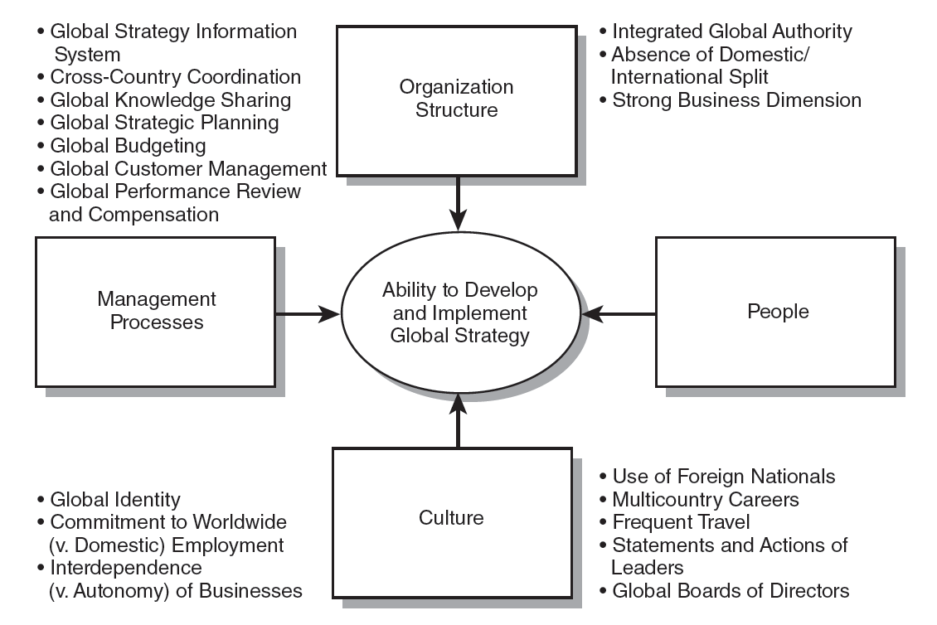
Are U.S. Firms Ready to Globalize More?

Slide 20
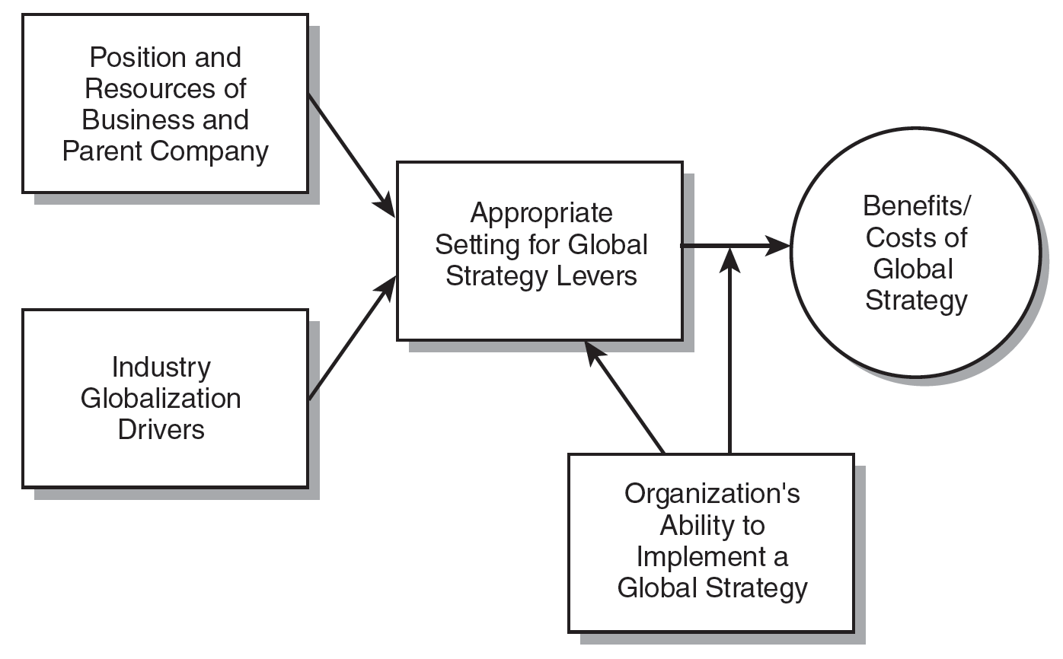

Slide 21
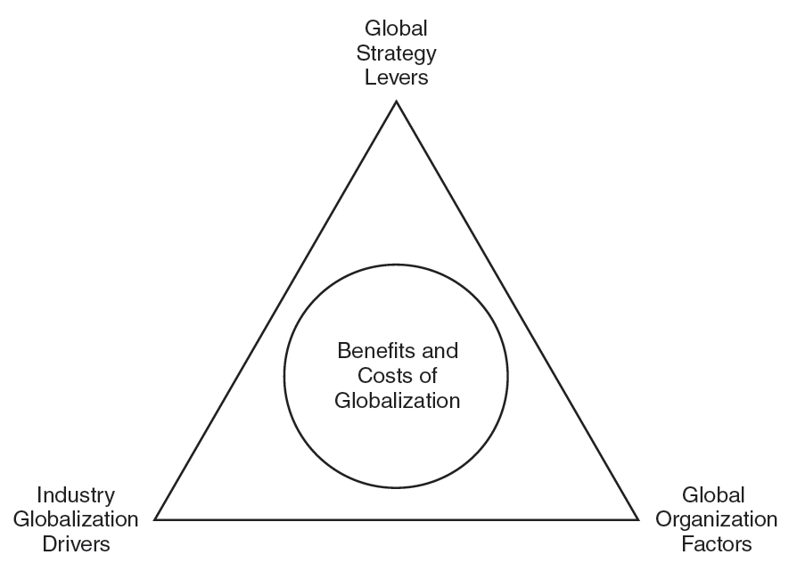

Slide 22
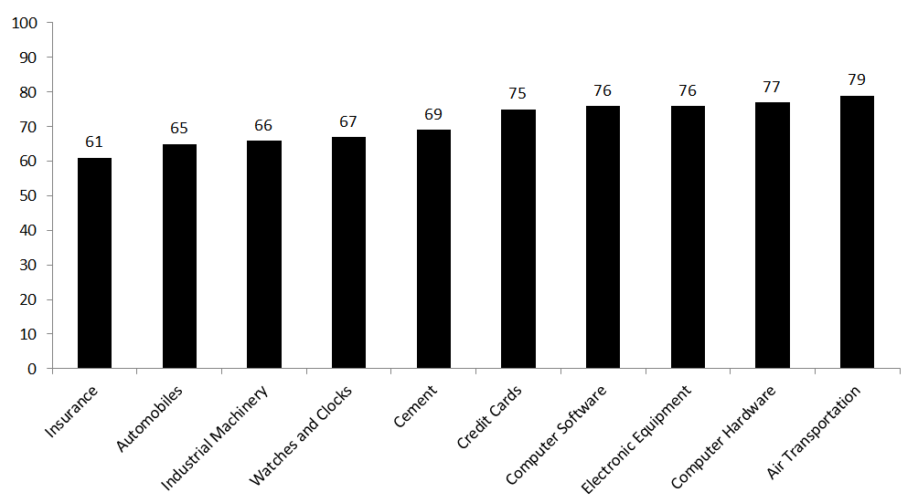
Analyzing Industry Globalization
Market, Cost, Government, and Competitive Drivers
G
L
O
B
A
L

Slide 23
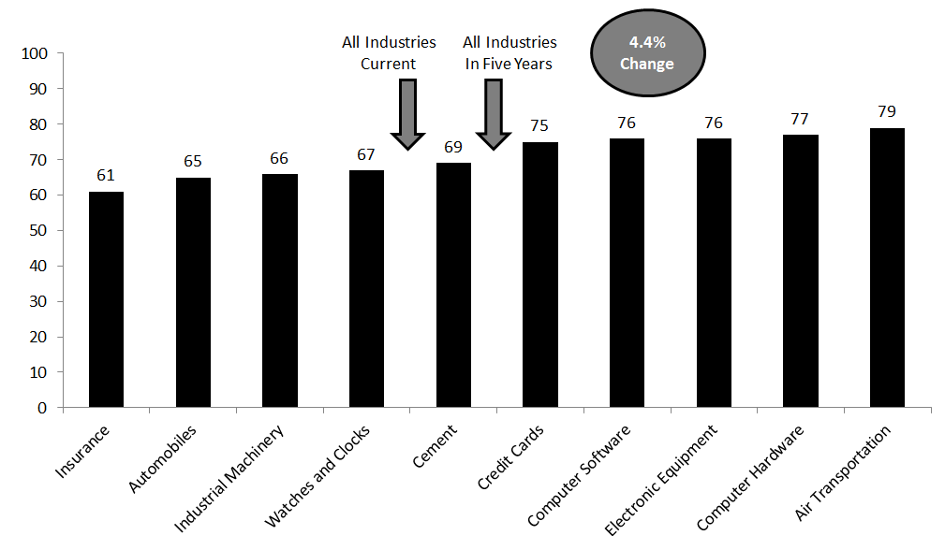
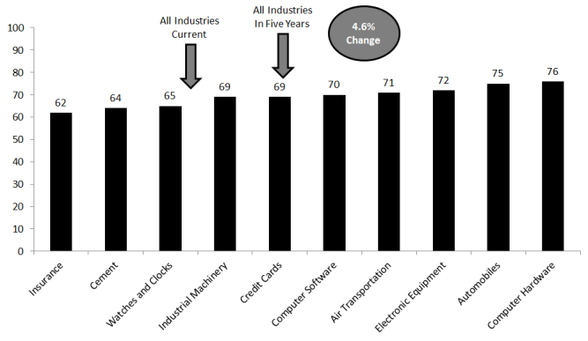
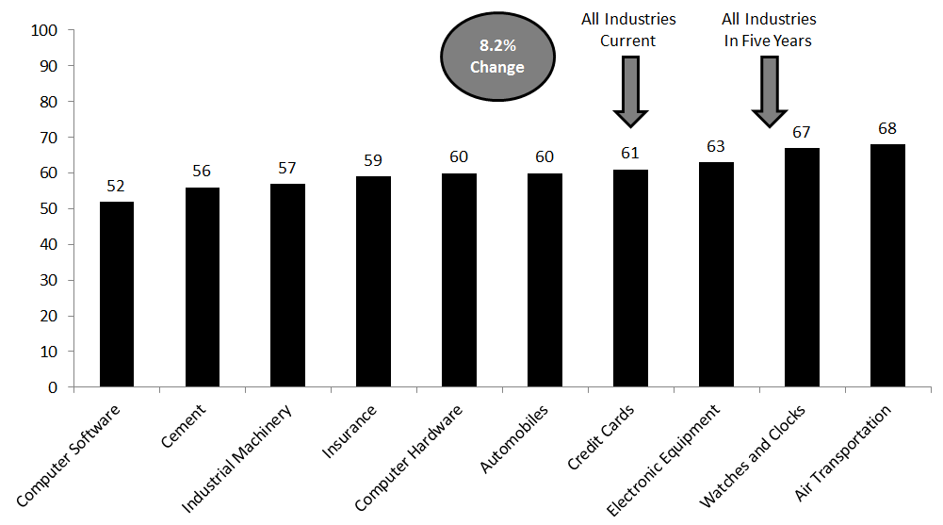
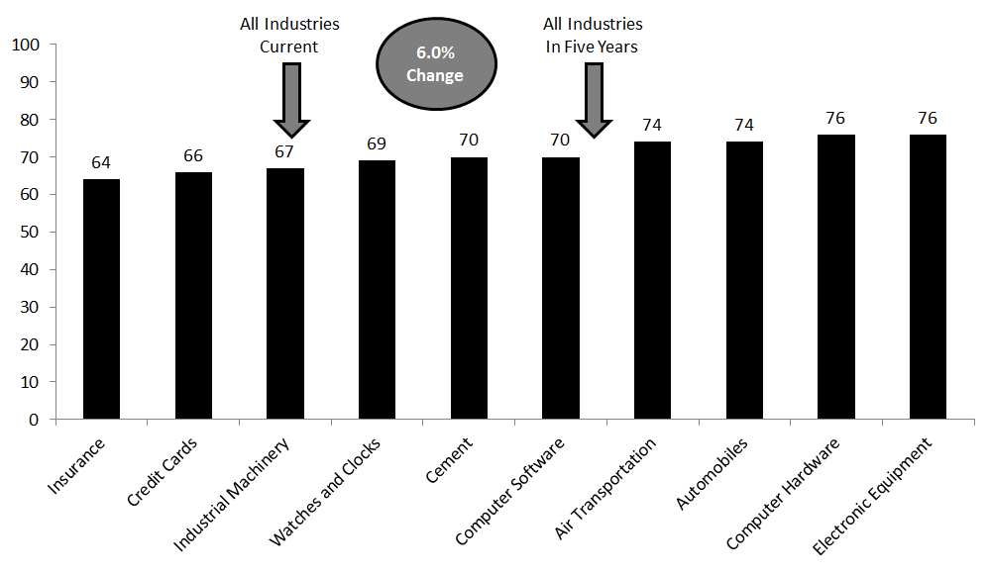

Slide 24
Expected increases
from 2013 to 2018
and 2018 to 2023
4.4%
19.1%
4.6%
19.6%
8.2%
23.0%
6.0%
20.9%

Slide 25
Global Strategy Levers
(0 to 100, with 100 being “global”)
Competitive Moves
Marketing
Locating Activities
Products/ Services
Market Participation
Scores in 2013
and expected increase by 2018
11.3%
13.1%
6.0%
15.0%
15.3%

Slide 26
Effort of Select Global Companies
Cemex emphasizes market participation
Mercedes emphasizes making competitive moves

Slide 27

Dell made vertical supply chain integration their initial success and still relies on global supply chains for the largest share of their success at 23%.

Slide 28

FedEx based in Memphis, Tennessee relies the least on global supply chains for their success but offers supply chain solutions for others companies’ success.

Slide 29
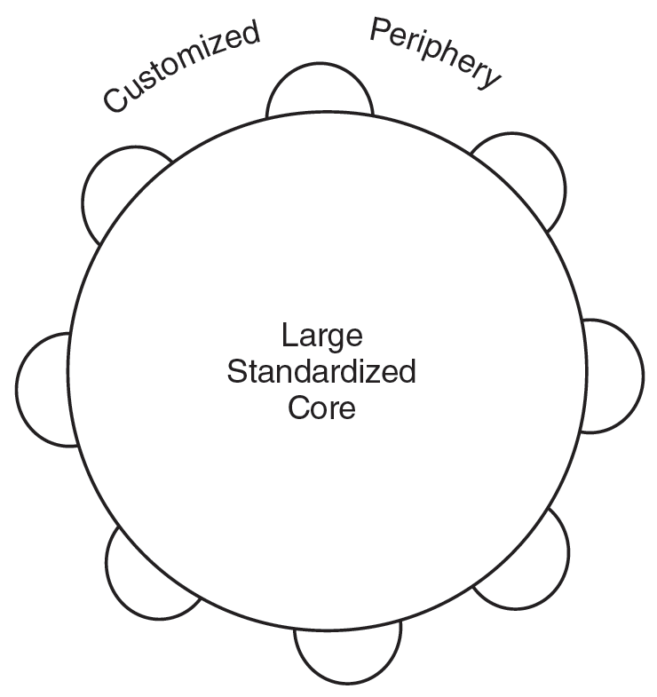
We Generally Know the Ideal Product

Slide 30
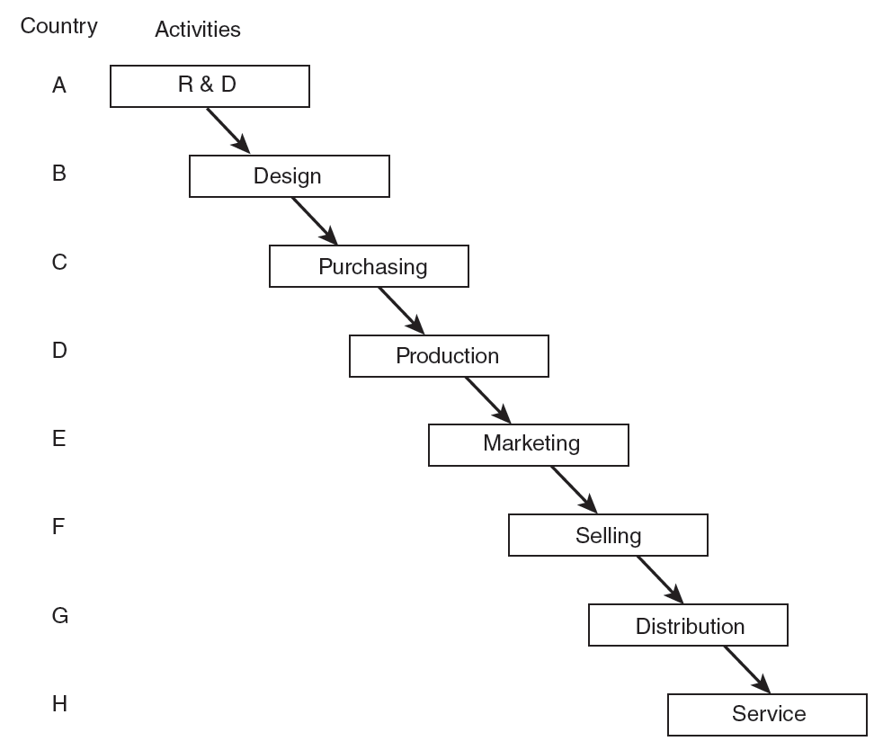
What Is the Ideal Value Chain?

Slide 31
Global Supply Chains
2013, 2018, 2023
100%
Globalized
40%
23%
40

Slide 32
U.S. Multinational Corporations
Market channels (“last mile”) of the global SCM drives success
Global Logistics
Importance: 93 Globalness: 65
Global Purchasing
Global Market Channels
Global Suppliers
Global Customers
Importance: 89
Globalness: 66
Importance: 95
Globalness: 65
Global Operations
Importance: 92 Globalness: 64

Slide 33
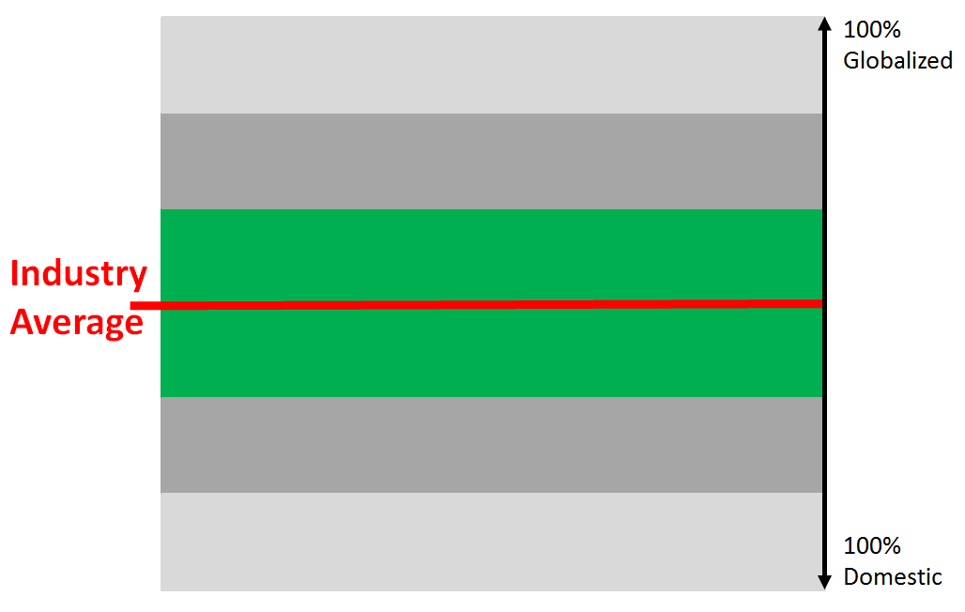
Functional Alignment and Globalization
Logistics
Purchasing
Operations
Market Channels

Slide 34
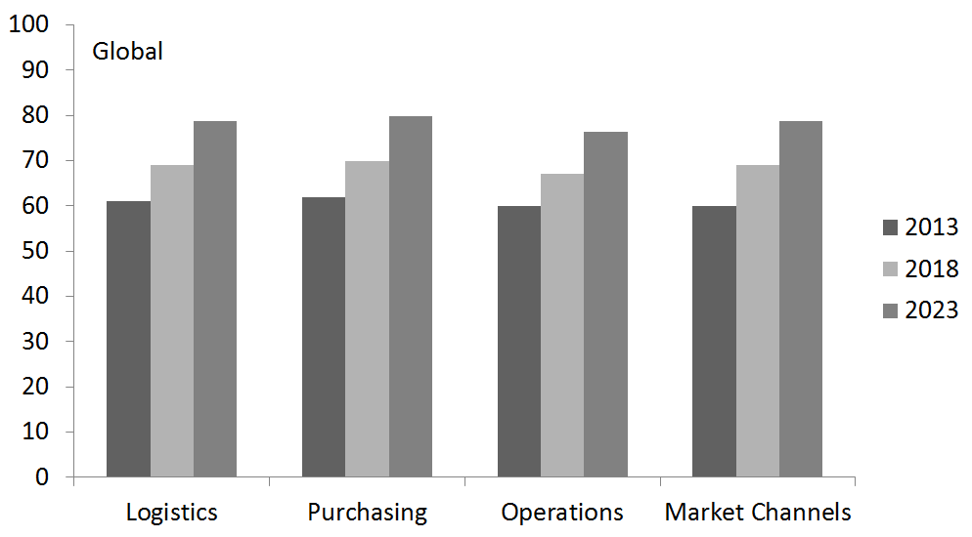
Purchasing Leads in Globalization

Slide 35
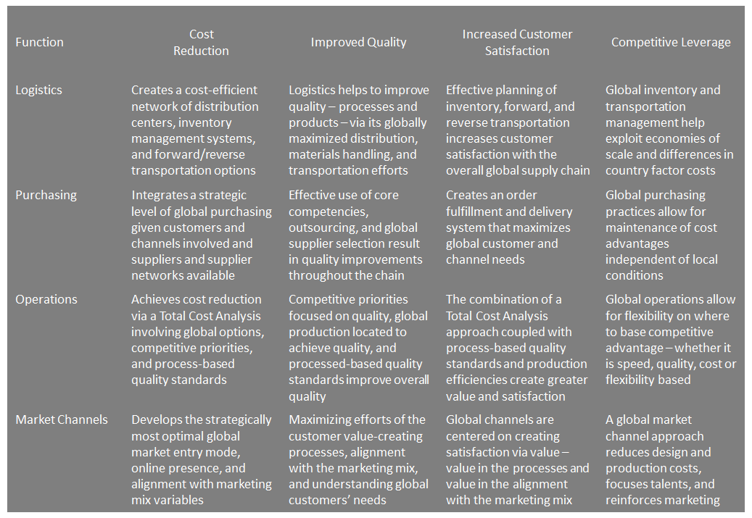
Cost Reduction
Increased Customer
Satisfaction
Improved Quality
Competitive
Leverage

Slide 36
Inventories-to-Assets
The average company carries 14.41 percent of their total assets in total inventories

Slide 37
Inventory Positions
Raw
Materials
Work-in-Process
Finished Goods
Global Suppliers
Global Customers
32.30%
17.94%
49.76%
Denmark 28.5% 20.0% 51.5%
Finland 22.5% 35.7% 41.8%
Norway 29.5% 21.0% 49.5%
Sweden 38.4% 19.0% 42.6%

Slide 38
Purchasing Activities
Views of SCM Professionals
2013
2018
2023
Domestic Purchasing
Level I
Engage in domestic purchasing activities only
33%
23%
26%
Level II
Engage in international purchasing activities only as needed
22%
23%
22%
International Purchasing
Level III
International purchasing activities as a part of SCM strategy
16%
20%
21%
Level IV
Global purchasing activities integrated across worldwide locations
15%
15%
13%
Global Purchasing
Level V
Global purchasing activities integrated across worldwide locations & functional groups
14%
19%
18%
Notes:
The framework is based on Monczka et al. (2005), Purchasing and Supply Chain Management. The 2005 data are based on Trent and Monczka (2005, Sloan Mgmt Review). The 2013, 2018, and 2023 data are based on my benchmarking study

Slide 39
Purchasing Activities
Views of C-Suite Managers of MNCs
2013
2018
2023
Domestic Purchasing
Level I
Engage in domestic purchasing activities only
9%
5%
5%
Non-
Existent
Level II
Engage in international purchasing activities only as needed
23%
15%
12%
International Purchasing
Level III
International purchasing activities as a part of SCM strategy
19%
15%
12%
Level IV
Global purchasing activities integrated across worldwide locations
19%
23%
10%
Global Purchasing
Level V
Global purchasing activities integrated across worldwide locations & functional groups
30%
53%
61%
Much higher than SCM Professionals
Notes:
The framework is based on Monczka et al. (2005), Purchasing and Supply Chain Management. The 2005 data are based on Trent and Monczka (2005, Sloan Mgmt Review). The 2013, 2018, and 2023 data are based on my benchmark study

Slide 40
Growth of International
Production Plants 1990 to 2010

Slide 41
Operationally Favoring a Make or Buy Decision
Cost
Production Capacity
Notes:
http://www.enotes.com/make-buy-decisions-reference/make-buy-decisions

Slide 42
Operationally Favoring a Make Decision
Cost
Quality Control
Proprietary Technology
Limited Suppliers
Excess Capacity
Having Control
Assurance of Continual Supply
Industry Drivers
Production Capacity
Notes:
http://www.enotes.com/make-buy-decisions-reference/make-buy-decisions

Slide 43
Operationally Favoring a Buy Decision
Cost
Production Capacity
Non-Essential Item
Brand preference
Inventory Planning
Small Volumes
Supplier Compe-tencies
Lack of Expertise
Multi-Source Policy
Notes:
http://www.enotes.com/make-buy-decisions-reference/make-buy-decisions

Slide 44
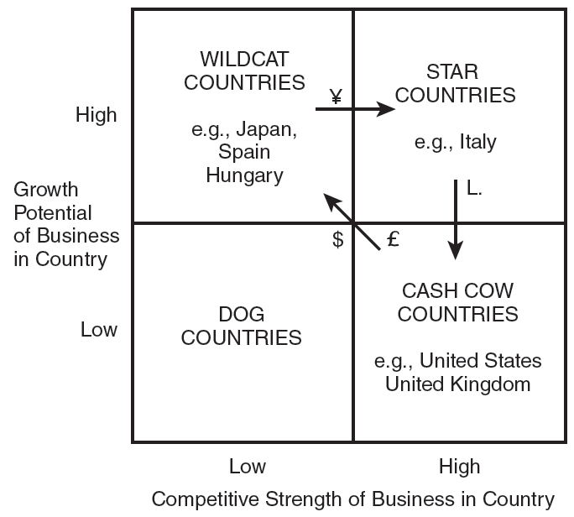
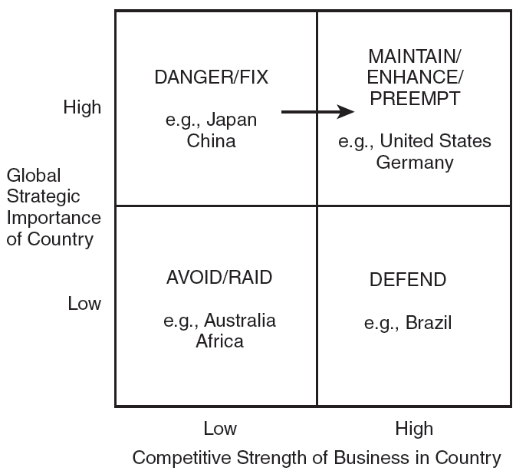
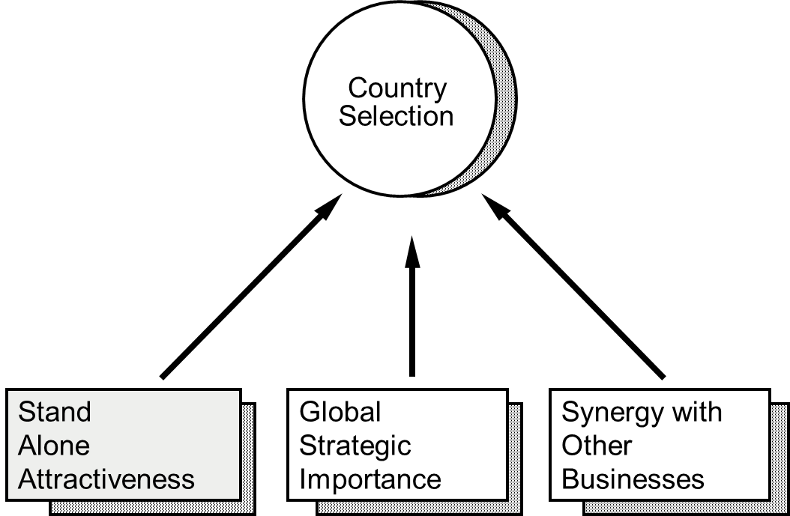
Market Participation
Which Countries?

Slide 45
10,300 Michigan Companies
Traded in 2012 (91% SMEs)

Slide 46
A Michigan Example
Plans for Expanding International Trade by 2015
86%
89%
10,300 Michigan Companies Traded Internationally in 2012 (91% SMEs)

Slide 47
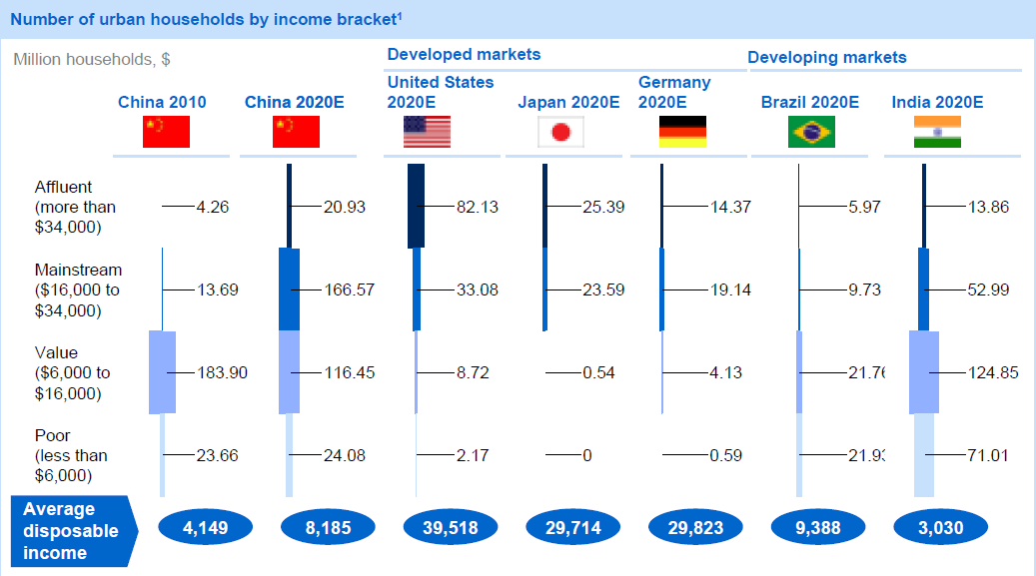
Michigan to China?

Slide 48

Explaining Performance
70% 25%
Global Strategy
Global Supply Chains
To stay competitive, companies need to increase the globalization efforts of their supply chain by at least 20 percent in the next five years and 40 percent in the next 10 years.

Slide 49


Slide 50
Importance of Global Education
Today, many community colleges need to be more globally integrated, use globally coherent education strategies, operating within global education networks, and maximizing learning on global topics.
  How global is the education industry (e.g., workforce development at community colleges)?
  How global should your community college’s courses, programs, and culture be?

Slide 51
International Business Education at Community Colleges 2012
http://global.broad.msu.edu/ibc/publications/research/

Slide 52



Research Support
We are grateful to the U.S. Department of Education for financial support for the series of Benchmark Studies on International Business Education at Community Colleges. We are also grateful to the International Business Center in the Eli Broad College of Business at Michigan State University and the Business and Economics Department at Lansing Community College for research and administrative support to conduct the study.

Slide 53
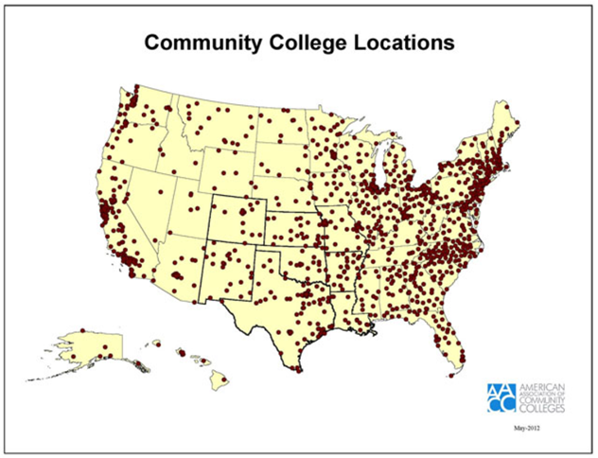
1,132 Community Colleges in the USA

Slide 54
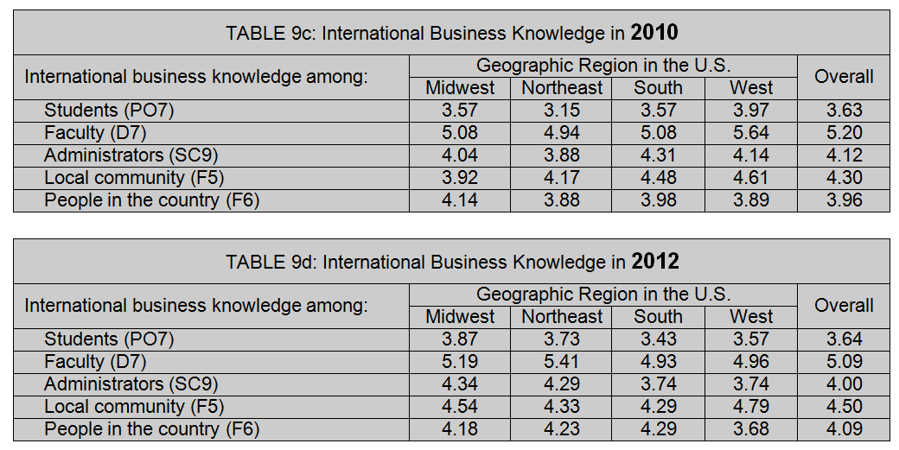
International Business Knowledge
The scores in Table 9 are based on a range from 1 (no awareness) to 10 (great expertise).

Slide 55
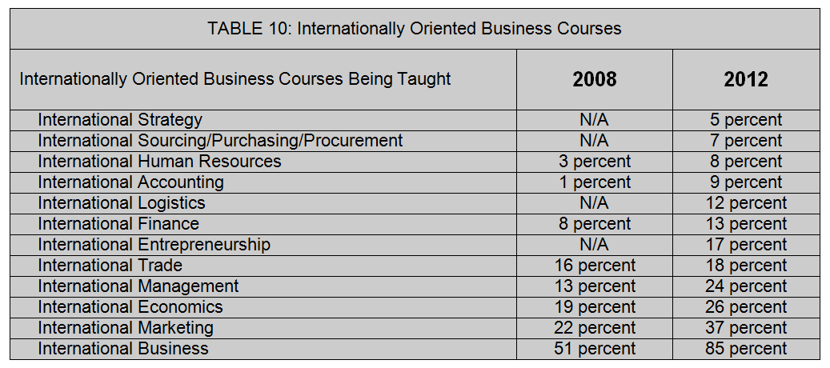
What Is Being Taught

Slide 56
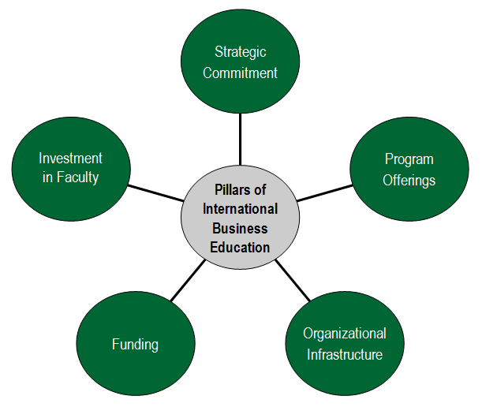

Slide 57
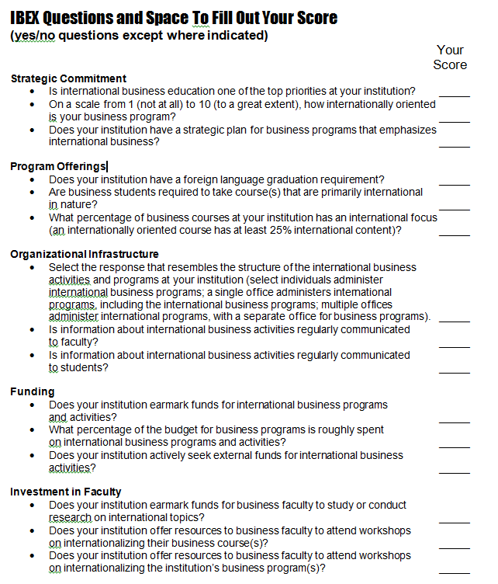

Slide 58
IBEX Scores
International Business Education Index
The scores in Table 1 are based on a range from 0 to 1, with 1 being the best.

Slide 59
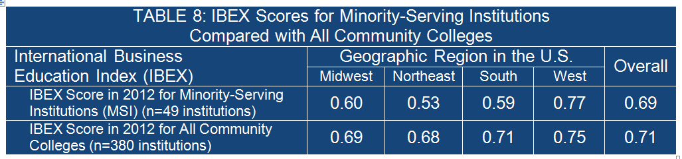
Minority-Serving Institutions
The scores in Table 8 are based on a range from 0 to 1, with 1 being the best.

Slide 60
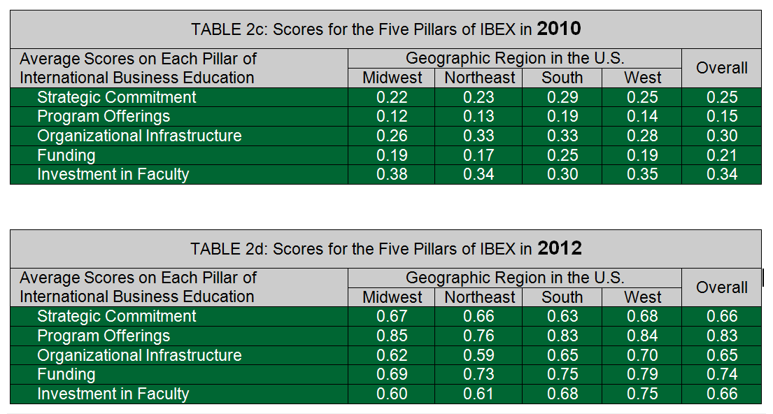
Five Pillars
The scores in Table 2 are based on a range from 0 to 1, with 1 being the best.

Slide 61
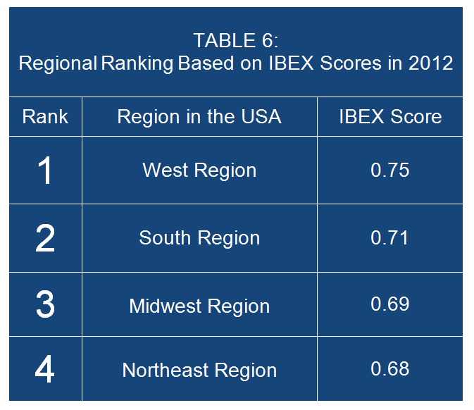
IBEX Scores by Region
The scores in Table 6 are based on a range from 0 to 1, with 1 being the best.

Slide 62
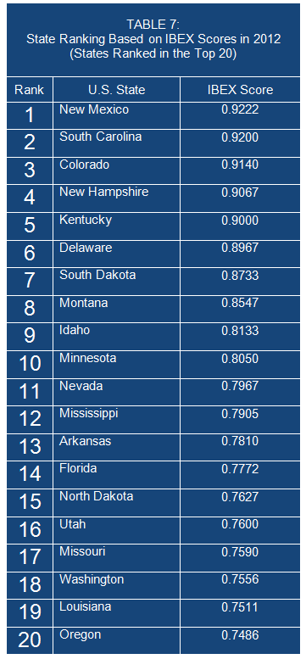
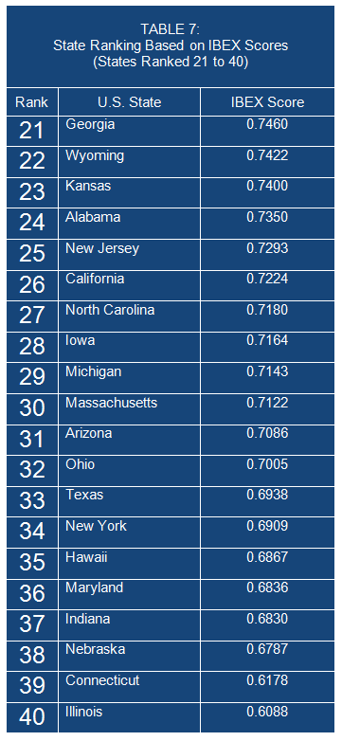
The scores in Table 1 are based on a range from 0 to 1, with 1 being the best.

Slide 63
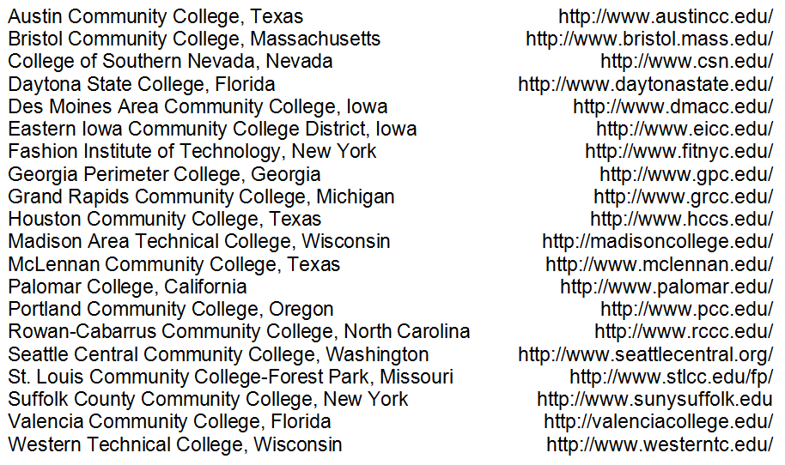
Community Colleges with
Sustained Excellence (“Top 20”)

Slide 64
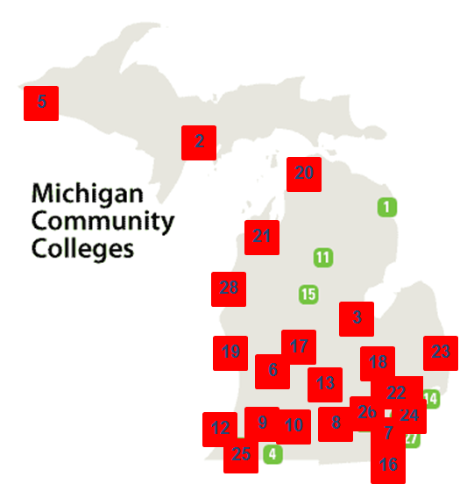
Michigan’s Community
Colleges IBEX
Grand Rapids Community College
Mott Community College
St. Clair County Community College
Jackson Community College
Lansing Community College
Kalamazoo Valley Community College
Oakland Community College
West Shore Community College
Bay De Noc Community College
Southwestern Michigan College
Monroe County Community College
Lake Michigan College
Henry Ford Community College
Kellogg Community College
Muskegon Community College
Northwestern Michigan College
Schoolcraft College
Delta College
Washtenaw Community College
Montcalm Community College
North Central Community College
Gogebic Community College
Alpena Community College
Glen Oaks Community College
Kirtland Community College
Macomb Community College
Mid Michigan Community College
Wayne County Community College

Slide 65
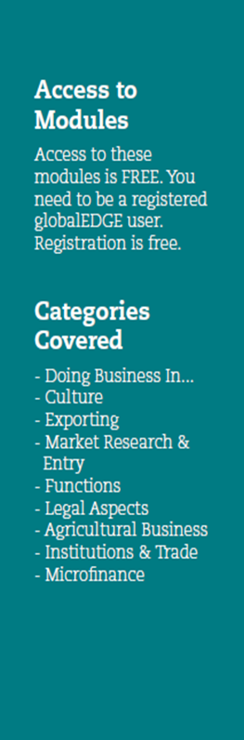
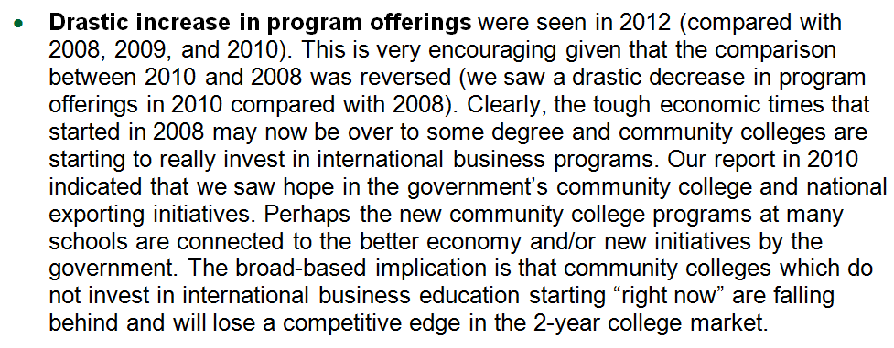
Conclusion 1

Slide 66

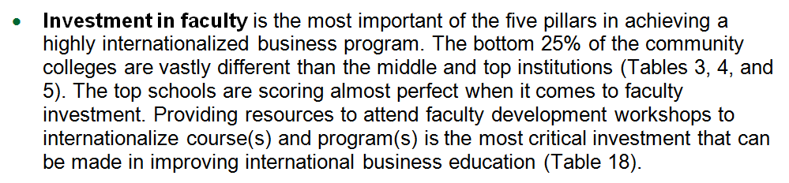
Conclusion 2

Slide 67

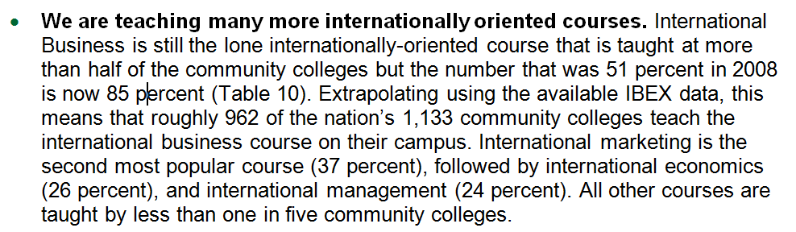
Conclusion 3

Slide 68
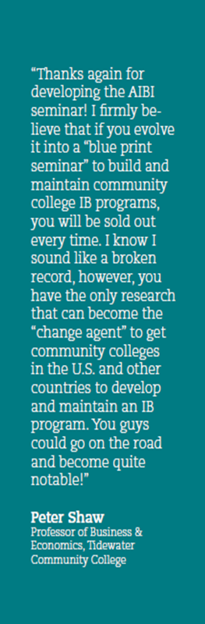
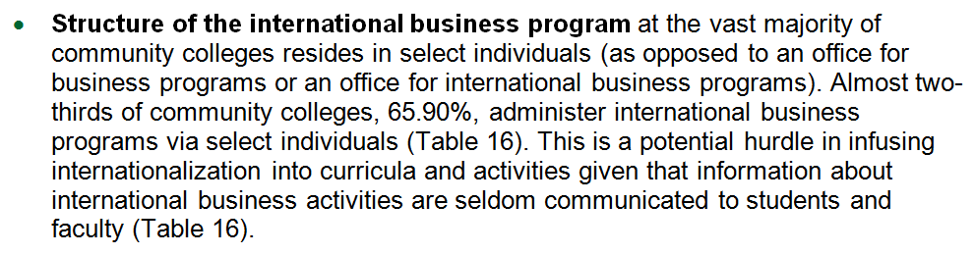
Conclusion 4

Slide 70
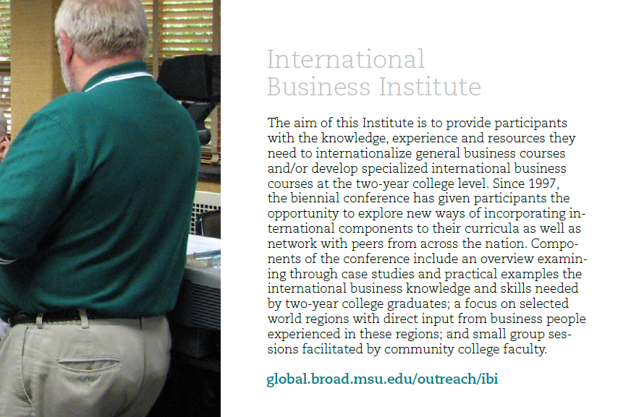

Slide 71


Slide 72


Slide 73
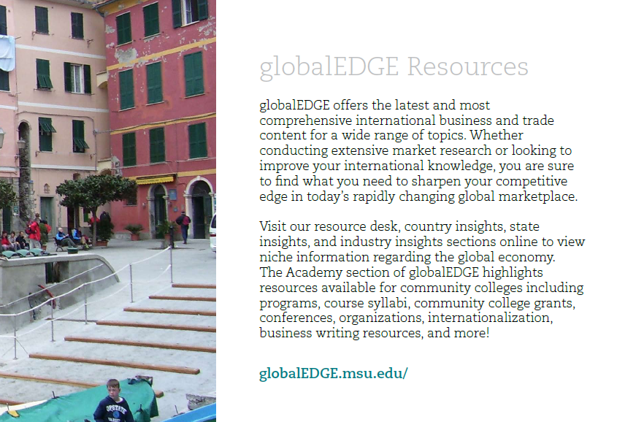

Slide 74
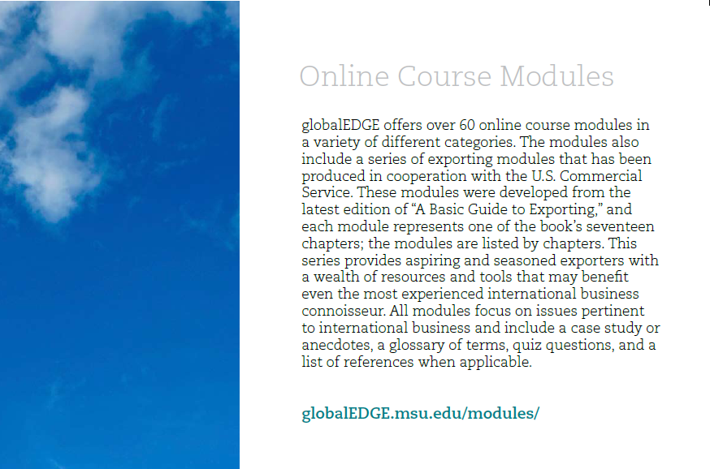

Slide 75
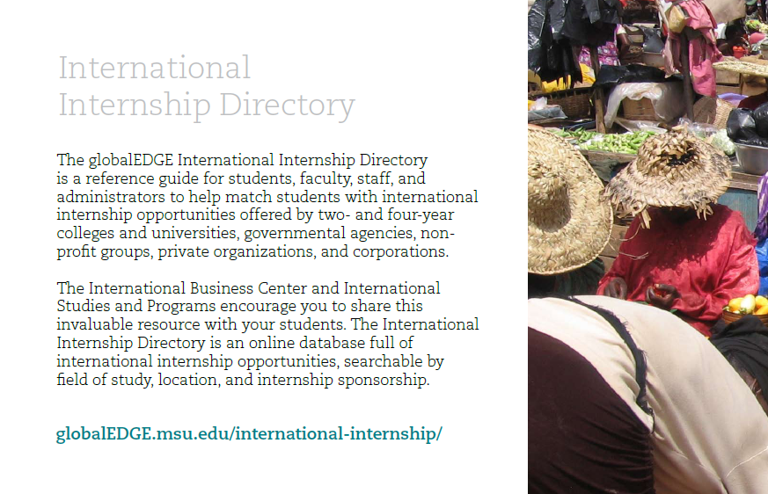

Slide 76
The best global strategy is usually one that is designed as such from a zero-based assumptions and constraints.
However, realistically, strategy becomes globalized when the benefits outweigh the costs. Such cost/benefit analysis needs to be done for the inbound and outbound parts of the global value chain separately and for each of the “value relationships” (nodes/actors) in the chain – including vendors, suppliers, and partners on the inbound side and buyers, customers, and clients on the outbound side.
Top Five Global Strategy Issues #5

Slide 77
Do not assume that industries are either global or not. Nearly every industry has global potential in some aspects and not others.
Different industry globalization drivers (market, cost, government, competitive) can also operate in different directions, some favoring global strategy and others making it difficult. Companies should respond selectively to industry globalization drivers and globalize activities affected by favorable drivers.
Top Five Global Strategy Issues #4

Slide 78
Similarities and differences of potential countries are important factors to consider. Most of the time, the best approach is to assess when similarities outweigh the differences and stress those in global strategy making.
Companies need to select countries for global strategy development and implementation based on comparative advantage and alignment with the company’s competitive advantage. Different countries can play different strategic roles, such as inbound value-added (sourcing) and outbound value-added (market channels).
Top Five Global Strategy Issues #3

Slide 79
Do not assume that global strategy is not for your company and “it cannot happen here.” Almost any industry and company have the potential for globalization of their strategy. Oftentimes, it may be best to first globalize those parts of the company that are the easiest to globalize as a way to initiate culture/behavior changes for the more difficult parts.
Global strategy is not born but instead created by companies based on need, cost benefit analysis, opportunity, or diversification interests. Proactive globalization is always preferred to reap some first-mover advantage as opposed to globalizing based on a reactive approach motivated by competitors’ actions.
Top Five Global Strategy Issues #2

Slide 80
Not globalizing a company’s strategy – or parts of it – can be detrimental to the company’s performance in the long term, as the forecast is that companies will globalize more and more of their strategies in the next ten years.
Top Five Global Strategy Issues #1
20% Increase
from 2013 to 2018
38% Increase
from 2013 to 2023

Slide 82
The best global courses and/or programs are usually those that are designed as such from zero-based assumptions and constraints.
However, realistically, global courses/programs become globalized when the benefits outweigh the costs (student enrollment, competition).
Top Five Global Education
Issues at Community Colleges #5

Slide 83
Do not assume that your region of the country is either global or not. Nearly every U.S. region has global potential in some aspects and not others.
Different education drivers can also operate in different directions, some favoring global education and others making it difficult. Community colleges should respond selectively to globalization drivers and globalize courses, activities, and/or programs affected by favorable drivers (e.g., study abroad, marketing courses but not finance courses, etc.).
Top Five Global Education
Issues at Community Colleges #4

Slide 84
Similarities and differences of potential countries are important factors to consider. Most of the time, the best approach is to assess when similarities outweigh the differences and stress those in global strategy making.
Traditionally, higher education has been focused on figuring out differences and teach students to account for differences. More and more community colleges should educate their students, in the spirit of workforce development, to be able to identify similarities that outweigh the differences across countries and companies’ global strategies.
Top Five Global Education
Issues at Community Colleges #3

Slide 85
Do not assume that global education (courses, activities, programs) is not for your community college and “it cannot happen here.” Almost any region of the country and community college have the potential for globalization of their education. Oftentimes, it may be best to first globalize those parts of the curriculum that are the easiest to globalize as a way to initiate culture/behavior changes for the more difficult parts (e.g., a foreign faculty in finance can teach international finance).
Top Five Global Education
Issues at Community Colleges #2

Slide 86
Not globalizing a company’s strategy – or parts of it – can be detrimental to the company’s performance in the long term, as the forecast is that companies will globalize more and more of their strategies in the next ten years.
Community colleges educate roughly 47 percent of the nation’s workforce/students and they need to be an integral part of achieving the 38 percent increase in the country’s global mindset, knowledge, and skills by 2023.
Top Five Global Education
Issues at Community Colleges #1
20% Increase
from 2013 to 2018
38% Increase
from 2013 to 2023

Slide 87
Globalization and Community Colleges
Dr. Tomas Hult hult@msu.edu
517.353.4336 (office)
517.980.4450 (mobile)
Byington Endowed Chair & Professor of International Business
Director, Center for International Business Education and Research
Michigan State University
Executive Director, Academy of International Business
President, Sheth Foundation

