Slide 1
Teaching International Marketing
Tunga Kiyak Outreach Specialist, MSU International Business Center Adjunct Professor, Broad College of Business

Slide 2
Framework for International Marketing
Environmental Factors (PESTE)
Market Analysis and Selection
Product
Place
Price
Promotion
Marketing Strategy
Segmentation, Targeting, and Positioning
Primary analysis is outside in but the levels interact with each other.
Marketing Mix
Standardization vs. Adaptation

Slide 3
Level 1 Environmental Factors
Political and Legal
Economic
Social and Cultural
Technological
Environmental
P
E
S
T
E

Slide 4
Level 1 – Environmental Factors
Sample Factors:
Political Risk
Government stability
Employment law
Trade barriers and restrictions
Business regulations
Commercial law
Bureaucracy
Taxation policies
Intellectual property protection
Bribery and corruption
Political and Legal
Economic
Social and Cultural
Technological
Environmental
P
E
S
T
E

Slide 5
Level 1 – Environmental Factors
Sample Factors:
Economic composition
GDP Trends and growth
Interest rates
Disposable income
Credit availability
Employment costs
Economic risk factors
Transportation infrastructure
Energy costs and infrastructure
Political and Legal
Economic
Social and Cultural
Technological
Environmental
P
E
S
T
E

Slide 6
Level 1 – Environmental Factors
Sample Factors:
Demographics
Income distribution / social classes
Educational levels
Religion
Language
Attitudes and beliefs
Lifestyles
Consumerism
Workforce mobility
Worker rights and benefits
Political and Legal
Economic
Social and Cultural
Technological
Environmental
P
E
S
T
E

Slide 7
Level 1 – Environmental Factors
Sample Factors:
Basic infrastructure
Communications infrastructure
Network connectedness
R&D spending
Adoption diffusion patterns
Speed of transfer
Rate of obsolescence
Political and Legal
Economic
Social and Cultural
Technological
Environmental
P
E
S
T
E

Slide 8
Level 1 – Environmental Factors
Sample Factors:
Environmental awareness and sensitivity
Environmental protection regulations
Pollution levels
Waste management
Attitudes towards green or ecological products
Presence of environmental groups
Political and Legal
Economic
Social and Cultural
Technological
Environmental
P
E
S
T
E

Slide 9
Application Idea
Country Reports
Assign or let the student select a product
Assign or let the student select a country
Conduct a comprehensive analysis of PESTE factors, conduct a SWOT analysis of these factors
Resources from globalEDGE to assist the task:
Country Insights Pages
World Bank Doing Business Indicators
Country Commercial Guides
Deloitte International Tax and Business Guides

Slide 10
Market Analysis and Selection
Objective: To reduce the number of countries that warrant in-depth investigation as potential target markets. Identification of 5-6 high potential country markets that are the most promising to the firm.

Slide 11
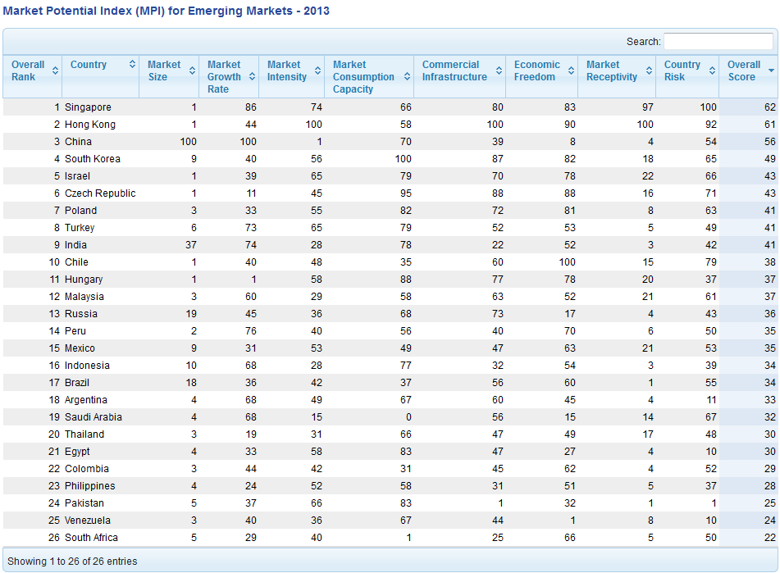
Market Potential Index
Ranking the market potential of emerging markets for US Exporters. Updated annually at http://globaledge.msu.edu/mpi/

Slide 12
Additional Topics of Discussion/Emphasis
Importance of cultural similarity/familiarity
Targeting regions vs. individual countries
Gateway countries and regional hubs
Variations in screening depending on entry strategy (e.g., exporting vs. direct investment vs. licensing/franchising)
Variations in screening based on industry/product

Slide 13
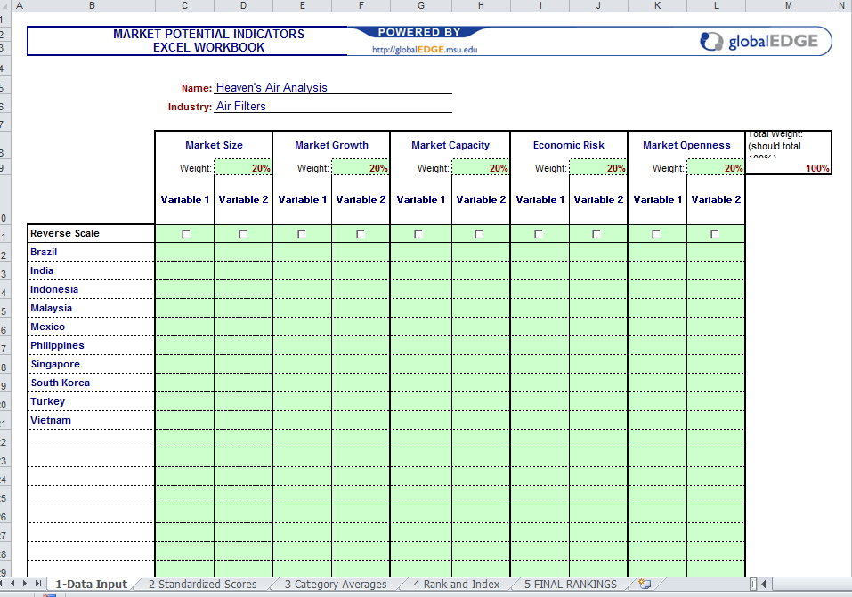
MPI as an Application Idea
Excel spreadsheet for student projects:
Assign an industry/company
Let students determine dimensions and weights
Let students collect and analyze their own data

Slide 14
Level 2 Marketing Strategy
Market Segmentation
Market Targeting
Market Positioning
Identify distinct groups of customers whose purchasing behavior
differs from others in important ways
Evaluate segments
and decide which
to go after
Design a strategy and develop a marketing mix that will create a competitive advantage in the minds of the selected target market

Slide 15
Primary Issues in Market Segmentation
The structure of market segments
Type of user (e.g., consumer, corporate, educational)
Demographic segmentation (age/gender/income)
Psychographic segmentation (attitudes/values)
Behavior segmentation (usage rate/adoption style)
Existence of segments that transcend national borders
Ever-growing due to the Internet and social media

Slide 16
Market Targeting
Marketers evaluate the attractiveness of each potential segment and decide which of these groups they will try to turn into customers
Mass (standardized)
Concentrated (niche)
Differentiated (multi-segment)
Custom
Dependent on both segments identified and resources available.

Slide 17
Discussion: Hidden Champions
Companies that hold #1 or #2 position in their respective industry in the world.
Usually earn more than 50% of their revenues from exports.
Many of them are still family-owned (thus relatively low profile)
May never show up in Fortune Global 500, etc. because they are not big enough companies (in terms of revenue).

Slide 18
Sample Hidden Champions
Hohner
Harmonicas and accordions – 85% market share. Established in Germany in 1857. First products were sold to the U.S.
Haribo
Confectioner, best known for gummi bears. Established in 1920. almost went bankrupt during World War II. Still the biggest manufacturer of gummi and jelly sweets.
Joh. Barth & Sohn
Largest private hop grower and processor, the number one merchant, trading and processing roughly 40% of the world's hop production. Established in 1794 in Germany. Currently operates as Barth-Haas group after a number of mergers.
Tetra
Fish food – 50 year old company, developed a market share over 50%. All production still in Germany, has only warehouses in the U.S. (purchased by Spectrum Brands in 2005)
St. Jude Medical
60 percent market share in artificial heart valves.

Slide 19
Strategy for Success
Follow a super-niche strategy: they define their markets very narrowly, but go very deep in that niche market
Union Knopf – only manufactures buttons, but 250,000 different kinds
“It is better to be a large fish in a small pond, then be a small fish in a large pond with lots of sharks”
In many cases, they actually create their own markets by combining customer needs with product/technology approaches.
They emphasize R&D and innovation in their approach.

Slide 20
Market Positioning
Developing and communicating a marketing strategy aimed at influencing how a particular market segment perceives a product or service in comparison to the competition
Attribute / benefit (“ultimate driving machine”)
Quality / Price (Bose and Bang & Olufsen)
Celebrity Users
Positioning can be different in different target markets
Four common positioning errors
Underpositioning: lack of differentiation
Overpositioning: too narrow
Confused: too many things to too many people
Doubtful: consumer just doesn’t believe it

Slide 21
Level 3 Marketing Mix
Product
Place
Price
Promotion
Marketing Mix
Standardization vs. Adaptation
Key challenges are:
Resolving the trade-off between standardization and adaptation of the individual elements
Coordination of Marketing Activities across multiple markets

Slide 22
Standardization vs. Adaptation

Slide 23
Product
Products may require significant adaptation because of one of the following three:
Cultural differences
Tradition, language, religion, education, social structure
Economic differences
Number of features and performance expectations
Technical and regulatory standards
Metric vs. Imperial (US) units; voltage; safety standards
Frequently used as trade-barriers
Sample globalEDGE Resource: Interpower

Slide 24
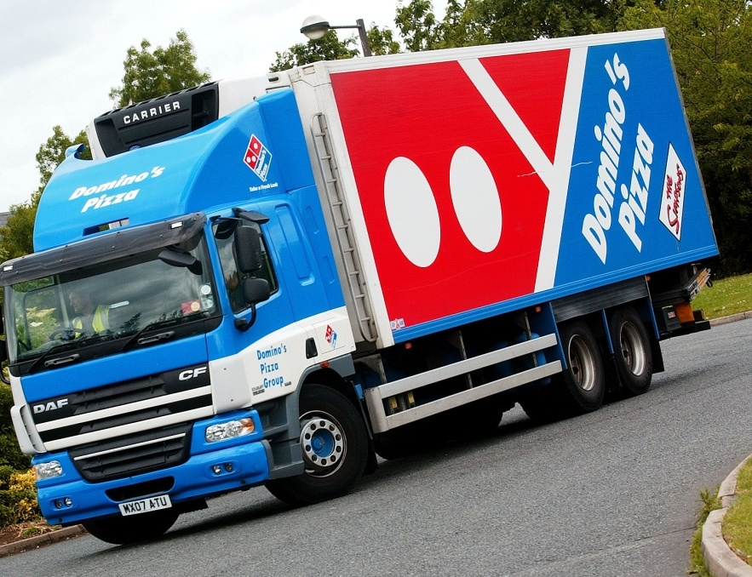
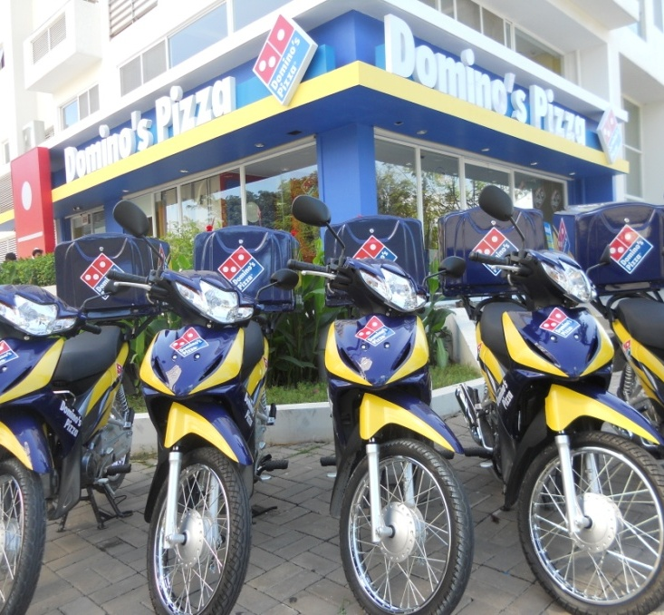
Domino’s Pizza: One Brand – One System Worldwide
Marketing: Same brand, logo and consumer promise
Operations: Same layouts, training and people focus
Quality Control: Same core products, audits and approved local suppliers
Notes:
Same core strategy…
Images (L-R):
UK – Delivery truck
Vietnam – 1st store

Slide 25
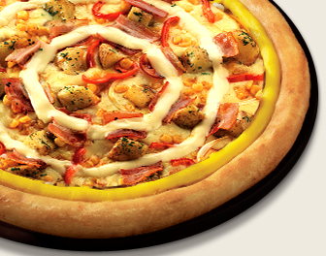
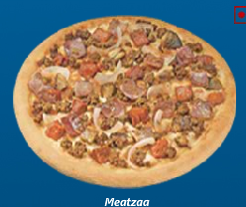
Taiwan: “Seafood Delight” with onions, peas, squid, shrimp and crab France: “Four-Cheese” pizza with goat, emmentaler, bleu and mozzarella cheeses South Korea: “Potato Pizza” with onions, bacon, mushrooms, corn, pepperoni, extra cheese and…mayonnaise!!! India: Spicy chicken sausage replaces pepperoni and beef products due to Hindu reverence for the cow
Local Product Adaptations: International Toppings

Slide 26
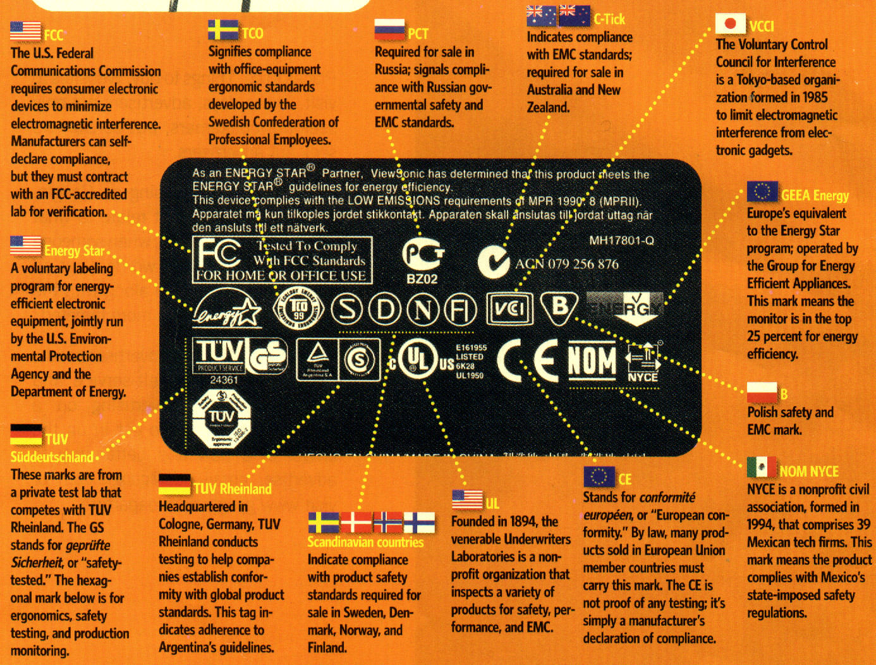

Slide 27
Place
Distribution systems differ across markets:
Retail concentration (concentrated vs. fragmented)
Channel length (number of intermediaries)
Channel exclusivity (ease of accessing channels)
Channel quality
Sample globalEDGE Resources:
Global Retail Development Index (A.T. Kearney)
Logistics Performance Index (World Bank)
Compendium of Trade Laws (Lexmark Intl)

Slide 28
Price
Price discrimination
Charging what the market will bear
Pricing strategies
Penetration Pricing
Market Skimming
Cost-plus Pricing
Regulatory and economic factors
Currency fluctuations
Anti-dumping and price fixing regulations, price ceilings

Slide 29
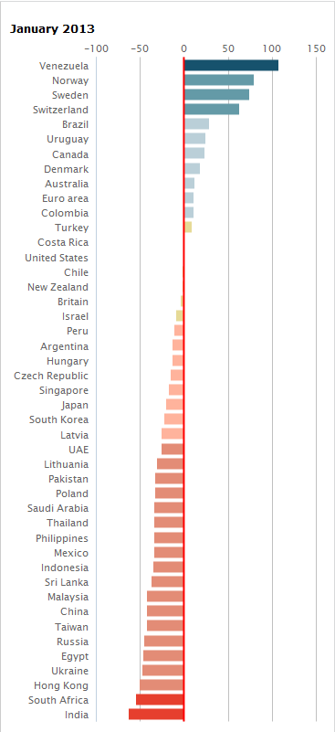
Application Idea
The Economist Big Mac Index
A lighthearted guide to measure which currencies are over-valued and which ones are under-valued, based on PPP.
Purchasing-power parity (PPP):
A dollar (or local currency equivalent to a dollar) should buy the same amount of goods in all countries.
In China, Big-Mac was 16 Yuan in Jan 2013
16.0 Yuan / 6.22 Yuan/USD = $2.57 In US, a Big Mac is $4.37
So, the exchange rate should really be 16 Yuan / 4.37 USD = 3.66 Yuan / USD
$2.57/$4.37=0.59 ⇒ so, the Yuan is 41% under-valued
Discussion: What are the potential problem with this approach?

Slide 30
Promotion
Cultural and Legal Barriers
An ad that works in one culture may not work in another
Comparative advertising is illegal in certain markets
Country of origin effects
Emphasize/de-emphasize origin
Noise levels
amount of promotional activity in the market competing for the customer’s attention
Push vs. Pull strategies
personal selling vs. mass media
Depends on product type, channel length, customer sophistication, and media availability
Internet and Social Media
Can be a benefit, but can also be disastrous for a brand

Slide 32
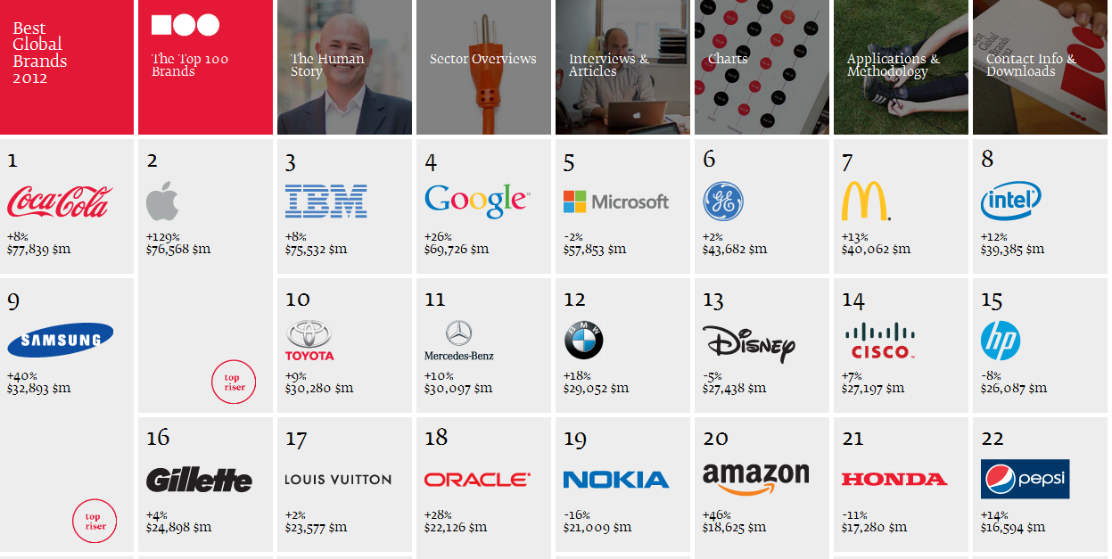
Application Idea
Best Global Brands (Interbrand/Business Week)

Slide 33
THANK YOU!
Tunga Kiyak
Outreach Specialist, MSU International Business Center
Email: kiyaktun@broad.msu.edu
http://globalEDGE.msu.edu/

