Slide 1
globalEDGE.msu.edu A Free Resource for Teaching, Education, and Training
Tunga Kiyak Outreach Specialist, MSU International Business Center Adjunct Professor, Broad College of Business

Slide 2
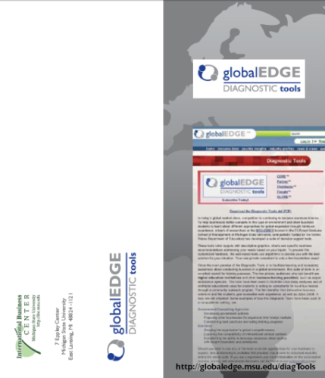
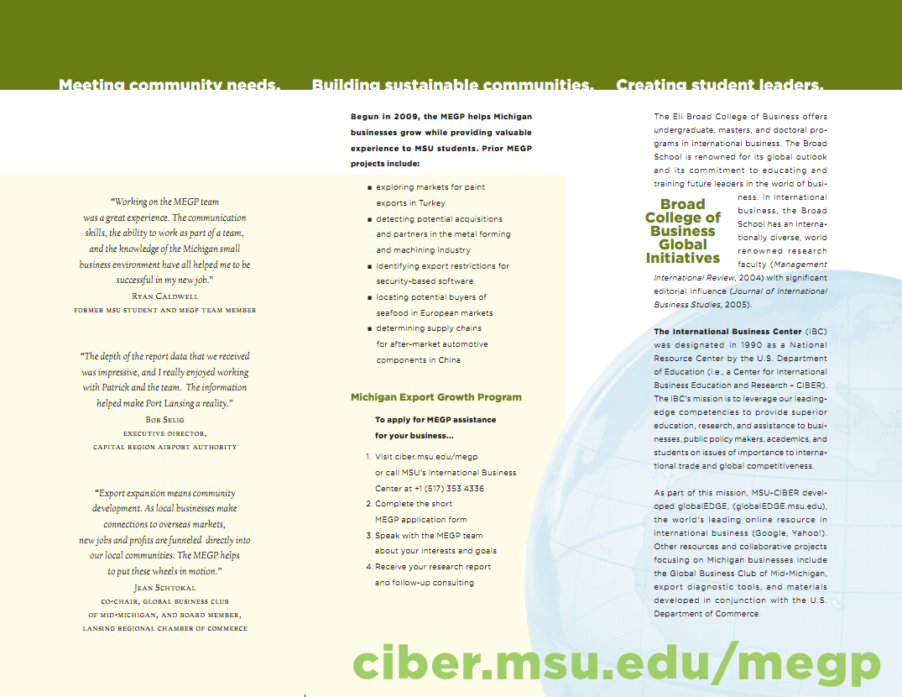
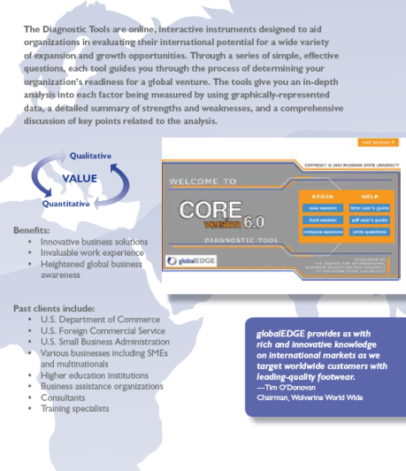
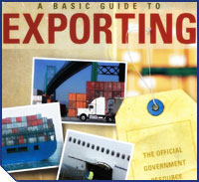
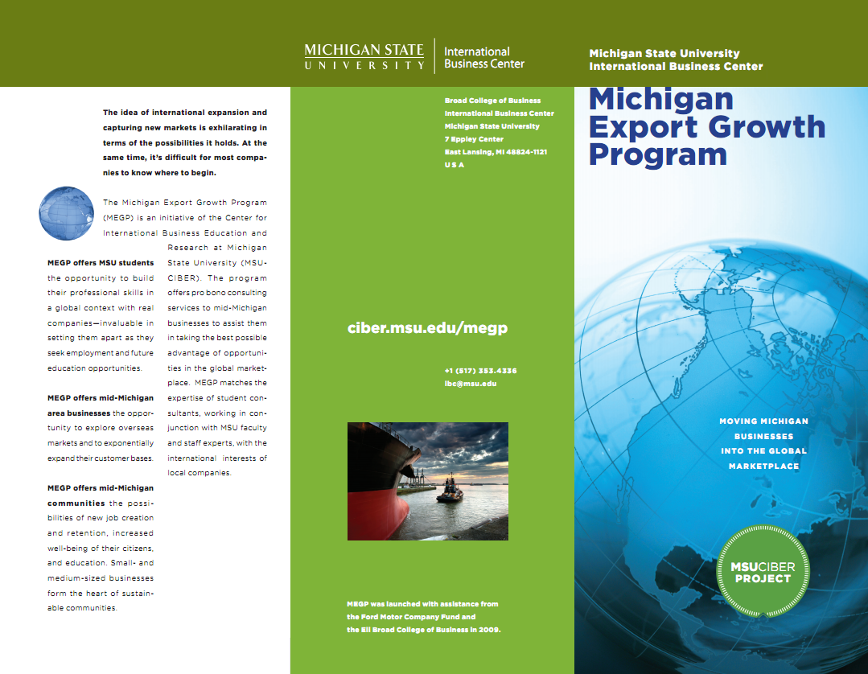
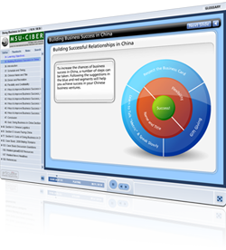
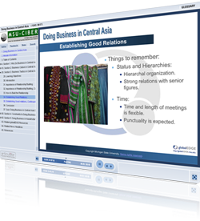
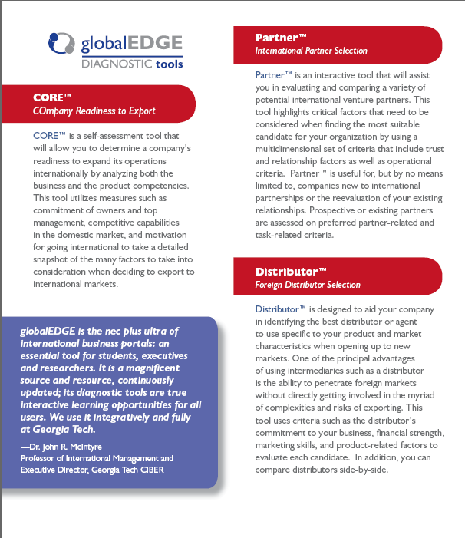
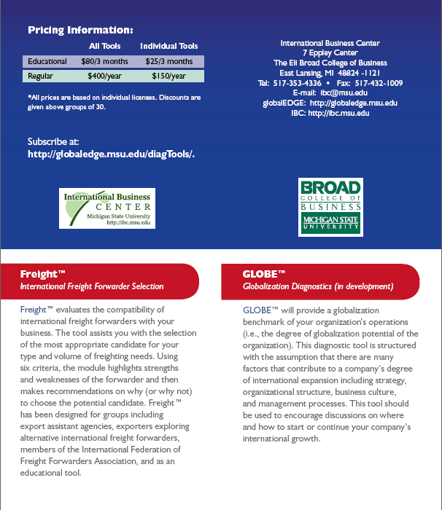
International Business Center
Mission: To provide superior education, research, and assistance to businesses, public policy makers, academics, and students on international business and trade.
CIBER – National Resource Center (since 1990) through funding by the U.S. Dept. of Education
U.S. Commercial Service Affiliate – partners with and supports the Commercial Service in mid-Michigan
MEDC STEP Program Statewide Partner – will provide training and resources to all Michigan businesses.

Slide 3
MSU’s Expertise in International Business
The Broad College of Business has 75 business professors with expertise on IB and trade topics who are natives of 22 different countries.
Both undergraduate and graduate programs in IB are ranked in the top 20 nationally (US News)
Most productive IB research faculty in the world (Management International Review, 2004; International Business Review 2010)
Most editorial influence in the world (Journal of International Business Studies, 2005).
The International Business Center is the headquarters to the Academy of International Business, and also maintains the online presence of all CIBER programs and all BIE programs for the U.S. Dept. of Education.

Slide 4
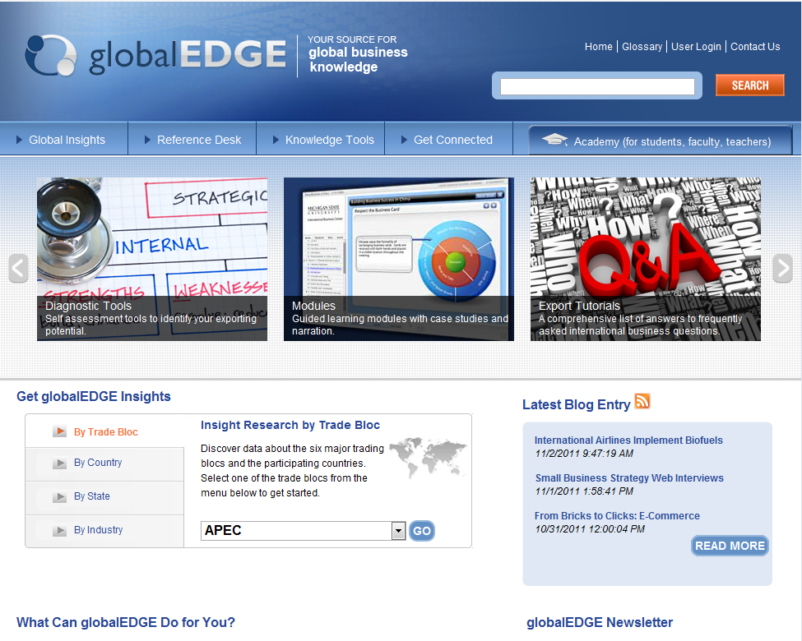
globalEDGE
Started out in1995. Relaunched as globalEDGE in 2001
Integrated into many leading textbooks
Majority of content accessible for free (except diagnostic tools)
http://globaledge.msu.edu/

Slide 5
Using globalEDGE in Teaching
Resources for developing your syllabus, from exercises and simulations to sample syllabi.
Online modules to enhance your course delivery
Chapter-end exercises in multiple IB and other international (e.g., Intl. Marketing) textbooks.
Market research projects that require country and industry level analysis and statistics.
Market Entry exercises using MPI as a ranking tool.
Diagnostic Tools, particularly CORE, as a teaching tool.

Slide 6
Sample Chapter End Question
The use of bribery in the business setting is an important ethical dilemma many companies face both domestically and abroad. While illegal for US companies to use as a business strategy, there are still industries and countries where such practices are common practice. An index assessing the likelihood of firms to offer bribes also ranks industries based on the prevalence of bribery. This index can be found by using the search term “bribe payers” at http://globaledge.msu.edu/. Compare the three industries thought to have the largest problems with bribery with those three that have the least problems. What patterns do you see? What factors make some industries more conducive to bribery than others?

Slide 7
Sample Chapter End Question
You work for a pharmaceuticals company that hopes to provide products and services in New Zealand. After searching a resource that enumerates the import and export regulations for each country, outline the most important foreign trade barriers your firm’s managers must keep in mind while developing a strategy for entry into New Zealand's pharmaceutical market.

Slide 8
Sample Chapter End Question
A.T. Kearney publishes an annual study to help retailers prioritize their global development strategies by ranking the retail expansion attractiveness of emerging countries based on a particular set of criteria. Find the latest version of this Global Retail Development Index. What criteria are used to identify the attractiveness of the retail environment in emerging countries? Categorize the top 10 countries by world region. Are there any of these countries that surprise you? Why (or, why not)?

Slide 9
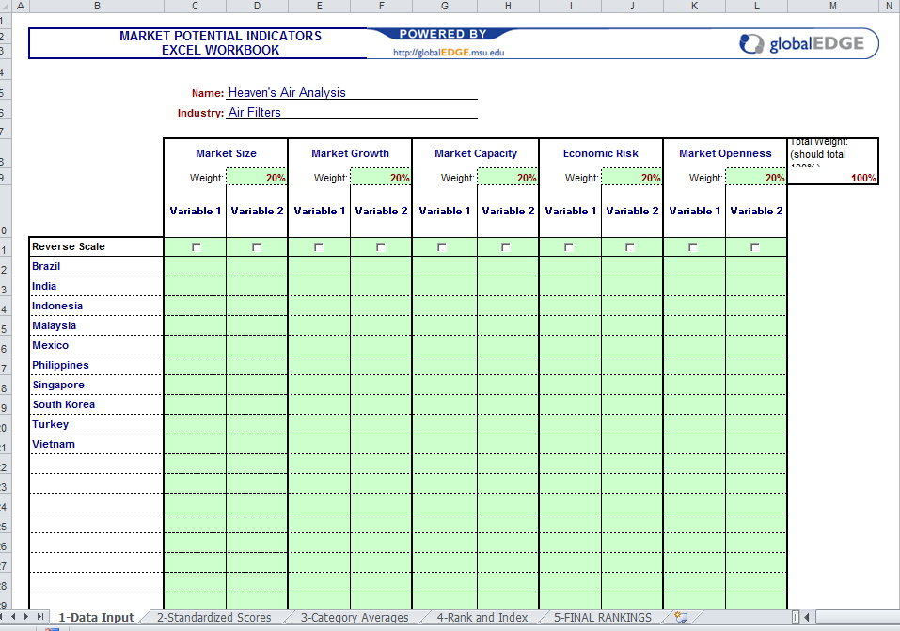
MPI as an Exercise

Slide 10
THANK YOU!
Tunga Kiyak
Outreach Specialist, MSU International Business Center
Email: kiyaktun@broad.msu.edu
http://globalEDGE.msu.edu/

Slide 11
globalEDGE Screenshots

Slide 12
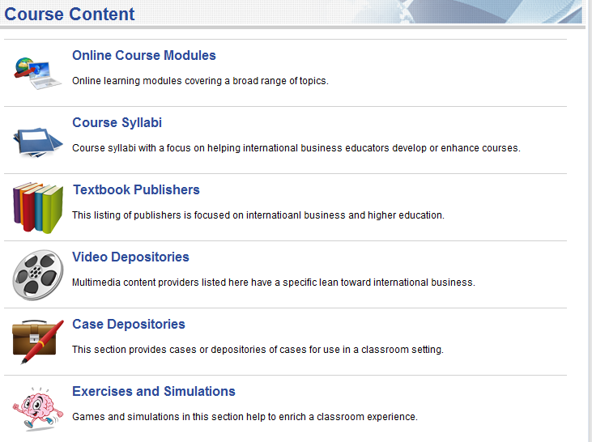
Academy – Course Content

Slide 13
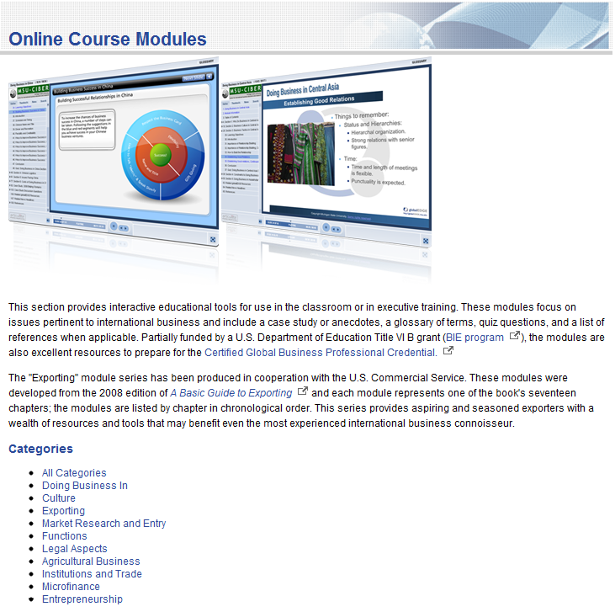
globalEDGE – Online Course Modules
Notes:
The online course modules provide interactive educational tools for use in the classroom or in executive training. These modules focus on issues pertinent to international business and include a case study or anecdotes, a glossary of terms, quiz questions, and a list of references when applicable. They are approximately equivalent to a chapter of a textbook. There are 60 modules currently, and the list keeps on growing.

Slide 14
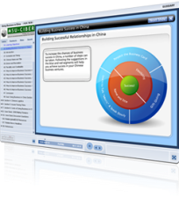
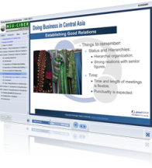
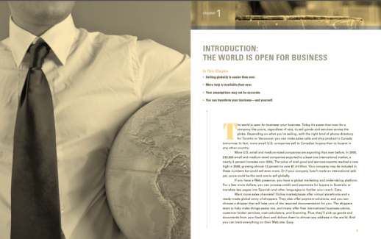
globalEDGE - Export Modules
“Sourcing and selling goods around the world has never been easier, and more and more small U.S. businesses are competing and winning in the global economy. A Basic Guide to Exporting is a great source for anyone preparing to do business or to increase their sales overseas. We strongly recommend it to our customers.”
Frederick W. Smith
President, Chairman, and CEO
FedEx Corporation
The World is Open for Business
Developing An Export Strategy
Export Advice
Developing a Marketing Plan
Methods and Channels
Finding Qualified Buyers
Using Technology Licensing and Joint Ventures
Preparing Your Product for Export
Exporting Services
International Legal Considerations
Going Online: E-Exporting Tools for Small Businesses
Shipping Your Product
Pricing, Quotations, and Terms
Methods of Payment
Financing Export Transactions
Business Travel Abroad
Selling Overseas and After-Sales Service
BONUS MODULE: Analyzing a Company's Ability to Export
Notes:
The "Exporting" module series has been produced in cooperation with the U.S. Commercial Service. These modules were developed from the 2008 edition of A Basic Guide to Exporting and each module represents one of the book's seventeen chapters; the modules are listed by chapter in chronological order.

Slide 15
globalEDGE – Module Walkthrough - 1

Slide 16
globalEDGE – Module Walkthrough - 2

Slide 17
globalEDGE – Module Walkthrough - 3
Your own sub headline

Slide 18
globalEDGE – Module Walkthrough - 4

Slide 19
globalEDGE – Module Walkthrough - 5
Your own sub headline

Slide 20
globalEDGE – Module Walkthrough - 6
Your own sub headline

Slide 21
globalEDGE – Module Walkthrough - 7

Slide 22
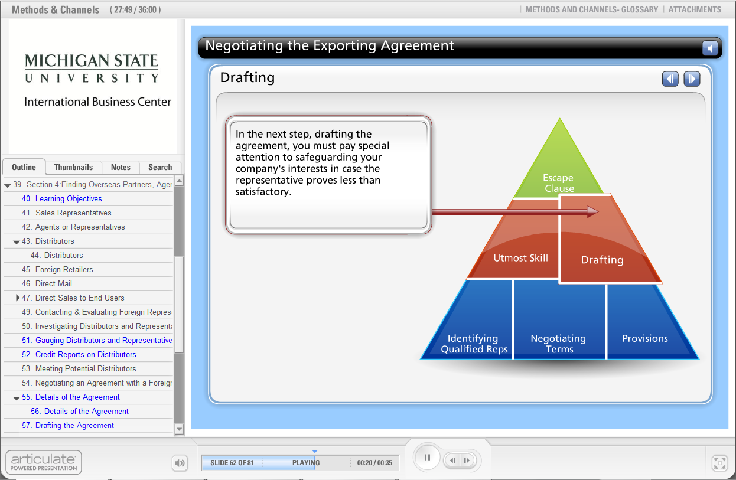
globalEDGE – Module Walkthrough - 8

Slide 23
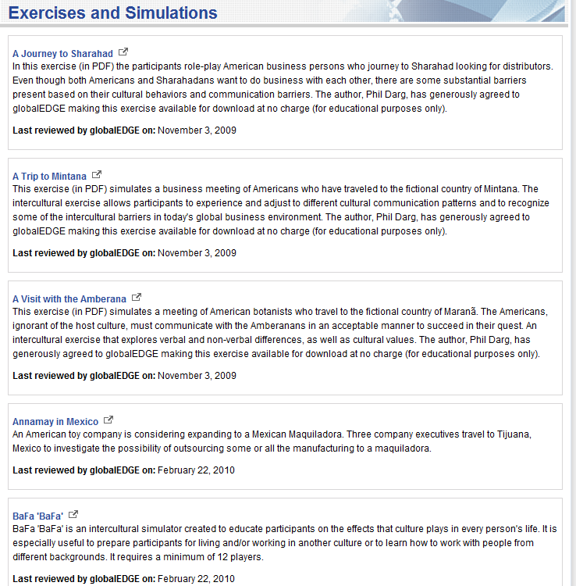
Exercises and Simulations

Slide 24
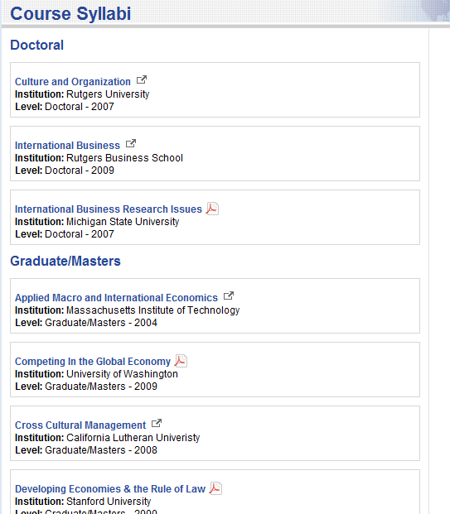
Course Syllabi

Slide 25
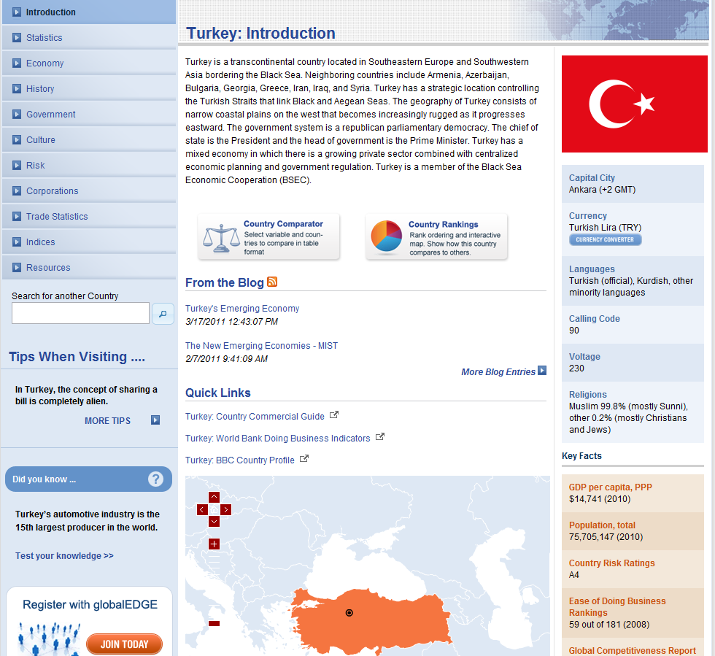
globalEDGE – Country Insights
Notes:
The site includes pages on 200 countries and all 50 states. A lot of content is aggregated from a wide variety of sources to present a single destination for international business related information on these countries and states. Historical, economic, and political backgrounds, detailed information on business etiquette and culture, assessment of economic risk in the country, a list of largest multinationals from the country, trade statistics (top export products, top import products, top export partner countries, top import partner countries), a page that lists where the country stands on a multitude of rankings available, and links to additional resources.

Slide 26
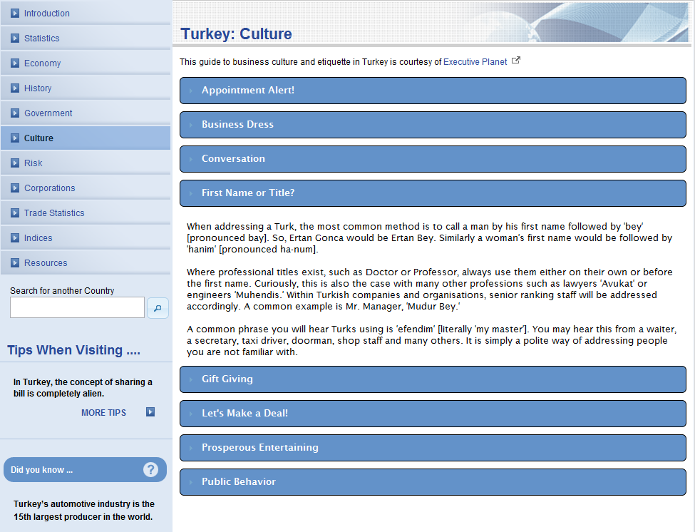
globalEDGE – Country Insights - Culture

Slide 27
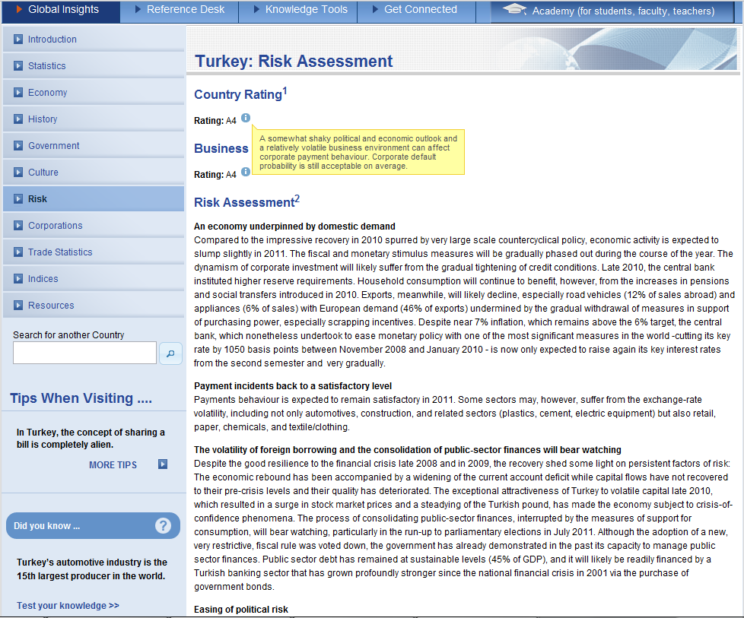
globalEDGE – Country Insights - Risk

Slide 28
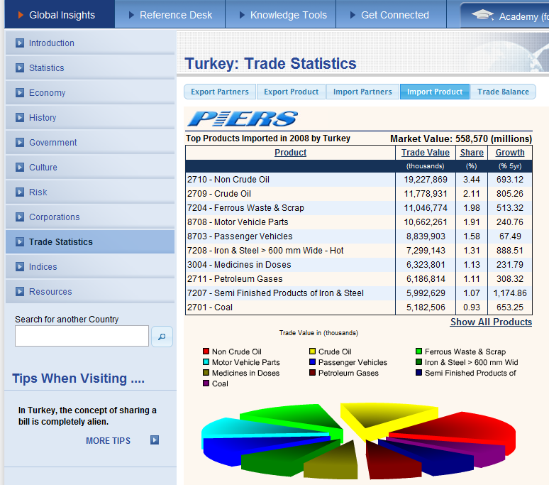
globalEDGE – Country Insights – Trade Stats

Slide 29
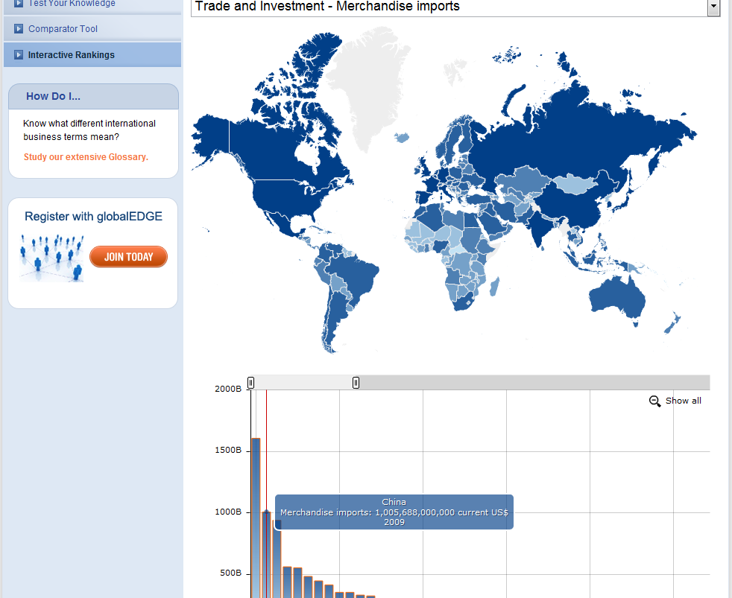
globalEDGE – Interactive Rankings and Comparisons

Slide 30
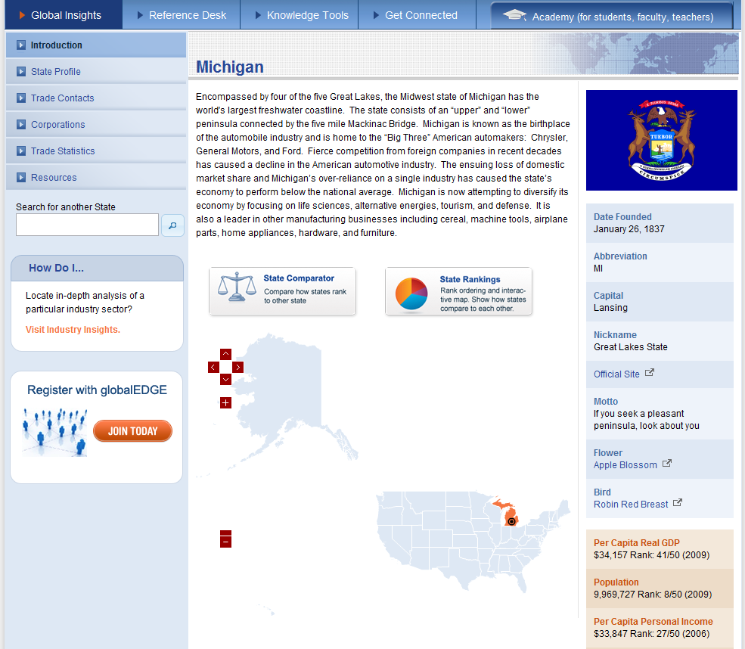
globalEDGE – State Insights

Slide 31
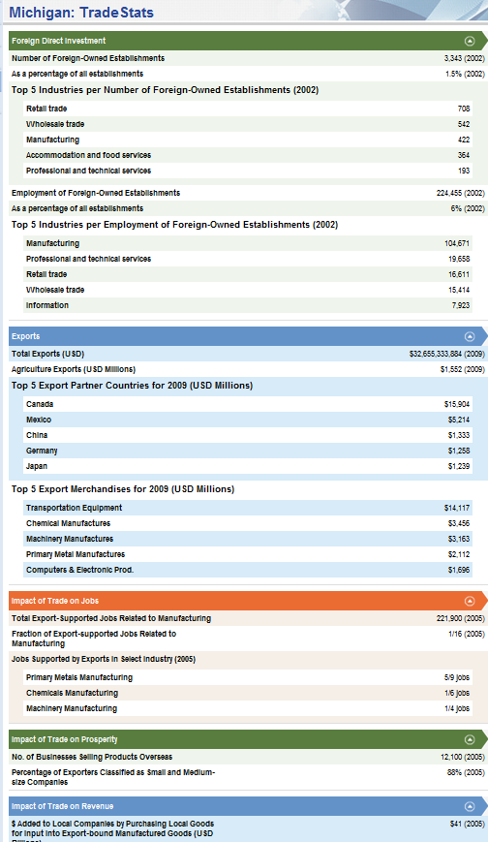
globalEDGE – State Trade Stats
No of foreign owned establishments
Export-supported jobs
Top Industries supported by exports
Number of companies selling overseas
Top products, top markets

Slide 32
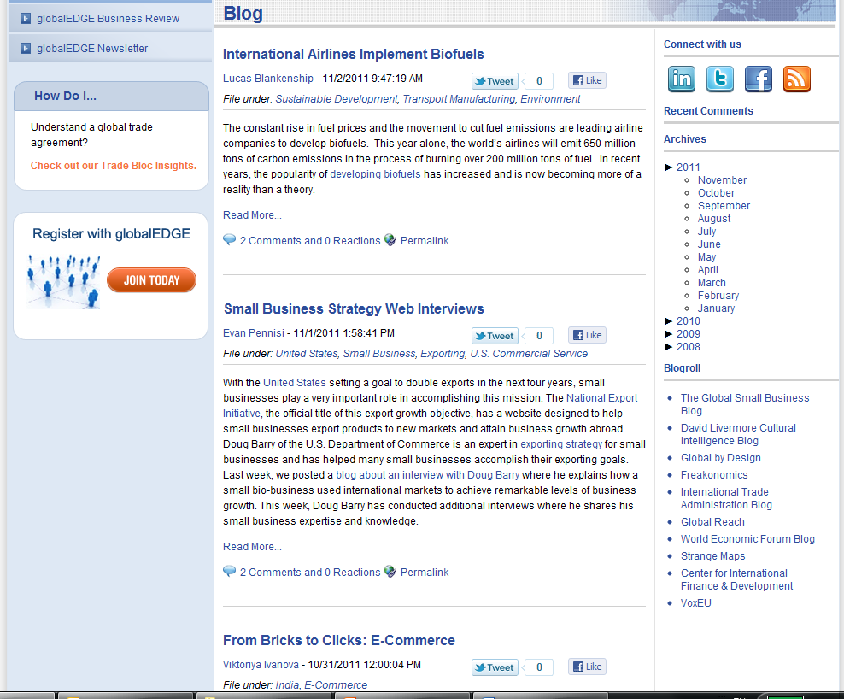
globalEDGE Blog

Slide 33
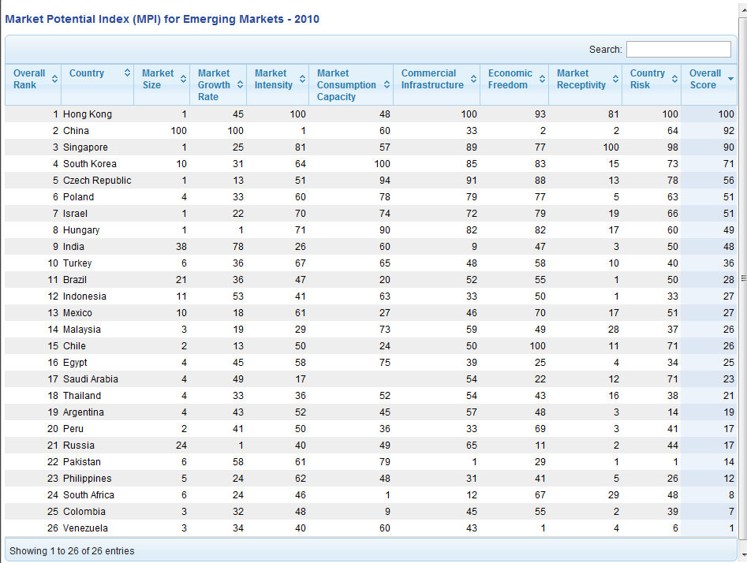
Market Potential Index
An Excel spreadsheet is also available for projects to let students collect and analyze their own data.

Slide 34
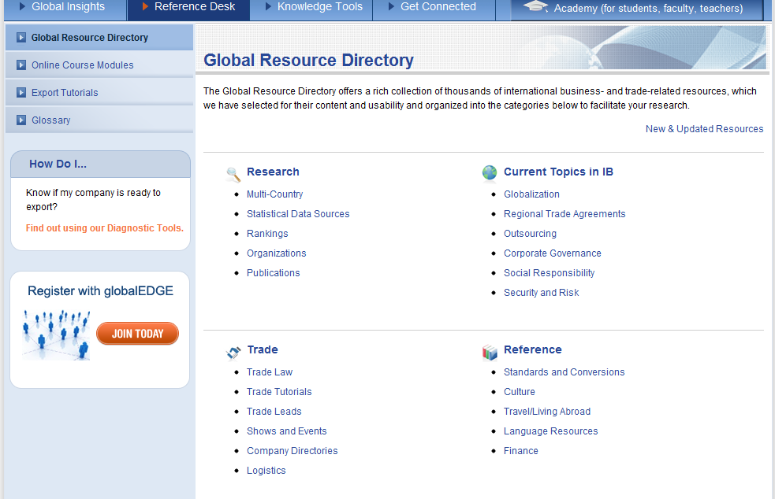
globalEDGE – Resource Directory
Notes:
Categorized and annotated listing of select international business resources on the Internet. The Rankings category and the “Current Topics in IB” section was highlighted in the session as examples of the parts of website that can be integrated into classroom discussions or assignments.

Slide 35
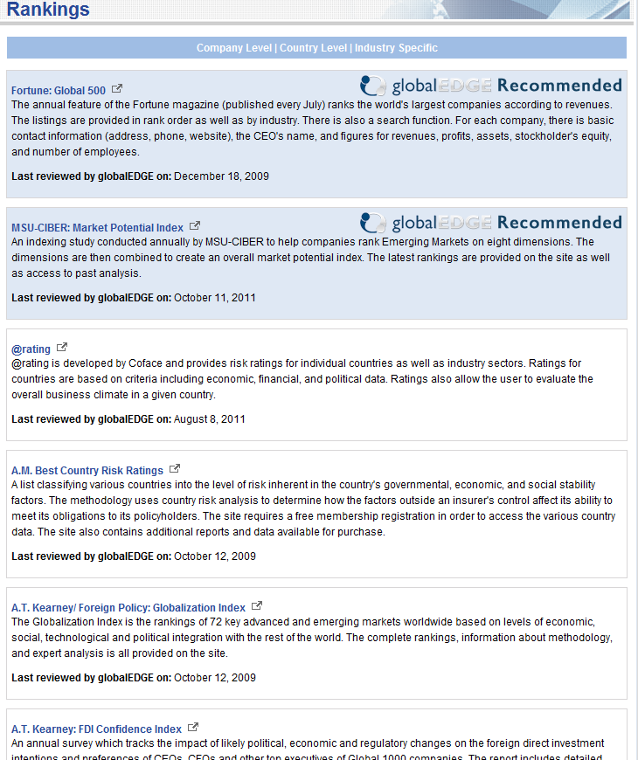
Rankings
Various studies that rank countries and companies.
Makes for good discussion in the class

Slide 36
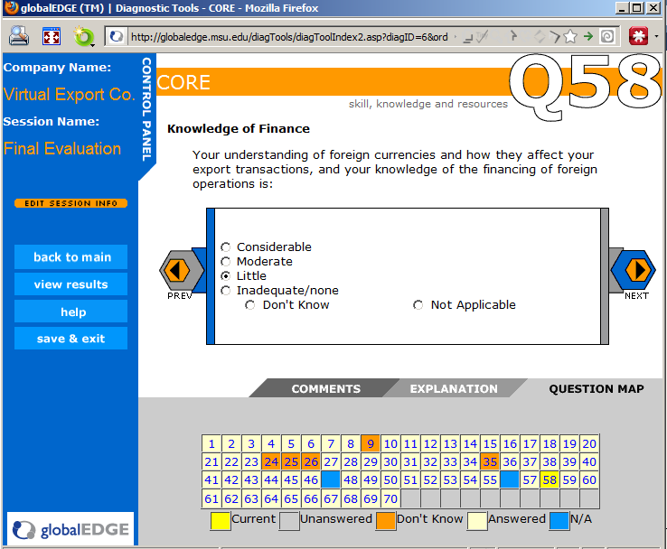
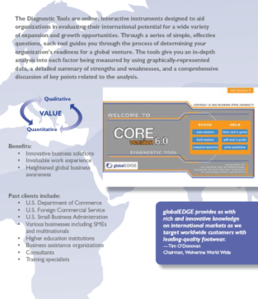
globalEDGE Diagnostic Tools
Four decision support tools for SMEs:
- CORE – Company Readiness to Export
- Freight – evaluate freight forwarders
- Partner – evaluate potential partners
- Distributor – evaluate potential distributors
Notes:
Diagnostic Tools are the only part of the website that are not available for free. There is a minor cost for the tools. The rate changes significantly for educational purposes, so please make sure to contact us. There are also cases and teaching notes available for the diagnostic tools to facilitate a more structured teaching experience.
36

Slide 37
globalEDGE – Also Features …
Industry Insights – global info on 20 industries
Trade Bloc Insights – info on major trade blocs
Glossary – comprehensive collection of business and trade terms
And much more…
Visit: http://globaledge.msu.edu/

Slide 38
THANK YOU!
Tunga Kiyak
Outreach Specialist, MSU International Business Center
Email: kiyaktun@bus.msu.edu
http://globalEDGE.msu.edu/

