Slide 1
INTERNATIONAL
ECONOMICS
Notes:
1

Slide 2
Carl Liedholm
Professor, Economics
Notes:
2

Slide 3
INTERNATIONAL TRADE
BASIC FACTS
Notes:
3

Slide 4
Which of the following is true about the United States and its international trade role?
The world’s largest exporter in absolute terms
A relatively “closed” economy (X/GDP low)
Its largest trading partner is China
Imports more gasoline than it exports
None of the above
Notes:
4

Slide 5
WORLD EXPORTS – 2011 MERCHANDISE
1)
U.S. $ 1.48 Trillion
GERMANY $ 1.47 Trillion
4) JAPAN $ 0.82 Trillion
5) NETHERLANDS $ 0.66 Trillion
Notes:
5

Slide 6
OPENNNESS
MEASURE
EXPORTS/GROSS DOMESTIC PRODUCT
Notes:
6

Slide 7
EXPORTS/GDP 2011
THAILAND 77%
KOREA 56%
GERMANY 50%
CHINA 31%
WORLD AVERAGE 29%
JAPAN 15%
Notes:
7

Slide 8
U.S TRADING PARTNERS
Notes:
8

Slide 9
U.S TRADING PARTNERS (Percent of US Exports) 2011
1)_______
MEXICO 13 %
CHINA 7 %
JAPAN 5 %
U.K. 4 %
GERMANY 3%
Notes:
9

Slide 10
WHAT GOODS?
Exports
Imports
Notes:
10

Slide 11
WHAT GOODS?
UNITED STATES
EXPORTS –BOTH MANUFACTURED AND PRIMARY
IMPORTS – BOTH MANUFACTURED AND PRIMARY
JAPAN
EXPORTS – MANUFACTURED
IMPORTS - PRIMARY PRODUCTS
CANADA
EXPORTS – PRIMARY PRODUCTS
IMPORTS – MANUFACTURED PRODUCTS
Notes:
11

Slide 12
Which of the following is true about the United States and its international trade role?
The world’s largest exporter in absolute terms
A relatively “closed” economy (X/GDP low)
Largest trading partner is China
Largest trading partner is Mexico
None of the above
Notes:
12

Slide 13
GLOBALIZATION
*
Notes:
13

Slide 14
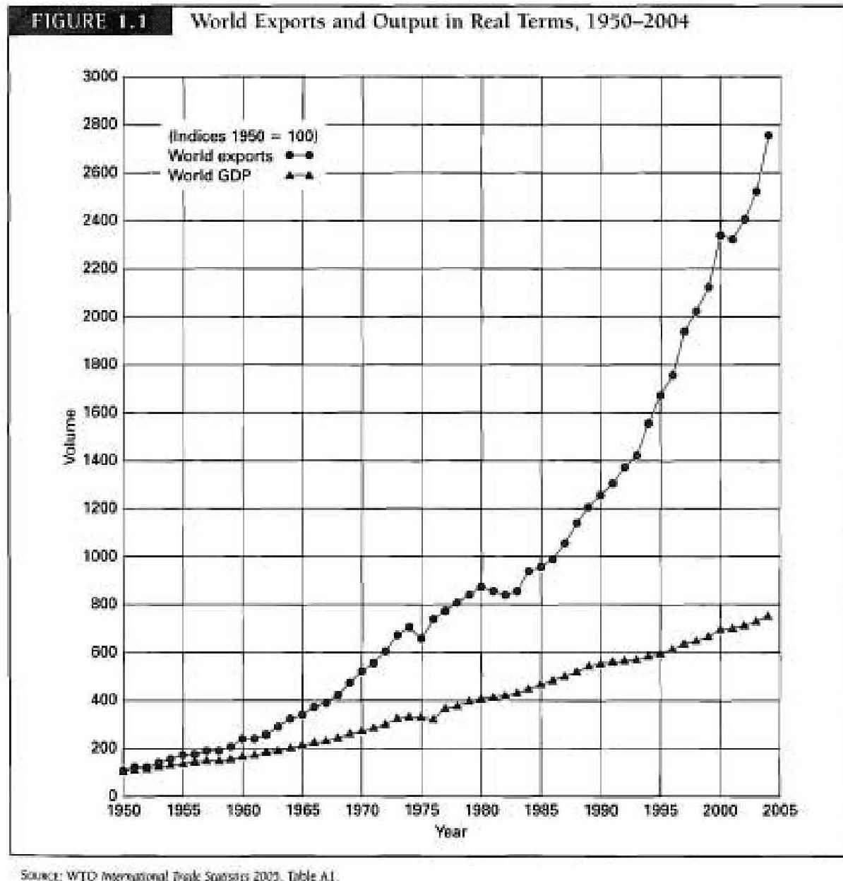
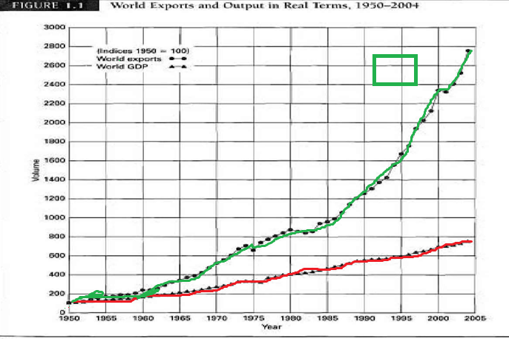
Exports
GDP
Notes:
14

Slide 15
GROWTH SINCE 1950
WORLD TRADE 25X
WORLD OUTPUT 8X
Notes:
15

Slide 16
Recent Period
6 %
2 %
-12 %
+13.8 %
+ 5.0 %
+ 3.8 % (World Bank)
Notes:
16

Slide 17
GLOBALIZATION
NOT A NEW PHENOMENON
Expansion of Roman Empire
Voyages of Discovery
End of Napoleonic Wars
Notes:
17

Slide 18
PRIMARY DRIVING FORCES OF RECENT WAVE OF GLOBALIZATION
REDUCTION OF TRADE BARRIERS
*
Notes:
18

Slide 19
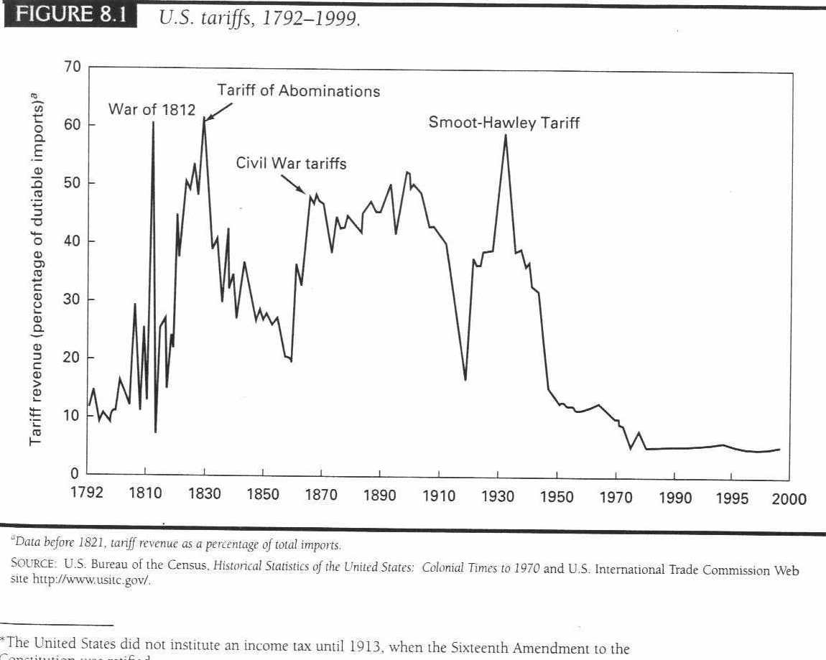

Slide 20
Effect on U.S. Household
$1 Trillion/year
$10,000/ household per year
Notes:
20

Slide 21
2. TECHNOLOGICAL CHANGE
Notes:
21

Slide 22
3. EMERGENCE OF NEW COUNTRIES
1)
2)
3)
Notes:
22

Slide 23
EFFECT ON JOBS
Notes:
23

Slide 24
EFFECT ON TRADE BALANCE
IMPORTS NOW GREATLY EXCEED EXPORTS
Notes:
24

Slide 25
U.S. FOREIGN TRADE DEFICIT 2011
CURRENT ACCOUNT DEFICIT
- $ 465.9 Billion
3.1 % of GDP
Notes:
25

Slide 26
INTERNATIONAL ACCOUNTING
CURRENT ACCOUNT
-$465 Billion
+
FINANCIAL ACCOUNT
+$465 Billion (Liability to Foreigners)
=
0
Notes:
26

Slide 27
PROBLEM ?
FINANCE OR TRADE?
JOINTLY DETERMINED
CAPITAL SAVINGS GLUT?
5% GDP RED FLAG

Slide 28
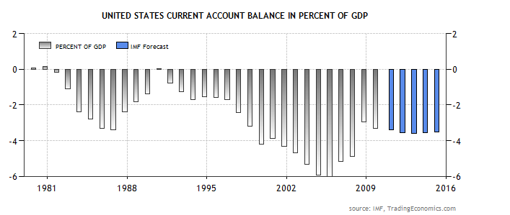
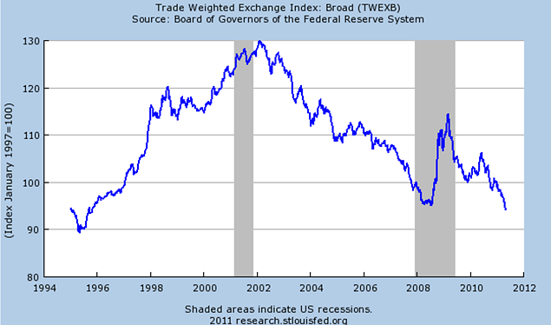
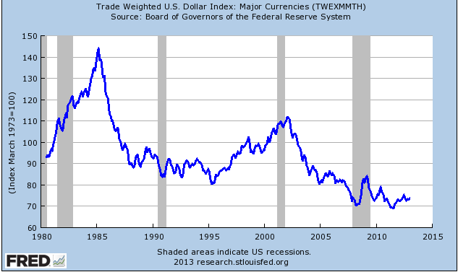
2011
3.1%
2012(3)
2.7%
5 %

Slide 29
INTERNATIONAL FINANCE
*
Notes:
29

Slide 30
:
$
*
Notes:
30

Slide 31
The coins used in colonial America were primarily::
British (Shillings and Pounds)
Spanish (Pieces of Eight)
German (Thalers)
French (Ecus)
Dutch ( Ducatoons)

Slide 32
EXCHANGE RATE
PRICE (RATIO)OF ONE CURRENCY IN TERMS OF ANOTHER
L/$
CURRENCY ON BOTTOM KEY
Notes:
32

Slide 33
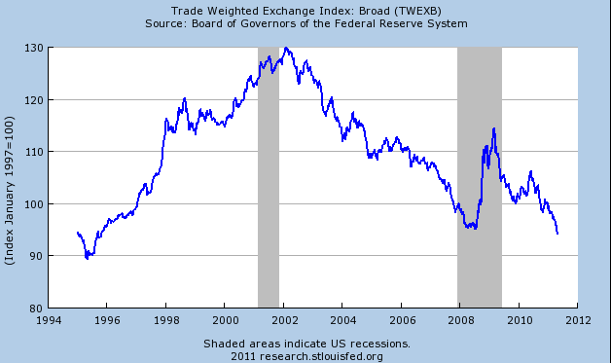

Slide 34
EFFECT OF FALLING DOLLAR
MAKES U.S. FIRMS MORE COMPETITIVE INTERNATIONALLY
LOWERS PRICE OF U.S. GOODS ABROAD
INCREASES PRICE OF IMPORTED GOODS
Notes:
34

