Slide 1
Developing a Study Abroad Program
Dr. Sarah Singer

Slide 2
My background
Assistant Director of International Business Center since January 2007
PhD in Higher Education Administration
Dissertation: The Impact of Macro-Level Factors on the Development of Study Abroad in Community Colleges
Studied abroad/homestays with local families in France, Germany, Brazil, and UK
First program: 3 weeks in France as a 5th grader…
2012-2013 developed and led IB/Marketing program to Japan

Slide 3
Dissertation Research
Factors that impacted study abroad at community colleges to some extent:
Financial factors (wealth of institution, student body, surrounding community)
Community make-up and employment base
Connections to other countries/regions
Institutional support
Community colleges with study abroad programs tended to have higher levels of internationalization, as well as being larger and more urban than those that didn’t offer study abroad.

Slide 4
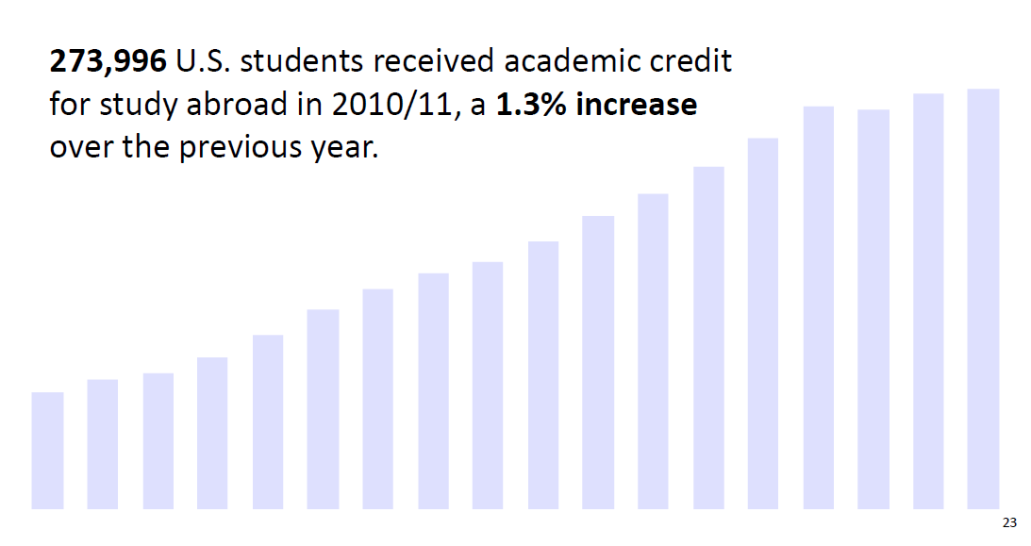
U.S. Study Abroad Trends
Source: IIE 2012 Open Doors Report

Slide 5
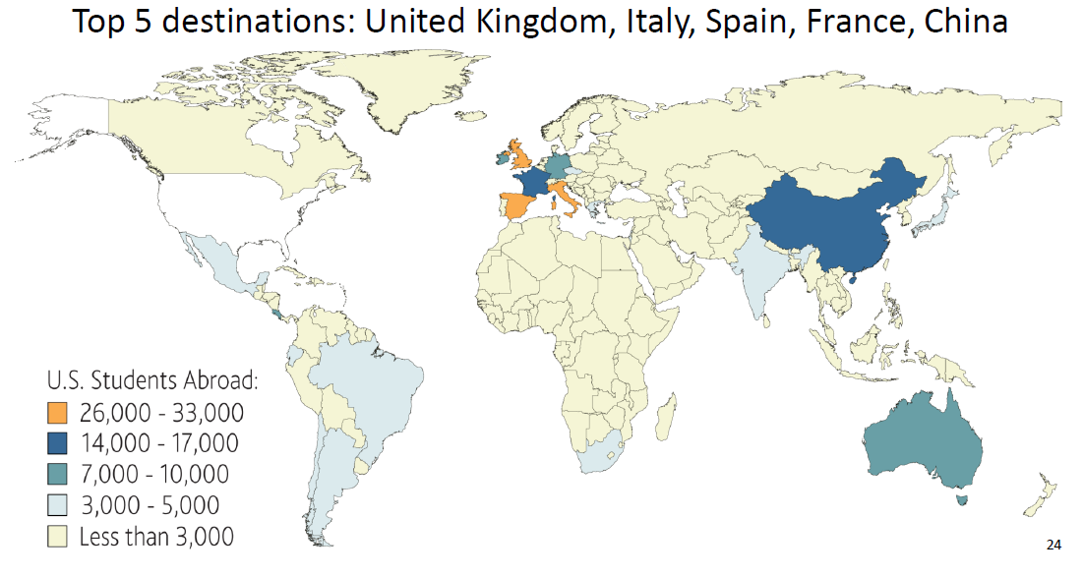
U.S. Study Abroad Trends, Cont.
Source: IIE 2012 Open Doors Report
Notes:
Destinations: 14 of the top 25 destinations are outside Europe; only 5 of the top 25 are Anglophone countries
• Large increases among the top 25 hosts: Costa Rica (16%), South Korea (16%), Brazil (13%), India (12%), Denmark (11%)
• Large declines: Mexico (42%), Japan (33%)
• Fall 2012 snapshot survey: Growth for China, India and Japan

Slide 6
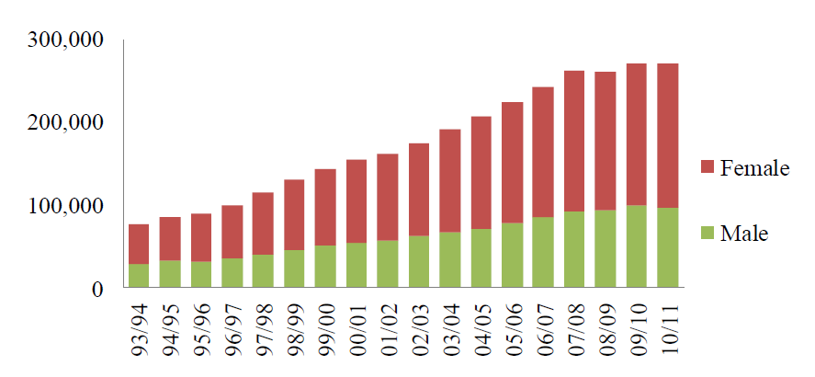
U.S. Study Abroad Trends, Cont.
Women comprised 64% of U.S. study abroad students in 2010-11.
Source: IIE 2012 Open Doors Report
Notes:
Highly variable, though. For example, two-thirds of the students on my Japan program this past May were male!

Slide 7
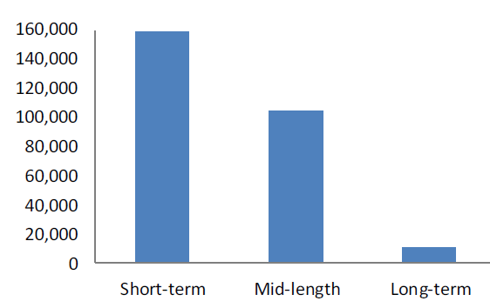
U.S. Study Abroad Trends, Cont.
Short-term: Summer, January term, or less than 8 weeks during AY
Mid-length: One quarter, two quarters, or one semester
Long-term: Academic year or calendar year
Source: IIE 2012 Open Doors Report

Slide 8
Why do students study abroad?
Personal and intellectual growth
Cultural experiences/understanding
Communicating with diverse audiences
Enhancing self-awareness and understanding of own cultural beliefs
Enhance/build/differentiate resume
Explore career possibilities
Applied learning
Travel

Slide 9
Study Abroad Program Models
Faculty-led
Faculty organized
3rd party provider
Consortium
Exchanges/direct enroll
MSU’s Office of Study Abroad has an excellent list of program types with examples.

Slide 10
So you’re going to lead a program…
Where to go?
What to teach?
When to go and how long?
How to organize?

Slide 11
Two options:
Figure it out…
OR
3rd party providers
This presentation will focus on figuring it out.

Slide 12
Where to go?
Manageable
Probably not Syria, for example!
Interesting
Attractive to students, but also for you – remember, you will make multiple trips to this destination
University connections
Personal connections
Additional factors to think about:
Public transportation
Air connections/availability of direct flights
Housing
Language barriers

Slide 13
What to teach?
Easiest and most obvious: International Business
International Marketing or Finance
Finance: focus on banks, monetary systems, stock exchanges
Marketing: focus on local products, marketing campaigns, how different industries/products use marketing
Specialized course
Example: Business and Culture in Japan
Independent Study

Slide 14
When to go and how long?
Options: Winter break/January term; spring break; summer
Considerations:
weather
national holidays
student interest and preferences (i.e., Do students want/need to work over the summer?)
Trip length
Long enough for the students to have a real sense of the country, BUT length is directly proportional to cost and, often, student availability…

Slide 15
How to organize it?
Appropriate mix of professional and cultural visits (and in-class lectures/activities).
Use connections
Personal networks
Other faculty/admin networks
Alumni/student networks
Be resourceful
Nara: free, guided tours in English
Many companies offer free tours

Slide 16
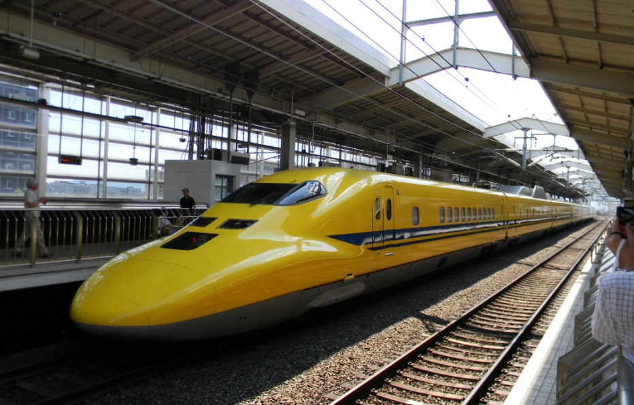
Budgeting
Think BIG
Lodging
Transportation
Salary
Think SMALL
Gifts for presenters
Entrance to museums
Welcome/farewell meal

Slide 17
Planning
Allow yourself at least one year of prep time.
Site visit or other familiarization.
Sweat the small stuff.
How will you get from point A to point B?
Will you require a group flight?
Will meals be included? Under what conditions?
Spreadsheets and schedules are your friends!

Slide 18
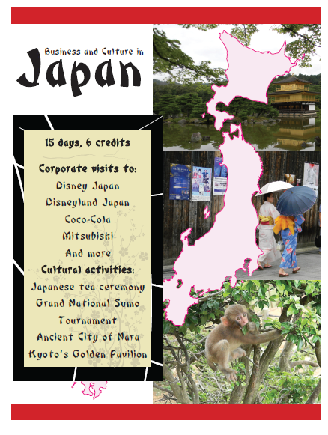
Recruiting students
Info sessions
College-wide events,
such as int’l fairs
In-class presentations
Don’t forget the foreign language students!
Follow-up, follow-up,
FOLLOW-UP!
Notes:
Remember: A picture is worth 1,000 words!

Slide 19
Preparing students
“You represent yourself, your family, your college, and your country.”
Cultural readings and discussions
Food
Attire
Behavior
During group visits and on “down time”
Attitude toward guest lecturers/businesspeople
Logistics
The program folder
Dealing with airlines, passports, visas, insurance
What to expect in country
Notes:
The cold, raw horsemeat story.
Appropriate attire is described in excruciating detail in the syllabus. Don’t even think about wandering around Tokyo in flip flops and Daisy Dukes!

Slide 20
Resources
CCID
Community college consortia and programming
NAFSA
Professional development opportunities and connections with third-party providers
globalEDGE
Country information and memos, travel abroad tips, currency converters, sample syllabi, etc.

Slide 21
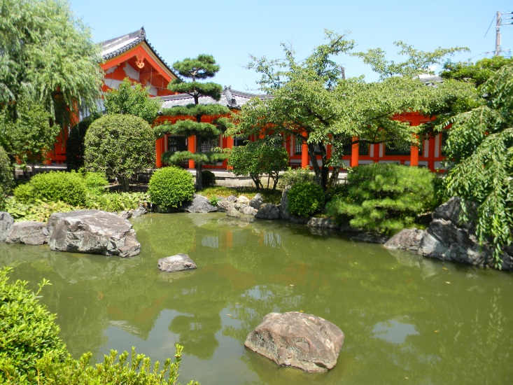
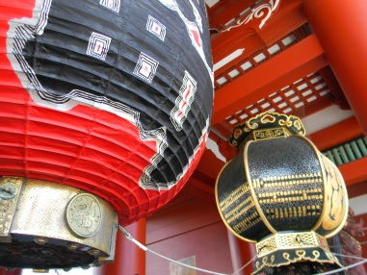
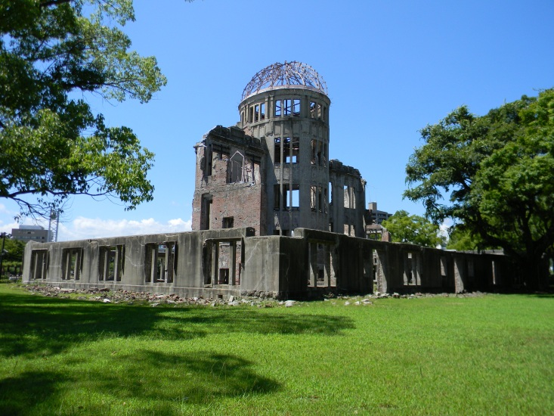
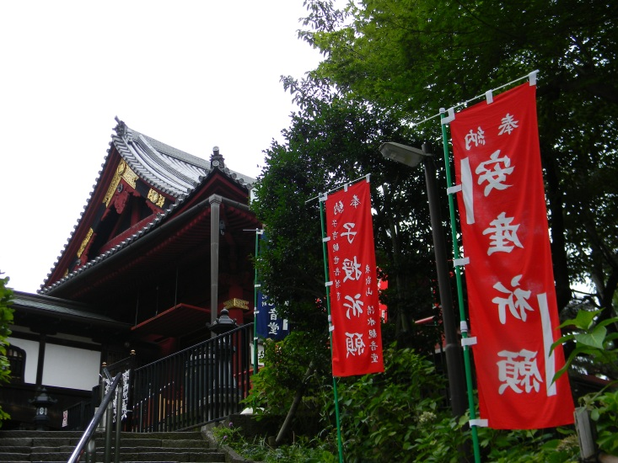
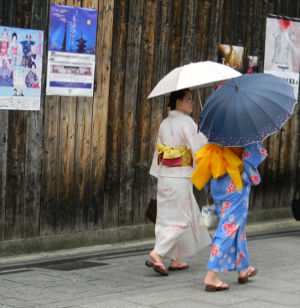
Thank you!
singersm@msu.edu

