Slide 1
Global Strategic Management
A tale of Risk and Reward
International Business Institute
June 4, 2013
Robert M. Wiseman
Eli Broad Legacy Fellow of Management

Slide 2
Agenda
Nature of Strategy
Why Globalization?
  Motivations for foreign entry
Liability of Foreigness
  Risks of globalization
Institutional Infrastructure
  Opportunity v opportunism
  Managing Across Borders
  Balancing economic and political imperatives

Slide 3
Business vs Strategy?
Business: Creating and appropriating value
Strategy: Exploiting market inefficiencies

Slide 4
Value Chain
Administration and Infrastructure
Human Resource Management
Information Management
Purchasing
PROFIT
Inbound
Logistics
Outbound
Logistics
Operations
Marketing
Service
M. Porter, “Competitive Advantage”, 1984

Slide 5
FIRM INFRASTRUCTURE
Recruiting
Training
Recruiting
Training
Recruiting
Training
System
Design
Component,
Machine Design &
Testing
Info System
Development
Market Research
Service
Manuals &
Procedures
MARGIN
Materials, Energy
& Parts Supplies
Computer
Media Services
Supplies &
Travel
Spare Parts
Good strategies.. “activities complement one another in ways that create real economic value”
-M. Porter
Transpt’n
Services
Travel &
Subsistence
Inbound
Material
Handling
Component
Fabrication
Service Reps.
Assembly
Shipping
Advertising
Spare Parts
Systems
Fine Tuning
& Testing
Promotion
Inbound
Inspection
Order
Processing
MARGIN
Sales Force
Parts
Picking &
Delivery
Maintenance
Facilities
Operation
Inbound
Logistics
Operations
Outbound
Logistics
Marketing
& Sales
Service

Slide 6
Creating and Appropriating Value
Bargaining
Power of
Buyers &
Quality of
Substitutes
{
Buyer’s Surplus
Market
Price
Value
Created
{
Seller’s Profits
Net
Benefit
Bargaining
Power of
Suppliers
Input Costs

Slide 7
Influences on Pricing
Supply and Demand
  Increasing demand increases prices
  Increasing supply decreases prices
$ Hi
D₁
s
Price
Price
Price
Lo
Lo
Products sold
Hi

Slide 8

Influences on Pricing
Willingness-to pay (WTP)
Parker Hannifin Corp.
Cost-plus pricing to WTP pricing in 2002
Net income: $120mm (’02) to $673mm (’06)
ROI: 7% (’02) to 21% (’06)
WSJ, 3/27/2007: A1

Slide 9
Influences on Pricing
Market Structure
  Bargaining power
  Importance of substitutes
  Intensity of Rivalry
Potential Entrants
Industry
Rivals
Suppliers
Buyers
Substitutes

Slide 10
Influences on Pricing
Government Regulations
  What transactions are allowed
    Who may transact to buy/sell what product or service
  How transactions are implemented
    Degree of transparency in the exchange
  Additional burdens on the exchange
    Safety and environmental requirements
  Amount of information available about exchange partners
    Information reporting requirements

Slide 11
Creating and Appropriating Value
Buyer’s Surplus
Market
Price
Value
Created
Seller’s Profits
Seller’s Profits
Net
Benefit
Input Costs

Slide 12
Forms of Economic Rent
Ricardian Rent
  ownership of a valuable assets (land, patents, brand, etc.)
Entrepreneurial (Schumpetarian) Rent
  entrepreneurial insight in a complex/uncertain environment (e.g., Microsoft, Amazon, Netflicks)
Monopoly Rent
  protection against competition (regulated industry or collusion), generally through control of supply
Quasi-rent (first-best minus second-best use)
  the amount a firm may appropriate from idiosyncratic capital or assets

Slide 13
Strategy in a Global Context
Challenges and Opportunities

Slide 14
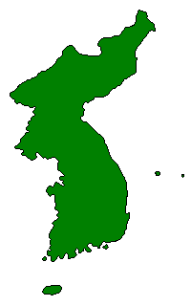
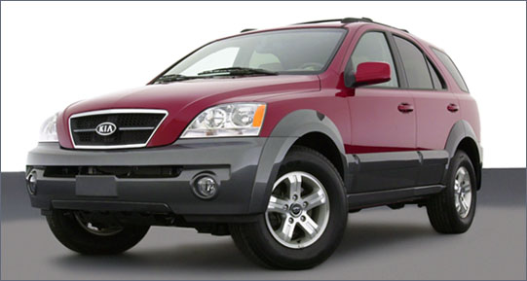
A Truly Global Economy
Korea
30,000 parts from Wales, Mexico, Sweden, China, Thailand….
Kia Sorento
Notes:
It takes 30,000 parts to make one Kia Sorento.
Tires from Michelin, Shocks from ZF Sachs, 4wheel drive from BorgWarner, Airbags from Autoliv (Sweden), electric motors from Daewoo Electronics, Mirrors from Gentex. Wales, Mexico, Sweden, China, Thailand,
Panasonic Automotive sources optical pickup units which read CDs in China.
These get shipped to Thailand. In Thailand, the mechanical structure and electronic components get added.
The unit is next shipped to Matsushita Communications, Industrial Plant in Reynosa Mexico where additional electronic components are assembled.
The units are then trucked to a Delco Electronics plan in Matamorros, Mexico where all components are assembled into into an audio system.
The audio system is then trucked into California where it is shipped to South Korea for insertion into the car.
The completed car is then shipped to the U.S. where it gets sold.

Slide 15
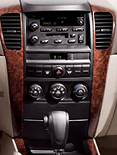
A Truly Global Economy
Making a Radio/CD player
Kia Sorento
One Radio, 5 countries, 5 companies
Notes:
It takes 30,000 parts to make one Kia Sorento.
Tires from Michelin, Shocks from ZF Sachs, 4wheel drive from BorgWarner, Airbags from Autoliv (Sweden), electric motors from Daewoo Electronics, Mirrors from Gentex. Wales, Mexico, Sweden, China, Thailand,
Panasonic Automotive sources optical pickup units which read CDs in China.
These get shipped to Thailand. In Thailand, the mechanical structure and electronic components get added.
The unit is next shipped to Matsushita Communications, Industrial Plant in Reynosa Mexico where additional electronic components are assembled.
The units are then trucked to a Delco Electronics plan in Matamorros, Mexico where all components are assembled into into an audio system.
The audio system is then trucked into California where it is shipped to South Korea for insertion into the car.
The completed car is then shipped to the U.S. where it gets sold.

Slide 16
Four Questions of Global Strategic Management
Why do firms globalize?
What challenges do global firms face?
What determines success in foreign markets?
How do you manage a multinational business?

Slide 17
Motivations for Globalization
Scale economies
Growth potential
Lower factor costs
Vertical integration demands
Opportunities
  Homogenization of global culture
Competitive dynamics
  Defending local markets may require competing globally

Slide 18
Global Challenges
The Liability of Foreignness

Slide 19
It’s a Different World
Geographic Context
  Transportation, education, and communication
Socio-Cultural Context
  Tastes, values and language differences
Industry Contexts
  Competitive rivalry, entry barriers, etc. differences
Political Context
  Regulatory, economic and political differences

Slide 20
Formidable Threats
Currency Risk
  Foreign exchange rates, inflation
Political Risk
  Nationalization of investment, political instability, repatriation of earnings, import/export barriers
Social Risk
  Terrorism, social unrest
Transaction Cost Risk
  Intellectual property protection, contract enforcement, transparency in exchanges

Slide 21
Walmart Enters Germany
Does Small Town America Sell
in Europe?

Slide 22
Wal-Mart Activity System
Local Ctrl over prices
“We Sell for Less”
Efficiency from
Technology
Efficient use of
Floor Space
Low cost
store leases
Hard bargaining
w/ vendors
“Everyday Low
Prices”
Low Prices
Culture Emphasis:
Efficiency
Efficient
Operations
High T/O
Merchandise
Minimal Advertising
Strict Cost
Control
Hub & Spoke
Distr. System
Low Cost
Store Fixtures
Inventory Mgmt
Few Stock outs
Rural
Store Locations
Inbound Logistics:
Back Haul
Greeters”
Customer
Friendly
Low Pay scale
Incentive based
Frequent
Communication
Return Policy
Low in-Store
Licensing Fees
Non-union
Employees
Convenient
Store Hours
The
“Wal-Mart Cheer”
Associate
Satisfaction
“Product Mix”
Customer Demographic

Slide 23
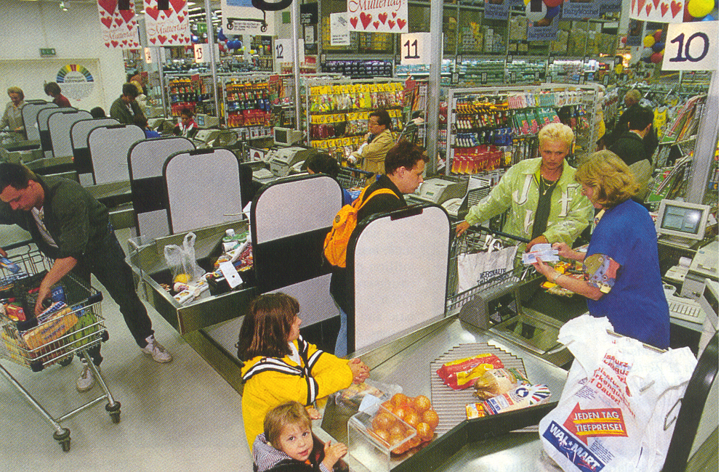

Slide 24
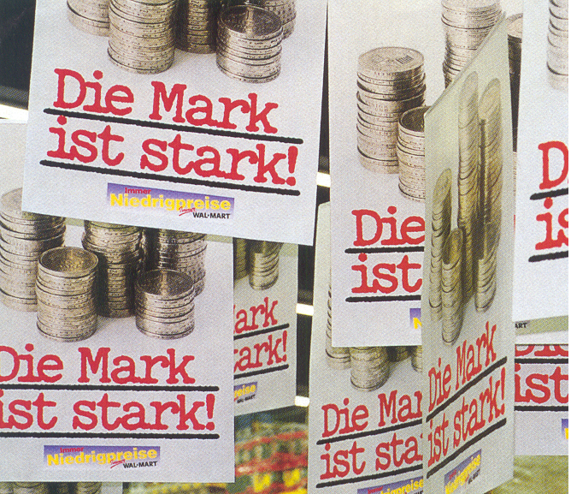

Slide 25
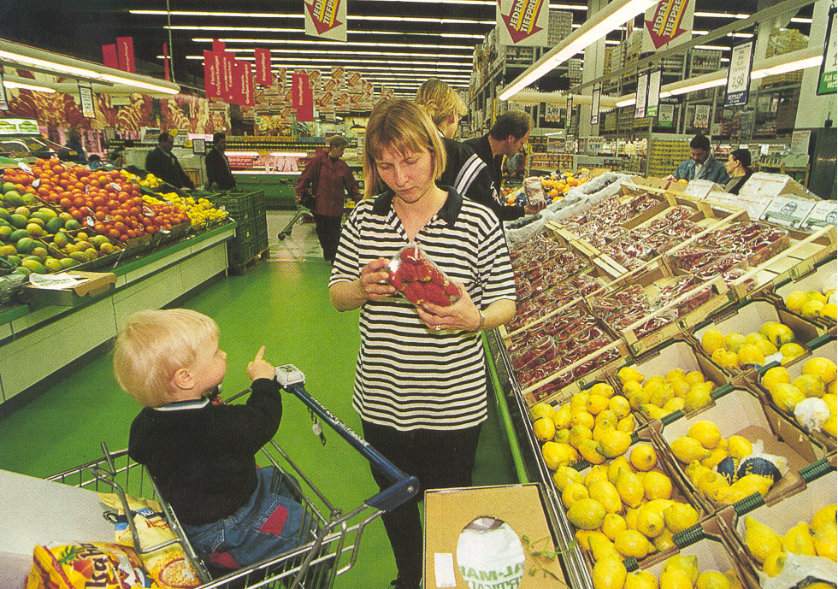

Slide 26
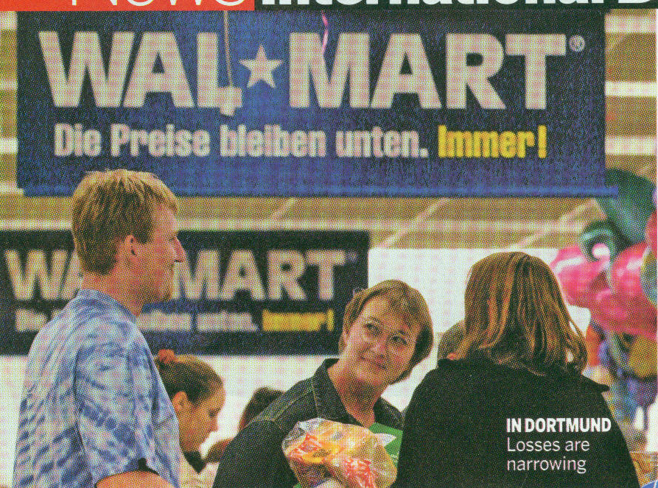
Wal-mart: Wir Übergaben!
Business Week, April 18, 2005
Notes:
Walmart’s performance in Germany of late has not been good. At present they have been forced close some stores (they are down to 91 stores from 95 two years ago). They still only have a 2% market share only turned a profit in 2004, after 7 years. The problem Walmart faces in Germany is partly that they have been unable to duplicate the competitive advantages that has allowed them to grow so rapidly in the US. In particular they don’t have sufficient sales volume in all product lines to give them bargaining power over suppliers. They do have volume advantages in some global product categories such as detergent and toiletries, but this is only a small percentage of the total product line that must be carried in stores in Germany. Most of the products are local, like local foods , and Walmart is at a distinct disadvantage against rivals Aldi (with 19% of the market) and Kaufland (which as five times as many stores as Walmart).
In addition, Walmart has tried to implement its own ethical standards on their employees (e.g., no romantic relations between supervisor and subordinates) which lead to significant conflict with its labor union.

Slide 27
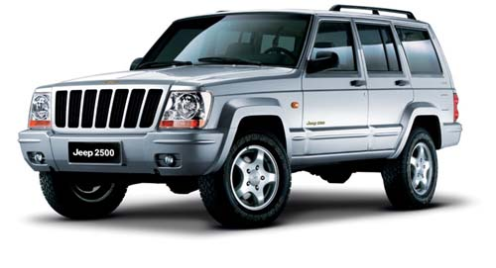
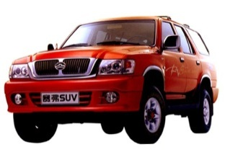
The Chinese Price Advantage
Jeep 2500 (Chrysler Group)
Price: $13,200
3 Domestic Competitors
Average Price: $10,000
158 unit sales
First 2 months of 2005
5,304 unit sales
Combined, First 2 months of 2005
“From Fat Profits to Hardscrabble?” The Outlook for China Car Market 2005-2010, Automotive News China Conference, 20 April 2005 Michael J. Dunne

Slide 28

What Type of Advantages Transfer
Downstream advantages are less transferrable
  Cost structure, product design, or product features
Midstream are moderately transferrable
  Patents, processes, technology, and other assets
Upstream advantages are most transferrable
  An ability to adapt and learn

Slide 29
Institutional Infrastructure
Transaction Costs Rise

Slide 30
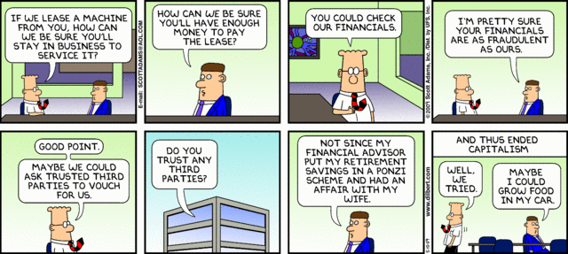
Markets Fail When Exchanges Don’t Occur
Dilbert, May 10, 2009

Slide 31
Market Failures: Institutional voids
Market failure occurs when mutually beneficial transactions do not occur because the cost of performing the transaction is too high.
Transactions costs arise from uncertainty about potential transaction partners, the cost of writing and enforcing contracts.

Slide 32
Transaction Costs: information asymmetry
Those who are information disadvantaged may be reluctant to transact
  the market for “lemons” leads to lower prices offered
  Lower market prices leads to the removal of higher valued goods from the market.
Costly to overcome information asymmetry
  If costs are privately born they may exceed value of transaction

Slide 33
Transaction Costs: Contracting costs
Long-term relationships in dynamic settings.
  A 5-yr contract to build an aluminum smelter in Botswana.
Relationship-specific investments, including all upfront costs to service the partner.
  Creates a potential for “hold-up.”
  Building a railroad spur to an auto plant.
Unclear property rights.
  especially true for intangible assets like knowledge, ideas, innovations.
  Who owns the rights to an idea for a movie?

Slide 34
Transaction Costs: Lack of public goods
Absence of impartial courts
Absence of laws protecting property rights
Absence of political will or ability to enforce laws
Absence of reliable economic facts!
  Hernando de Soto (Bloomberg Businessweek, 4/28/2011)
    The Mystery of Capital: Why capitalism triumphs in the west and fails everywhere else
  Douglass North (Institutions, Institutional Change & Economic Performance, 1990)

Slide 35
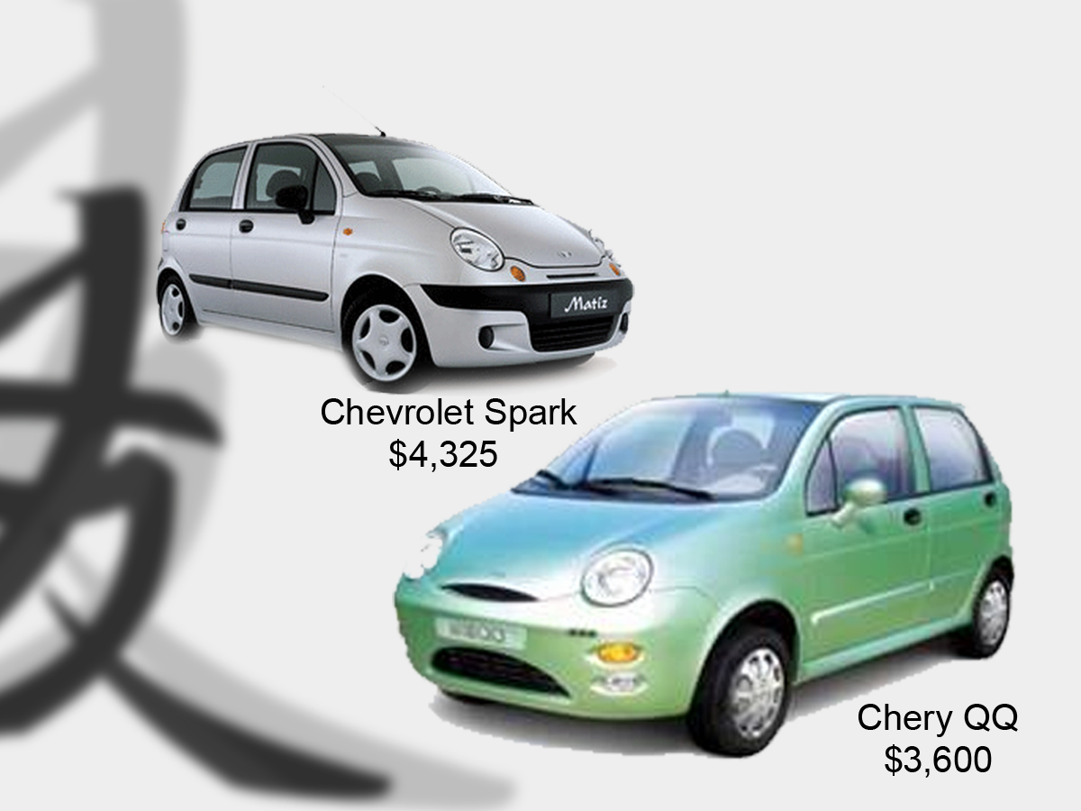
IP Protection in China?

Slide 36
Overcoming Market Failure
Bring transactions into the firm (i.e., hierarchical control)
  Prevents transaction parties from walking away
  Reduces “property rights” problem
  Provides enforcement mechanism
  Reduces information asymmetry

Slide 37
Overcoming Market Failure
Clustering of firms in geographic regions
  Frequent intra-group trading increases information
    Finding a key resource is more likely (e.g., talent)
  Tight communities discourage deviant behavior among rivals
    Informal networks develop to share information
  Lower risks of hold-up, hence more up-front investment
    Locate where there are many players

Slide 38
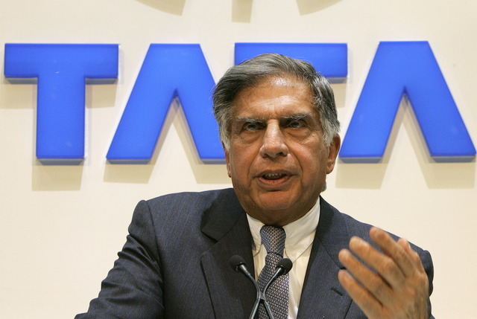
Overcoming Market Failure: Business Group
Family ties reduces information asymmetry, increases trust
Creates an internal private capital market
Interlocking ownership provides enforcement mechanism

Slide 39
Tata Group Holdings, 1997
Company | Tata Sons’ Stake | Total Holdings*
Tisco | 8.5% | 15.0%
Telco | 2.9% | 15.2%
Tata Power | 6.4% | 20.0%
Tata Chemicals | 8.2% | 29.6%
Tata Tea | 8.6% | 29.0%
Indian Hotels | 14.5% | 37.0%
ACC | 11.2% | 12.0%
*Includes all cross-holdings

Slide 40
Tata Board Interlocks Among Directors
Company | Chairman | Board Size | Dir. Overlap
Tata Sons | Ratan Tata | 16 | 13
TIL | Ratan Tata | 16 | 12
Telco | Ratan Tata | 11 | 5
Tisco | Ratan Tata | 11 | 4
Tata Chem. | Ratan Tata | 10 | 3
Tata Tea | Ratan Tata | 8 | 1
Tata Power | Ratan Tata | 6 | 1
Indian Hotels | Kerkar | 11 | 6
ACC | N. Palkhivala | 11 | 4

Slide 41
Nature of Business Groups
Business groups are not a legal entities
  Loose alliance of companies
Each individual company is legally independent
  Several companies are likely to be publicly traded
Group members hold ownership in each other

Slide 42
Development of Intermediation
As public sources of intermediation develop, the need for business groups declines.
  Active and reliable markets for labor, capital, technology, human resources etc.
  Government enforcement of contracts & property rights
  Independent sources of information about transaction partners
  Hence, the value added from being in a business group declines

Slide 43
Managing Multinational
Balancing Economics and Socio-Politics

Slide 44
Economic Demands to be Competitive
Improve efficiency by streamlining operations
Achieve economies of scale
Coordinate R&D efforts
Share assets and knowledge as much as possible
Transfer people and knowledge

Slide 45
Socio-Political Demands to be Responsive
Be responsible to local government demands
  jobs and taxes
Adjust to different regulatory setting
  restrictions on competitive practices
Recognize cultural differences
  product design and placement
  human resource practices

Slide 46
Balancing Demands with a Transnational Strategy
Balances cost with differentiation benefits
Balance global efficiency and competitiveness with national-level responsiveness and flexibility
Cross market capacity to leverage learning
Team Organization Structure
  business manager
  country manager
  functional manager
  corporate manager

Slide 47
Summary
Strategic management seeks to generate economic rents by exploiting market imperfections
  Controlling supply, owning valuable resources or creating market disruptions
Foreign markets offer opportunities to leverage existing resources and forestall competitive threats
  Growth opportunities, leverage capabilities, forestall competitive threats
  Transferring advantages across national boundaries is risky and costly

Slide 48
Summary
Foreign markets present unique risks
  Liability of foreignness, lack of critical infrastructure, and threat of opportunism
  Political risks including investment and foreign exchange risks
Managing a multinational firm requires balancing economic and political imperatives
  Global efficiency versus satisfying unique local demands
  Managing the tension between corporate headquarters and local subsidiaries

Slide 49
Global Strategic Management
“I don’t think we’re in Kansas anymore, Toto.”
--Dorothy, Wizard of Oz

