Slide 1
Seven Themes of Highly Successful Exporters
Exporting is a key to growth
Exporting companies are good at business fundamentals
The world is flat so embrace competition
Make it in the U.S.A.
The Immigrant Myth that isn’t
Engage government assistance programs
Rich learning = Better companies, products and services

Slide 2
The Hero and Heroine Myth
The American narrative of the lone entrepreneur

Slide 13
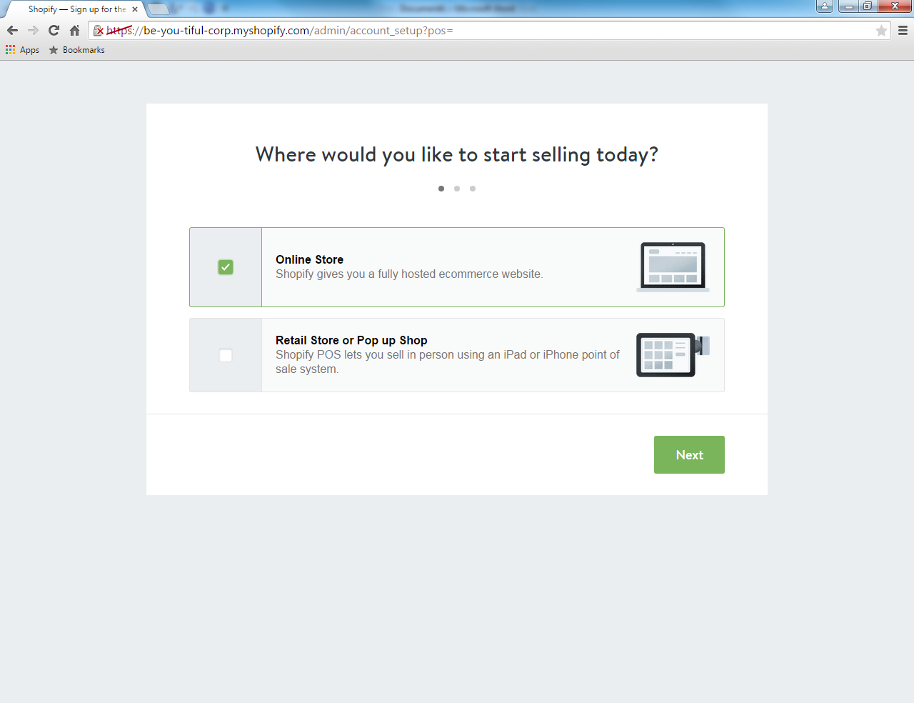
Notes:
After you have googled “E-Commerce websites” Shopify is one of the first websites that pop up on your search engine. You will prompted to register for an account by providing email, password, and a store name. Following you will be taken to this screen, which ask “where would you like to start selling today?” you may choose online or retail. Choose whichever you believe is applicable to your organization.

Slide 14
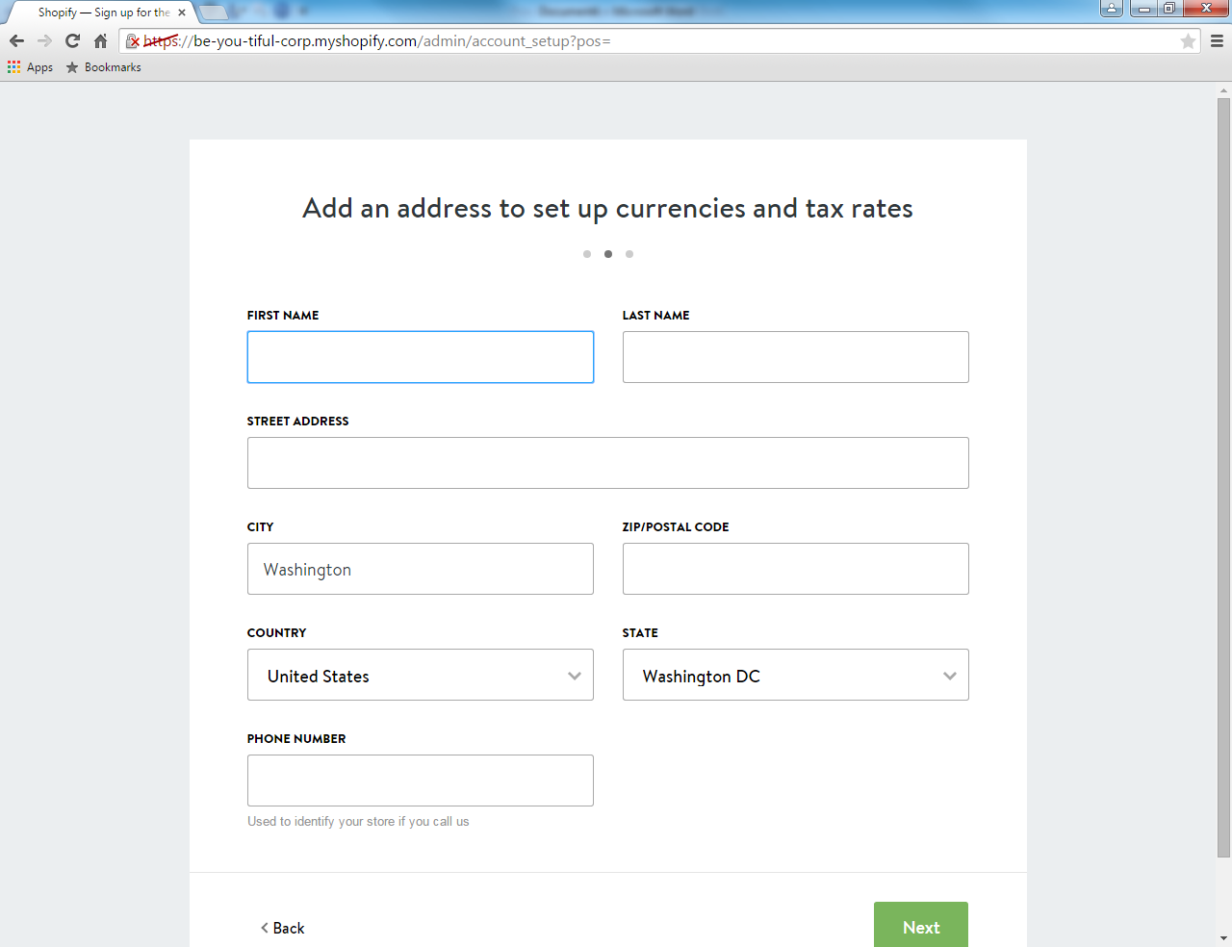
Notes:
Next, you will be guided to a second screen asking to fill out personal information.

Slide 15
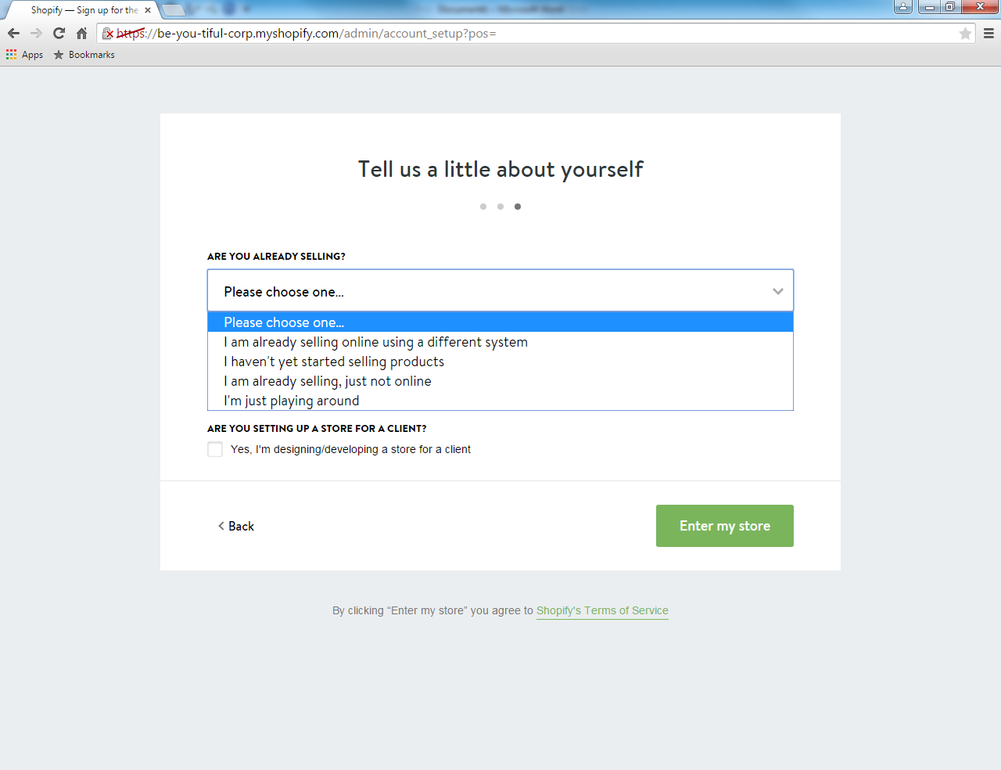
Notes:
The third and final step before being sent to the main menu/main portal. You will be asked two questions about your business. Please answer according.

Slide 16
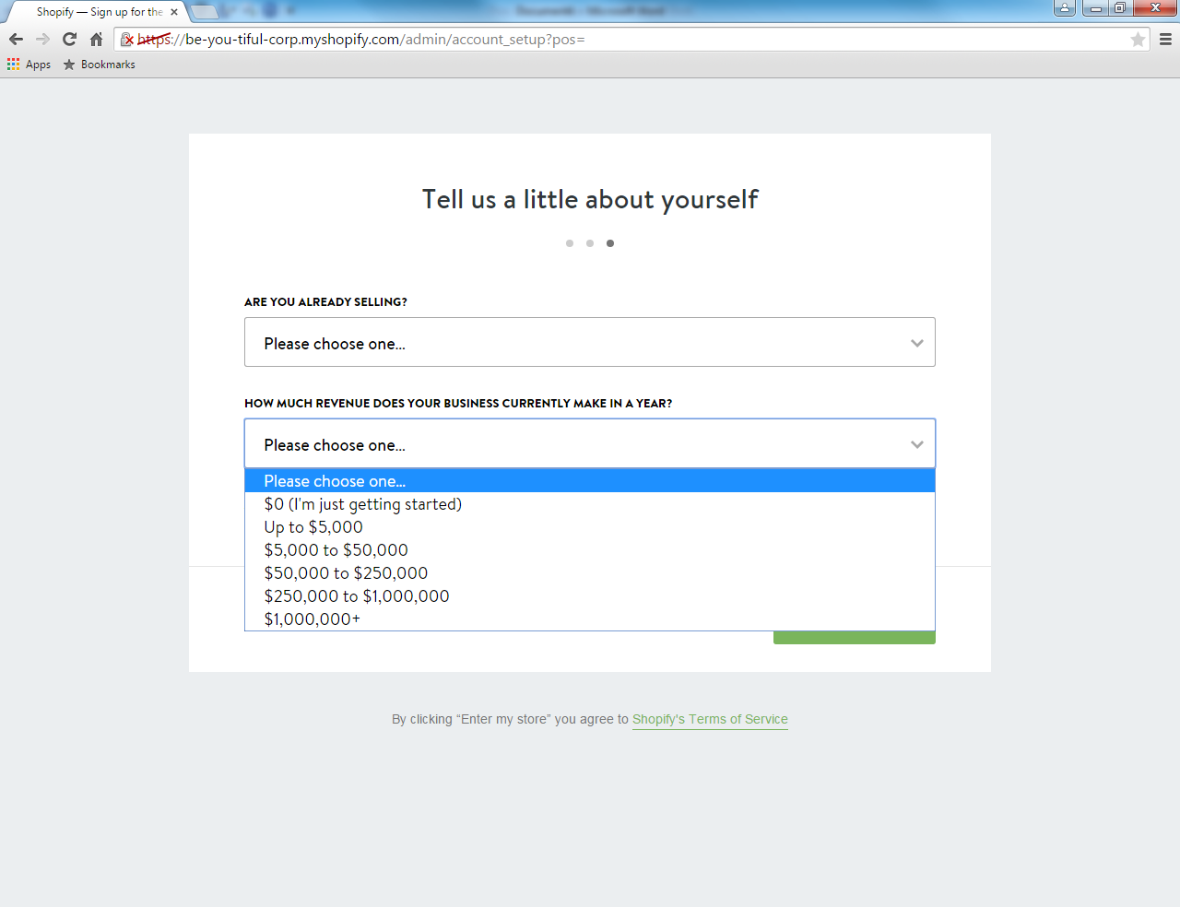

Slide 18
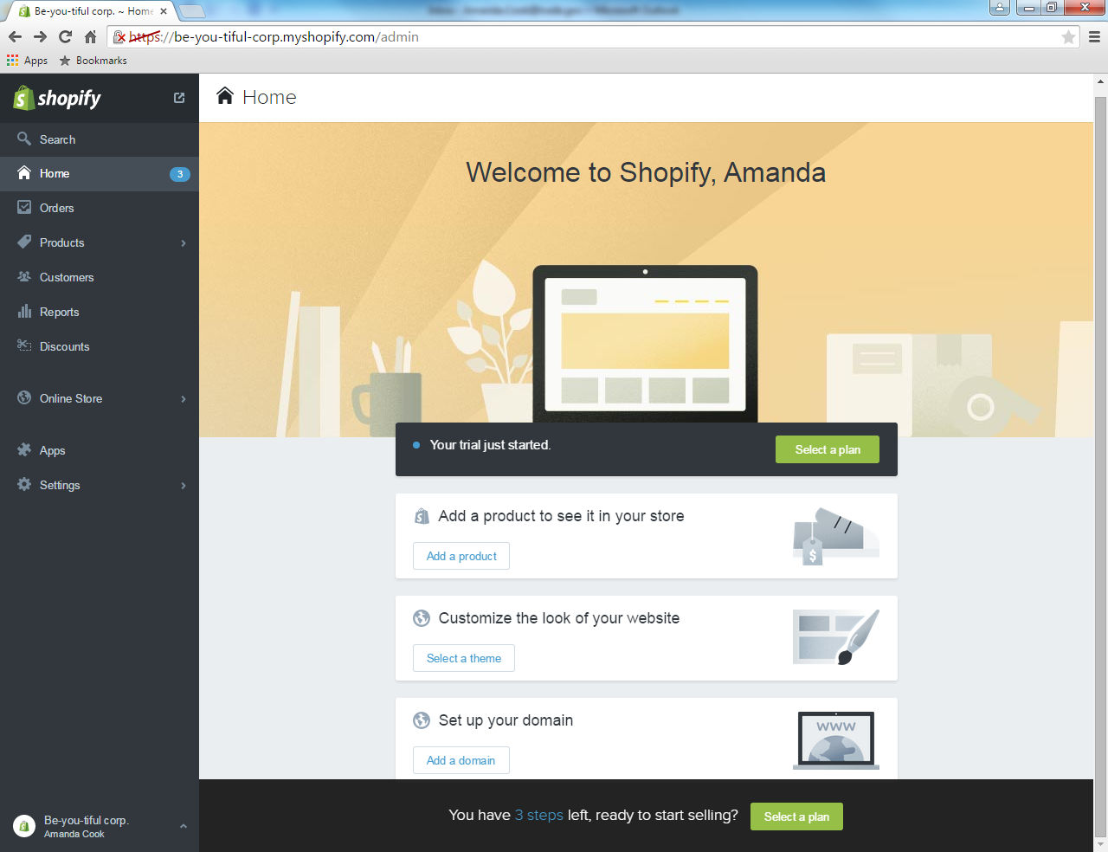
Notes:
This is the main menu/main portal. 3 steps are required in order for you to get started. Add products, Customize your website, and set up a domain name.

Slide 19
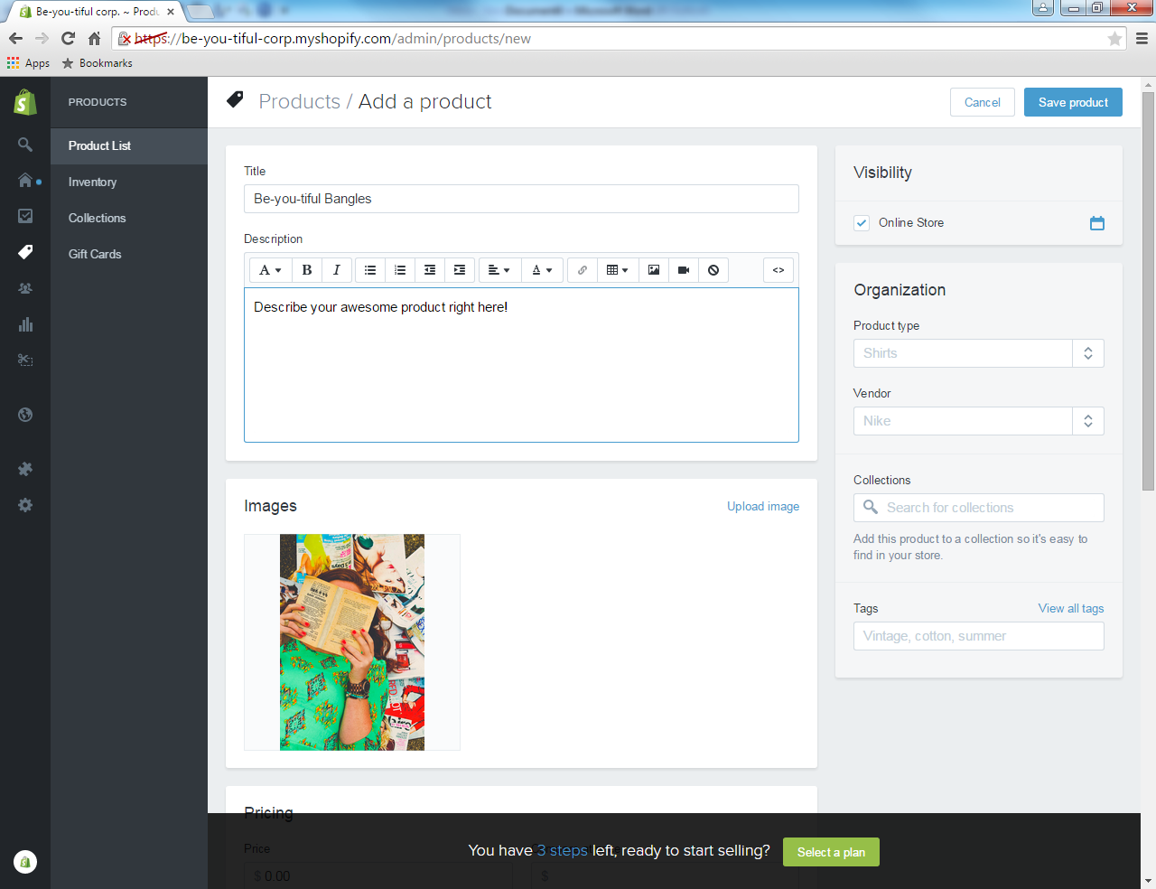
Notes:
The first one I clicked on was add a product . You can create the title of your product and a description. You can put any image you would like in the Images box. No pre-loaded images are on this software,Shopify , but you are able to upload whatever you may like. You are able to sell any product on this site. Shopify even enables you to have gift cards and create collections for your products.

Slide 20
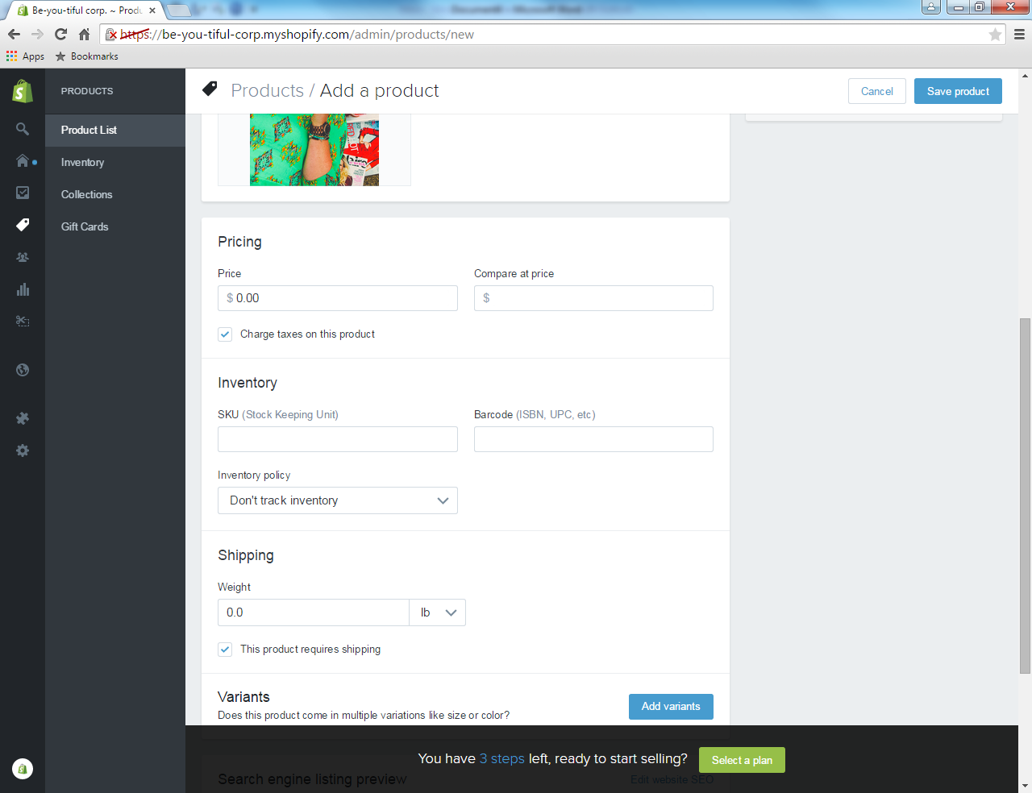
Notes:
As you scroll down on the same page, you will see pricing, inventory, and shipping. You can enable features like charge taxes on that specific product.

Slide 21
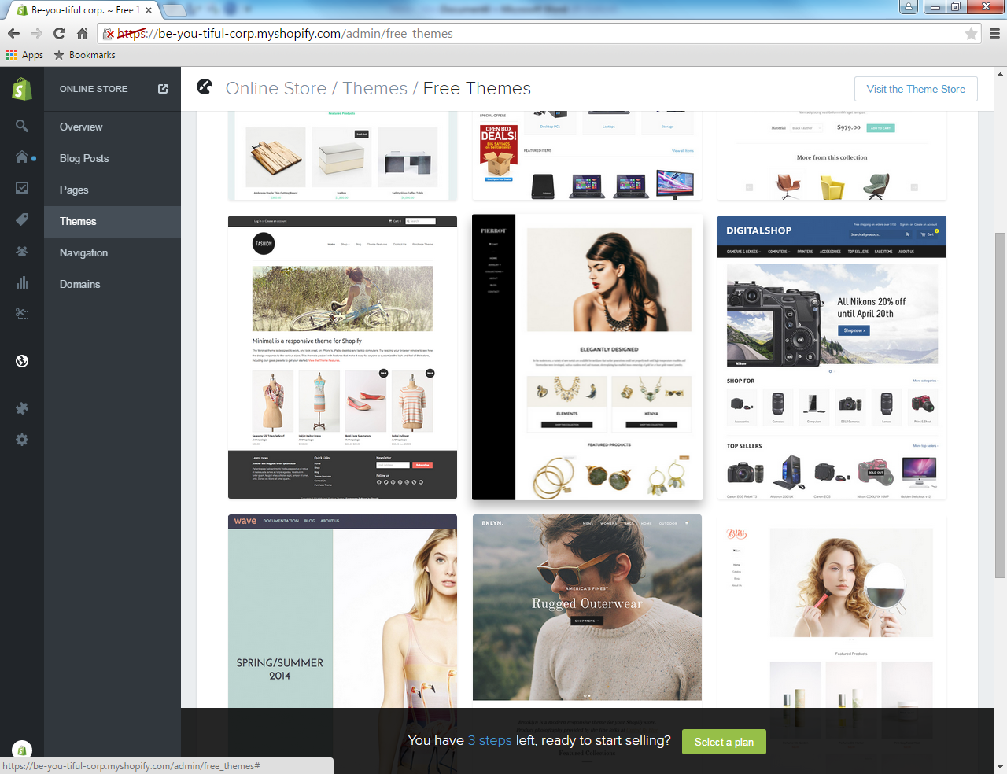
Notes:
After saving your first product, you will be guided back to the main portal. You will may then go and customize your “theme” for your website. Shopify has around 30 themes that are free to use. You may also buy themes through shopify. Themes costs vary.

Slide 22
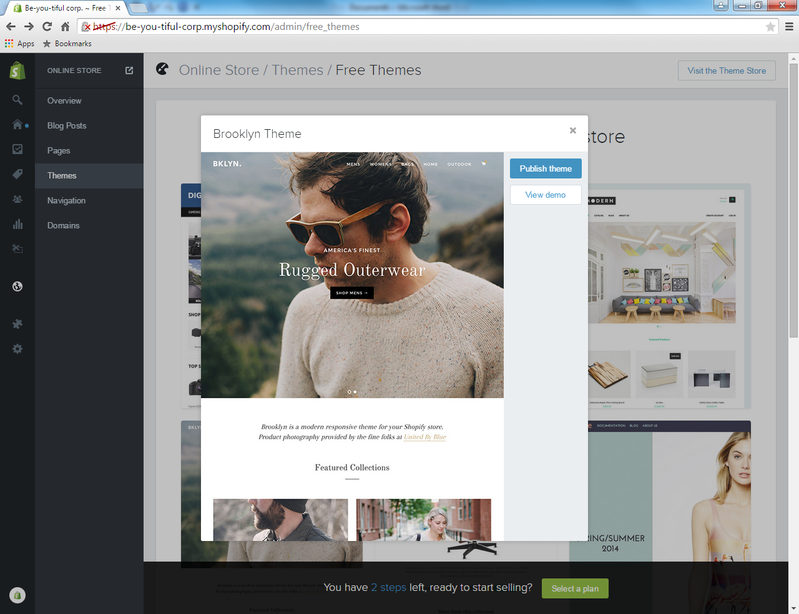
Notes:
To use a free theme, just click publish and the theme will be applied to your shopify website.

Slide 23
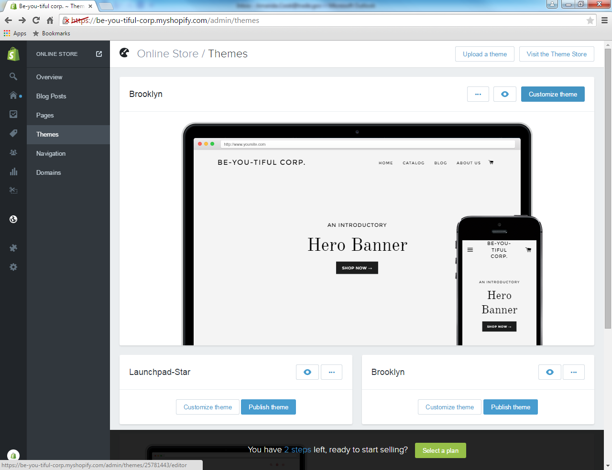
Notes:
After you have chosen a specific theme, you have the ability to customize your theme with your own pictures and sayings.

Slide 24
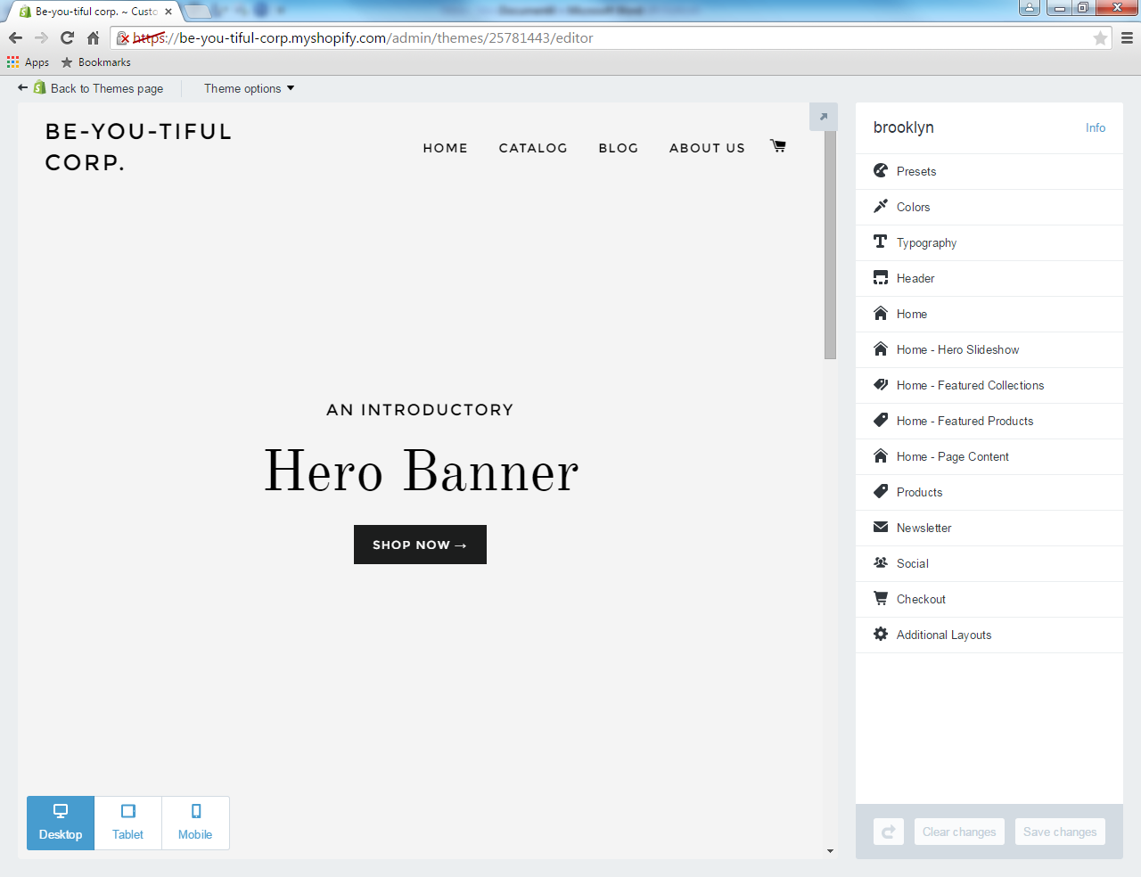
Notes:
This is the home of you customizing your theme for your online shop. You have the ability to change colors and upload your logo on this page. If you know html, you may edit the themes in “theme options” at the top left of the webpage.

Slide 25
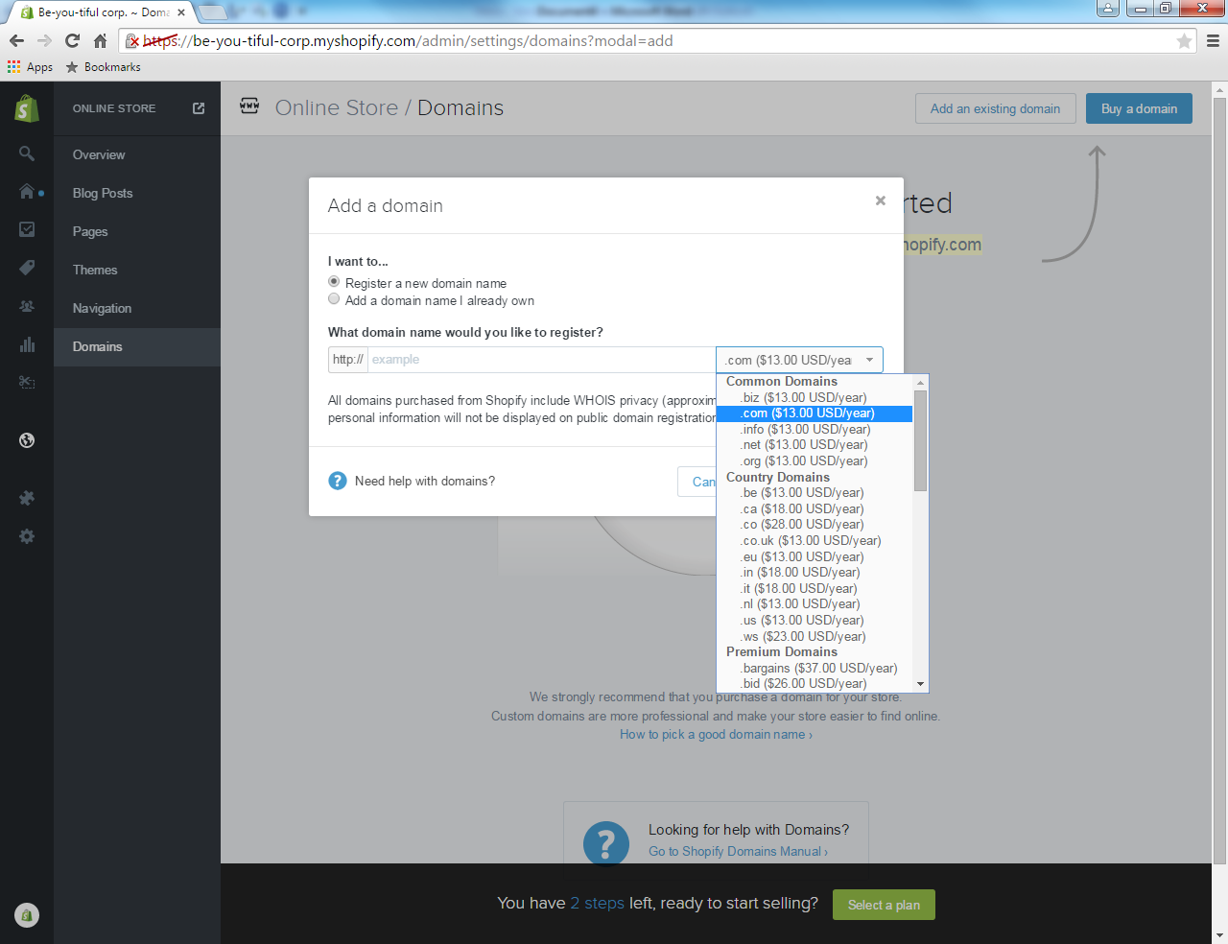
Notes:
The final step is creating a domain name. For a small fee, you are able to create a domain name. This gives you access to not only local markets but international markets. While the administrative interface of the shop is in English, your shop may be written in different languages.

Slide 26
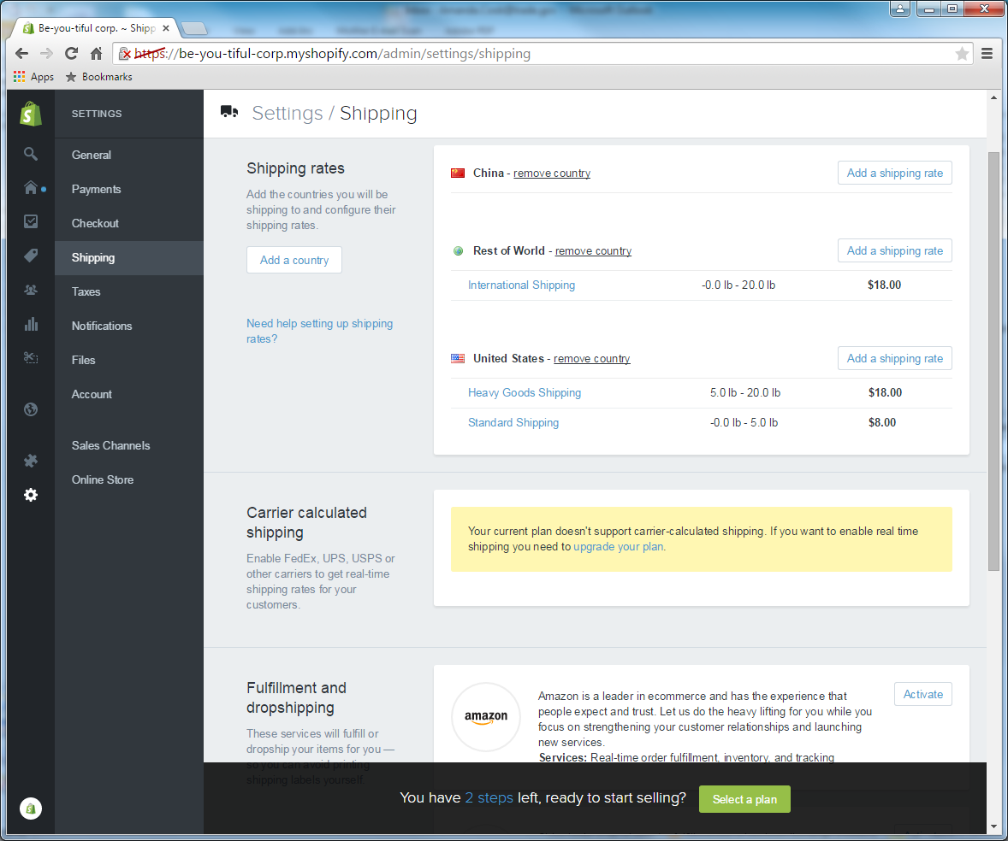
Notes:
In the settings tab, if you click under shipping, you will be able to set up international shipping rates. This shipping tab also connects you with different fulfillment and drop shipping services.

