Slide 1
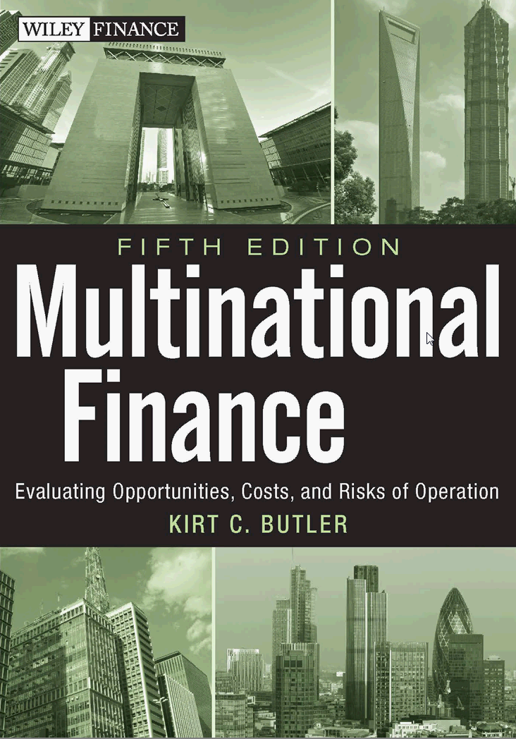
International finance
with selected topics from Multinational Finance
by Kirt C. Butler
5th edition, 2012, Wiley & Sons
- Multinational corporate finance
- Capital markets
- Foreign exchange (FX) and risk management
Notes:
This quote describes the approach of the book. International finance is a difficult and complex subject, but we ignore the complexity at our peril.
The statement on the slide is Einstein’s version of Occam's razor, which can be paraphrased as:
“Of two competing theories that make exactly the same predictions, the simpler theory is the better.”
Occam's razor is attributed to the 14th century logician and Franciscan friar William of Occam.

Slide 2
A starting point…
Financial management refers to the efficient and effective management of funds in such a manner as to accomplish the objectives of the organization, including how to raise & allocate capital. (Wikipedia)
Multinational financial management is financial management conducted in more than one cultural, social, economic, or political environment (Butler)
Notes:
Financial management refers to the efficient and effective management of funds in such a manner as to accomplish the objectives of the organization. It includes how to raise and allocate capital. …from Wikipedia
The multinational financial manager must be sensitive to cultural differences in the conduct of both professional and personal life. Failing to accommodate cultural patterns and expectations can obstruct negotiations and result in hostility and mistrust even if both counterparties have the best of intentions.

Slide 3
Multinational Finance
by Kirt C. Butler
Multinational
corporate
finance
Parity
conditions
Capital markets & investments
Financial risk management

Slide 4
Why it’s important
An appreciation of the domestic currency increases domestic purchasing power
  This is good for importers because it increases their purchasing power in international markets
  This is bad for exporters as it increases the price of their outputs in international markets
A depreciation of the domestic currency decreases domestic purchasing power
  This is bad for importers because it reduces their purchasing power in international markets
  This is good for exporters as it decreases the price of their outputs in international markets
The impact on you depends on who you are…
Notes:
Note that operating (noncontractual) exposures are to real exchange rates, whereas transaction (contractual) exposures are to nominal exchange rates.

Slide 5
Multinational corporate finance…
Vivé la difference
Multinational finance is interdisciplinary across the various fields of business
  - Language & culture - Human resource management
  - Accounting - Marketing
  - Distribution - Logistics
  - Financial markets - Corporate governance
  - Business conventions
  (laws, taxes, accounting, regulatory, etc.)
as well as within the field of finance
Notes:
Cultural differences create additional costs and risks for multinational operations. This increases business risks.
Example: GM tried to sell the subcompact Nova in Mexico - literally translated, “no va” means “it goes not.”
Consequently, multinational financial managers must be experts in finance, as well as knowledgeable in a variety of related business disciplines.
Indeed, the term “an expert in multinational finance” is an oxymoron, like “jumbo shrimp” or “military intelligence.”

Slide 6
The notes I handle no better
than many pianists,
but the pauses between the notes…
ah, that is where the art resides.
Arthur Schnabel
Notes:
It is the linkages between the various business disciplines that make the opportunities and challenges of international business and finance both more interesting and more difficult than those of “domestic” business.

Slide 7
Country risk is the risk that the business environment in a host country will unexpectedly change
  Political risk is the risk that a host government will unexpectedly change the rules of the game under which businesses operate
  Financial risk refers more generally to unexpected events in a country’s financial, economic, or business life
Notes:
Examples…
Expropriation risk – Assets have been expropriated after revolutions in Iran, Chile, Venezuela, and elsewhere.
Disruptions in operations – are much more common than expropriation and can happen even in peacetime.
Protectionism - e.g., French champagne versus “champagne-method” wine, “purity laws” for German beer, Japanese rice protections
Blocked funds - funds that cannot be immediately remitted to the parent company.
Loss of intellectual property rights - particularly problematic in developing and transitional economies, such as China and the former states of the Soviet Union.

Slide 8
Assessments of country risk
  Aon Risk Services political risk/terrorism
  Bank of America forecasts/outlooks
  BERI political/operational/repatriation
  Coface Group country/political/financial
  Dun and Bradstreet payment risk
  Economist Intel Unit political/policy/lending
  Euromoney political/fin/econ/composite
  Institutional Investor credit ratings
  Moody’s Investor Services sovereign debt
  Political Risk Services pol/fin/econ/composite
  Standard and Poor’s sovereign debt

Slide 9
Country risk assessments (coface.com)
Africa Asia Europe Mid-East Americas
A1 - Japan HK Germany - Canada
Singapore Switzerland USA
A2 - Australia Denmark Kuwait Chile
S. Korea Finland UK Qatar
A3 Mauritius China France Israel Trinidad
Namibia Netherlands Oman UAE
A4 Morocco India Czech Rep. Bahrain Brazil Mexico
S Africa Indonesia Spain S. Arabia Panama Peru
B Kenya - Hungary Italy Jordan Ecuador
Tunisia Portugal Turkey El Salvador
C Congo Mongolia Greece Egypt Argentina
Nigeria Vietnam Russia Lebanon
D Libya Sudan Afghanistan Belarus Iraq Venezuela
Zimbabwe Pakistan Bosnia Iran Cuba
NR Somalia N Korea - - -
Notes:
This figure shows Coface Group’s country risk rankings from January 2015.
See their Website www.coface.com for current rankings.
Coface ratings measure average default risk on corporate payments, and reflect local business, financial, and political outlooks.

Slide 10
Intellectual property rights
  A patent is a government-approved right to make, use, or sell an invention for a period of time.
  A copyright prohibits the unauthorized reproduction of a creative work.
  A trademark is a distinctive name, word, symbol, or device used to distinguish a company’s goods or services.
  A trade secret is an idea, process, formula, device, technique, or information that a company uses to its advantage.
Notes:
Patents – Most countries follow a “first-to-file” policy for patents.
The U.S. is changing from a “first-to-invent” to a “first-to-file” policy in 2013.
U.S. patent protection is for 20 years. Most countries are for less.
Copyrights – Copyrights are protected in the U.S. for the life of the creator, plus an additional 70 years.
Trademarks – Most countries follow a “first-to-file” policy.
The U.S. is changing from a “first-to-invent” to a “first-to-file” policy in 2013.
Trademarks are protected in the U.S. as long as they are in active use.
Trade secrets are protected in the U.S. as long as the owner takes reasonable steps to maintain secrecy.
Just for fun (not in the text )
The Copyright Term Extension Act of 1998 increased the length of U.S. copyright protection to include the life of the author plus 70 years.
The act is sometimes called the “Mickey Mouse Protection Act” in reference to the Walt Disney Co.’s lobbying efforts to achieve extended protection of its early works.
Disney’s use of Mickey Mouse as a trademark is protected as long as the trademark is actively in use.

Slide 11
Moving $s today into €s tomorrow
Capital markets: Space and time
Invest in dollars
V₀$
Convert to euros at S₀$/€
Convert to euros at F_{t}$/€
V_{t}€
Invest in euros
Time 0 Time t
Eurocurrencies (e.g., Eurodollars) are bank deposits & loans residing outside the country that issued the currency
Notes:
These transactions illustrate why we need to study currency and Eurocurrency markets.
Eurocurrency interest rate markets allow us to move value forward or backward in time within a particular currency.
Currency (foreign exchange) markets allow us to move value from one currency to another at a particular point in time.
These markets compliment one another.
If the international parity conditions described in Chapter 4 hold, then the values of the two paths are equal.
Note that the same algebra applies in the opposite direction when moving euros from a future period back toward dollars today.

Slide 12
The foreign exchange (FX) market
Volume
  On average, more than $5.3 trillion trades each day through commercial banks
  Only 38% is in spot contracts, with the remainder in forward or swap contracts
Spot market
  Immediate exchange of currencies
Forward and swap markets
  Exchange at prearranged dates and prices
Notes:
Average volume was $5.345 trillion per day in the April 2013 Bank for International Settlements (BIS) survey.
For comparison, U.S. gross national product in 2014 was around $17 trillion.
About 56% of FX volume is conducted in the forward or swap markets.
The inter-bank market comprises about 75% of all transactions.
The major banks’ remaining business is with retail customers including governments, business, and smaller financial institutions.
Dealers earn their profit on the bid-ask spread.
Spreads depend on 1) the size of the transaction, 2) the volatility of the exchange rate, and 3) liquidity in the market.
Efficiency: Bid-ask spreads on large transactions in the interbank market are very small (the market is operationally efficient).
Bid-ask spreads transactions at retail stores can be as high as 20%.
Visa and Mastercard charge fees of about 3% on international transactions.
It can be hazardous to use a credit card in some countries. For example, merchants in Nigeria have charged customers for phantom purchases through off-shore shell corporations set up to deceive the customers.

Slide 13
Exposures to FX (currency) risk
FX risk exposure refers to a change in firm value due to unexpected changes in FX rates
Transaction exposure to FX risk
  change in the value of contractual cash flows
Operating exposure to FX risk
  change in the value of non-contractual cash flows arising from the firm’s real assets
Contractual assets
Contractual liabilities
Equity exposure
= net transaction exposure
+ operating exposure
Real assets
Common equity
Notes:
Net monetary assets = monetary assets - monetary liabilities
Monetary assets and liabilities that are denominated in the domestic currency are not exposed to currency risk.
Real assets may be exposed to currency risk regardless of where they are located.
Equity exposure is the sum of the transaction exposure of net monetary assets plus the operating exposure of real assets.
Translation exposure (accounting exposure) refers to changes in financial statements due to unexpected changes in exchange rates.
Translation exposure to currency risk may or may not be related to an underlying transaction or operating exposure.

Slide 14
Managing transaction exposure
Forward hedge of a long pound exposure
Underlying position
(long pounds)
Sell pounds forward
(short pounds and long dollars)
Net position
Net pound exposure
+£100,000
+$150,000
−£100,000
+$150,000
$ value of position
_{short pounds}
_{long pounds}
Value of the £
Notes:
This example takes a U.S. perspective toward the exposure of a British pound cash inflow.
In the forward contract, the foreign currency is being sold.
Foreign currency cash outflows are negatively exposed to foreign currency values.
Hence, the slope of the risk profile is negatively sloped.
The forward contract provides a perfect hedge because the values of both the underlying exposure and the forward contract are derived from the same underlying asset price - the dollar value of the pound.

Slide 15
Operating exposures to currency risk
Revenues
Local
Global
Local
Domestic firms
Exporters
(0)
(+)
Operating
expenses
Global MNCs &
importers/exporters
in competitive
global markets
(?)
Global
Importers
(-)
Notes:
“Classic” operating exposures to currency risk
Domestic firms buy and sell locally when local markets are segmented from foreign markets.
Importers buy globally and sell locally.
If the local market is segmented from other markets (as in the southwest quadrant), the importer will have a negative exposure to foreign currency values.
Exporters manufacture locally and sell globally.
If the local market is segmented from other markets (as in the northeast quadrant), the exporter is positively exposed to foreign currency values.
Multinational corporations (and importers/exporters operating in competitive world markets) buy and sell in global markets and are hence sensitive to foreign currency values.

Slide 16
Managing operating exposure
Leverage the MNC’s ability to respond to differences in real exchange rates
Plant location: Gain access to low-cost labor or capital resources
Product sourcing: Shift production to countries with low real costs
Market selection: Shift marketing efforts toward countries with higher demand or “overvalued” currencies
Notes:
The real exchange rate measures a currency’s purchasing power relative to another currency or currencies.
Diversification (whether product market or geographic) provides the MNC with flexibility in its sourcing, production, and marketing decisions.

Slide 17
Treasury management in practice
Active management of currency risk
Bodnar, Hayt, and Marston, “1998 Wharton Survey of Financial Risk Management by U.S. Non-Financial Firms,” Financial Management (1998).
Notes:
It is difficult to distinguish between active risk management and speculation.
The 1996 Wharton Survey asked managers if they speculated on currency values. Almost everyone answered “No.”
The 1998 survey was more specific in asking whether managers took active positions and what types of active positions they took.

Slide 18
A classroom exercise to simulate the foreign exchange market
Learning objectives
To develop practice in dealing with foreign exchange
To develop intuition regarding market forces, including arbitrage
Market Participants
Dealers make a market in fx; that is, quote bid and offer (or ask) prices
Traders trade for their own account
Notes:
Here are some alternatives for making the game more interesting:
Students are often uncertain of what to do at the start of the game. To get things rolling, I often jump in and make a few trades myself. The more aggressive students quickly follow this example. The rest of your time during the game can be spent answering students’ questions.
In large classes, try separating the class into Eastern and Western markets. Let the markets trade independently for a time. About halfway through the game, confer “world-speak” on some of the more successful traders so that they can trade in either market. Cross-market arbitrage usually yields bigger profits than arbitrage between the banks in a single market. This can be brought out in the post-game analysis.
If dealers refuse to move their prices so that arbitrage is not possible, quietly identify one of the banks as the U.S. Fed. Have the Fed “defend its currency” with artificially high bid and offer quotes for the dollar. The U.S. Fed will eventually run out of foreign exchange reserves as traders sell dollars to the bank at the inflated price (and the bank is forced to buy dollars with its fx reserves). The speed with which this happens can be analyzed after the game. (This is one of the reasons why I insist the fx dealers keep track of their cumulative balances.)

Slide 19
Rules of the game
“Buy low and sell high”
One contract ≡ One million U.S. dollars
Trades can be for up to 10 contracts
Record each transaction as a purchase or sale
Maximum bid-offer spread is 1 basis point
(1 bp = €0.0001/$)
Dealer quotes are good for 2 minutes
Notes:
The small bid-ask spread ensures at least some arbitrage opportunities for the traders in the game.

Slide 20
Buy low and sell high
Bank A: “€0.8220/$ bid and €0.8221/$ ask”
Bank B: “€0.8222/$ bid and €0.8223/$ ask”
Bank A Bank B
€0.8223/$ ask
€0.8222/$ bid
Buy from A
Sell to B
€0.8221/$ ask
Arbitrage profit
€0.0001/$
€0.8220/$ bid
Notes:
I introduce this series of slides (“arbitrage profit in the fx market) before playing the foreign exchange game so that students understand their objective (buy low and sell high).
Note that the bid-ask spread is a reflection of operational efficiency in the fx market. Both speculation and arbitrage of price discrepancies serve to promote informational efficiency.

Slide 21
Riskless arbitrage profit
  Buy 1 million dollars from Bank A at their €0.8221/€ ask price
  Sell 1 million dollars to Bank B at their €0.8222/€ bid price
Arbitrage Profit
= (€0.0001/$)($1 million)
= €100 with…
Arbitrage Profit
= no net investment and no risk
Notes:
This example is designed to illustrate the mechanism of arbitrage and its effect on market prices.
With daily volume of more than $5.3 trillion in the most recent (April 2013) survey by the Bank for International Settlements, this type of arbitrage simply does not exist in the interbank fx markets.
Opportunities that do exist are usually speculative in nature.

Slide 22
Sample foreign exchange ledger
$1 million €/$ Cumulative
Counterparty contracts price balance
1 Deutsche Bank BUY 1 0.8221 +1
2 Citi BUY 3 0.8222 +4
3 Barclays SELL 2 0.8223 +2
4 UBS AG SELL 4 0.8223 -2
5 . . .
Notes:
Insist that students indicate whether they are buying or selling dollars, and that they keep track of their cumulative dollar balances.
Don’t bother with a closing transaction. Go right to post-game analysis and let the students’ share their observations and trading experiences.

Slide 23
Opening prices:
€0.8221/$ BID & €0.8222/$ OFFER
News announcements
The U.S. Fed and the European Central Bank announce that they are coordinating their efforts to euros in an effort to stabilize the value of the euro
The European Central Bank announces that in an effort to stimulate economic activity it is lowering short-term Eurozone interest rates
The European Central Bank reports that Eurozone money supply increased by €1 billion more than expected in the most recent quarter
Notes:
Post-game comments:
After the game, ask students to share their observations, trading strategies, or experiences. Emphasize the role of arbitrage in forcing dealers’ bid-ask quotes into conformity.
After students have discussed their experiences, summarize the game with the following observations:
Information moves prices.
Arbitrage enforces the law of one price.

Slide 24
The Impact of News Events
The Fed and ECB announce that they are buying euros in an effort to stabilize the value of the euro
Supply and demand for the euro
As the demand for euros rises, the dollar will depreciate and the spot rate S€/$ will fall
S€
P'€
P€
D'€
D€
Q€
Notes:
If the euro goes up in value, the dollar must go down against the euro.
This is a simple and intuitive result so long as students remember Rule # 2:
“Always think of buying or selling the currency in the denominator of a foreign exchange quote.”

Slide 25
The Impact of News Events
The ECB announces that in an effort to stimulate economic activity it is lowering short-term Eurozone interest rates
This makes it easier for European businesses to borrow and increases economic activity. If this also increases euro inflation, then the value of the euro should fall. This will result in an appreciation of the dollar against the euro.
An increase in the domestic discount rate usually, but not always, leads to an increase in the value of the domestic currency.
Notes:
The impact of this is a little less obvious than the impact of the first news item. Students’ understanding usually depends on the extent of their previous coursework in macroeconomics.

Slide 26
The Impact of News Events
The ECB reports that Eurozone money supply increased by €1 billion more than expected in the most recent quarter
This would appear to result in a larger supply of euros and hence a lower value for the euro. However, the increase in the money supply has already occurred and should already be reflected in the market price of the euro.
On the other hand, if the ECB is likely to increase the discount rate to slow down the economy, then the euro could rise in anticipation of this monetary policy.
If the euro rises against the dollar, then the dollar will fall against the euro.
Notes:
The impact of this bit of news is a bit more subtle than that of the previous two news items.
For this reason, I sometimes omit this item entirely in undergraduate classes or when I am short of time.

