Slide 1


INTERNATIONAL
ENTREPRENEURSHIP:
Birthing, Breeding, or Converting
To Educate - To Aide - To Inspire
Entrepreneurial Ideas
2015 Biennial International Business Institute for Community College Faculty
F. Samuel Carter
Associate Professor
Department of Marketing
Institute for Entrepreneurship

Slide 2

Assuming the International Entrepreneurship Course is ‘late’ in the curriculum, what are its unique value adding areas of content.

Slide 3

AGENDA
PERSPECTIVES
PROBLEMS
PROCEDURES

Slide 4
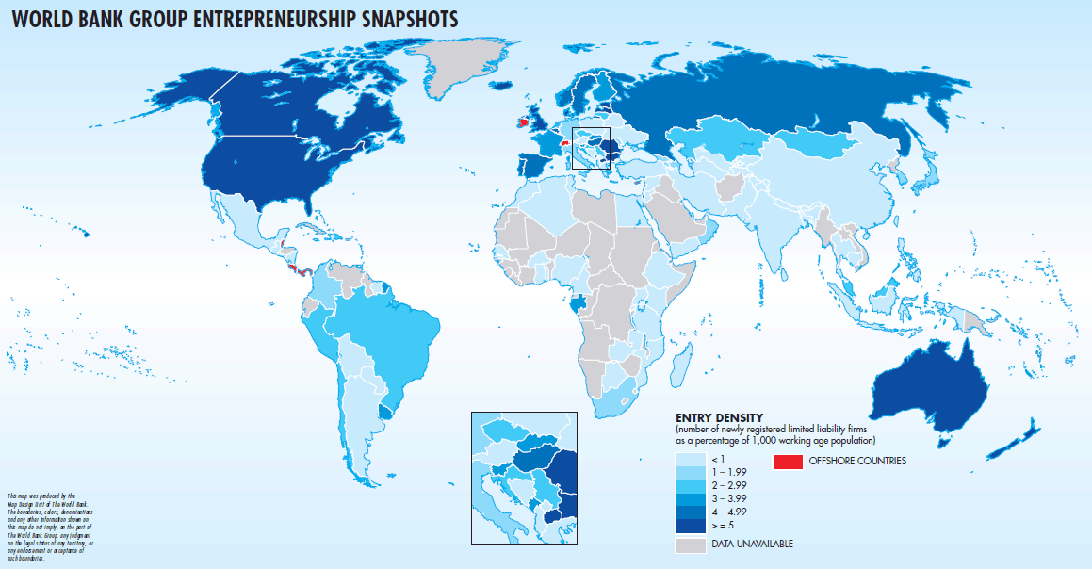


Slide 5
Total Early-Stage
Entrepreneurial Activity (TEA)
Global Entrepreneurship Monitor –
2014 Global Report

Slide 6

WHAT’S AT STAKE?
Opportunities for Success
Global Competitiveness
Replacement for World Tensions

Slide 7

PERSPECTIVES

Slide 8

The passionate pursuit and exploitation of opportunities across domestic borders through innovation, risk mitigation, and adaptive execution without regard to currently controlled resources.

Slide 9

BORN GLOBAL
McDougall (1989) states:
"international entrepreneurship is the study of the development of international new
ventures or start-ups that, from their inception, engage in international business, thus viewing
their operating domain as international from the initial stages of the firm's operation."
McDougall and Oviatt (1996) state:
"new and innovative activities that have the goal of value creation and growth in business
organization across national borders."
BORN
ENTREPRENEUR

Slide 10

BRED GLOBAL
McDougall and Oviatt (2000) state:
“International Entrepreneurship is a combination of innovative, proactive, and risk-seeking behavior that crosses or is compared across national borders and is intended to create value in business organizations."
Wright and Ricks (1994) suggests that international entrepreneurship is a firm-level activity that crosses national borders and focuses on the relationship between businesses and the
international environments in which they operate.

Slide 11

CONVERTED TO GLOBAL
Brain Butler (2010) states:
“International Entrepreneurship is the systematic overview of the opportunities, benefits, and rationales for engaging in global entrepreneurship.

Slide 12
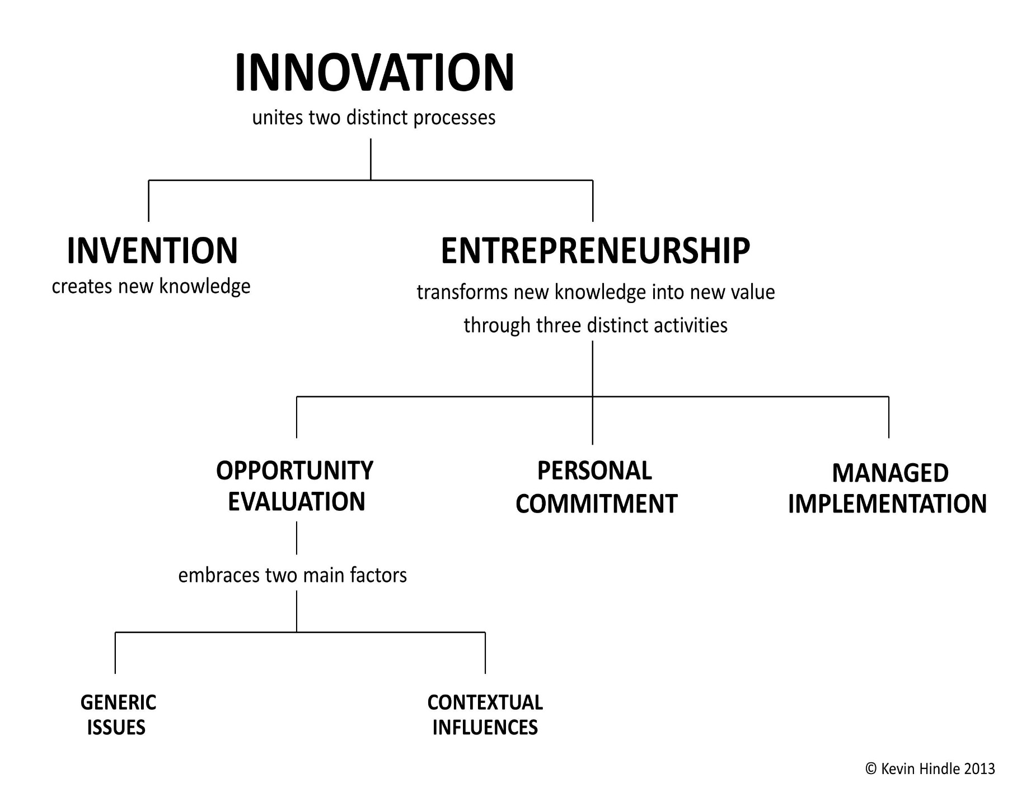
PERSPECTIVES
Creating something new that has value
Transform new knowledge and/or new value into a new venture
BIRTH
CONVERT
BREED
https://imenca.com/do-invention-and-innovation-mean-the-same-thing00/

Slide 13



PERSPECTIVE
The state of mind which orientates human conduct towards entrepreneurial activities and outcomes: passionate pursuit of opportunities with discipline, discernment, adaptive execution, and networking relationships. …McGrath & MacMillan
Broad Delivers
A Global Mindset combines an openness to and awareness of diversity across cultures and markets with a propensity and ability to see common patterns across countries and markets. ….Financial Times
Unique Methodologies for
Venture Development

Slide 14

METHODOLOGICAL
Broad Delivers

Slide 15
METHODOLOGICAL ISSUES
Opportunity Analysis
  Data Collection
  Targeting
  Value (Pain) Assessment
Risk Mitigation
  Engagement
  Collaboration Across Business Model
Adaptive Execution
  Scale & Access

Slide 16


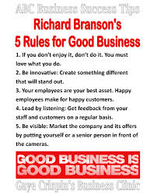
RATIONALE FOR VALIDATION
Not every
Is a
Key Here:
Does it Solve Problem & Is There an Opportunity
Not every
Is a
Key Here:
Is Can it Be Commercialized with a Profit

Slide 17


VALIDATING OPPORTUNITY
A favorable or advantageous set of circumstances that makes it possible, or at least highly probable that some set of actions achieves some goal.

Slide 18

VALIDATION CRITERIA
Validation Checklist
Solves
Problem
Opportunity
Business
Model
Life altering need
Sizable # with need
Have M.V.P.
Fits Passion
P.olitical
E.conomic
S.ocial
T.echnological
L.egal
E.nvironment
Industry/Competition
Lifetime customer value
Entry strategies / costs
Marginal costs

Slide 19
Getting it Right Involves Risk
Risk in the Enterprise Development Process
Risk (in control)
Risk (out of control)
Balanced Risk
Uncertainly (Remaining High)
Amount at Stake
Amount at Stake
Uncertainly (Coming Down)
IDEA TIME LAUNCH
IDEA TIME LAUNCH
IDEA TIME LAUNCH
a)
b)
c)
And ye shall know the truth & the truth shall set you free .J 8:32

Slide 20
De-Risking is Acquiring Specific Knowledge and Applying it Early in the Innovation Process***
***Based on 6500 case studies of projects launched
& meta-analysis of 12998 projects completed.
DECOMPOSED
_ R
I
SK
P(LOSS) Ordinary
Cum. Costs Ordinary
P(LOSS) ”D”
Cum. Costs “D”
FFE & DESIGN
LAUNCH
Project Progression Over Stages & Time
6/3/2015
Calantone
20

Slide 21
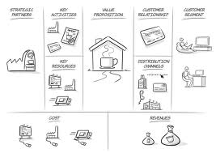


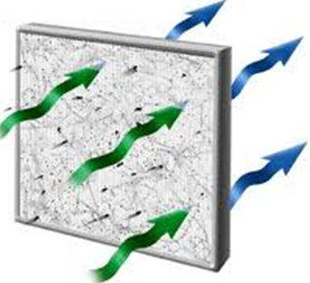

Business Development Process
Revisions
Lean
Startup
Process
Business
Model
Test
Minimum
Viable
Product
Revisions
Market
Validation
Customer Development
Idea

Slide 22
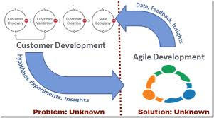
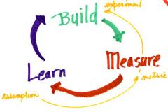
ITERATION

Slide 23

ADAPTIVE EXECUTION
Don’t Plan from a Fort (confined by your assumptions and uncertainties). Get out and attack your GOALS!
Passionately pursue contact with customers, suppliers, channel members, and potential partners

Slide 24

PROCEDURES

Slide 25

DATA ACCESSIBILITY
Market Creation activities involves the co-production of shared consciousness, meaning (culture) and moral responsibility in order to create a community for a platform for market intelligence and possible commercialization.
There is typically
A dearth of customer level and product level data

Slide 26

TARGETING:
GLOBAL CUSTOMER
A customer with a global mindset whose buying behavior is not limited by their domestic culture, market access, or national economic conditions

Slide 27
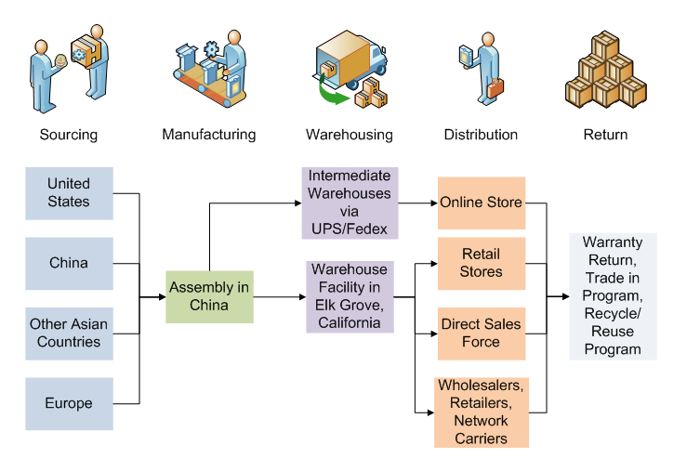
CHANNEL MAPPING
A step-by-step understanding of the intercompany product flow, and an estimate of the cost of each step, opportunities for improvement will literally jump off the page.

Slide 28
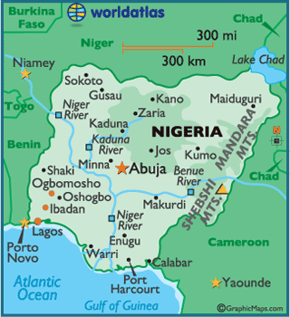
CHANNEL MAPPING
In collaboration with Tennessee State University, I participated in a study to assess the feasibility of a joint venture for small farm poultry production in Nigeria.
With a plethora of poultry farms within 60 kilometers of Lagos and comparable supply and production costs the price per pound was 10 times that in the U.S.

Slide 29


Core Curriculum Items

Slide 30

Forrest S. Carter, Ph.D.
Associate Professor of Marketing
Faculty Director, Institute of
Entrepreneurship & Innovation
carterf@msu.edu
517-432-6381

