Slide 1
Spotlight on Asia
Siddharth Chandra
Professor and Director
Asian Studies Center
Michigan State University

Slide 2
Four Messages
Asia is in the process of realizing its enormous economic potential
Asia’s size and rapid growth present and will continue to present attractive opportunities for American businesses and professionals
While Asia is a very diverse and complex place, it is connected by some basic themes
The rise of Asia poses great challenges for itself and the world

Slide 3
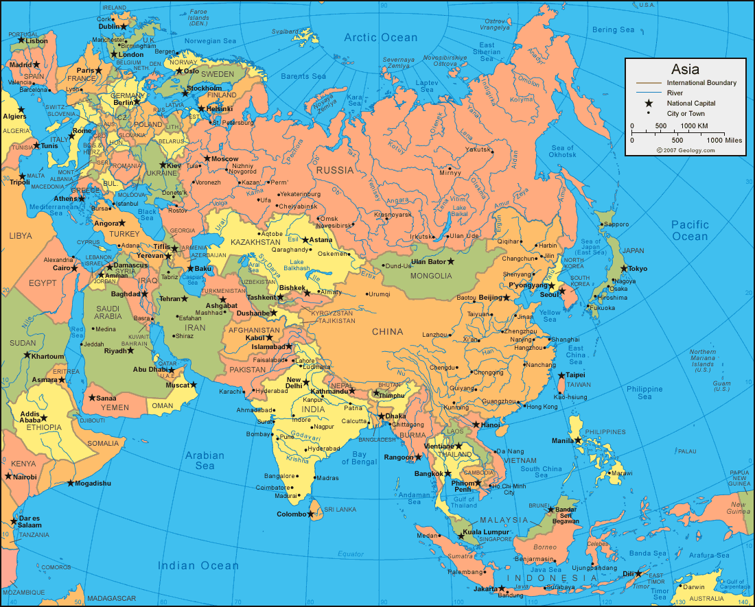
Asia

Slide 4
Focus Today
East, South, Southeast Asia
East Asia
China, Japan, Korea, Mongolia
South Asia
Afghanistan, Bangladesh, Bhutan, India, Nepal, Pakistan, Sri Lanka
Southeast Asia
Brunei, Burma, Cambodia, Indonesia, Laos, Malaysia, Philippines, Singapore, Thailand, Timor

Slide 5
Why Asia is important
Largest continent in terms of
Area (30% of world’s land area)
Population (60% of world’s population)
Economic activity (largest producer of GDP in PPP (purchasing power parity) terms)

Slide 6
Asia’s Population
Of the 10 most populous countries in the world, seven are in Asia
China (#1)
India (#2)
Indonesia (#4)
Pakistan (#6)
Bangladesh (#8)
Russia (#9, partly in Asia)
Japan (##10)

Slide 7
Message 1
Asia is in the process of realizing its enormous economic potential

Slide 8
Asia’s Economies
Of the 5 largest economies in the world (measured in purchasing parity terms), 3 are in Asia
China (#1)
India (#3)
Japan (#4)

Slide 9
Asia’s Economies
Globally, there is a discrepancy between location of population and location of economic activity
Asia’s potential lies in the gradual global re-alignment of the location of economic activity with the location of population
The world economy is reverting to the “old normal”
Pre-colonial era

Slide 10
Asia’s Potential
Home to the six most rapidly growing major economies in the world, including
India (7.5%)
China (6.9%)
Indonesia (5.2%)
Figures from the Economist of May 2-8, 2015
Forecast for 2015
These also happen to be among the most populous countries in the world (#1,#2,#4)

Slide 11
Asia’s Potential
These economies have a long way to go before they catch up
Per capita GDP in 2013 of
China $11,907
Indonesia $9,561
India $5,418
Compare to US per capita GDP of $53,042

Slide 12
Asia’s Potential
Will Asia’s poorer economies catch up?
Singapore, Taiwan, Hong Kong did
and they are small by Asian standards
If Asia’s larger countries come even part of the way (which they will)…..
…..then Asia will regain its position at the center of the global economy

Slide 13
Message 2
Asia’s size and rapid growth present and will continue to present attractive opportunities for American businesses and professionals

Slide 14
Opportunities in Asia
A corollary to large populations
Large markets
Rapid growth and increasing affluence
Rapidly growing markets
Rapidly changing markets
Large numbers of US and multinational corporations have an Asian presence
Major Asian cities have large concentrations of offices of major corporations

Slide 15
Why Young Americans Should Learn About Asia
Career opportunities
Rapidly growing demand for well-trained professionals
Asian higher education systems are inadequate
Quantity and quality
Therefore, increasing opportunities for American professionals in Asia
Two-way movement: Asia to/from the USA

Slide 16
Young Americans in Asia
Examples
Craft brewer in Beijing
Mall development in India
What may be mundane in the USA can be new and exciting in Asia
Transition brings opportunities

Slide 17
Theme 3
While Asia is a very diverse and complex place, it is connected by some basic themes

Slide 18
Common Theme 1
Asian cultures:
Individual self vs. relational self
Less emphasis on individualism than in the USA
More emphasis on self in relation to others
It is important to be part of a whole that is (much) larger than the self
Example: definition of family

Slide 19
Doing Business in Asia
Importance of being part of a relational mindset
Importance of connections
Family, friends, colleagues, acquaintances

Slide 20
Common Theme 2
Asian cultures are old
Thousands of years
Example: Indus Valley Civilization (India/Pakistan), Zhou dynasty (China)
Egypt, Mesopotamia
Tradition (often unbroken) plays a very strong role

Slide 21
Doing Business in Asia
Know your local customs (very well)
Hierarchy --- China, order of entry into a room
Do’s and don’ts --- India, feet on the ground, face down
Better still, learn the language
A little bit can go a very long way
Become part of the “family”
Relate, relate, relate

Slide 22
For every rule there is an exception
Asia is extremely diverse
Old cultures + large populations
=
Cultural, ethnic, linguistic diversity

Slide 23
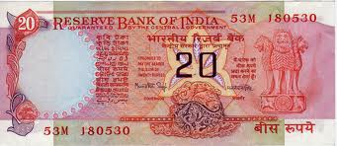
Asian Diversity: An Example

Slide 24
Message 4
The rise of Asia poses great challenges for itself and the world

Slide 25
Challenge 1: The Environment
Large populations
Asia = 5 * (USA + EU)
Rapid economic growth
If the USA and Europe started global warming….
….Asia could very well finish the job.
Environmental problems
Debate: Developing vs. developed countries

Slide 26
Challenge 2: Geopolitics, Security
Emergence of at least one great power
China
Renegotiation of bilateral relationships
China, Japan (Senkaku)
China, Southeast Asia (South China Sea)
China, India (border)
China, USA (militarization, containment)
Will economics trump geopolitics?
Strong economic relationships
Internal politics, nationalism
Baggage of history

Slide 27
Conclusions
Asia is important
Asia is becoming increasingly important
Asia is a continent of opportunity
Knowledge about Asia is a valuable asset that will become increasingly valuable as the 21st century progresses

