Slide 1
Spotlight on Latin America
2015 International Business Institute for Community College Faculty
Dr. Manuel Chavez
MICHIGAN STATE UNIVERSITY
College of Communication Arts & Sciences School of Journalism

Slide 2
Central Questions about
Latin America
What are the differences in the Latin American economies?
Has Latin America improved in the last two years?
Is there another country-leader besides Mexico and Brazil?
Is Latin America ready to become an emerging market region?
Is the business environment the same across Latin America?
Reality vs Assumptions

Slide 3
Business Realities in Latin America the hard way…
Significant differences across Latin America by country and by region (e.g. Brazil)
More than economics, institutional capacity is critical
…and accountability and transparency
…and more importantly, the Rule of Law
National cultures vs Corporate cultures
Is Mexico a good example?…

Slide 4
Is Mexico a good example? –the NAFTA connector
Corporate exchange very fluid and positive, resulting in:
Mexico continues to be the largest recipient of FDI, specially from the United States and Canada (strategic sectors of Canada Investments)
American & Canadian corporations are in most Mexican cities and regions (except for the South)
How well do U.S. corporations do in Mexico?
  Aeronautics (GE, RR, Bombardier, Bell Aviation)
  Auto Industry (GM, Ford, Chrysler, BMW, VW, Toyota, Honda, Nissan)
  Electronics & computers (Apple, Dell, Sony, HP)
  Appliances (GE, Whirlpool, LG)
  Agro-industries (Kellogg’s, Pilgrims Pride, Monsanto)
So, the business and economic model is working

Slide 5


North American Free Trade Agreement –2014 Results
2014 Total Value $1.20 Trillion
Increase in the last 2 years by 8%
Trade with Canada equals $658 billion, increase by 7%
Trade with Mexico equals $535 billion increase by 9%
Trade with Canada and Mexico accounts for almost 30% of the total global U.S. trade
The U.S. is trade partner #1 for Canada and Mexico. For the U.S. # 1 and # 3.
U.S. corporations seeking to export to EU through Mexico
2005 Security and prosperity agenda (logistics, logistics, and logistics)
---context: Brazil trade is $72 billion
Data: U.S. Dept. of Commerce and U.S. Trade Authority Office

Slide 6
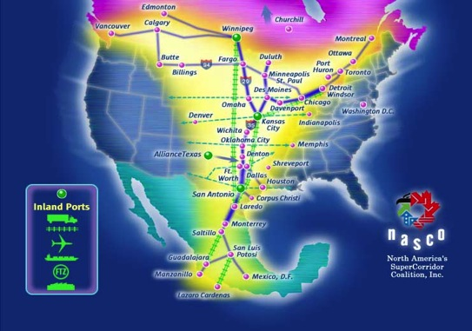

North America XXI Century Realities (Political & Economic)
NAFTA consolidation and expansion (NA currency)
Economic regional free trade with the Americas
Competition focusing on the EU + EE countries
2005 Security and Prosperity Partnership (SPP) of North America
ENERGY INTEGRATION
NATIONAL SECURITY

Slide 7
New initiative to strengthen regional interdependence in NAFTA Countries –the Post 9/11 effect (SPP)

Slide 8
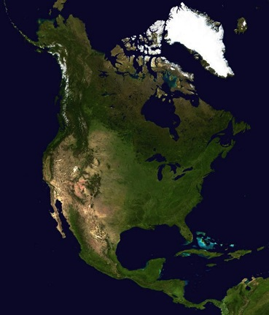
The New Economic Pattern of
North America
Post-industrial USA, from manufacturing based to technology-knowledge based.
U.S. vertical integration
Canada and Mexico link to the U.S. market
US-FTA with Chile, Panama, Peru, and Colombia
US-CAFTA (Central America and the DR)
FTAA (is it dead?)

Slide 9
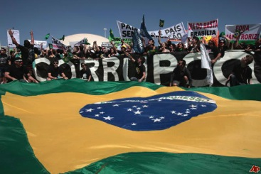
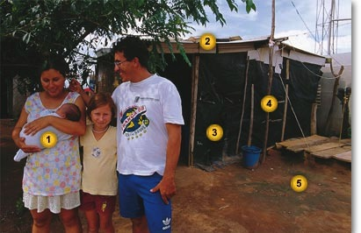
What Are the Regional Political Realities of Latin America?
Brazil governmental corruption
Cuba -opening the transition to market economics
Venezuela economic collapse
Argentina debt and economic decline
HDI as a real challenge for development and economic growth

Slide 10
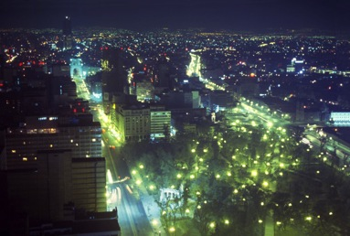
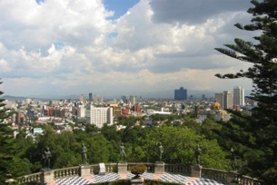
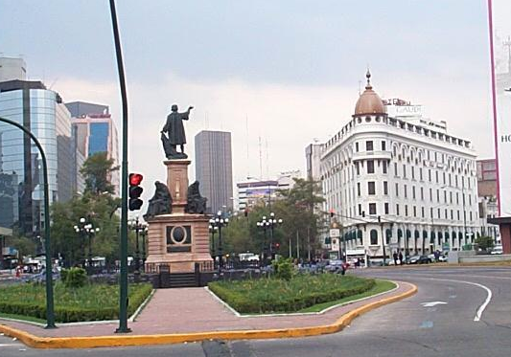
Mexico Basic Briefing
Population 2014: 120.1 million
Capital (population): Mexico City (18,000,000)
Life expectancy at birth: male 74.5 years, female 79.8 years (2013)
Physicians per 1000 people: 2.9
Rural/urban population ratio: 25/75
GDP: $1.3 trillion
GDP per capita: $13,900 (2013)

Slide 11
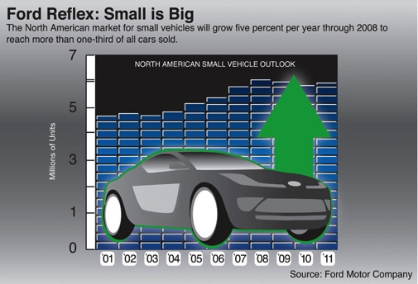





Mexico’s Economic Model
North American Transportation sector
  Auto
  Aircraft
3rd generation “maquiladora” production
Energy & Oil production
Tourism
Retirement

Slide 12


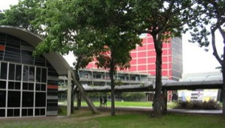
What are the Challenges of Mexico’s Economic Future?
Rule of law, accountability, and transparency
Reduction of social inequality
Investment in R&D
Heavy investment in human capital infrastructure

Slide 13
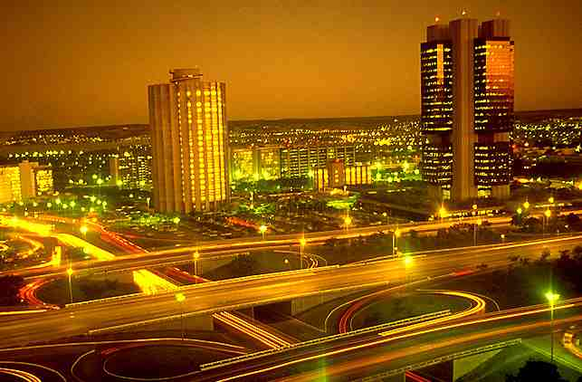
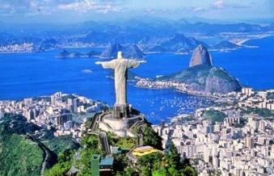
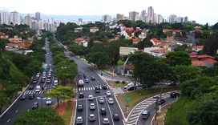
Brazil Basic Briefing
Population 2014: 200.7 million
Capital (population): Brasilia City (4.5 million)
Life expectancy at birth: male 69.4 years, female 76.2 years (2011)
Physicians per 1000 people: 1.72
Rural/urban population ratio: 13/87
GDP: $2.2 trillion (decline of $200 billion)
Trade with U.S.:
$72 billion (decline of $3 billion)
GDP per capita: $11,200 (2013)

Slide 14

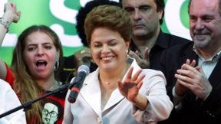
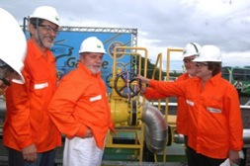
Brazil’s Economic Model
Economic closeness with Europe –not with the U.S.
Less dependency from the U.S.
Energy and Industrialization
Alliances with China, France, and Germany
National –not regional- economic development
Global Oil supplier

Slide 15
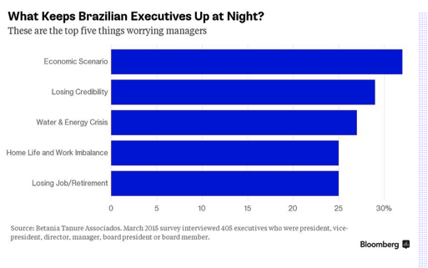
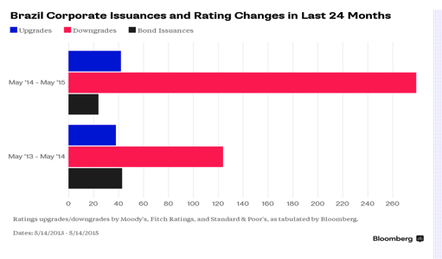
What are the Challenges for Brazil’s Economic Future?
Rule of Law, accountability, and transparency
Rapid reduction of social inequality
Credibility
Investment in R&D
Investment in human capital infrastructure
Limited domestic market

Slide 16
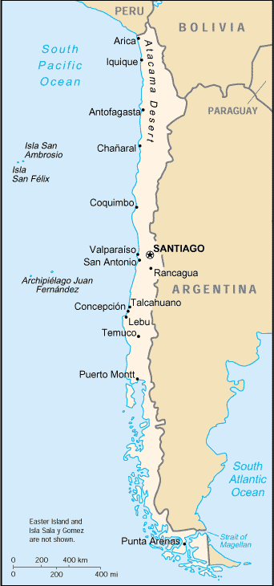

Chile Basic Briefing
Population (2014): 17.6 million
Capital (population): Santiago (5 million)
Life expectancy at birth: male 75.1 years, female 81.42 years (2011)
Physicians per 1000 people: 1.09
Rural/urban population ratio: 15/85
GDP $280 billion (2013)
GDP per capita: $15,700 (2013)

Slide 17

Chile Economic Development Model
Aggressive industrialization on agricultural and metal production
Based on open economy since 1980
Foreign investment heaven
Stability and social investment
Investment in R&D
NAFTA member

Slide 18



So, for CC to Train Working Force in these conditions --it demands to add International Education and Skills (+)
Working Knowledge in:
  Language skills –functional level
  Culture at the exchange level
  Political, economic, and social systems.
  National cultures
  Corporate cultures abroad

