Slide 1
Global Business Today Tomas Hult
Comparing Views of Company Managers and Customers

Slide 3
Globalization (IB11e Chapter 1)
Globalization refers to the shift toward a more integrated and interdependent world economy (including globalization of markets and globalization of production).
Hello How are you?

Slide 4
Globalization (IB11e Chapter 1)
%
How much of a company’s activities are global (in %): Today? In 5 years? In 10 years? In 20 years?
n=3206 companies n=1692 customers
Data from March 2015
The margin of error for the company (managerial) sample (n=3206) is 1.59 percent, and the margin of error for the customer sample (n=1692) is 2.28 percent

Slide 5
Globalization (IB11e Chapter 1)
Compared with now, customers expect a rapid increase in globalization
10 to 20 years from now
Customers
With a similar starting point as customers, companies expect a moderate increase in globalization in the next
five to 20 years
Companies

Slide 6
National Differences
Global Trade
& Investment Environment
Global
Monetary
System
Globalization
Strategy and
Structure of
International
Business
International
Business
Functions

Slide 7
Global Business Today
n=3206 companies n=1692 customers
Data from March 2015; Scores range from 1=strongly disagree to 10=strongly agree
The margin of error for the company (managerial) sample (n=3206) is 1.59 percent, and the margin of error for the customer sample (n=1692) is 2.28 percent

Slide 8
Global Business in 5 Years
n=3206 companies n=1692 customers
Data from March 2015; Scores range from 1=strongly disagree to 10=strongly agree
The margin of error for the company (managerial) sample (n=3206) is 1.59 percent, and the margin of error for the customer sample (n=1692) is 2.28 percent

Slide 9
Global Business in 10 Years
n=3206 companies n=1692 customers
Data from March 2015; Scores range from 1=strongly disagree to 10=strongly agree
The margin of error for the company (managerial) sample (n=3206) is 1.59 percent, and the margin of error for the customer sample (n=1692) is 2.28 percent

Slide 10
Hello How are you?
National Differences
(IB11e Chapters 2 to 5)

Slide 11
National Differences (IB11e Chapters 2 to 5)
n=3206 companies n=1692 customers
Data from March 2015; Scores range from 1=strongly disagree to 10=strongly agree
The margin of error for the company (managerial) sample (n=3206) is 1.59 percent, and the margin of error for the customer sample (n=1692) is 2.28 percent

Slide 12
National Differences (IB11e Chapters 2 to 5)
Expectation for decrease in national differences
Customers
Expectation for modest increase in national differences; in practical terms it is a flat trend
Companies

Slide 13
Hello How are you?
Global Trade and
Investment Environment
(IB11e Chapters 6 to 9)

Slide 14
Global Trade and Investment Environment (IB11e Chapters 6 to 9)
n=3206 companies n=1692 customers
Data from March 2015; Scores range from 1=strongly disagree to 10=strongly agree
The margin of error for the company (managerial) sample (n=3206) is 1.59 percent, and the margin of error for the customer sample (n=1692) is 2.28 percent

Slide 15
Global Trade and Investment Environment (IB11e Chapters 6 to 9)
Expectation for consistent and greater period increases in countries’ benefit from investment in global trade
Customers
Expectation for consistent increases in countries’ benefit from investment in global trade
Companies

Slide 16
Hello How are you?
Global Monetary System
(IB11e Chapters 10 to 12)

Slide 17
Global Monetary System (IB11e Chapters 10 to 12)
n=3206 companies n=1692 customers
Data from March 2015; Scores range from 1=strongly disagree to 10=strongly agree
The margin of error for the company (managerial) sample (n=3206) is 1.59 percent, and the margin of error for the customer sample (n=1692) is 2.28 percent

Slide 18
Global Monetary System (IB11e Chapters 10 to 12)
Foreign exchange, monetary system, and capital markets will become significantly more important
Customers
Foreign exchange, monetary system, and capital markets will become moderately more important
Companies

Slide 19
Hello How are you?
Strategy and Structure of International Business
(IB11e Chapters 13 to 15)

Slide 20
Strategy and Structure of International Business (IB11e Chapters 13 to 15)
n=3206 companies n=1692 customers
Data from March 2015; Scores range from 1=strongly disagree to 10=strongly agree
The margin of error for the company (managerial) sample (n=3206) is 1.59 percent, and the margin of error for the customer sample (n=1692) is 2.28 percent

Slide 21
Strategy and Structure of International Business (IB11e Chapters 13 to 15)
Strategy and structure of international business will become significantly more important, but still be below companies
Customers
Strategy and structure of international business will become moderately more important, staying above what customers think
Companies

Slide 22
Hello How are you?
International Business Functions
(IB11e Chapters 13 to 15)

Slide 23
International Business Functions (IB11e Chapters 16 to 20)
n=3206 companies n=1692 customers
Data from March 2015; Scores range from 1=strongly disagree to 10=strongly agree
The margin of error for the company (managerial) sample (n=3206) is 1.59 percent, and the margin of error for the customer sample (n=1692) is 2.28 percent

Slide 24
International Business Functions (IB11e Chapters 16 to 20)
The international business functions will become significantly more important in the next 5 years; still below companies
Customers
The international business functions will become moderately more important, staying above what customers think
Companies

Slide 25
NATIONAL DIFFERENCES
Global Trade
& Investment Environment
Global
Monetary
System
Globalization
Strategy and
Structure of
International
Business
International
Business
Functions

Slide 26
National Differences in Political, Economic, and Legal Systems (IB11e Chapter 2)
Hello How are you?
Political, economic, and legal systems are all a function of the government (influences) in a nation.

Slide 27
National Differences in Political, Economic, and Legal Systems (IB11e Chapter 2)
%
National differences in infrastructure (e.g., political, economic, legal) are very noticeable across global markets: Today? In 5 years? In 10 years?
n=3206 companies n=1692 customers
Data from March 2015; Scores range from 1=strongly disagree to 10=strongly agree
The margin of error for the company (managerial) sample (n=3206) is 1.59 percent, and the margin of error for the customer sample (n=1692) is 2.28 percent

Slide 28
National Differences in Political, Economic, and Legal Systems (IB11e Chapter 2)
Expectation for decrease in national differences in political, economic, and legal systems
Customers
Expectation for modest increase in national differences in political, economic, and legal systems
Companies

Slide 29
National Differences in
Economic Development (IB11e Chapter 3)
Hello How are you?
How the (macro-level) political economy influences economic development of a nation.

Slide 30
National Differences in Economic Development (IB11e Chapter 3)
National differences in economic development are very noticeable across global markets: Today? In 5 years? In 10 years?
n=3206 companies n=1692 customers
Data from March 2015; Scores range from 1=strongly disagree to 10=strongly agree
The margin of error for the company (managerial) sample (n=3206) is 1.59 percent, and the margin of error for the customer sample (n=1692) is 2.28 percent

Slide 31
National Differences in Economic Development (IB11e Chapter 3)
Expectation for decrease in national differences in economic development
Customers
Expectation for modest increase in national differences in economic
Companies

Slide 32
Differences in Culture (IB11e Chapter 4)
Hello How are you?
Culture is a system of values and norms that are shared among a group of people and that when taken together constitute a design for living.

Slide 33
Differences in Culture (IB11e Chapter 4)
National differences in culture are very noticeable across global markets: Today? In 5 years? In 10 years?
n=3206 companies n=1692 customers
Data from March 2015; Scores range from 1=strongly disagree to 10=strongly agree
The margin of error for the company (managerial) sample (n=3206) is 1.59 percent, and the margin of error for the customer sample (n=1692) is 2.28 percent

Slide 34
Differences in Culture (IB11e Chapter 4)
Expectation for significant decrease in national differences in culture
Customers
Expectation for modest decrease in national differences in culture
Companies

Slide 35
Ethics, Corporate Social Responsibility, and Sustainability (IB11e Chapter 5)
Hello How are you?
Business ethics are the accepted principles of right and wrong governing the conduct of businesspeople; CSR (focus on environment) and sustainability (focus on stakeholders) are company-level implementations of business ethics.

Slide 36
Ethics, Corporate Social Responsibility, and Sustainability (IB11e Chapter 5)
National differences in ethics, corporate social responsibility, and sustainability are very noticeable across global markets: Today? In 5 years? In 10 years?
n=3206 companies n=1692 customers
Data from March 2015; Scores range from 1=strongly disagree to 10=strongly agree
The margin of error for the company (managerial) sample (n=3206) is 1.59 percent, and the margin of error for the customer sample (n=1692) is 2.28 percent

Slide 37
Ethics, Corporate Social Responsibility, and Sustainability (IB11e Chapter 5)
Expectation for minimal changes in the next 10 years but differences are less noticeable to customers
Customers
Expectation for minimal changes in the next 10 years but differences are more noticeable to companies (managers)
Companies

Slide 38
National Differences
GLOBAL TRADE
& INVESTMENT ENVIRONMENT
Global
Monetary
System
Globalization
Strategy and
Structure of
International
Business
International
Business
Functions

Slide 39
International Trade Theory (IB11e Chapter 6)
Hello How are you?
Trade theory explains (and justifies) why countries and companies from countries trade across country borders.

Slide 40
International Trade Theory (IB11e Chapter 6)
Countries’ benefit from international trade is very noticeable across global markets: Today? In 5 years? In 10 years?
n=3206 companies n=1692 customers
Data from March 2015; Scores range from 1=strongly disagree to 10=strongly agree
The margin of error for the company (managerial) sample (n=3206) is 1.59 percent, and the margin of error for the customer sample (n=1692) is 2.28 percent

Slide 41
International Trade Theory (IB11e Chapter 6)
Countries’ benefit from international trade is less noticeable than for companies but converges in 10 years
Customers
Countries’ benefit from international trade is and will become more noticeable
Companies

Slide 42
Government Policy and
International Trade (IB11e Chapter 7)
Government trade policy uses seven main instruments: tariffs, subsidies, import quotas, voluntary export restraints, local content requirements, administrative policies, and antidumping duties.

Slide 43
Government Policy and International Trade (IB11e Chapter 7)
Countries’ government policies are very favorable toward international trade across global markets: Today? In 5 years? In 10 years?
n=3206 companies n=1692 customers
Data from March 2015; Scores range from 1=strongly disagree to 10=strongly agree
The margin of error for the company (managerial) sample (n=3206) is 1.59 percent, and the margin of error for the customer sample (n=1692) is 2.28 percent

Slide 44
Government Policy and International Trade (IB11e Chapter 7)
Countries’ government policies are moderately favorable toward trade, less than companies think
Customers
Countries’ government policies are moderately favorable toward trade, more than customer think
Companies

Slide 45
Foreign Direct Investment (IB11e Chapter 8)
Foreign Direct Investment (FDI) occurs when a firm invests directly in facilities to produce or market a product in a foreign country.

Slide 46
Foreign Direct Investment (IB11e Chapter 8)
Countries’ benefit from Foreign Direct Investment (FDI) is very noticeable across global markets: Today? In 5 years? In 10 years?
n=3206 companies n=1692 customers
Data from March 2015; Scores range from 1=strongly disagree to 10=strongly agree
The margin of error for the company (managerial) sample (n=3206) is 1.59 percent, and the margin of error for the customer sample (n=1692) is 2.28 percent

Slide 47
Foreign Direct Investment (IB11e Chapter 8)
Countries’ benefit from FDI is moderately noticeable, less than companies think
Customers
Countries’ benefit from FDI is moderately noticeable, more than customer think
Companies

Slide 48
Regional Economic Integration (IB11e Chapter 9)
By regional economic integration, we mean agreements among countries in a geographic region to reduce, and ultimately remove, tariff and nontariff barriers to the free flow of goods, services, and factors of production between each other.

Slide 49
Regional Economic Integration (IB11e Chapter 9)
The world is very regionally integrated across global markets: Today? In 5 years? In 10 years?
n=3206 companies n=1692 customers
Data from March 2015; Scores range from 1=strongly disagree to 10=strongly agree
The margin of error for the company (managerial) sample (n=3206) is 1.59 percent, and the margin of error for the customer sample (n=1692) is 2.28 percent

Slide 50
Regional Economic Integration (IB11e Chapter 9)
Customers see the world as far less regionally integrated than companies but becoming more integrated
Customers
Company representatives see the world as far more regionally integrated than customers
Companies

Slide 51
National Differences
Global Trade
& Investment Environment
GLOBAL
MONETARY
SYSTEM
Globalization
Strategy and
Structure of
International
Business
International
Business
Functions

Slide 52
The Foreign Exchange Market (IB11e Chapter 10)
The Foreign Exchange Market is a market for converting the currency of one country into that of another country.

Slide 53
The Foreign Exchange Market (IB11e Chapter 10)
The Foreign Exchange Market is a very important part of global business: Today? In 5 years? In 10 years?
n=3206 companies n=1692 customers
Data from March 2015; Scores range from 1=strongly disagree to 10=strongly agree
The margin of error for the company (managerial) sample (n=3206) is 1.59 percent, and the margin of error for the customer sample (n=1692) is 2.28 percent

Slide 54
The Foreign Exchange Market (IB11e Chapter 10)
Customers think the Foreign Exchange Market will become more important over time than companies
Customers
Companies think the Foreign Exchange Market will become slightly more important over time
Companies

Slide 55
The International Monetary System (IB11e Chapter 11)
The International Monetary System refers to the institutional arrangements that govern exchange rates.

Slide 56
The International Monetary System (IB11e Chapter 11)
The International Monetary System is a very important part of global business: Today? In 5 years? In 10 years?
n=3206 companies n=1692 customers
Data from March 2015; Scores range from 1=strongly disagree to 10=strongly agree
The margin of error for the company (managerial) sample (n=3206) is 1.59 percent, and the margin of error for the customer sample (n=1692) is 2.28 percent

Slide 57
The International Monetary System (IB11e Chapter 11)
Customers also think the IMS will become more important over time, converging in views with companies in 5 and 10 years
Customers
Companies think the International Monetary System will become slightly more important over time
Companies

Slide 58
The Global Capital Market (IB11e Chapter 12)
The Global Capital Market includes investors (companies, individuals, and institutions), market makers (commercial banks and investment bankers), and borrowers (individuals, companies, and governments)

Slide 59
The Global Capital Market (IB11e Chapter 12)
The Global Capital Market (e.g., borrowing and lending funds globally) is a very important part of global business: Today? In 5 years? In 10 years?
n=3206 companies n=1692 customers
Data from March 2015; Scores range from 1=strongly disagree to 10=strongly agree
The margin of error for the company (managerial) sample (n=3206) is 1.59 percent, and the margin of error for the customer sample (n=1692) is 2.28 percent

Slide 60
The Global Capital Market (IB11e Chapter 12)
Customers think the Global Capital Market will become significantly more important over time
Customers
Companies think the Global Capital Market will become slightly more important over time
Companies

Slide 61
National Differences
Global Trade
& Investment Environment
Global
Monetary
System
Globalization
STRATEGY AND
STRUCTURE OF
INTERNATIONAL
BUSINESS
International
Business
Functions

Slide 62
The Strategy of International Business (IB11e Chapter 13)
A firm’s strategy result in the actions that managers take (or should take) to attain the performance goals of the firm.

Slide 63
The Strategy of International Business (IB11e Chapter 13)
A company’s global strategy development is a very important part of a company’s overall global strategy: Today? In 5 years? In 10 years?
n=3206 companies n=1692 customers
Data from March 2015; Scores range from 1=strongly disagree to 10=strongly agree
The margin of error for the company (managerial) sample (n=3206) is 1.59 percent, and the margin of error for the customer sample (n=1692) is 2.28 percent

Slide 64
The Strategy of International Business (IB11e Chapter 13)
Global strategy is a very important part of a company’s overall global strategy; customer catch up to this view in 10 years
Customers
Global strategy is a very important part of a company’s overall global strategy, more than customers think
Companies

Slide 65
The Organization of
International Business (IB11e Chapter 14)
By organizational architecture, we mean the totality of a firm’s organization, including formal organizational structure, control systems and incentives, processes, organizational culture, and people.

Slide 66
The Organization of International Business (IB11e Chapter 14)
A company’s organizational infrastructure is a very important part of a company’s overall global business efforts: Today? In 5 years? In 10 years?
n=3206 companies n=1692 customers
Data from March 2015; Scores range from 1=strongly disagree to 10=strongly agree
The margin of error for the company (managerial) sample (n=3206) is 1.59 percent, and the margin of error for the customer sample (n=1692) is 2.28 percent

Slide 67
The Organization of International Business (IB11e Chapter 14)
Organizational infrastructure is important in global business efforts, but not as important as companies think
Customers
Organizational infrastructure is an important part of global business efforts, and will become more important
Companies

Slide 68
Entry Strategy and Strategic Alliances (IB11e Chapter 15)
Here we focus on three closely related issues: (1) the decision of which foreign markets to enter, when to enter them, and on what scale; (2) the choice of entry mode; and (3) the role of strategic alliances.

Slide 69
Entry Strategy and Strategic Alliances (IB11e Chapter 15)
A company’s global entry strategy is a very important part of its global business efforts: Today? In 5 years? In 10 years?
n=3206 companies n=1692 customers
Data from March 2015; Scores range from 1=strongly disagree to 10=strongly agree
The margin of error for the company (managerial) sample (n=3206) is 1.59 percent, and the margin of error for the customer sample (n=1692) is 2.28 percent

Slide 70
Entry Strategy and Strategic Alliances (IB11e Chapter 15)
Global entry strategy is an important part of global business, but not as important as managers of companies think
Customers
A company’s global entry strategy is an important part of its global business efforts, and will become more important
Companies

Slide 71
National Differences
Global Trade
& Investment Environment
Global
Monetary
System
Globalization
Strategy and
Structure of
International
Business
INTERNATIONAL
BUSINESS
FUNCTIONS

Slide 72
Exporting, Importing, and Countertrade (IB11e Chapter 16)
Exporting and importing both refer to cross-country border trade (outbound and inbound). Countertrade is a barter-form of agreement, e.g., shipping goods for other goods.

Slide 73
Exporting, Importing, and Countertrade (IB11e Chapter 16)
Basic trade across country borders (exporting, importing) is a very important part of a company’s business: Today? In 5 years? In 10 years?
n=3206 companies n=1692 customers
Data from March 2015; Scores range from 1=strongly disagree to 10=strongly agree
The margin of error for the company (managerial) sample (n=3206) is 1.59 percent, and the margin of error for the customer sample (n=1692) is 2.28 percent

Slide 74
Exporting, Importing, and Countertrade (IB11e Chapter 16)
Basic trade across country borders is moderately important, converging with companies’ greater importance in 10 years
Customers
Basic trade across country borders is an important part of a company’s business
Companies

Slide 75
Global Production and
Supply Chain Management (IB11e Chapter 17)
Production refers to activities involved in creating a product. Supply chain management refers to the integration and coordination of logistics, purchasing, operations, and market channels activities from raw material to the end-customer.

Slide 76
Global Production and Supply Chain Management (IB11e Chapter 17)
A company’s production and supply chain management is a very important part of a company’s overall global business efforts: Today? In 5 years? In 10 years?
n=3206 companies n=1692 customers
Data from March 2015; Scores range from 1=strongly disagree to 10=strongly agree
The margin of error for the company (managerial) sample (n=3206) is 1.59 percent, and the margin of error for the customer sample (n=1692) is 2.28 percent

Slide 77
Global Production and Supply Chain Management (IB11e Chapter 17)
Production and SCM are important in global business, reaching alignment with companies views in 5 and 10 years
Customers
Production and SCM are important parts of a company’s overall global business efforts and will become more important
Companies

Slide 78
Global Marketing and R&D (IB11e Chapter 18)
Marketing deals with choices about product attributes, distribution strategy, communication strategy, and pricing strategy that a firm offers its target market (i.e., a market segment of the global market).

Slide 79
Global Marketing and R&D (IB11e Chapter 18)
A company’s marketing and R&D efforts are a very important part of a company’s overall global business efforts: Today? In 5 years? In 10 years?
n=3206 companies n=1692 customers
Data from March 2015; Scores range from 1=strongly disagree to 10=strongly agree
The margin of error for the company (managerial) sample (n=3206) is 1.59 percent, and the margin of error for the customer sample (n=1692) is 2.28 percent

Slide 80
Global Marketing and R&D (IB11e Chapter 18)
Marketing and R&D are important in global business, reaching alignment with companies views in 10 years
Customers
Marketing and R&D are important parts of a company’s overall global business efforts and will become more important
Companies

Slide 81
Global Human Resource Management (IB11e Chapter 19)
Human Resource Management (HRM) refers to the activities an organization carries out to use its human resource effectively. These include human resource strategy, staffing, performance evaluation, management development, compensation, and labor relations

Slide 82
Global Human Resource Management (IB11e Chapter 19)
A company’s Human Resource Management efforts are a very important part of a company’s overall global business efforts: Today? In 5 years? In 10 years?
n=3206 companies n=1692 customers
Data from March 2015; Scores range from 1=strongly disagree to 10=strongly agree
The margin of error for the company (managerial) sample (n=3206) is 1.59 percent, and the margin of error for the customer sample (n=1692) is 2.28 percent

Slide 83
Global Human Resource Management (IB11e Chapter 19)
Global HRM is less important for a company’s global business efforts and will stay about the same in the next 10 years
Customers
Global HRM is very important for a company’s overall global business efforts and will become more important
Companies

Slide 84
Accounting and Finance in the International Business (IB11e Chapter 19)
Accounting is shaped by country/regional environments, although international standards are becoming more used. Financial management deals with quantifying the benefits, costs, and risks flowing from an investment in a given global location.

Slide 85
Accounting and Finance in the International Business (IB11e Chapter 19)
A company’s accounting and financial management practices are a very important part of a company’s overall global business efforts: Today? In 5 years? In 10 years?
n=3206 companies n=1692 customers
Data from March 2015; Scores range from 1=strongly disagree to 10=strongly agree
The margin of error for the company (managerial) sample (n=3206) is 1.59 percent, and the margin of error for the customer sample (n=1692) is 2.28 percent

Slide 86
Accounting and Finance in International Business (IB11e Chapter 19)
Accounting and finance are somewhat important and will start catching up in importance levels over time to the views by companies
Customers
Accounting and financial management practices are an important part of a company’s overall global business efforts
Companies

Slide 87
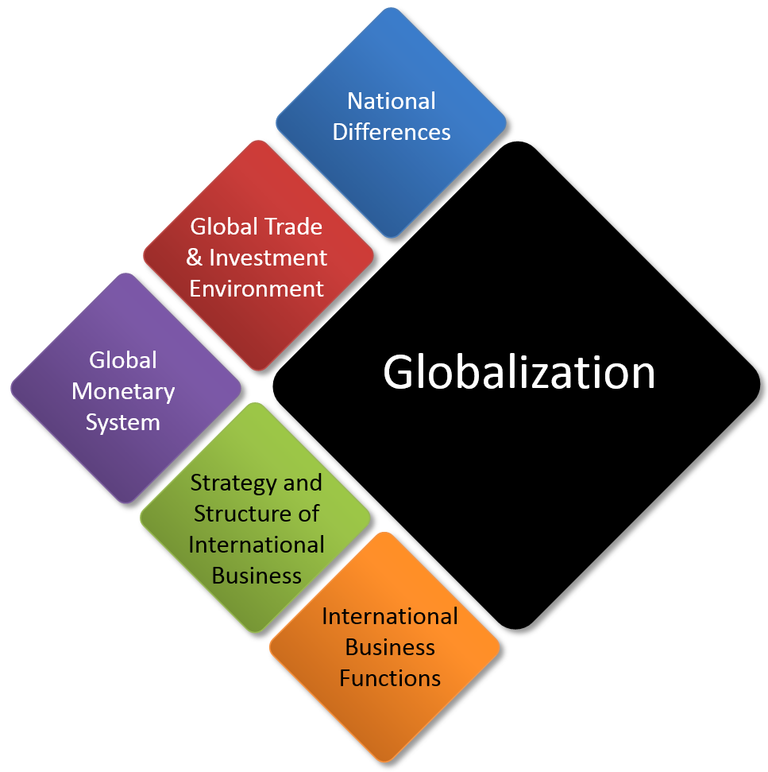
Global Business Today 9e International Business 11e Charles W. L. Hill G. Tomas M. Hult
Comparing Views of Company Managers and Customers

