Slide 1
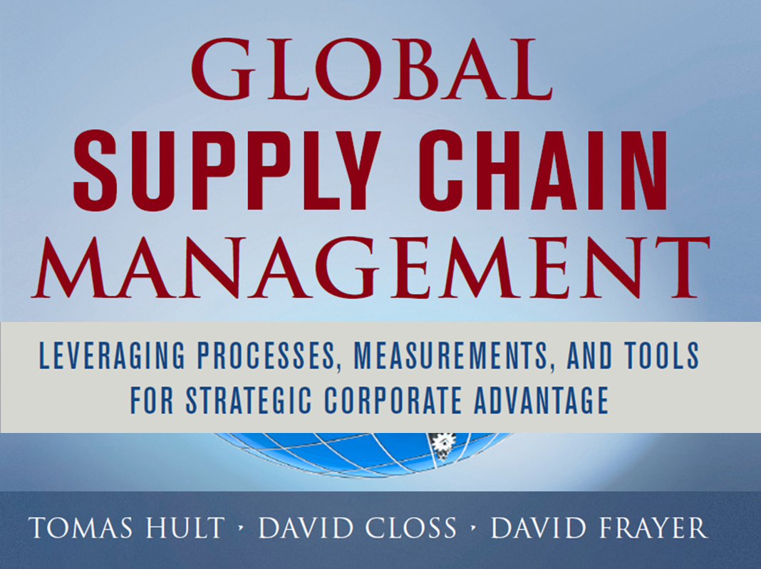
Notes:
This complete presentation is Copyright 2013 Tomas Hult. All rights reserved.

Slide 2


Slide 3



Slide 4



Slide 5
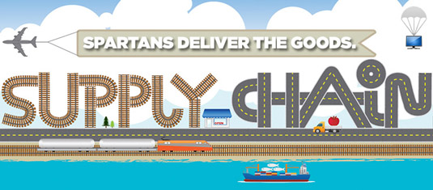


Slide 6


Slide 7


Slide 8


Slide 9


Slide 10


Slide 11
90 Percent
43 Percent
25 Percent

Slide 12
90% of global demand is not fully satisfied by local supply
Supply chains are driving growth in world trade
Source: The World Bank World Development Indicators

Slide 13
Companies’
Expected SCM
Globalization
14%
43%
Companies’
Expected SCM
Globalization
25%
57
Companies’
Current SCM
Globalization
50
40

Slide 14
Global Supply Chain Strategy
17 % in 2005 → 21% in 2013 → 25% in 2018
Source: The World Bank World Development Indicators

Slide 15
Global Supply Chain Management
Conversion (Firm and SBU Activities, Behaviors)
Value
Stakeholder Performance

Slide 16

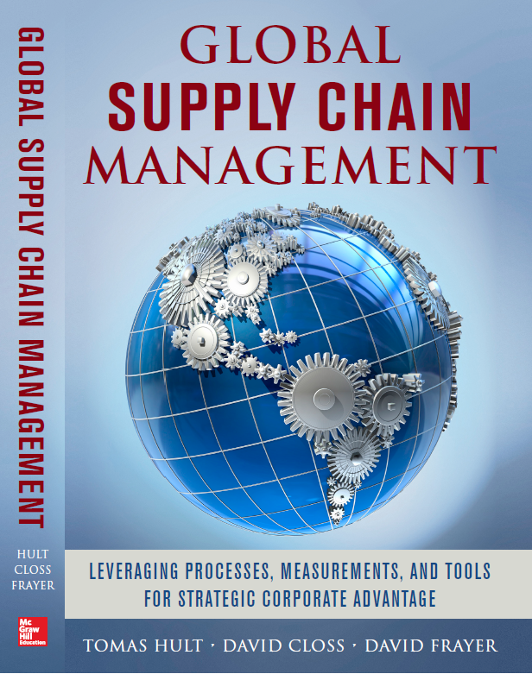

Slide 17

Goals of Global SCM
Develop and maintain strategic and operational aspects of global supply chains
Identify and leverage industry globalization drivers that affect global supply chains
Have knowledge of and leverage the worldwide infrastructure for global supply chains
Manage coordination and integration of global supply chains

Slide 18
But most importantly, identify leverage points for
Identify leverage points for:
  Global logistics in global supply chains
  Global purchasing in global supply chains
  Global operations in global supply chains
  Global market channels in global supply chains

Slide 19
  How global is the industry?
  How global should the firm’s strategy be?
  How global should the supply chains be?

Slide 20
100%
Globalized
Need to educate the global marketplace
(e.g., potential wasting of resources)
Ideal
Strategy
Alignment
Range
Industry
Average
Not leveraging the global marketplace
(e.g., potential wasting of market opportunities)
100%
Domestic

Slide 21
Denmark
2013 to 2018: +27%
2013 to 2023: +42%
Finland
2013 to 2018: +23%
2013 to 2023: +42%
Norway
2013 to 2018: +20%
2013 to 2023: +43%
Sweden
2013 to 2018: +30%
2013 to 2023: +53%
USA
2013 to 2018: +20%
2013 to 2023: +38%
INDUSTRY
Under-
Globalized
USA
Sweden
Finland
Norway
Denmark

Slide 22
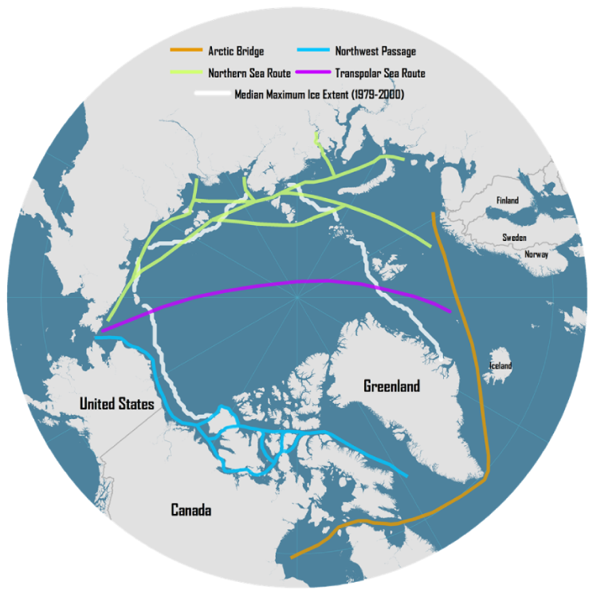
Strategically compete supply chain vs. supply chain

Slide 23

“What makes you unique?”

Slide 24
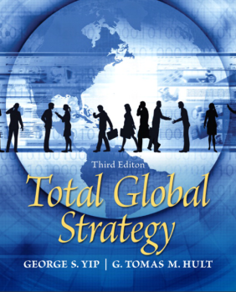
Global Strategy Levers 2013
(0-100)
Market Participation
Products/ Services
Marketing
Competitive Moves
Supply Chain Management
62
61
66
60
59

Slide 25
Forecasted Change 2013-2018 (0-100)
Market Participation
Products/ Services
Marketing
Competitive Moves
Supply Chain Management
+7
+8
+4
+9
+9

Slide 26
Global Strategy Composition

Slide 27
Function | Cost Reduction | Improved Quality | Increased Customer Satisfaction | Competitive Leverage
Logistics | Creates a cost-efficient network of distribution centers, inventory management systems, and forward/reverse transportation options | Logistics helps to improve quality – processes and products – via its globally maximized distribution, materials handling, and transportation efforts | Effective planning of inventory, forward, and reverse transportation increases customer satisfaction with the overall global supply chain | Global inventory and transportation management help exploit economies of scale and differences in country factor costs
Purchasing | Integrates a strategic level of global purchasing given customers and channels involved and suppliers and supplier networks available | Effective use of core competencies, outsourcing, and global supplier selection result in quality improvements throughout the chain | Creates an order fulfillment and delivery system that maximizes global customer and channel needs | Global purchasing practices allow for maintenance of cost advantages independent of local conditions
Operations | Achieves cost reduction via a Total Cost Analysis involving global options, competitive priorities, and process-based quality standards | Competitive priorities focused on quality, global production located to achieve quality, and processed-based quality standards improve overall quality | The combination of a Total Cost Analysis approach coupled with process-based quality standards and production efficiencies create greater value and satisfaction | Global operations allow for flexibility on where to base competitive advantage – whether it is speed, quality, cost or flexibility based
Market Channels | Develops the strategically most optimal global market entry mode, online presence, and alignment with marketing mix variables | Maximizing efforts of the customer value-creating processes, alignment with the marketing mix, and understanding global customers’ needs | Global channels are centered on creating satisfaction via value – value in the processes and value in the alignment with the marketing mix | A global market channel approach reduces design and production costs, focuses talents, and reinforces marketing

Slide 28
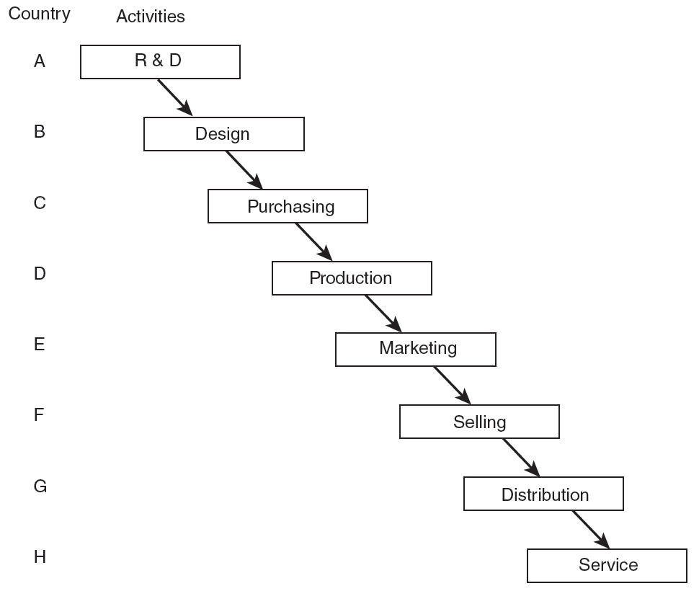
The Extreme Global Value Chain

Slide 29
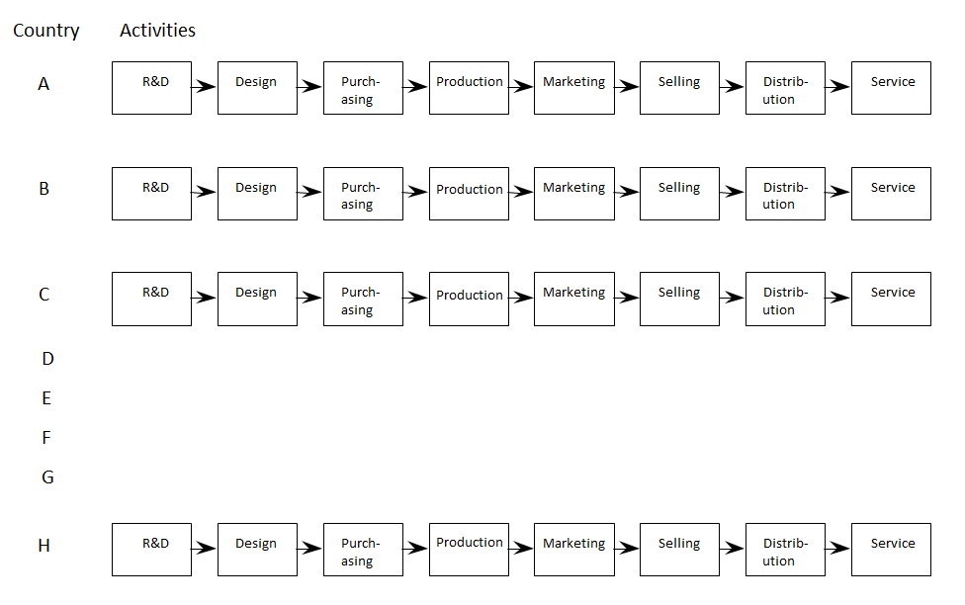
The Fully Multilocal Value Chain

Slide 30
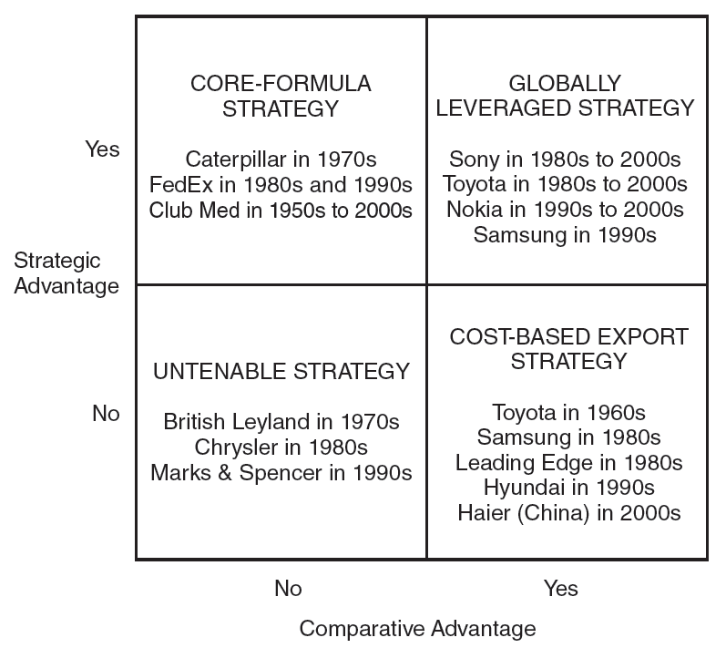
Locating Global Activities
Make Sure to Combine Strategic (Company) and Comparative (Country) Advantages

Slide 31
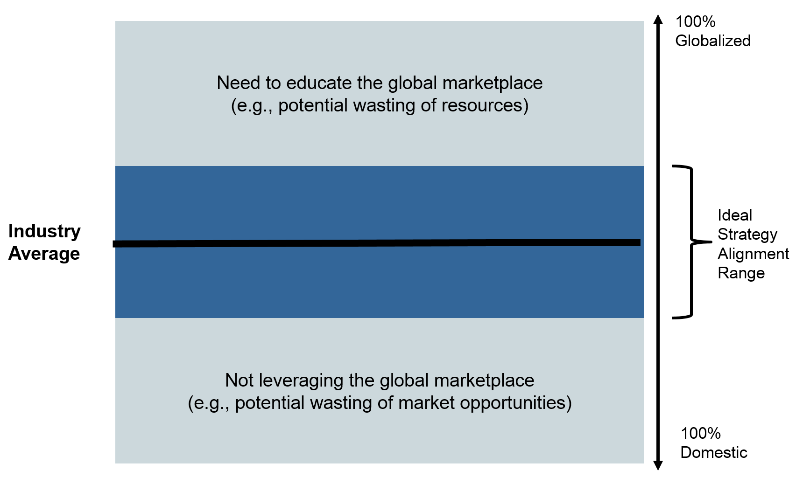
Industry
Globalization Drivers

Slide 32

Industry Globalization Drivers
MARKET
Common customer needs and tastes
Global customers and channels
Transferable marketing
Lead countries
GOVERNMENT
Favorable trade policies
Compatible technical standards
Common marketing regulations
Government-owned competitors & customers
Host government concerns
COST
Global scale economies
Steep experience curve
Global sourcing efficiencies
Favourable logistics
Differences in country costs
High product development costs
Need for technology transfer
COMPETITIVE
High exports and imports
Competitors from different continents
Interdependence of countries
Competitors globalized
Transferable competitive advantage

Slide 33
Global

Slide 34
All Industries
In Ten Years
All Industries
Current
All Industries
In Five Years
Market Globalization Drivers

Slide 35
All Industries
In Five Years
All Industries
In Ten Years
All Industries
Current
Cost Globalization Drivers

Slide 36
All Industries
In Ten Years
All Industries
Current
All Industries
In Five Years
Government Globalization Drivers

Slide 37
All Industries
Current
All Industries
In Five Years
All Industries
In Ten Years
Competitive Globalization Drivers

Slide 38
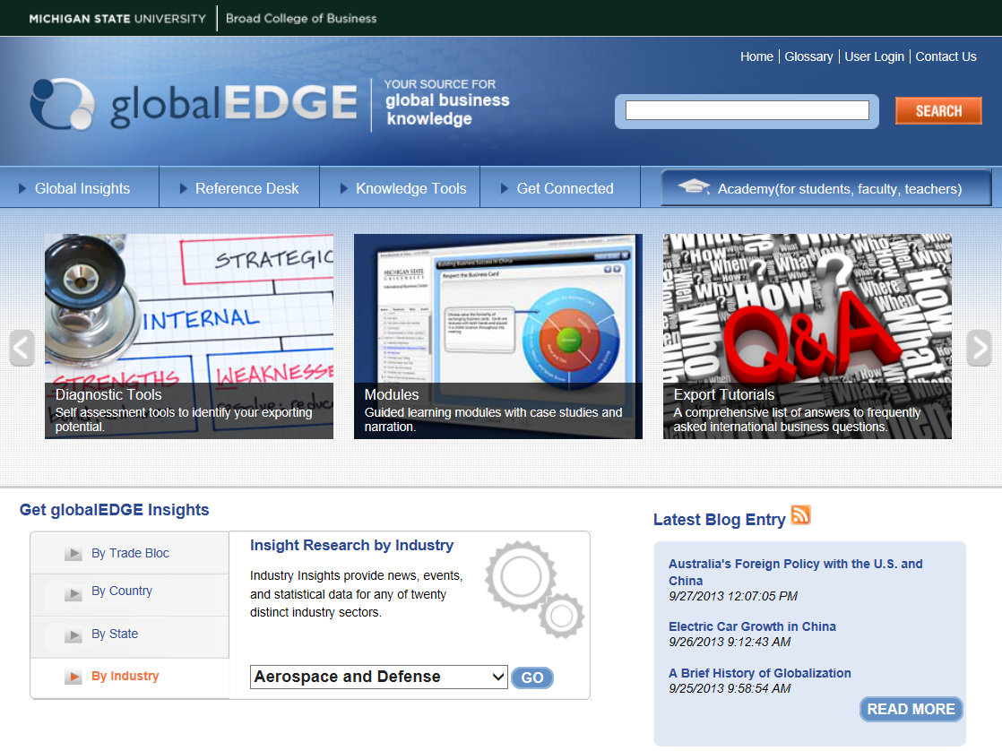

Slide 39
Global Logistics
Global Purchasing
Global Market Channels
Global Suppliers
Global Customers
Global Operations

Slide 40
Global SCM
Logistics
Purchasing
Operations
Market Channels
Global SCM
Logistics
Purchasing
Operations
Market Channels
Logistics is 2nd most important (94) and 2nd most globalized (61)
Inventory Management
Transportation
61
60
94
96
89
92
62
60

Slide 41
Logistics Changes 2013 to 2018
Global SCM
Logistics
Purchasing
Operations
Market Channels
Largest industry impact from:
  Market globalization drivers
  Cost globalization drivers
+8
+9
-1
-2
0
+1
+8
+7

Slide 42
Global Logistics Topics
Global distribution centers
Global inventory management
Global packaging and materials handling
Ocean transportation
Air transportation
Land and intermodal transportation
Reverse logistics

Slide 43
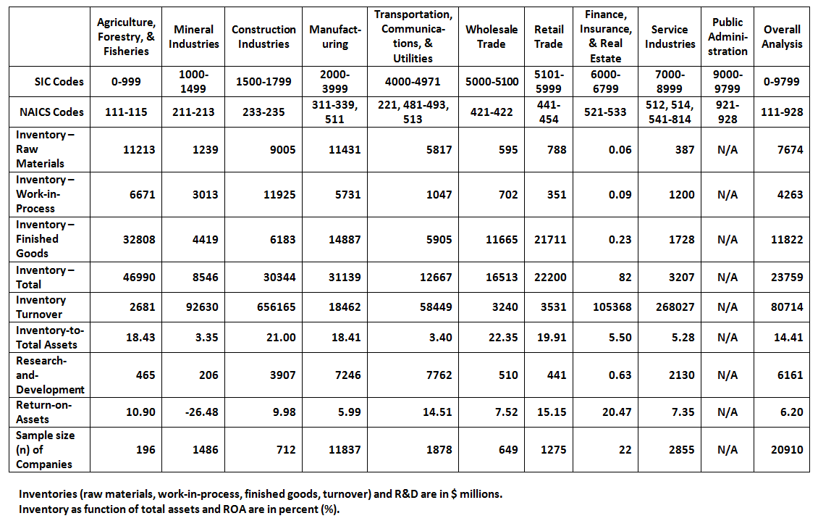
Global Inventory Statistics Across Industries
20,910 Companies in 105 Countries

Slide 44
Inventory Positions
Raw
Materials
Work-in-Process
Finished Goods
Global Suppliers
Global Customers
32.30%
17.94%
49.76%

Slide 45
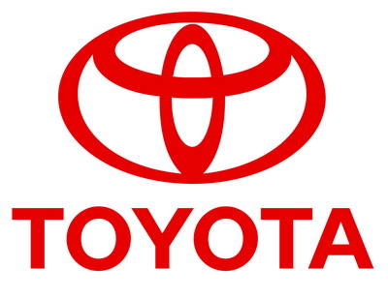
Toyota
Toyota is from Japan and one of the largest automobile companies in the world
25.87 percent of Toyota’s inventories are in raw materials and component parts
13.63 percent of Toyota’s inventories are in work-in-process
60.50 percent of Toyota’s inventories are in finished vehicles that are ready for sale
8.71 percent of Toyota’s assets are in total inventories (raw materials, work-in-process, and finished goods)

Slide 46

Siemens
Siemens from Germany is an integrated technology company with a primary focus on energy, water, healthcare
17.50 percent of Siemen’s inventories are in raw materials and component parts
67.20 percent of Siemen’s inventories are in work-in-process
15.30 percent of Siemen’s inventories are in finished goods that is ready for sale
24.28 percent of Siemen’s assets are in total inventories (raw materials, work-in-process, and finished goods)

Slide 47

GlaxoSmithKline
GlaxoSmithKline British multinational pharmaceutical, biologics, vaccines and consumer healthcare company headquartered in Brentford, London.
24.30 percent of GlaxoSmithKline’s inventories are in raw materials and component parts
33.70 percent of GlaxoSmithKline’s inventories are in work-in-process
42.00 percent of GlaxoSmithKline’s inventories are in finished goods that is ready for sale
23.95 percent of GlaxoSmithKline’s assets are in total inventories (raw materials, work-in-process, and finished goods)

Slide 48
Global Logistics
Global Purchasing
Global Market Channels
Global Suppliers
Global Customers
Global Operations

Slide 49
Global Purchasing Topics
Evolving from international to global purchasing
Types of purchasing strategy
Outsourcing and offshoring
Global customer and channel management
Order fulfillment and delivery
Global supplier selection
Global supplier networks

Slide 50
Domestic Purchasing
Level I
Engage in domestic purchasing activities only
No concerted effort is made to engage in purchasing internationally
Some companies using a “domestic” oriented purchasing do engage in international market channels for B2B or B2C sales
Level II
Level III
Level IV
Level V
Notes:
Monczka et al. (2005), Purchasing and Supply Chain Management

Slide 51
International Purchasing
Level I
Level II represents basic international purchasing that is typically responsive and uncoordinated
Level III represents purchasing strategies that begin to recognize that well-developed worldwide purchasing strategy can be very beneficial
Level II
Level III
Level IV
Level V
Notes:
Monczka et al. (2005), Purchasing and Supply Chain Management

Slide 52
Global Purchasing
Level I
Level IV represents the cross-locational integration and coordination of purchasing strategy across worldwide locations
Level V represents the cross-functional integration and coordination of purchasing strategy across worldwide locations
Level II
Level III
Level IV
Level V
Notes:
Monczka et al. (2005), Purchasing and Supply Chain Management

Slide 53
Purchasing Activities:
The View by Purchasing Professionals
2013
2018
2023
Domestic Purchasing
Level I
Engage in domestic purchasing activities only
33%
23%
26%
Level II
Engage in international purchasing activities only as needed
22%
23%
22%
International Purchasing
Level III
International purchasing activities as a part of SCM strategy
16%
20%
21%
Level IV
Global purchasing activities integrated across worldwide locations
15%
15%
13%
Global Purchasing
Level V
Global purchasing activities integrated across worldwide locations & functional groups
14%
19%
18%

Slide 54
Purchasing Activities:
The View by C-Suite Executives
2013
2018
2023
Domestic Purchasing
Level I
Engage in domestic purchasing activities only
9%
5%
5%
Level II
Engage in international purchasing activities only as needed
23%
15%
12%
International Purchasing
Level III
International purchasing activities as a part of SCM strategy
19%
15%
12%
Level IV
Global purchasing activities integrated across worldwide locations
19%
13%
10%
Global Purchasing
Level V
Global purchasing activities integrated across worldwide locations & functional groups
30%
52%
61%

Slide 55
Global Logistics
Global Purchasing
Global Market Channels
Global Suppliers
Global Customers
Global Operations

Slide 56
Global Operations Topics
Make-or-buy decision in global supply chains
Global production and manufacturing
Competitive priorities in global supply chains
Total cost analysis in global supply chains
Process-based quality standards
Supply chain operations reference model
Operational logistics providers (1PL/2PL/3PL/4PL/5PL)

Slide 57
Growth of International Production

Slide 58
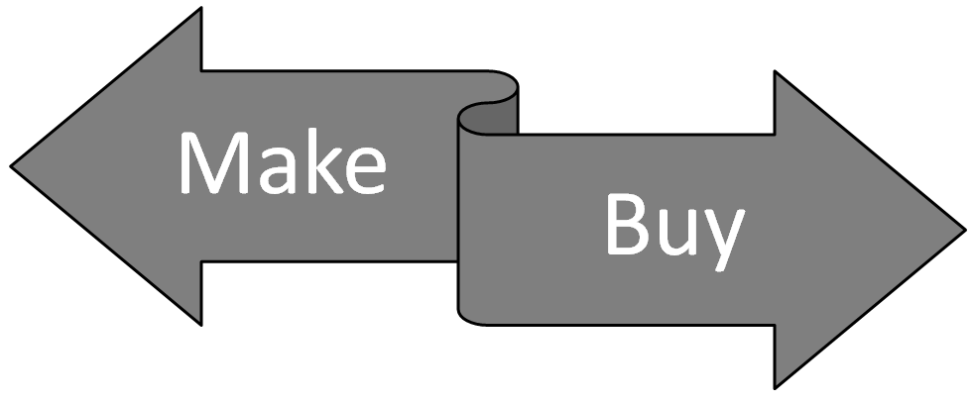
Cost
Production Capacity
Notes:
http://www.enotes.com/make-buy-decisions-reference/make-buy-decisions

Slide 59
Operationally Favoring a Make Decision
Cost
Quality Control
Proprietary Technology
Limited Suppliers
Excess Capacity
Having Control
Assurance of Continual Supply
Industry Drivers
Production Capacity
Notes:
http://www.enotes.com/make-buy-decisions-reference/make-buy-decisions

Slide 60
Operationally Favoring a Buy Decision
Cost
Production Capacity
Non-Essential Item
Brand preference
Inventory Planning
Small Volumes
Supplier Compe-tencies
Lack of Expertise
Multi-Source Policy
Notes:
http://www.enotes.com/make-buy-decisions-reference/make-buy-decisions

Slide 61
Global Logistics
Global Purchasing
Global Market Channels
Global Suppliers
Global Customers
Global Operations

Slide 62
Global Market Channels Topics
Customer value-creating global processes
International market entry modes
International wholesaling, retailing, and franchising
Exporting and importing
Going global online
Place and the other 3Ps
globalEDGE diagnostic tools for global market channel partners

Slide 63
Customer Value-Creating Processes
Effects of PDM, MCM, and CRM in Global Market Channels
Customer
Relationship
Management
Product
Development
Management
Market Channels
Management
Satisfied
Customer
Notes:
Srivastava et al. 1999, JM (customer value-creating processes)
Data from Managerial ACSI study

Slide 64
Managing Global
Supply Chains

Slide 65
Global Supply Chains
Logistics
Purchasing
Market Channels
Operations
Industry
Globalization
Drivers
Strategic and
Operational
Managing
Coordination
and Integration
Worldwide
Infrastructure

Slide 66
Managing Global Supply Chains
Value of Managing the Location of Global Activities
Importance of Coordination on Global Supply Chains
Coordination Mechanisms in Global Supply Chains
Interorganizational Relationships in Global Supply Chains
Value Propositions in Global Supply Chain Relationships
Stakeholders and Global Supply Chains Sustainability
Guidelines for Managing Global Supply Chains
Wrap-up of the Intriguing World of Global Supply Chain Management

Slide 67
Importance and Globalization 2013
Global SCM
Logistics
Purchasing
Operations
Market Channels
61
93
60
Coordination
62
88
89
96
92
60
60

Slide 68
Changes 2013 to 2018
Global SCM
Logistics
Purchasing
Operations
Market Channels
+8
0
+9
Coordination
+8
+5
0
-2
+1
+9
+7

Slide 69


Slide 70
Explaining Performance
70% 21 25%
→
Global Strategy
Global Supply Chains
To stay competitive, companies need to increase the globalization efforts of their supply chain by 25 percent in the next five years and 43 percent in the next 10 years.

Slide 71



www.SCMstrategy.com

