Slide 1
Spotlight on the Middle East
Ahmet H. Kirca, Ph.D.
Associate Professor
Michigan State University
Eli Broad Graduate School of Management
Department of Marketing
11th Biennial International Business Institute
for Community College Faculty
Copyright © 2015 by Ahmet H. Kirca

Slide 2
Agenda
Boundaries of the “Middle East”
Some Statistics
Key Challenges
Key Opportunities
Tips for Middle East
Recommended Sources

Slide 3
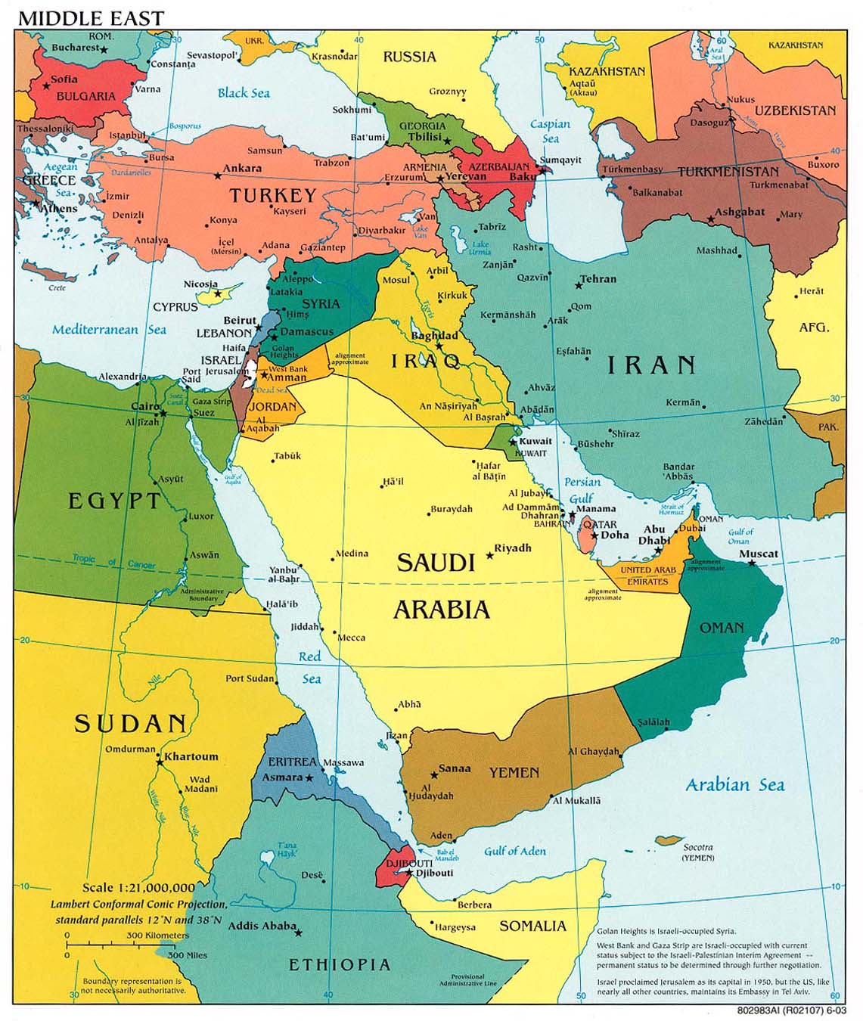
Azerbaijan (?) - Armenia (?) - Bahrain - Cyprus (?) - Egypt - Georgia (?) - Jordan - Iraq - Iran - Israel - Kuwait - Lebanon - Libya (?) - Oman - Qatar - Saudi Arabia - Syria - Turkey (?) - Yemen - UAE
http://en.wikipedia.org/wiki/Middle_East
Notes:
Middle East defines a geographic area but does not have a precise defined borders.
Eisenhower Doctrine in 1957: “Near East”, “Middle East” and “Far East”
The area lying between and including Libya on the west and Pakistan on the east and Turkey on the North and the Arabian peninsula to the south, plus the Sudan and Ethiopia.

Slide 4
Some Statistics of Interest
Country | Population | Land Area (km²) | % Internet Users
Bahrain | 1,300,000 | 760 | 88.0
Egypt | 14,000,000 | 1,001,450 | 21.2
Iran | 75,100,000 | 1,648,195 | 43.2
Iraq | 31,500,000 | 438,317 | 1.1
Israel | 7,600,000 | 20,770 | 71.6
Oman | 3,100,000 | 309,500 | 41.7
Qatar | 1,700,000 | 11,586 | 51.8
Saudi Arabia | 29,200,000 | 2,149,690 | 38.1
Turkey | 73,600,000 | 783,562 | 45.0
UAE | 5,400,000 | 83,600 | 75.9
Yemen | 23,600,000 | 527,968 | 1.8
USA | 309,600,000 | 9,826,675 | 77.3

Slide 5
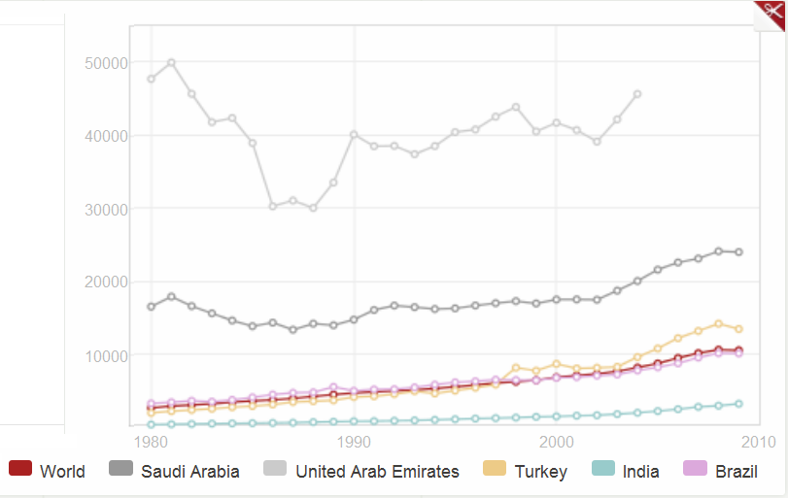
GNI per Capita

Slide 6
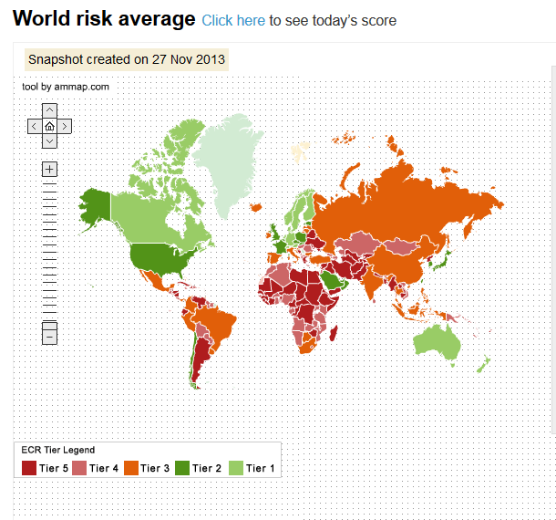

Slide 7
Key Challenges in the Middle East
Regional conflicts and political/economic uncertainty.
Global security issues.
Restrictions and trade sanctions (e.g. Iran, Syria).
Dependence on oil revenues and state-sponsored subsidiaries.
High unemployment rates, young population, and other problems common to emerging country markets.
Cultural, political, and economic differences among countries in the Middle East. (e.g. Turkey, Israel, Iran, Saudi Arabia).

Slide 8
Key Opportunities in the Middle East
Bilateral free trade initiatives and agreements with the US and EU (e.g., Saudi Arabia, Israel, Jordan, Egypt)
Regional integration efforts (Gulf Cooperation Council – GCC; Middle East Free Trade Area by 2013)
Policies intended to attract FDI and to diversify economically.
Privatization of traditionally state-owned enterprises.
Significant progress on building institutional infrastructure (e.g., Bahrain, Israel, Turkey, UAE, Kuwait)
Population growth and economic development.

Slide 9
Opportunities (continued)
Resource rich countries with stable governments with high rates of economic development (e.g. Saudi Arabia, Qatar, Kuwait).
Select countries with close trade relationship with the rest of the World (e.g., Bahrain, Israel, Turkey, UAE).
Potentially high growth/high potential markets.
Reconstruction efforts in Iraq.
Fostering trade and investment in the region is fundamental to restoring stability in the Middle East.

Slide 10
Reality versus Perception…
Starting a Business
Economy | Procedures (number) | Duration (days) | Cost | Min. Capital
 |  |  | (% GNI per capita) | (% GNI per capita)
United States | 5 | 5 | 0.7 | 0
Brazil | 17 | 152 | 9.9 | 0
China | 13 | 35 | 9.3 | 213.1
Hungary | 6 | 38 | 20.9 | 74.2
India | 11 | 35 | 73.7 | 0
Indonesia | 12 | 97 | 86.7 | 83.4
Mexico | 8 | 27 | 14.2 | 12.5
Average of Selected Emerging Country Markets | 11.2 | 64.0 | 35.8 | 63.9
Egypt | 10 | 19 | 68.8 | 694.7
Iran | 8 | 47 | 5.4 | 1.3
Israel | 5 | 34 | 5.1 | 0
Kuwait | 13 | 35 | 1.6 | 100.8
Oman | 9 | 34 | 4.5 | 84.7
Saudi Arabia | 13 | 39 | 58.6 | 1,057.50
Turkey | 8 | 9 | 26.8 | 18.7
United Arab Emirates | 12 | 63 | 36.4 | 338.2
Average of Selected Countries in the Middle East | 9.8 | 35.0 | 25.9 | 287.0
Source: WB - Doing Business in 2008

Slide 11
How to do Business in the Middle East?
Region’s rich history, culture and religion, and their implications.
Critical role of government in the Middle East.
The role of skepticism of Western institutions/ companies in the Middle East.
Islam is the glue of the Middle Eastern social fabric.
Collectivist, hierarchical, and close knit societies.
The importance of shame / face / honor / consensus / respect for authority / seniority.

Slide 12
Top 10 Tips for Middle East
It’s not what you know that is important so much as who you know -- “Wasta”
“Who is your sponsor?” - Connections can make or break a deal
With the right people, you will find that doors open for you and rules are bent enough to accommodate you.
Favors are not forgotten and often reciprocated.
Choosing the right partner is critical – take your time to find someone with commercial synergy, intellectual synergy, and with political muscle and business acumen.
Start with a couple small, quick deals to test the partner out before going for that mega deal.

Slide 13
Top 10 Tips for Middle East
2. Patience is a virtue
Patience is the single most important trait you need to have when dealing with Middle Eastern countries.
Closing a deal, finalizing an agreement, establishing consensus will take time. Set your expectations accordingly.
Showing impatience is a poor reflection on your character
Be flexible, be able to accommodate shifting schedules
Meetings may often start late, or cancelled all together due to ‘family obligations’. But you are expected to be punctual.

Slide 14
Top 10 Tips for Middle East
3. Business and Personal Relationships are One and the Same
“Do not take it personal, this is business” does not mean much for most Middle Easterners
Arabs will do business only with people they know and like
Small talk is essential for the counterparts to become comfortable with you
Trying to get down to business immediately is a sure way to fail
Humor is appreciated and is commonly used
Try to get personal

Slide 15
Top 10 Tips for Middle East
4. Face-to-face Communication is Essential
Regular personal visits are essential
No important business will be conducted or finalized over the phone, but minor business can be conducted this way
Emails and faxes are the least personal and the least important and may be ignored until you follow-up with the phone.
Body language is usually as important as the spoken word, so be on the lookout for non-verbal signals and also pay attention to your own posture. Maintain eye contact.

Slide 16
Top 10 Tips for Middle East
Be prepared to bargainds: “Am I buying or sell
Bargaining is in their blood. Everyone bargains, it’s seen as ‘entertainment’ or ‘sport’ .
No other business activity is more important or more stimulating
The Arabs may raise their voice, show temperament or engage in sudden outbursts – It’s part of their theatrics
However, you have to maintain composure; not raising your voice or losing your temper is critical. So is showing confidence.

Slide 17
Top 10 Tips for Middle East
6. Personal word is more important than a written agreement
Everything is negotiable, even a contract (which is seen more of a memorandum of understanding)
Personal relationships and trust are more important than legal papers or man-made laws
Spoken promises carry more weight than contractual clauses.
Important: Do not expect this to work in both directions. Westerners are outsiders and they are expected to follow their contractual obligations.

Slide 18
Top 10 Tips for Middle East
7. Understand Islam’s influence on business and personal life
Islam permeates all levels of society, and provides guidance, values and rules for personal life as well as for doing business.
All offices have prayer rooms, and meetings will not be scheduled during prayer times, Ramadan, and two religious holidays. Avoid conducting business during those times.
Friday is the day of congregational worship where all males are required to attend the prayers. No business is conducted on Fridays (Saturday is the other weekend day usually).
DO NOT criticize Islam under any circumstance! It’s not only offensive, but is also illegal in many countries.

Slide 19
Top 10 Tips for Middle East
Like many other cultures, showing appreciation of one’s culture is appreciated
Business language is English (it is a status symbol), but learning a few words of Arabic will be very appreciated
Do not generalize as “Arabs” or “Middle Easterns” – there are significant differences between the different countries and tribes, and many folks do not appreciate being put into a single basket.
Understand how names work. The name structure is:
First name - Father’s Name - Family name
People are usually referred to by their first names, so it’s Mr. John, not Mr. Smith.
Dress conservatively
‘Loss of face’ is the same as ‘loss of reputation’ and is important for them to avoid. If you take the blame, you will be appreciated.

Slide 20
Top 10 Tips for Middle East
9. Personal Space
Arabs enjoy standing in close proximity, and casual touching to the person they speak to is common. Showing signs of discomfort or moving away is offensive.
Handshakes are almost ceremonial. Expect a strong handshake and expect it to last very long. Islamic etiquette requires you to wait until the other person withdraws their hand. It’s common for men to walk while holding hands.
IMPORTANT: These only apply to people of same gender.
Do not initiate a handshake with an opposing gender. If they are used to dealing with Westerners, they may extend their hand in which case you can accept (then a short, soft, and brief handshake is appropriate), but if you initiate it you may be refused.
Do not touch or keep eye contact with a person of the opposite sex

Slide 21
Top 10 Tips for Middle East
10. Food and drinks are a sign of generosity
If offered a snack, always accept, and take at last a bite. You don’t have to finish it but you cannot refuse it.
Tea and coffee is a feature of meetings (companies typically have a “tea man” employed) and is a mark of hospitality, so do not refuse that either. After the first one, you can wiggle your cup to indicate you have had enough
Arabic Coffee – spicy, more like tea
Turkish Coffee – small, with settlements
Tea – sometimes black, sometimes sweet with condensed milk
Role of entertainment and hospitality in business dealings

Slide 22
Recommended Sources:
The Middle East: A Brief History of the Last 2,000 Years 1996 - By Bernard Lewis.
The Ottoman Centuries: The Rise and Fall of the Turkish Empire 1979 - By Lord Kinross.
A Peace to End All Peace: The Fall of the Ottoman Empire and the Creation of the Modern Middle East 1989 – David Fromkin
Legal Aspects of Doing Business in the Middle East 2006 - By Christian Campbell,
“Oasis Economies” in Business + Strategy, Issue 50, Spring 2008
Breakout Nations 2013 - By Ruchir Sharma

