Slide 1

INTERNATIONAL
ECONOMICS
Notes:
1

Slide 2

Carl Liedholm
Professor, Economics
Notes:
2

Slide 3
INTERNATIONAL TRADE
BASIC FACTS
Notes:
3

Slide 4
Which of the following is true about the United States and its international trade role?
The world’s largest exporter in absolute terms
A relatively “closed” economy (X/GDP low)
Its largest trading partner is China
Imports more gasoline than it exports
None of the above
Notes:
4

Slide 5
MAGNITUDE
2013
MERCHANDISE TRADE $18.8 TRILLION
SERVICES $ 4.6 TRILLION
Notes:
5

Slide 6
WORLD EXPORTS – 2013
MERCHANDISE
1) ?
2) U.S. $ 1.58 Trillion
3) GERMANY $ 1.45Trillion
4) JAPAN $ 0.72 Trillion
5) NETHERLANDS $ 0.67 Trillion
10/14
Notes:
6

Slide 7
OPENNNESS
MEASURE
EXPORTS/GROSS DOMESTIC PRODUCT
Notes:
7

Slide 8
EXPORTS/GDP
2013
THAILAND 74%
KOREA 54%
GERMANY 51%
WORLD AVERAGE 31%
CHINA 26%
JAPAN 15%
UNITED STATES 14%
NEPAL 11%
Notes:
8

Slide 9
DIRECTION OF TRADE
2011
INDUSTRIALIZED TO INDUSTRIALIZED 35%
DEVELOPING TO DEVELOPING 23%
INDUSTRIALIZED TO DEVELOPING 24%
DEVELOPING TO INDUSTRIALIZED 18%
Notes:
9

Slide 10
U.S TRADING PARTNERS
(Percent of US Exports)
2013
1) ?
MEXICO 13 %
CHINA 7 %
JAPAN 4 %
U.K. 3 %
GERMANY 3%
Notes:
10

Slide 11
WHAT GOODS?
Notes:
11

Slide 12
WHAT GOODS?
Exports
Imports
Notes:
12

Slide 13
UNITED STATES - 2013
GROSS EXPORTS ($ Millions)
FUEL OIL $ 64,000
GASOLINE $ 60,000
PASSENGER CARS $57,000
Notes:
13

Slide 14
GROSS EXPORTS AND NET EXPORTS (X-M)
GROSS EXPORTS OF GASOLINE $60 Bill.
e.g. to Latin America
- GROSS IMPORTS OF GASOLINE - $44 Bill.
e.g from Europe/Middle East
NET EXPORTS + $ 16
Notes:
14

Slide 15
UNITED STATES - 2013
NET EXPORTS (X-M) ($ Millions)
AIRCRAFT $ 40,000
SOYBEANS $ 23,000
CHEMICALS $ 20,000
FUEL OIL $ 20,000
GASOLINE $ 16,000
Notes:
15

Slide 16
UNITED STATES -2013
NET IMPORTS (X – M) ($ Millions)
CRUDE OIL - $ 267,000
PASSENGER CARS - $ 99,000
CELL PHONES - $ 90,000
Notes:
16

Slide 17
WHAT GOODS?
UNITED STATES
EXPORTS – BOTH MANUFACTURED AND PRIMARY
IMPORTS – BOTH MANUFACTURED AND PRIMARY
JAPAN
EXPORTS – MANUFACTURED
IMPORTS - PRIMARY PRODUCTS
CANADA
EXPORTS – PRIMARY PRODUCTS
IMPORTS – MANUFACTURED PRODUCTS
Notes:
17

Slide 18
Which of the following is true about the United States and its international trade role?
The world’s largest exporter in absolute terms
A relatively “closed” economy (X/GDP low)
Its largest trading partner is China
Imports more gasoline than it exports
None of the above
Notes:
18

Slide 19
GLOBALIZATION
*
Notes:
19

Slide 20
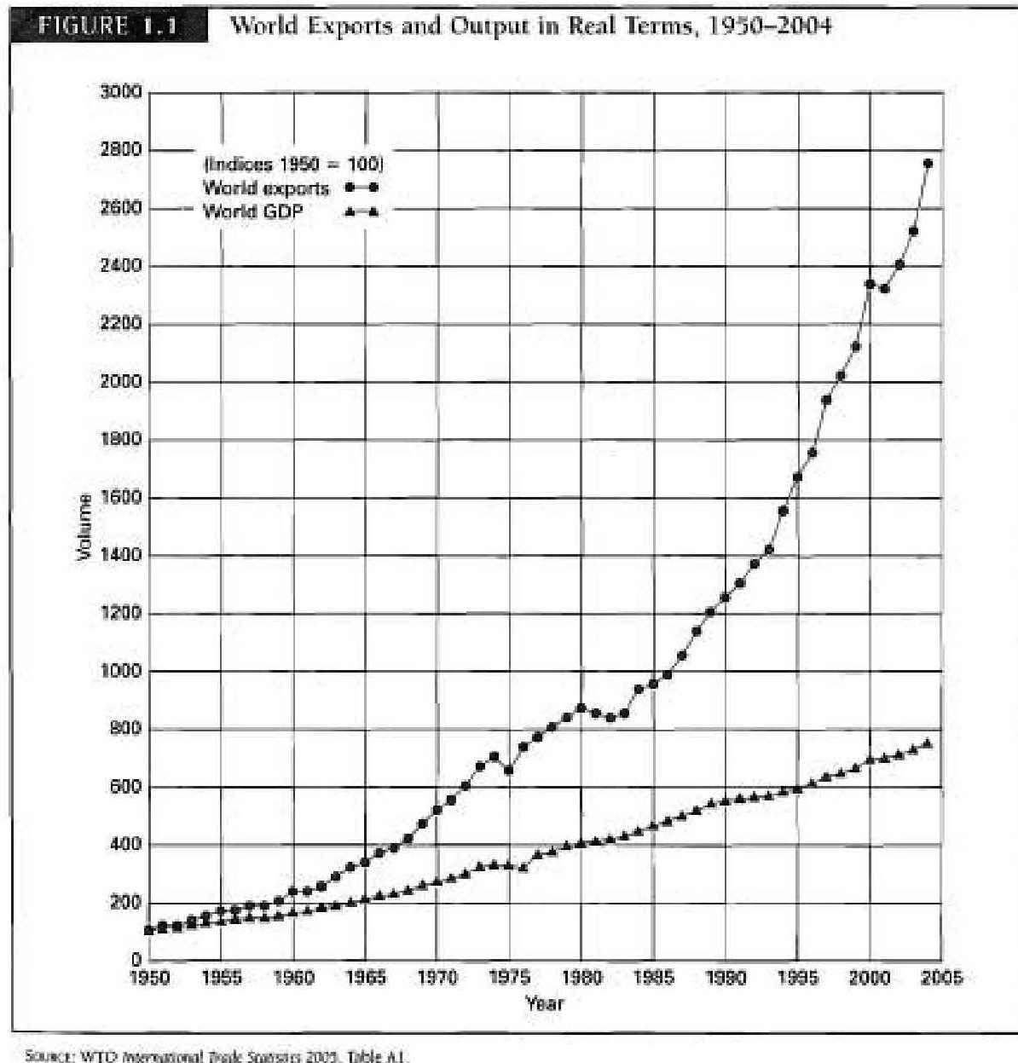
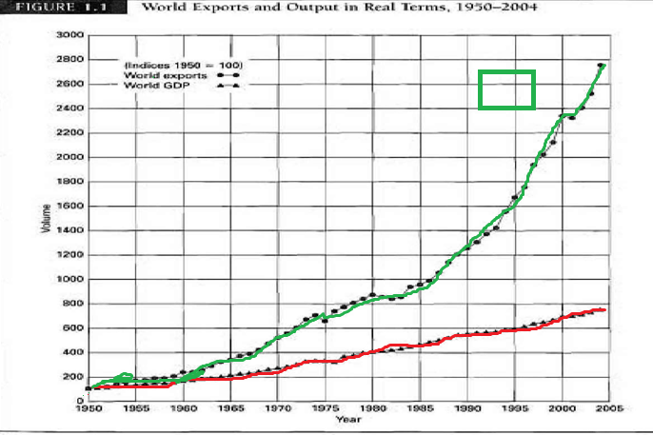
Exports
GDP
Notes:
20

Slide 21
GROWTH
SINCE 1950
WORLD TRADE 25X
WORLD OUTPUT 8X
Notes:
21

Slide 22
Recent Period
6 %
2 %
-12 %
+13.8 %
+ 5.5 %
+ 2.3%
+ 2.2%
Notes:
22

Slide 23
II -RECENT WAVE OF GLOBALIZATION
Notes:
23

Slide 24
GLOBALIZATION
NOT A NEW PHENOMENON
Expansion of Roman Empire
Voyages of Discovery
End of Napoleonic Wars
Notes:
24

Slide 25
PRIMARY DRIVING FORCES
OF RECENT WAVE OF GLOBALIZATION
1. REDUCTION OF TRADE BARRIERS
Notes:
25

Slide 26
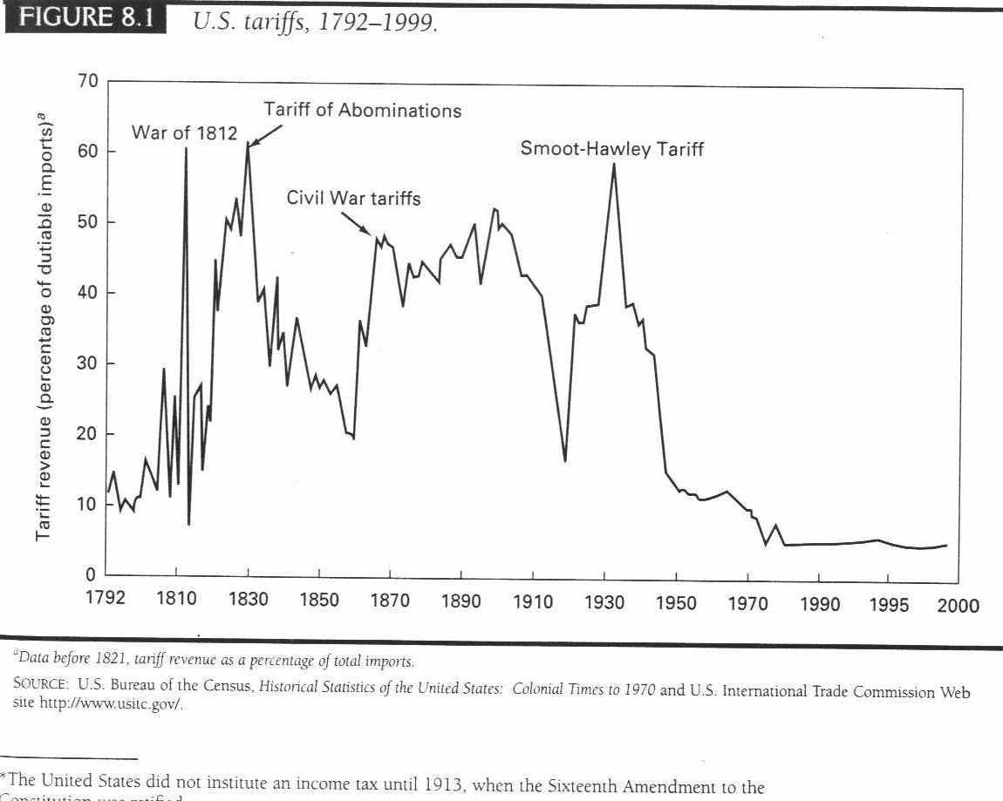
Trade and welfare
slide 26
Notes:
26
26

Slide 27
Effect on U.S. Household
$1 Trillion/year
$10,000/ household per year
Notes:
27

Slide 28
2. TECHNOLOGICAL CHANGE
Notes:
28

Slide 29
2. TECHNOLOGICAL CHANGE
I T
CONTAINERIZATION
Notes:
29

Slide 30
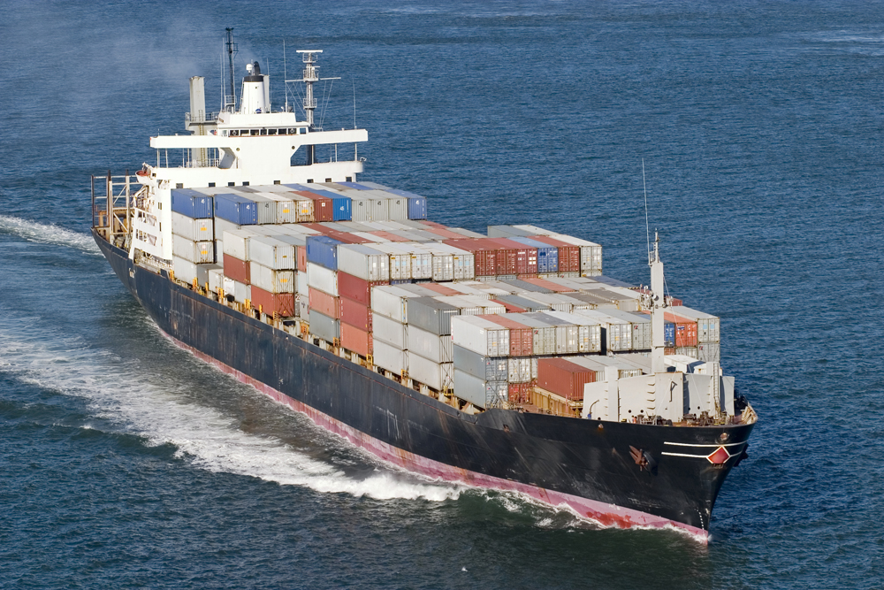
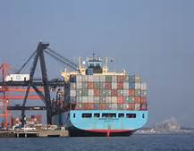

Slide 31
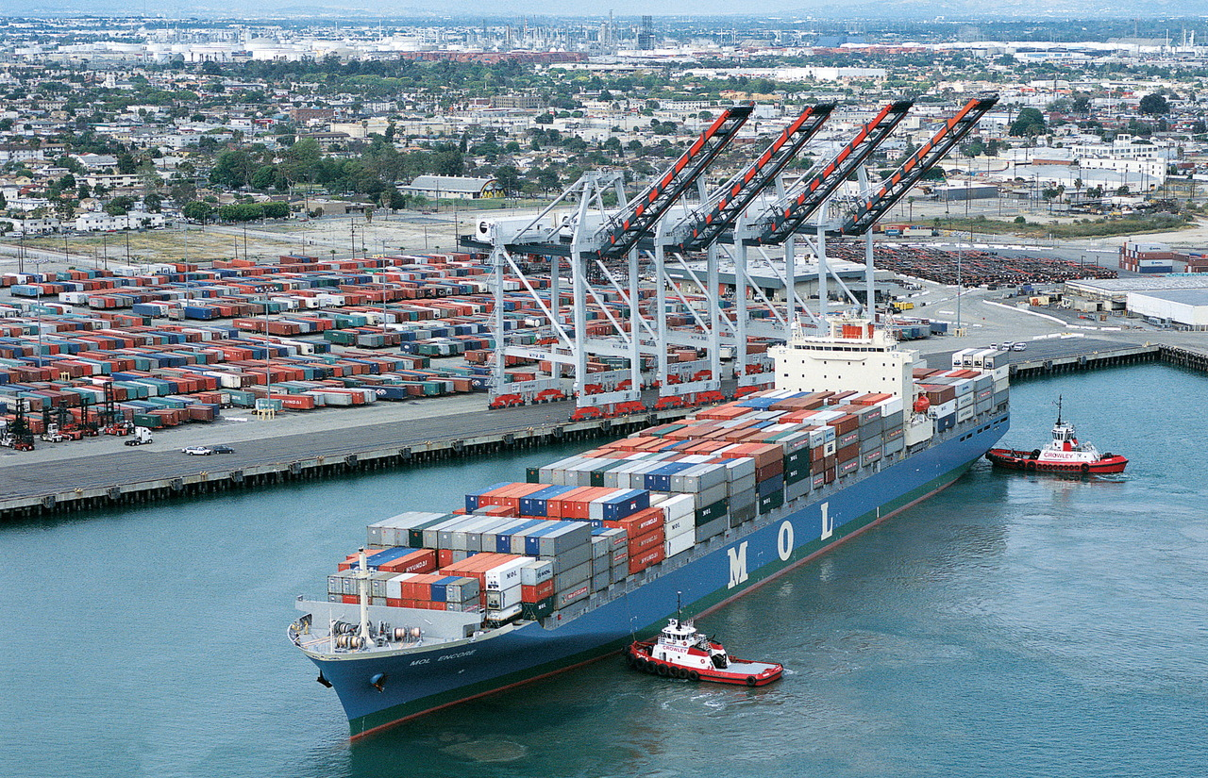

Slide 32
3. EMERGENCE OF NEW COUNTRIES
1)
2)
3)
Notes:
32

Slide 33
EFFECT ON JOBS
Notes:
33

Slide 34
EFFECT ON TRADE BALANCE
IMPORTS NOW GREATLY EXCEED EXPORTS
Notes:
34

Slide 35
U.S. FOREIGN TRADE DEFICIT
2014
CURRENT ACCOUNT DEFICIT
- $ 410m6 Billion
2.4% of GDP
Notes:
35

Slide 36
INTERNATIONAL ACCOUNTING
CURRENT ACCOUNT
-$410 Billion
+
FINANCIAL ACCOUNT
+$410 Billion (Liability to Foreigners)
=
0
Notes:
36

Slide 37
PROBLEM ?
FINANCE OR TRADE?
JOINTLY DETERMINED
CAPITAL SAVINGS GLUT?
5% GDP RED FLAG

Slide 38
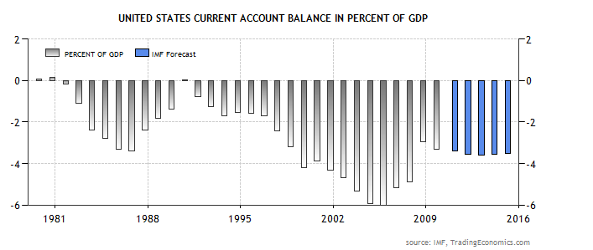
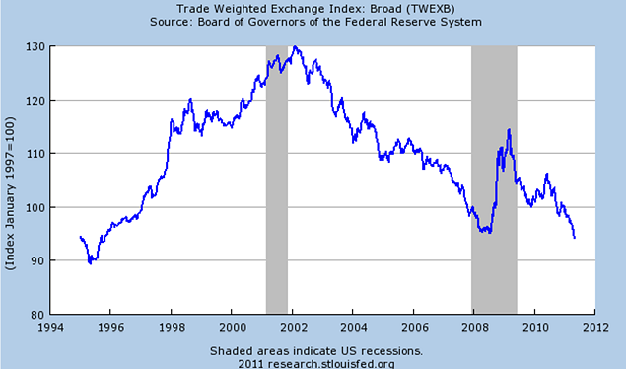
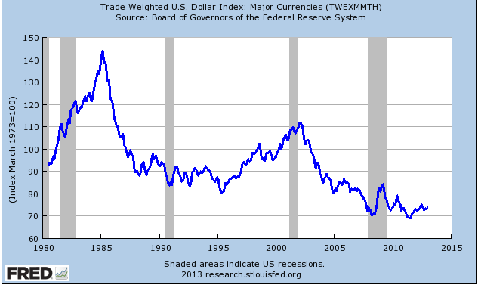
2011
3.1%
2014
2.4%
5 %

Slide 39
INTERNATIONAL FINANCE
*
Notes:
39

Slide 40
:
$
*
Notes:
40

Slide 41
The coins used in colonial America were primarily::
British (Shillings and Pounds)
Spanish (Pieces of Eight)
German (Thalers)
French (Ecus)
Dutch ( Ducatoons)

Slide 42
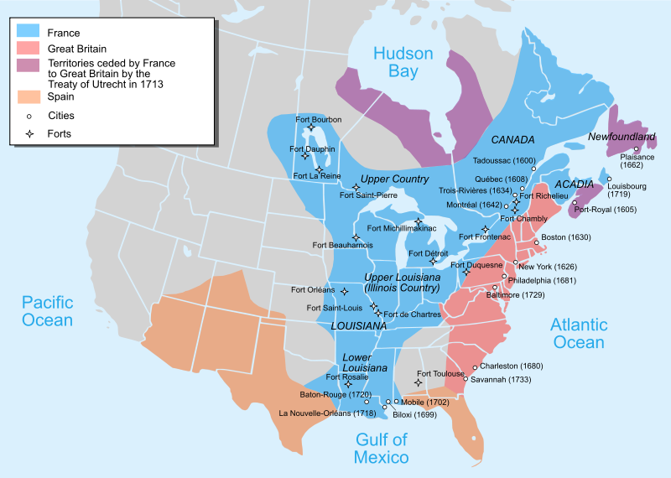
COLONIAL AMERICA - 1750
Notes:
42

Slide 43
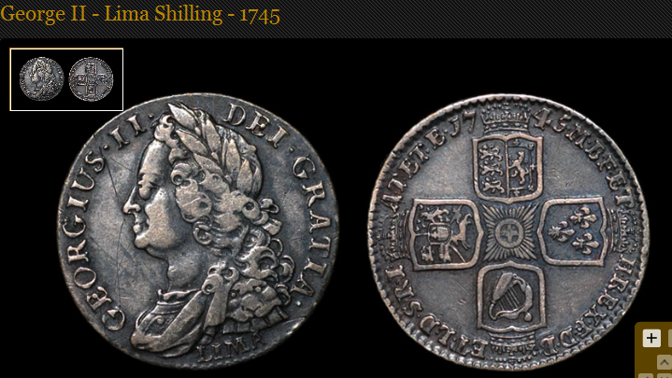
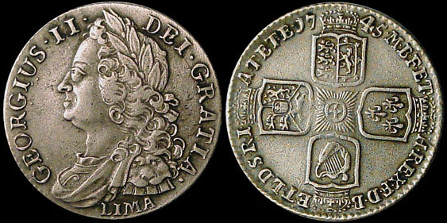
Notes:
43

Slide 44
EXCHANGE RATE
PRICE (RATIO)OF ONE CURRENCY IN TERMS OF ANOTHER
L/$
CURRENCY ON BOTTOM KEY
Notes:
44

Slide 45
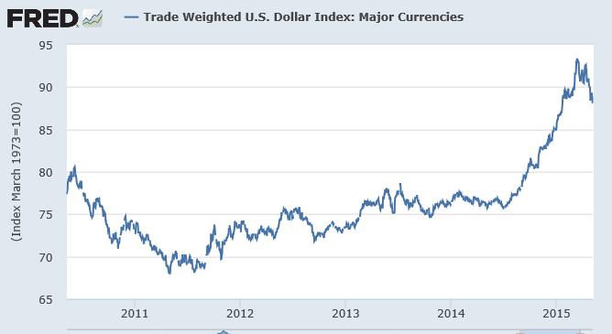

Slide 46
EFFECT OF STRONGER DOLLAR
MAKES U.S. FIRMS LESS COMPETITIVE INTERNATIONALLY
INCREASES PRICE OF U.S. GOODS ABROAD
DECREASES PRICE OF IMPORTED GOODS
Notes:
46

