Slide 1
2015 International Business Institute for Community College Faculty
Communications and Negotiating Style Differences between selected key countries
Keith Bezant Niblett
June 3, 2015 9.30.a.m.

Slide 2
On the Menu for Today
Ground rules for understanding other cultures
Considering how other country cultures prefer to negotiate
Individualistic Countries – Anglo Saxon (USA, UK), Germanic, Scandinavian (Sweden)
Mixed Culture Countries – Latin Mediterranean (France, Spain, Turkey)
Collectivist Countries – Asia (China, India, Korea)
Many more to chose from…but this does give you concepts of ‘How to value the difference’

Slide 3
Key Themes of Understanding Other Cultures:
Adopt, Adapt, Improve
British Prince of Wales Speech at The Trade Fair in Birmingham 1927
Personal ‘Voyage of Discovery’
Suspend Judgment – your value system may be challenged
Value the difference – it may not be your values, but the values expressed are reflective of a culture with a cultural history

Slide 4
Today We Draw from Two Key Sources
Richard D Lewis, author of the book “When Cultures Collide”. British linguist who works with many leading multi national companies
Gilles Spony, Academic and originator of the cross cultural tool, SPM that enables you to understand your cultural preferences and communications style when working with individuals and teams
These in turn draw from Kluckhohn & Strodbeck, Hofstede, Trompenaar & Shultz

Slide 5
Kluckhohn & Strodtbeck
The six common human problems or dilemmas:
Relationship to nature (Subjugation/Mastery)
Orientation to time (Past/Future)
Belief about basic human nature (Evil/Good)
Mode of human activity (Group/Doing on own)
Relationships among people (Hierarchy/Individual)
Use of space (Public/Private)
Kluckhohn, F. F. and Strodtbeck, F. L. (1961) Variations in Value Orientations
New York: Row, Peterson and Company.

Slide 6
Hofstede’s Five Dimensions
Power Distance
Individualism
Uncertainty avoidance
Masculinity
Long Term Orientation
Dilemmas theories drawn from IBM research 1990 - 2002

Slide 7
Trompenaars’ Concept of National Culture
Relationship with Time: Past, Present and Future Orientated
Relationship with the Environment: Degree of Control (Domination, Harmony, Subjugation – after Kluckhohn & Strudbeck)
Relationship with other People:
Universalism vs. particularism (rules vs. relations)
Individualism vs. collectivism (regard of oneself primarily as Individual or part of the group)
Neutral vs. emotional (task and objectives vs. feelings such as friendliness or trustworthiness)
Specific vs. diffuse (specific relationships as prescribed by contracts or is the ‘whole’ person involved)
Achievement vs. ascription (judged by ‘accomplishments’ or status derived by family, gender, age…)
Trompenaar +Hampden Turner, Riding the Waves of Culture - 1997
Notes:
Here is another set of cultural dimensions, which are fairly well known, which are important to understand.
These two commentators draw on the anthropologists: Kluckhon and Strodtbeck from early 60s and the sociologists Parson and Shils from early 50s.
They are different from Hofstede in that they do not want to represent nations as being at particular points on each axis, rather to focus on the dilemmas that people face and they argue that the key to success in intercultural interaction is in finding creative, synergistic solutions that can reconcile conflicting values and preferences.
It is also worth noting that they still do not offer the individual accuracy of The SPM.

Slide 8
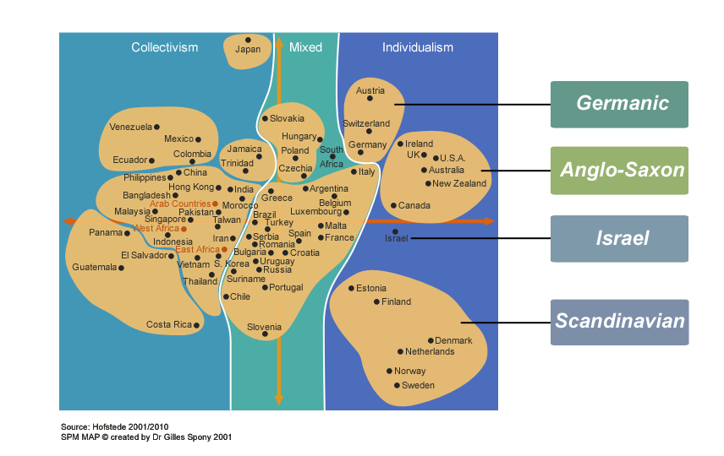
Individualistic Cultures Map

Slide 9
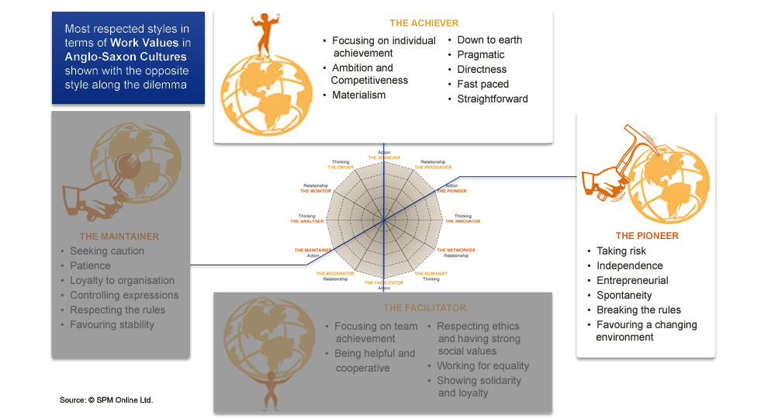
Anglo-Saxon Work Values (Ireland, UK, US Australia, NZ, Canada)

Slide 10
Anglo-Saxon Communication Styles

Slide 11
Anglo-Saxon Cultures
Result and Change Orientation
Individual achievement and personal success
Material rewards, remuneration perceived as a reflection of individuals’ worth Pragmatism, need for concrete, measurable results, quantitative approach
Short-term financial results
Preference for financial, general management skills
Management by objectives, profit center
Assertiveness, communication skills
Very strong orientation towards Action
Preference for a fast pace of decision and action, Need for change
Entrepreneurial spirit,
Informal style,
Delegation, little control, trust
Primacy of individual dynamics and individual responsibility
These are general themes to notice. BEWARE that observation and adaptation are still important. Individual differences may well increase the differences you feel when combined with the cultural differences.
Follows: 2 Negotiation Styles Examples, USA, UK/English

Slide 12
American Negotiation Style

Slide 13
English Negotiating Style

Slide 14
Germanic Communication Styles (Austria, Switzerland, Germany)
Germanic Communication Styles(Austria, Switzerland, Germany)

Slide 15
Germanic Cultures
Process and Result Orientation
Efficiency
Direct and effective exchange of information
Direct style of management
Focused on achieving objectives
High need for successful achievement
Competitiveness
Need for structure and precision
Rigorous methodical approaches, detailed and precise analyses
Well-organised and well-integrated courses of action
Valuing expertise and technical skills
Focus on quality standard
High level of professionalism
Well-defined functioning processes
These are general themes to notice. BEWARE that observation and adaptation are still important. Individual differences may well increase the differences you feel when combined with the cultural differences.
Follows: 1 Example of Negotiation Style; Germany

Slide 16
German Negotiating Style

Slide 17
Scandinavian Communication Styles
Estonia, Finland, Denmark, Netherlands, Norway, Sweden

Slide 18
Scandinavian Cultures
Result and Change Orientation
Egalitarian relationship
Social awareness and solidarity
Team work and team achievement
Participative management techniques
Dislike for assertiveness, moderation, search for consensus
Harmony
Quality of life
Harmony with natural environment
Trust towards others
Open-mindedness
Respect of individual differences
Open communication
Sincerity
Accepting criticisms
Openness and constructive mind set
Little status differentiation
Openness to change
These are general themes to notice. BEWARE that observation and adaptation are still important. Individual differences may well increase the differences you feel when combined with the cultural differences.
Follows: 1 Example of Negotiation Style; Sweden

Slide 19
Swedish Negotiating Style

Slide 20
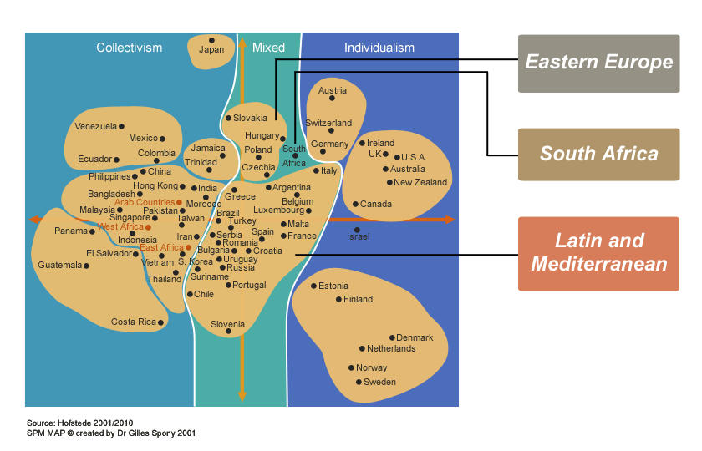
Mixed Cultures Map

Slide 21
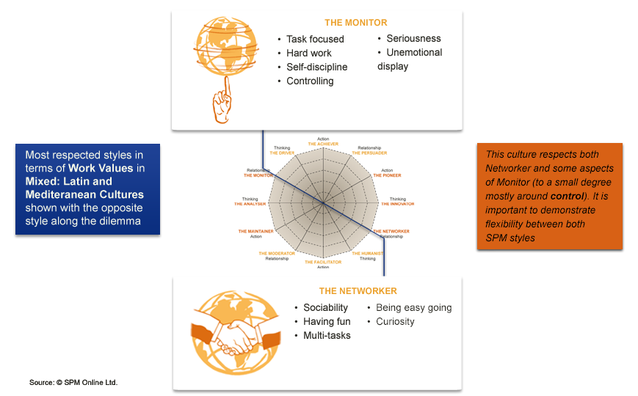
Latin and Mediterranean Work Values

Slide 22
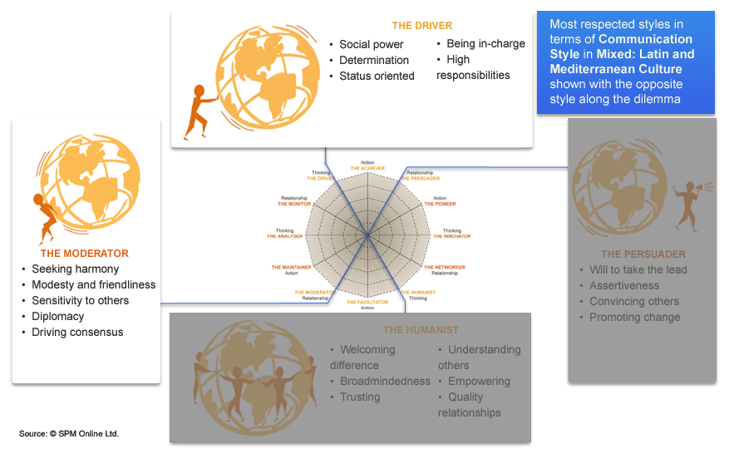
Latin and Mediterranean Communication Styles

Slide 23
Latin and Mediterranean Cultures
Process and Relationship Orientation
Networking aimed at reducing uncertainty
Importance of relationships and networking
Trust in people that one knows
Social solidarity, social rebellion
Spending time getting to know one another as a way of reducing uncertainty
Sensitivity; expression of emotions as a way to reduce stress and tensions
Importance of interaction and discussion
Family orientation, importance of social life and friendship
Compared to other western countries, more group oriented cultures:
Need for rules, but not often respected
Impression of chaos, as a reflection of individualistic attitudes
Pronounced hierarchical structures and strong expression of authority
Relationship based on status, but conflicts of power between different Hierarchical levels are common
Strong process / bureaucratic orientation
Sense of attachment to close network as a source of counter power
Sense of professionalism, stemming from old craftsmanship tradition
Cautiousness, slow pace of decision making
Conflict between the group dynamics and expression of individualism
These are general themes to notice. BEWARE that observation and adaptation are still important. Individual differences may well increase the differences you feel when combined with the cultural differences.
Follows: 3 Examples of Negotiation style; France, Spain, Turkey

Slide 24
French Negotiating Style

Slide 25
Spanish Negotiating Style

Slide 26
Turkish Negotiating Style

Slide 27
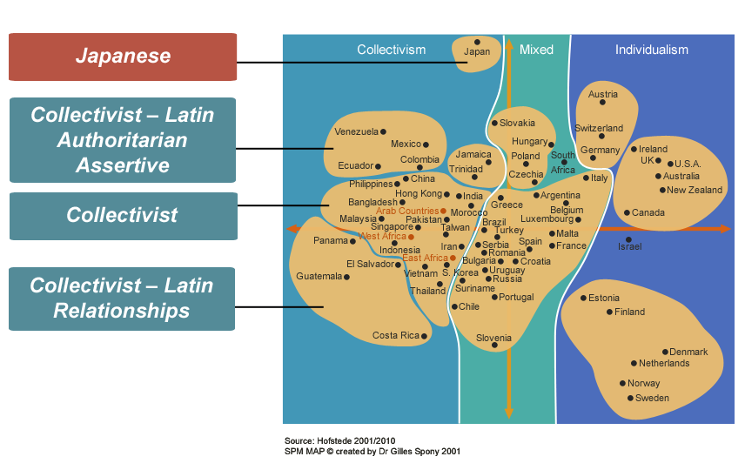
Collectivist Cultures Map

Slide 28
Collectivist Cultures Styles

Slide 29
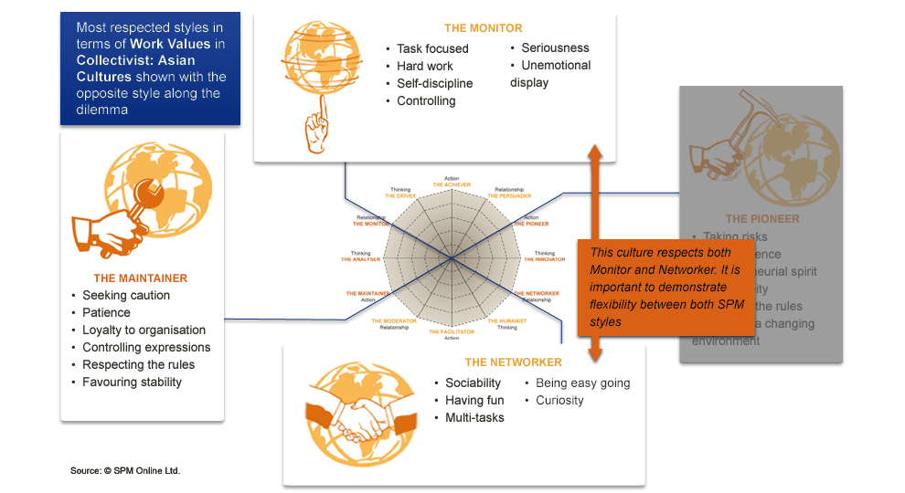
Collectivist Work Values

Slide 30
Collectivist Cultures
Highest scores on Group Dynamics – Average score on Self-enhancement/Consideration for Others
Individuals are socialised to put the requirement of their social environment above their personal interest
Culture of interdependence (as opposed to culture of independence)
Individual are bound with their social groups through informal and reciprocal rules of social behaviour
Showing a high level of loyalty
Strict respect of the social hierarchy
Obedience
Humility
Duty & Commitment towards the group objective
Long term relationship and reciprocal support
Reliability
Pronounced vertical and hierarchical structure and clear cut status differentiation
These are general themes to notice. BEWARE that observation and adaptation are still important. Individual differences may well increase the differences you feel when combined with the cultural differences.
Follows: 3 Examples of Negotiation Styles: China, India, Korea
Africa
Ethnic solidarity
Extended family
China
Confucian values
Family duty
Respect of social hierarchy
India/Muslim Countries
Religious values

Slide 31
Chinese Negotiating Style

Slide 32
Indian Negotiating Style

Slide 33
Korean Negotiating Style

Slide 34
Hope You Found This Useful
Any thoughts?
Comments?
Thanks for participating

