Slide 1
Building an International Business Program
Sarah Singer
Assistant Director, MSU International Business Center
singersm@msu.edu
ibc.msu.edu

Slide 2
Why an IB Program?
2014 U.S. Business Needs Survey
80% believe their business would increase if more staff had international expertise
39% have failed to fully exploit an international opportunity because of insufficient expertise on staff
Most important skills:
Appreciation for cross cultural differences
Understanding of country legal/govt requirements
Understanding of local markets/business practices
Understanding of global economic connectedness

Slide 3
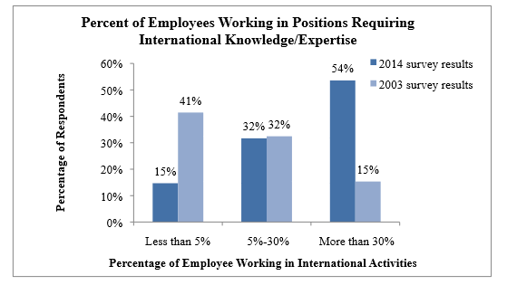
IB Is a Workforce Development Tool
Daniel, S. J., Xie, F., & Kedia, B. “2014 U.S. Business Needs for Employees with International Expertise.” In Internationalization of U.S. Education in the 21st Century: The Future of International and Foreign Language Studies Conference. The College of William and Mary, 2014.
http://www.wm.edu/offices/revescenter/internationalization/papers%20and%20presentations/danielkediafull.pdf

Slide 4
Pathways for Students
What do I do with IB degree?
Export departments of local firms
Logistics companies
Multinationals
Common job titles*
Import/export clerks, administrators, managers
Customs officer
Supply chain manager
Logistics analyst
*The Austin Community College IB Program website provides comprehensive information on titles and salaries for IB-related positions: http://www.austincc.edu/intlbus/faq.php.
Notes:
Especially relevant conversation to have with non-transfer students.

Slide 5
Program Components
Courses
Credentials
Study Abroad
Notes:
So you’re going to dive in and do it. Now what?

Slide 6
Courses

Slide 7
Core Courses
Most commonly offered, after IB:
International Marketing (26%)
International Economics (18%)
International Trade (15%)
International Management (12%)

Slide 8
Other Business Courses
Emerging Markets
International Entrepreneurship
Import/Export Regulations
Globalization and Culture
Intercultural Communication
Community College Course Syllabi Bank

Slide 9
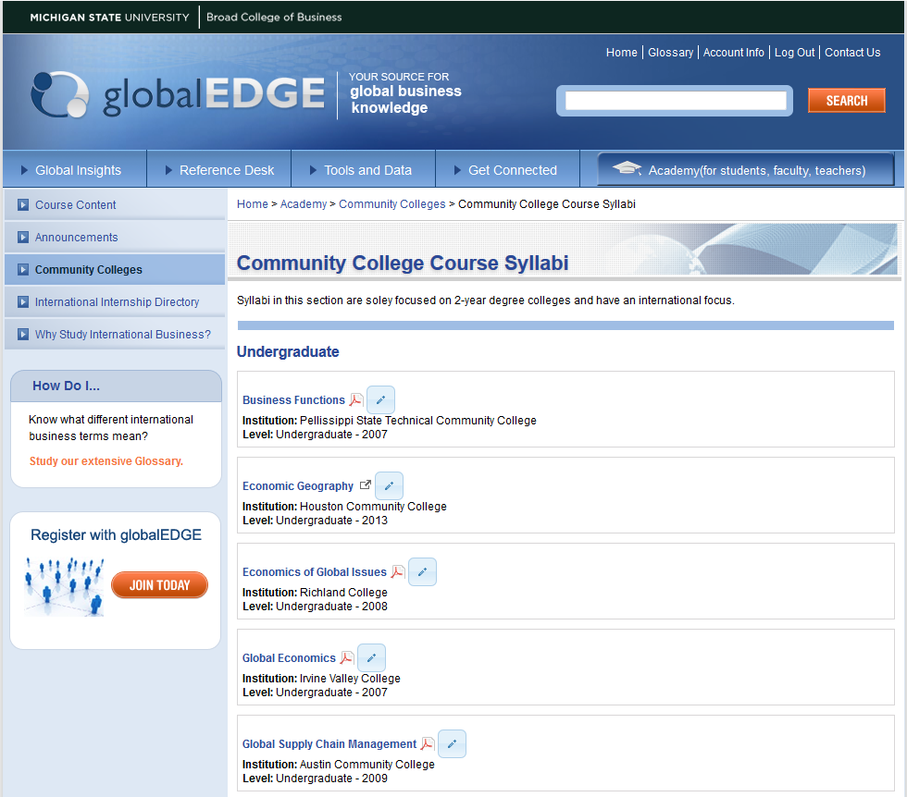

Slide 10
Globally-Focused Texts

Slide 11
Interdisciplinary Component
Will you have an interdisciplinary and/or language requirement?
Foreign Language
Language for the professions
Area Studies
Country specific
History of China; Mexico through the Ages
Region specific
African Music; Europe during World War II
Comparative courses
Economics, history, religion, political science, etc.

Slide 12
How to choose?
IBEX frequency
Survey of local needs/interests
Faculty expertise/interest
Follow a model

Slide 13
Take the R.o.a.D.*
globalEDGE Program Bank
Listing of all community college IB certificate and degree programs (with online listings)
*Rip-off and Duplicate!

Slide 14
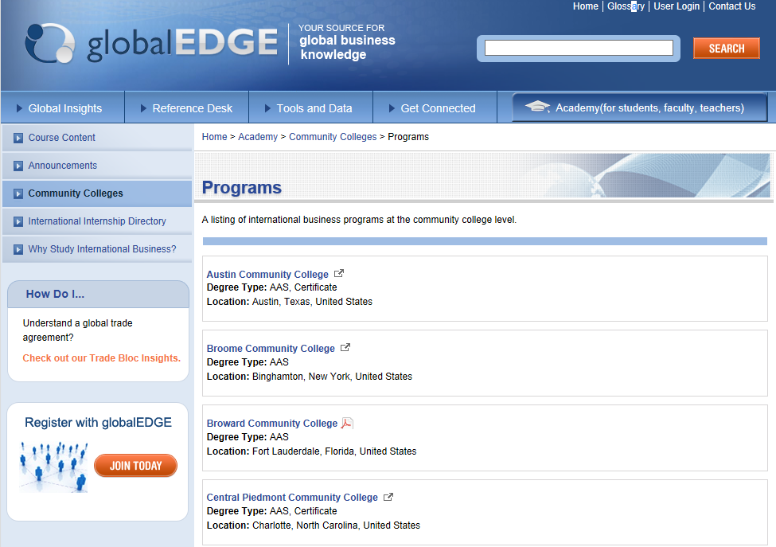

Slide 15
Credentials

Slide 16
NASBITE CGBP
NASBITE International
Member-based association committed to furthering international trade education.
1500 members from U.S., Canada, Latin America
Academia and industry, including SBDCs, World Trade Centers, Chambers of Commerce
Certified Global Business Professional (CGBP) credential since 2005
Notes:
NASBITE is a member-based association with approximately 1500 members from across the United States, Canada, and increasingly Latin America. Although the organization began as the North American Small Business International Trade Educators association, it is now known as NASBITE International, which reflects the growing international membership and broader focus of the organization generally. Our members – and I say our because, in the interest of full disclosure, I should tell you that I am a member of the Board of Governors – hail from public and private sector and certainly from colleges and universities.

Slide 17
NASBITE Partners
U.S. Departments of Education, Commerce, Agriculture
U.S. District Export Councils (DECs)
US Small Business Administration
ASBDC (Association of Small Business Development Centers)
USAID
Ex-Im Bank
Notes:
In cooperation with many of its partners as well as practitioners the NASBITE CGBP credential was developed. In March 2005 the first credentialing exam was given.
To date, nearly 1500 candidates have received the credential.

Slide 18
What Does the CGBP Test?
The exam tests the tasks and knowledge associated with a practitioner who has worked in global trade for two years.
The exam is broad, but not very deep.
Notes:
The exam is designed to certify competence for relatively early-career knowledge and skills in four primary areas of international business: management, marketing, supply chain, and finance.
It is much broader than it is deep – for example, a test taker will need to be familiar with all of the incoterms, but does not necessarily need to know everything there is to possibly know about each one, but rather have a general understand of how terms differ from one another and which are most commonly used.

Slide 19
CGBP Domains of Knowledge
Global Business Management
Global Marketing
Supply Chain Management
Trade Finance
Knowledge threads within each domain:
Documentation
Legal and Regulatory Compliance
Intercultural Awareness
Technology
Resources

Slide 20
Results Since 2005
National pass rate: 74%
Nearly 1,500 credentials awarded
Break-down by employer type:
Trade Assistance Organizations 11%
State Government 10%
Education/Training 25%
Federal Government 22%
Private Sector 32%
Notes:
The NASBITE host institution at Cleveland State University has provided a few statistics that give you a sense of how candidates have fared since the exam was created.
Within the private sector, companies that employ CGBPs include SunTrust Bank, Sprint, Haworth International, Lockheed Martin, DHL, the Sony Entertainment Group, Amazon.com, Del Monte Foods, and Embassy Suites.

Slide 21
Why credential?
Proves competency.
Provides a professional development goal for employers.
Raises the level of practice - the minimum ‘bar.’
It is a differentiator!
Notes:
Probably the biggest reason to credential is to prove competency in the international trade profession. The field of international trade is highly variable and obtaining the CGBP shows that one is well-versed in the many areas that comprise the field. That is, the CGBP assures an understanding of a broad range of issues rather than one or two areas. Being able to demonstrate proof of such knowledge is increasingly valuable to hiring managers who are seeking proof of competence in job candidates.
Students and professionals alike have shared with NASBITE that having the CGBP credential sets a job candidate apart from others in the pool who don’t have the credential. Even if a company does not yet recognize what the designation means, it’s certainly something they ask about, and sends a signal that this candidate is not only competent in the domains of international trade, but has undertaken the effort to certify themselves. For those companies who do employ and value CGBPs, seeing the credential on a resume can certainly help a job candidate land an interview!

Slide 22
Impacts on Colleges and Universities
Many are aligning their degree programs with the CGBP.
Colleges may see the CGBP as a way to enhance the current curriculum.
Offers differentiation among peer schools.
Program income is being generated through non-credit training programs.
Interest at both two- and four-year institutions.
Notes:
A number of colleges and universities are aligning their course offerings and even programs with the CGBP. It’s not that they are training to the test, but that they are training to the skills standard – after all, these are the skills that have been identified by experts throughout the country as necessary to be successful as an international trade professional. Great example: Santa Ana College in CA.
Certainly part of the interest by colleges in CGBP alignment is that it offers a way to enhance the current curriculum, as well as differentiation from peer institutions. And, I’d be remiss if I didn’t add that a number of colleges and universities have found CGBP training programs can generate income for the school.
Initially, the interest in the CGBP was primarily at two-year schools, but increasingly four-year colleges and universities are expressing interest in the CGBP, encouraging their students to sit for the exam, developing courses and training programs, etc.

Slide 23
Study Abroad

Slide 24
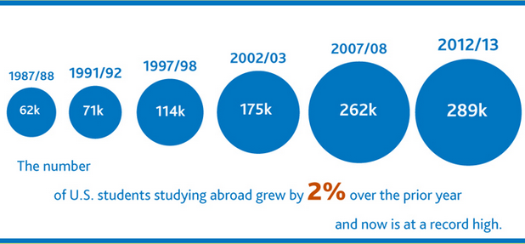
U.S. Study Abroad Trends
289,408 U.S. students received academic credit for study abroad in 2012-2013.
9% of undergraduates study abroad before graduating.
Institute of International Education: Open Doors 2014
Notes:
Is it a fact or a myth that it’s mostly language students who study abroad?
Originally it was a FACT. But today, Social Science is the most popular field of study among U.S. students abroad (22% of students abroad are social science students), but BUSINESS is a very close second, with 21% of students – the next closest is humanities at 11%.

Slide 25
Most Popular Destinations
Notes:
Destinations: 14 of the top 25 destinations are outside Europe; only 5 of the top 25 are Anglophone countries
• Large increases among the top 25 hosts: Costa Rica (16%), South Korea (16%), Brazil (13%), India (12%), Denmark (11%)
• Large declines: Mexico (42%), Japan (33%)

Slide 26
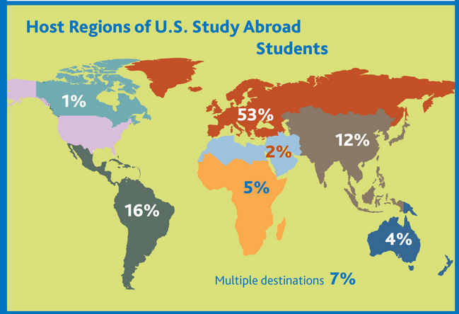
Notes:
Top 5 Destinations: UK, Italy, Spain, France, China
Any guesses as to the top destinations for study abroad?
Destinations: 14 of the top 25 destinations are outside Europe; only 5 of the top 25 are Anglophone countries
• Large increases among the top 25 hosts: Costa Rica (16%), South Korea (16%), Brazil (13%), India (12%), Denmark (11%)
• Large declines: Mexico (42%), Japan (33%)

Slide 27
Who Studies Abroad
Language students?
Originally, yes.
Currently
Social Science (22%)
Business (21%)
Humanities (11%)

Slide 28
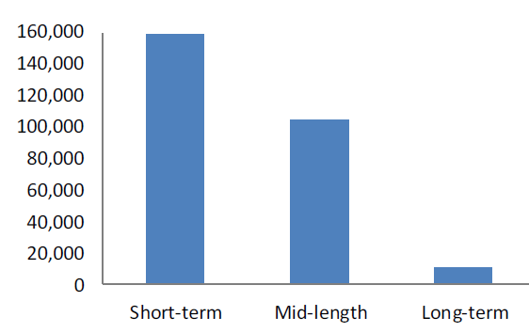
U.S. Study Abroad Trends, Cont.
60%
37%
3%
Short-term: Summer, January term, or less than 8 weeks during AY
Mid-length: One quarter, two quarters, or one semester
Long-term: Academic year or calendar year
Source: IIE 2013 Open Doors Report
Notes:
These numbers do a pretty good job of putting things in perspective, but more to the point is the fact that 59% of all students who study abroad do so as part of a short-term program compared to 3% who do so for an academic or calendar year. (38% go for one or two quarters or one semester.)

Slide 29
Why do students study abroad?
Personal and intellectual growth
Cultural experiences/understanding
Communicating with diverse audiences
Enhancing self-awareness and understanding of own cultural beliefs
Enhance/build/differentiate resume
Explore career possibilities
Applied learning
Travel

Slide 30
Study Abroad Program Models
Faculty-led
Faculty organized
3rd party provider
Consortium
Exchanges/direct enroll
MSU’s Office of Study Abroad has an excellent list of program types with examples.

Slide 31
Program Support
Faculty Development
Stakeholder Support
Funding Mechanisms

Slide 32
Faculty Development

Slide 33
Faculty and Program Development Resources
NASBITE
International trade training, credentialing, and resources
NAFSA
Professional development opportunities and connections with third-party providers
IBEX Report
Available on MSU’s website, global.broad.msu.edu
CCID and MSU-CIBER
Of course!

Slide 34
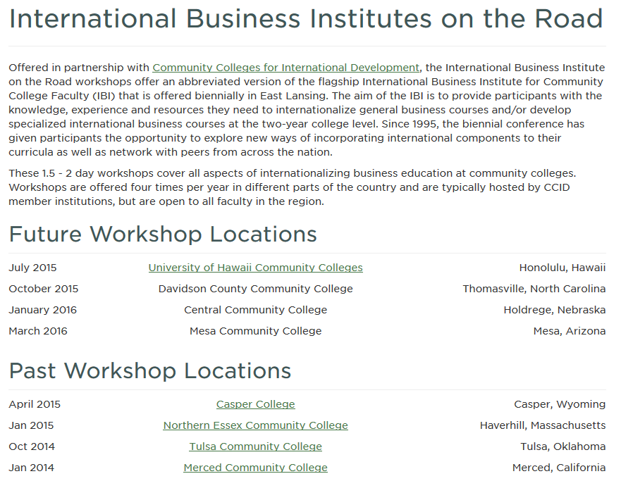

Slide 35
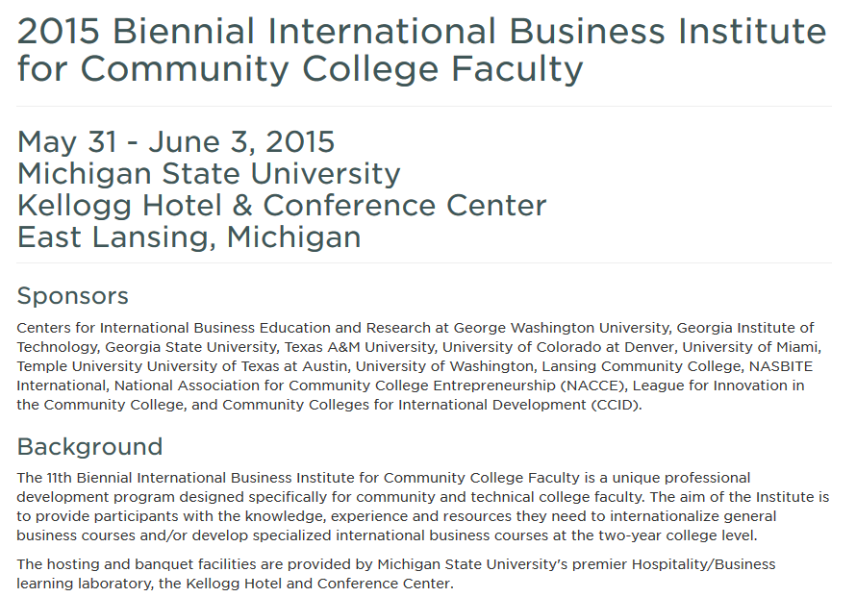

Slide 36
Stakeholder Support

Slide 37
Internal & External Stakeholders
Other campus units
Languages, area studies
International students office
President & trustees
Local business community
Addressing area business needs
Potential to partner with non-credit programs
Students
If you build it, will they come??
Notes:
Armed with survey information re what businesses are looking for re IB assistance from their local CC, a CC’s IB program could design their program based on what companies are looking for. That would also give the IB program solid information and footing with which to answer the question from administrators: “Why are we focusing on this international stuff? Our CC focus with local businesses should be concentrated on manufacturing and technical skills training…”

Slide 38
Funding Opportunities

Slide 39
Grants
UISFL Grants
UISFL is very useful!
1/3 of applicants in 2014 were community colleges
Competitive Priorities factor MSIs and especially community colleges
UISFL program permits and even suggests proposals focusing on the development of international business programs that include foreign language/area studies

Slide 40
Thank you!
singersm@msu.edu

