Slide 1
International Marketing
Brenda Sternquist, Professor
Department of Marketing

Slide 2
Seeing Cultural Differences

Slide 3
Important Cultural Concepts
Self-Reference Criterion
Ethnocentrism

Slide 5
High context vs. Low Context
Meaning of individual behavior depends on the situation
Greater emphasis on non-verbal messages
Seen in countries that comprise of one cultural group
Meaning of individual behavior depends on words, not the situation.
Intentions and feelings are expressed verbally
Occurs in multicultural countries

Slide 6
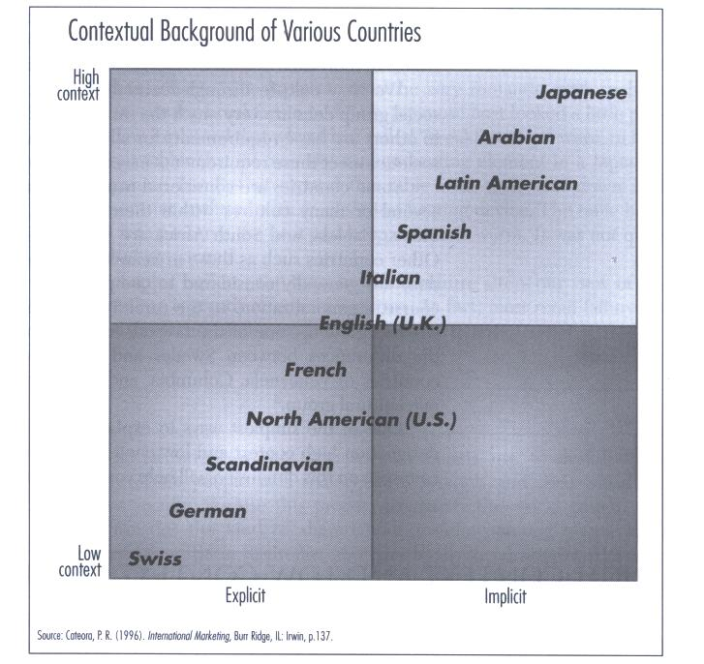
High and Low Context Countries

Slide 7
Silent Languages of Culture
Space
Material Possessions
Friendship Patterns
Agreements Among Cultures
Time

Slide 8
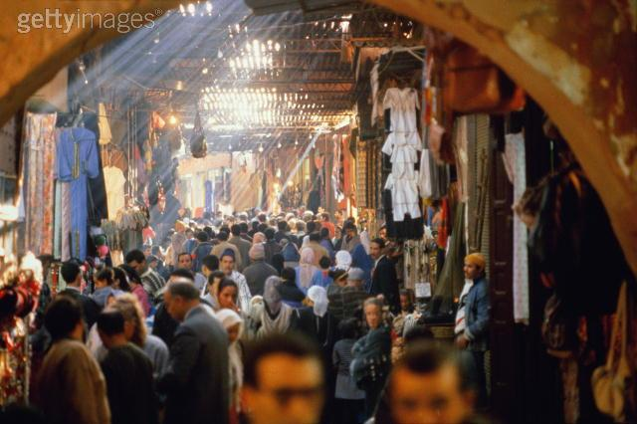
Space
A Middle-Eastern Souk (market place)
Source: gettyimages.com

Slide 9
Material Possessions
Source: gettyimages.com

Slide 10
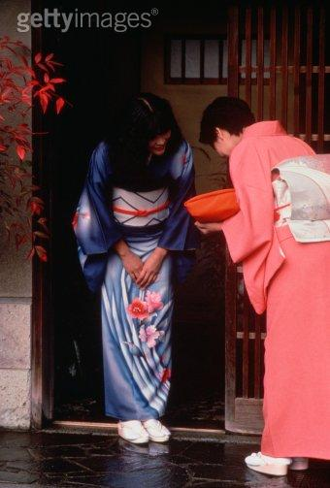
Friendship Patterns
Gift Giving across High and Low
Context Cultures
Source: gettyimages.com

Slide 11
Agreements Across Cultures
High context cultures lay greater emphasis on general agreement with business partners over contracts
Low context cultures rely on contractual agreements.

Slide 12
Time
Monochronic
Schedules
Lines
Polychronic
Meeting needs
No lines

Slide 13
Dimensions of Culture
Material Elements
Social Institutions
Humans and the Universe
Aesthetics
Language

Slide 14
Hofstede’s Cultural Dimensions Model: Individualism vs Collectivism
We
large companies
Products show group membership
emphasis on group membership
particularism
I
entrepreneurship
Greater product variety
emphasis on individual achievement
universalism

Slide 15
Low vs High Uncertainty Avoidance
Take risks
High stress
Deviant persons and ideas are tolerated
Belief is placed in generalists and common sense
Avoid risks
Ease and lower stress
Deviation is not tolerated
Belief is placed in experts and their knowledge

Slide 16
High vs Low Power Distance
There should be an ordered inequality in the world
Superiors are inaccessible
Decision making is limited to superiors
Power holders should have certain privileges
Inequality in society should be minimized.
Superiors are accessible.
Everyone can make decisions
Everyone has the same privileges

Slide 17
Masculinity vs Feminity
Differentiated sex roles
One sex may dominate
Live to Work
Independence is the ideal
Big and fast is the ideal
Undifferentiated sex roles
Equality between the sexes
Work to Live
Interdependence is the ideal
Small and Slow is beautiful

Slide 18
Standardization vs Adaptation

Slide 19
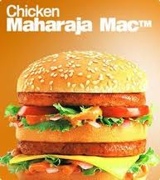
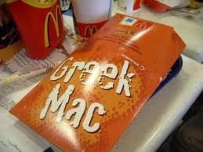
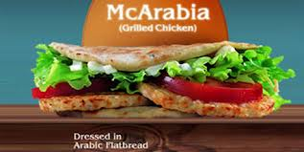
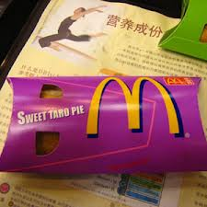
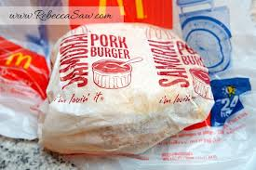
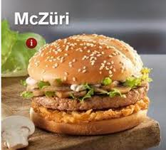
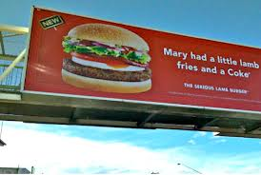
Putting it into Practice: Can you have a global product?
Was Levitt right?

Slide 20
Market Segmentation
Market segmentation - identifying distinct groups of consumers whose purchasing behavior differs from others in important ways
Global market segments are more likely to exist in industrial products than in consumer products
Notes:
Management Focus: Marketing to Black Brazil
Summary
This feature explores how companies are marketing to Brazil’s black population. Although Brazil is home to a sizable racial minority, to date companies have essentially ignored the market segment. Now however, companies are beginning to target the group using products and promotions specifically developed for the market. Discussion of the feature can begin with the following questions:
Suggested Discussion Questions
1. Describe the differences between the black population in the United States and the black population in Brazil. What are the implications of these differences for the Brazilian culture as a whole?
Discussion Points: Racial discrimination in the United States has made the country’s black population an identifiable subculture. In contrast, in Brazil racism has been more subtle, and the black population has not been excluded in the manner found in the United States. In fact, Brazil has encouraged marriages between blacks and whites. In the end, most African-Brazilians think of themselves as part of a culture that transcends race, rather than as black or white. Most students will probably suggest that this attitude promotes a more cohesive culture where biases toward or against certain groups are not prevalent.
2. How has Unilever targeted the black population in Brazil? How does the company’s strategy in Brazil differ from its strategy in other countries? What does your response tell you about Unilever’s overall global marketing strategy?
Discussion Points: Because Brazil’s blacks think of themselves as falling into a range of skin tones, rather than being simply black, Unilever’s approach to the Brazilian market has been to target the entire population rather than certain segments. The company’s advertisements show people with different skin tones, not just blacks or whites, and its products are labeled as being for tan and black people so as to cover a greater range of consumers. Students will probably note that this strategy indicates that Unilever is using a localization approach for its marketing.
Teaching Tip: Unilever’s web site {http://www.unilever.com/} is an interesting one to visit. You can click on countries and brands to see how the company sells its products in different markets.
Lecture Note: To extend this discussion to include some of Unilever’s other efforts in foreign markets, consider {http://www.businessweek.com/globalbiz/content/aug2009/gb2009087_040539.htm}, {http://www.businessweek.com/news/2010-06-23/unilever-to-boost-indonesia-spending-amid-p-g-threat.html}, and {http://www.businessweek.com/globalbiz/content/feb2008/gb20080215_454648.htm}.

Slide 21
Distribution Systems within a Country …Influence

Slide 22
Differences between Countries
The main differences between distribution systems are:
Retail concentration
Channel length
Channel exclusivity
Channel quality

Slide 23
Differences between Countries
Retail Concentration
In a concentrated system, a few retailers supply most of the market
In a fragmented system there are many retailers, no one of which has a major share of the market

Slide 24
Concentrated

Slide 25
Fragmented

Slide 26
Differences between Countries
Channel Length
Channel length refers to the number of intermediaries between the producer and the consumer
When the producer sells directly to the consumer, the channel is very short
When the producer sells through an import agent, a wholesaler, and a retailer, a long channel exists
Fragmented retail systems tend to have longer channels

Slide 27
Differences between Countries
Channel Exclusivity
An exclusive distribution channel is one that is difficult for outsiders to access
Japan's system is an example of a very exclusive system

Slide 28
Differences between Countries
Channel Quality
Channel quality refers to the expertise, competencies, and skills of established retailers in a nation, and their ability to sell and support the products of international businesses
The quality of retailers is good in most developed countries, but is variable at best in emerging markets and less developed countries
A poor quality channel can impede market entry

Slide 29
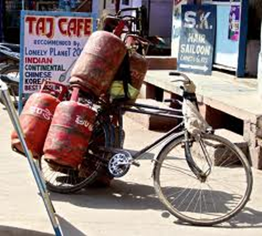
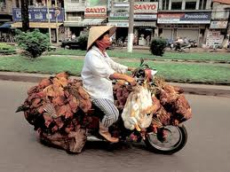
Putting it into Practice
Need to adapt distribution

Slide 30
Choosing a Distribution Strategy
More perishable=longer channel
Small purchase=longer channel
If a retail sector is very fragmented, a long channel is better

Slide 31
Push versus Pull Strategies
Firms must choose between a push strategy (emphasizes personnel selling) and a pull strategy (emphasizes mass media advertising)
The choice between the strategies depends upon:
Product type and consumer sophistication
Channel length
Media availability
Notes:
Management Focus: Unilever—Selling to India’s Poor
Summary
This feature explores Unilever’s innovative global marketing strategy. Unilever maintains a substantial presence in many of the world’s poorer nations where low-income levels, unsophisticated consumers, illiteracy, a fragmented retail distribution system, and unpaved roads make marketing difficult. Still, the company has managed to succeed thanks to its efforts to customize its marketing strategy to the local market. Discussion of the feature can begin with the following questions:
Suggested Discussion Questions
1. Discuss the effects of India’s culture on each of the components of Unilever’s marketing strategy. What can Unilever learn from its experiences in India?
Discussion Points: In India, Unilever faces numerous challenges to its marketing strategy. Income levels are low, consumers are unsophisticated and illiterate, the retail distribution system is fragmented, and the road system is poor. However, by adapting to the environment, Unilever has built a small, but successful business in the country. Because most consumers do not have access to television, the company posts advertisements in common meeting areas such as village wells and marketplaces. The company also takes part in weekly markets where it not only sells its products, but it also gives away free samples. Unilever has also made a strong effort to fit in with the country’s retail system, and stocks its products in small size packages in about 3 million stores, many of which are very tiny.
2. Is Unilever’s strategy in India a push strategy or a pull strategy? Explain.
Discussion Points: Most students will suggest that Unilever’s strategy in India is a push strategy. The country has few mass media options, and consequently has been forced to take a unique approach to developing awareness of its products among consumers. Unilever representatives frequently establish a presence in locations where people tend to congregate such as riverbanks where clothes washing takes place, or the village well or marketplace.
Teaching Tip: As noted earlier, Unilever’s web site {http://www.unilever.com/}is worth a visit. Go to the company’s Indian site by selecting it from the list available on the homepage and compare the company’s marketing efforts there to the strategy used in other countries.
Lecture Note: To learn more about Unilever’s efforts in India consider {http://www.businessweek.com/globalbiz/content/sep2007/gb20070926_123492.htm}.
Video Note: While India has been enjoying greater prosperity recently, the country’s rural citizens are still very poor. To explore the gap between India’s rich and poor, consider the iGlobe India's Economy Remains Robust Despite Global Downturn.

Slide 32
Push versus Pull Strategies
Product Type and Consumer Sophistication
Consumer goods firms trying to sell to a large segment of the market tend to prefer a pull strategy
Industrial products firms or makers of other complex products favor a push strategy

Slide 33
Push versus Pull Strategies
Channel Length
The longer the channel, the more intermediaries involved
Can be expensive to use direct selling to push a product through many layers of a distribution channel
A firm may try to pull its product through the channels by using mass advertising to create consumer demand

Slide 34
Push versus Pull Strategies
Media Availability
A pull strategy relies on access to advertising media
A push strategy is more attractive when there is limited access to mass media

Slide 35
Push versus Pull Strategies
Push strategies are common:
For industrial products and/or complex new products
When distribution channels are short
When few print or electronic media are available
Pull strategies tend are common:
For consumer goods products
When distribution channels are long
When sufficient print and electronic media are available to carry the marketing message

Slide 36
Global Advertising
Standardization versus Adaptation
Standardized advertising makes sense when:
It has significant economic advantages
Creative talent is scarce and one large effort to develop a campaign will be more successful than numerous smaller efforts
Brand names are global
Standardized advertising is not appropriate when:
Cultural differences among nations are significant
Country differences in advertising regulations block the implementation of standardized advertising

Slide 37
Price Discrimination
Firms can maximize profits through price discrimination - charging consumers in different countries different prices for the same product…but this can backfire
For price discrimination to work:
The firm must be able to keep national markets separate
Different price elasticities of demand must exist in different countries

Slide 38
Price Discrimination
Price elasticity of demand - measure of the responsiveness of demand to changes in price
Demand is elastic when a small change in price produces a large change in demand
Demand is inelastic when a large change in price produces only a small change in demand
Elasticity of demand is determined by income level and competitive conditions
Price elasticities tend to be greater in countries with lower income levels and greater numbers of competitors

Slide 39
International Marketing Strategic Pricing
Strategic pricing has three aspects:
Predatory pricing - the profit gained in one market is used to support aggressive pricing designed to drive competitors out in another market
Multi-point pricing - a firm’s pricing strategy in one market may have an impact on a rival’s pricing strategy in another market
Aggressive pricing in one market can prompt a competitive response from a rival in another market
Central monitoring of pricing decisions around the world is important

Slide 40
International Marketing
Brenda Sternquist, Professor
Department of Marketing

